Slide 1
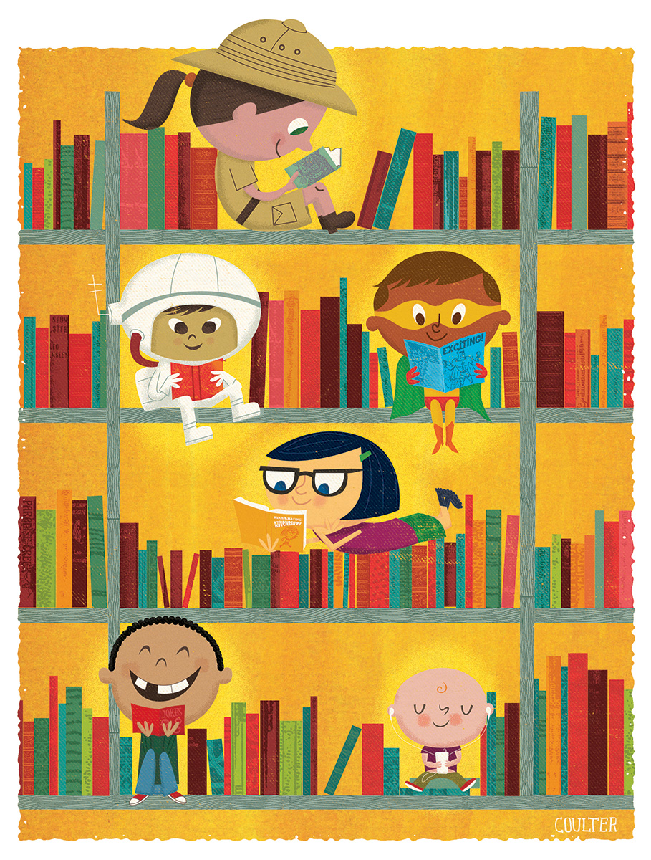
Characters……
Making them real

Slide 2
Harry Potter- J K Rowling
Harry had always been small and skinny for his age… Harry had a thin face, knobbly knees, black hair and bright green eyes. He wore round glasses held together with a lot of cellotape because of all the times Dudley had punched him in the nose. The only thing Harry liked about his appearance was a very thin scar on his forehead which was shaped like a bolt of lightning.
Can you tell me what information we learn about Harry from this description?
Is there much left for us to work out?

Slide 3
Jo- Bleak House
Charles Dickens
Jo sweeps his crossing all day long, and if he is asked a question he replies that he "don't know nothink." He knows that it's hard to keep the mud off the crossing in dirty weather, and harder still to live by doing it. Nobody taught him that much—he found it out.
Indeed, everything poor Jo knows he has had to find out for himself, for no one has even taken the trouble to tell him his real name.

Slide 4
It must be a strange state to be like Jo, not to know the feeling of a whole suit of clothes—to wear even in summer the same queer remnant of a fur cap; to be always dirty and ragged; to shuffle through the streets, unfamiliar with the shapes, and in utter darkness as to the meaning, of those mysterious symbols so abundant over the doors and at corners of the streets, and on the doors and in the windows. To see people read, and to see people write, and to see the postman deliver letters, and not to have the least idea of all that language,—to be to all of it stone blind and dumb.
What do you know about Jo?

Slide 5
Mrs.Pratchett- Boy Roald Dahl
Her name was Mrs. Pratchett. She was a small skinny old hag with a moustache on her upper lip and a mouth as sour as a green gooseberry. She never smiled. She never welcomed us when we went in. By far the most loathsome thing about Mrs. Pratchett was the filth that clung about her. Her apron was grey and greasy. Her blouse had bits of breakfast all over it, toast crumbs and tea stains and splotches of dried egg yolk. It was her hands , however, that disturbed us most. They were disgusting. They were black with dirt and grime. They looked as though they had been putting lumps of coal on the fire all day long. The mere sight of her grimy right hand with its black fingernails digging an ounce of Chocolate Fudge out of the jar would have caused a starving tramp to go running from the shop.
Describe Mrs. Pratchett in 3 words.
What does she do for a living?
How do you think she would speak or move?

Slide 6
Calpurnia-To Kill a Mockingbird Harper Lee
She was all angles and bones; she was nearsighted; she squinted; her hand was wide as a bed slat and twice as hard. She was always ordering me out of the kitchen, asking me why I couldn't behave as well as Jem when she knew he was older, and calling me home when I wasn't ready to come. Our battles were epic and one-sided. Calpurnia always won, mainly because Atticus always took her side. She had been with us ever since Jem was born, and I had felt her tyrannical presence as long as I could remember.

Slide 7
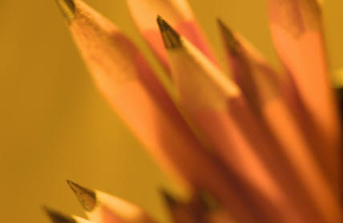
Your turn now!
Remember to ‘weave it in’- make your reader work!

