Slide 1
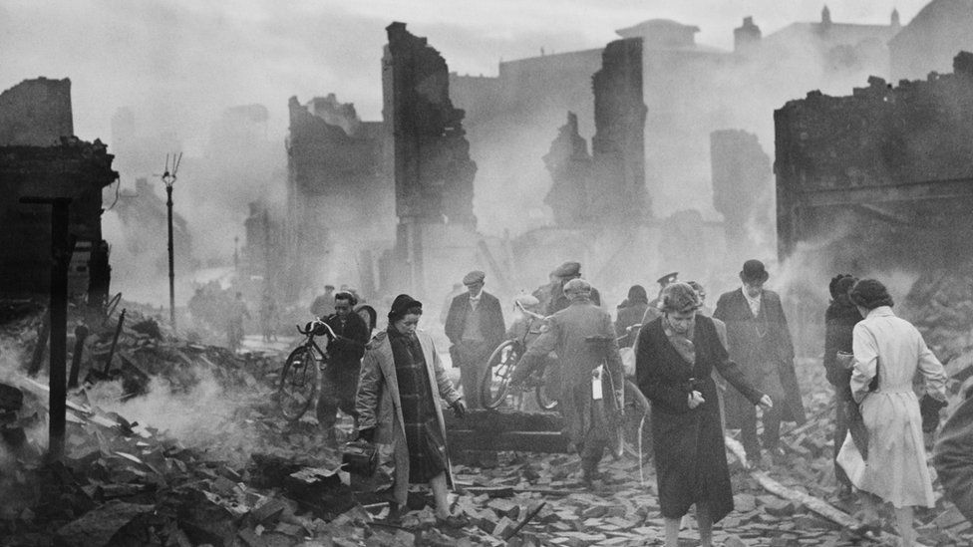
What can you see?
What can you hear?
What can you smell?

