Slide 1
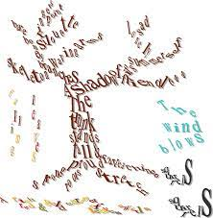
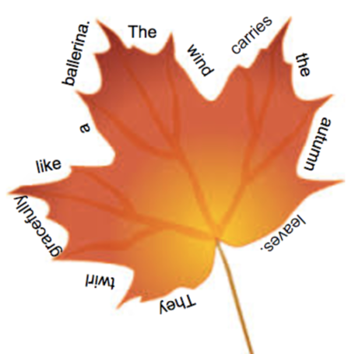
English – Wednesday 20th October
Calligrams are sometimes known as shape poems

Slide 2

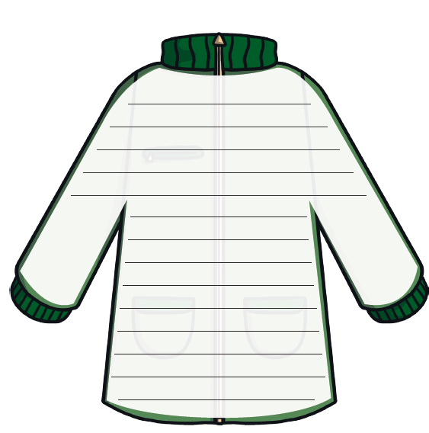



English –
Think of your own words and phrases that you could put in or around your autumn picture to create a shape poem

