Slide 1

Reading!

Slide 2

Handwriting – curly caterpillar letters

Slide 3


Slide 4


Slide 5
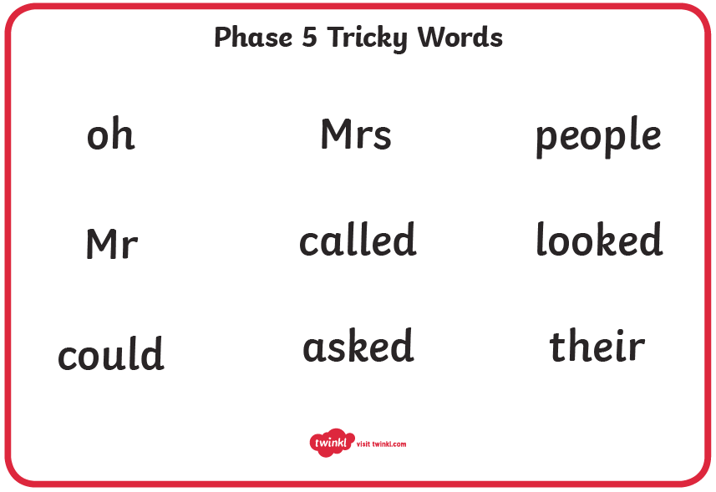

Slide 6
Phonics
Phase 5 revisit
Monday 27th September 2021
Sounds: wh, ph, ew, oe, au, ey
Tricky words for spelling: said, so, have, like

Slide 7
Tricky words
Mr
Mrs
looked
called
asked
oh
their
people
Spelling: said, so, have, like

Slide 8
Ire
https://www.youtube.com/watch?v=baPcEv6z6-Q

Slide 9
Fire

Slide 10
wire

Slide 11
hire

Slide 12
vampire

Slide 13
tired tyre

Slide 14
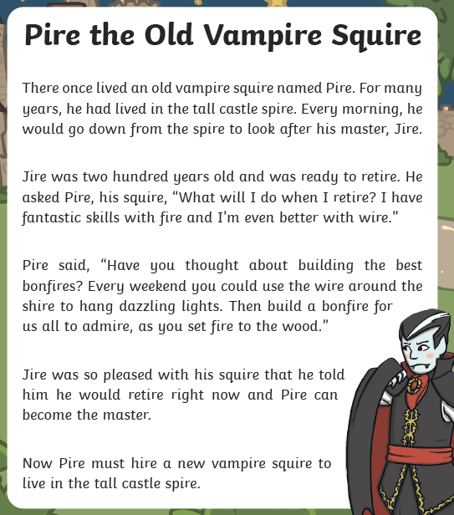
Ire
Fire Fire

Slide 15


