Slide 1
Thursday 21st October 2021

Slide 3
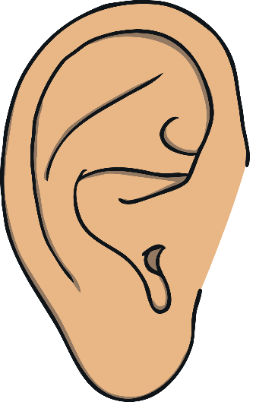
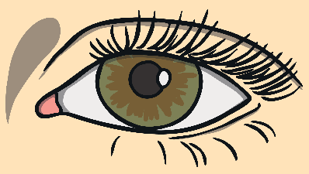


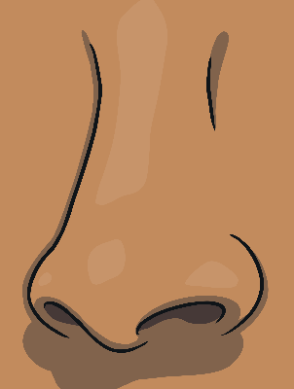
I use my five senses in autumn.

Slide 4

I hear leaves crunching under my feet…

Slide 5
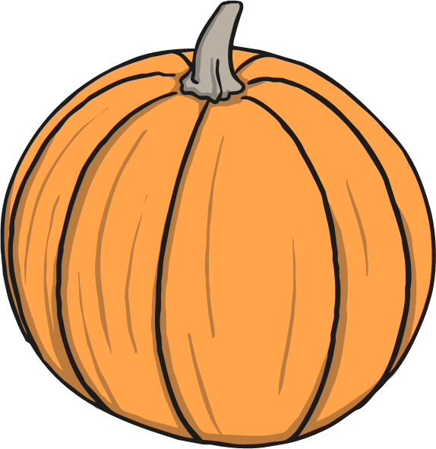
I see the big orange pumpkin.

Slide 6

I feel the wind.

Slide 7
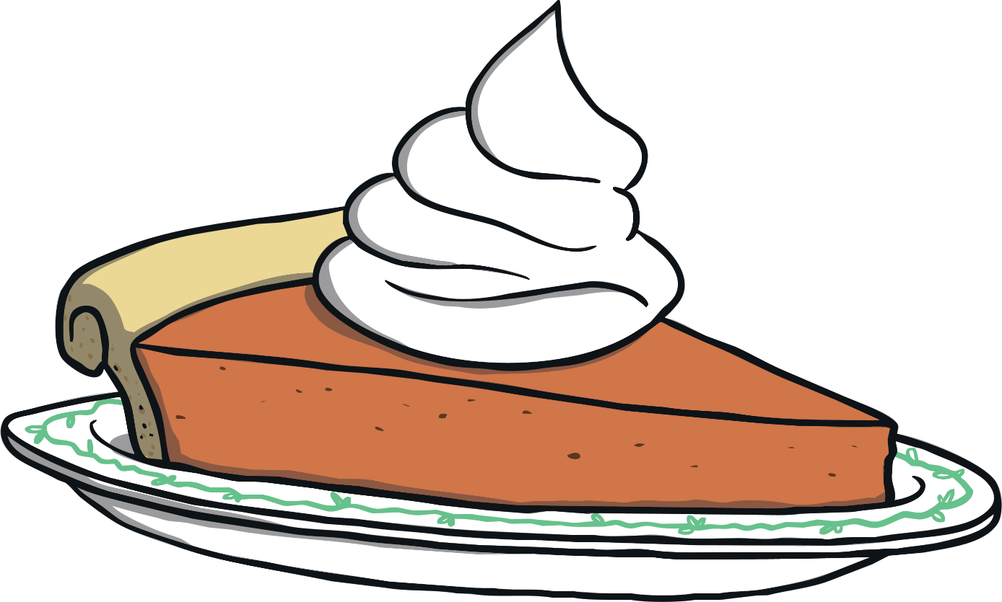
I smell the pumpkin pie.

Slide 8

I taste the autumn apples.

Slide 9
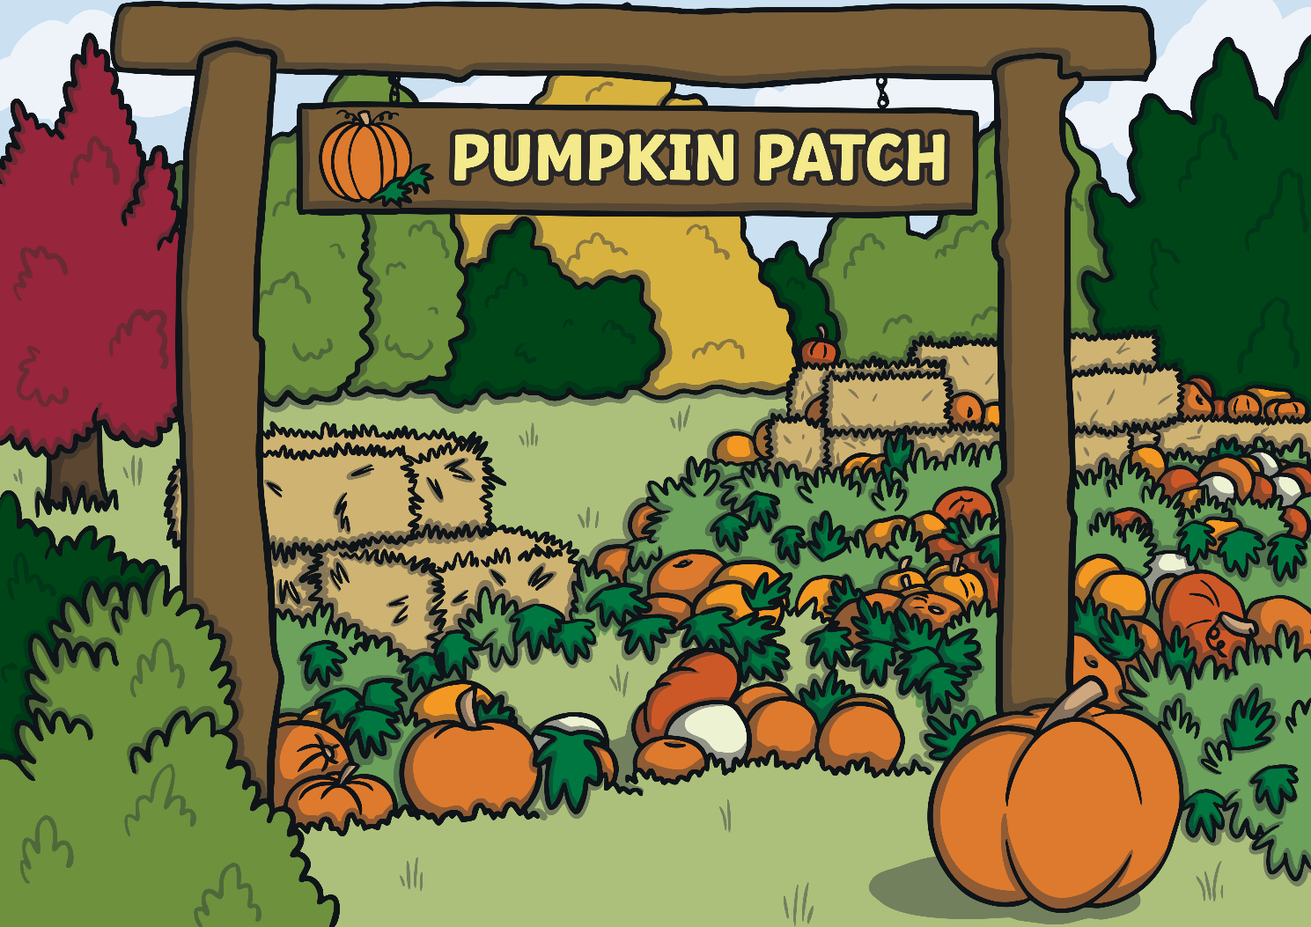
I can taste, touch, smell, hear and see autumn.

Slide 10
Look back through the poem and discuss your favourite words and phrases.

Slide 11
Look at the next slide and start to plan your own poem out loud ready for the writing session

Slide 12
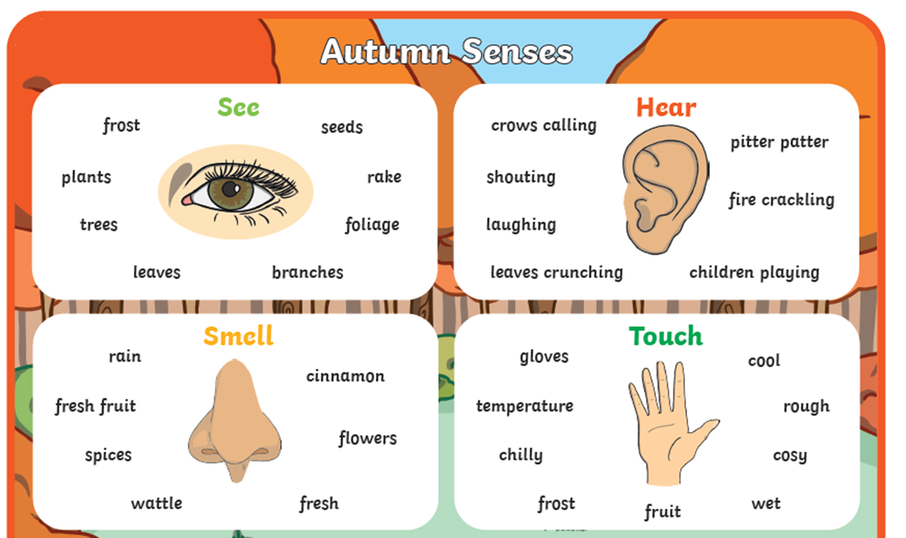

Slide 13
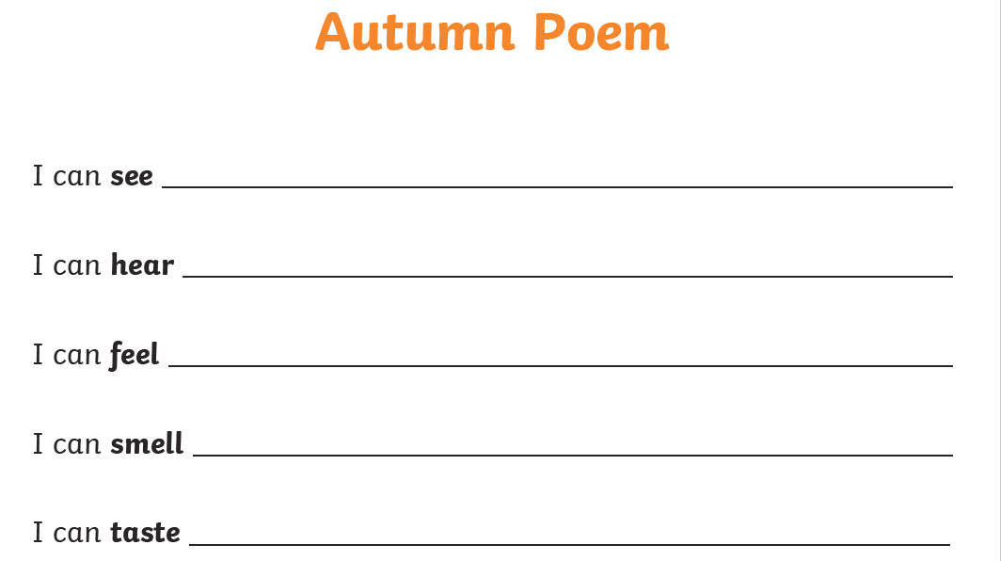

Slide 14
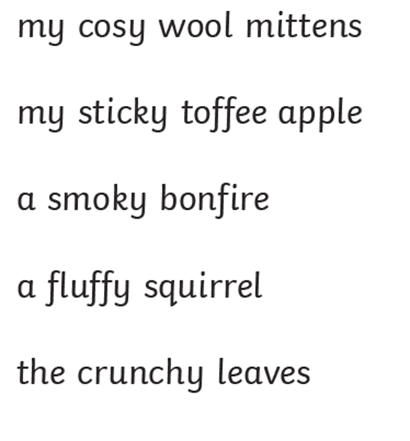
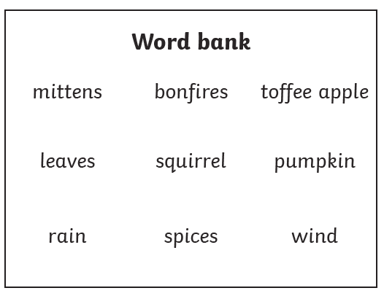
Some Ideas …

