Slide 1
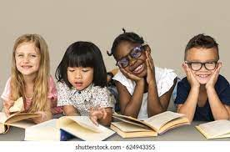
Reading!

Slide 2
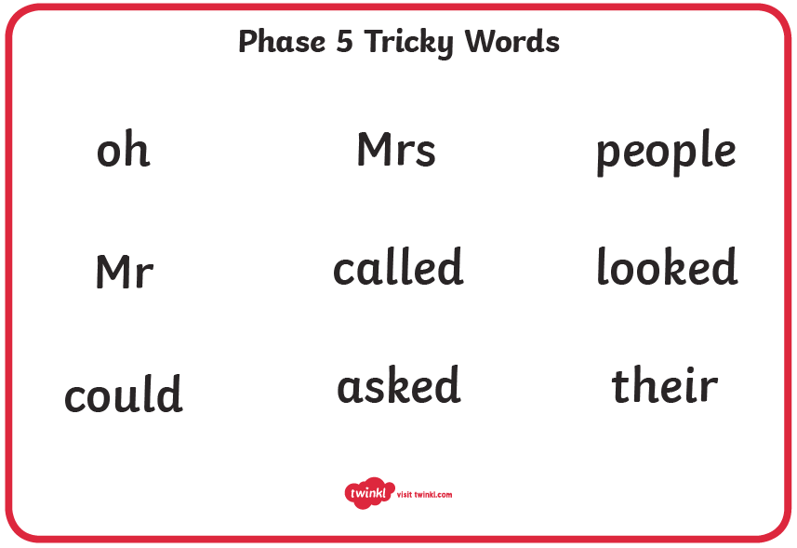

Slide 3
Phonics
Phase 5b revisit
Monday 18th October 2021
Sounds- ow, ie, ea, er
Tricky words for spelling: water, where, who, again, thought, through, work, mouse
little, one, do, when, what
said so have like come some were there

Slide 4


ay
Play Sound

Slide 5

ou
Play Sound

Slide 6

ie
Play Sound

Slide 7

ea
Play Sound

Slide 8
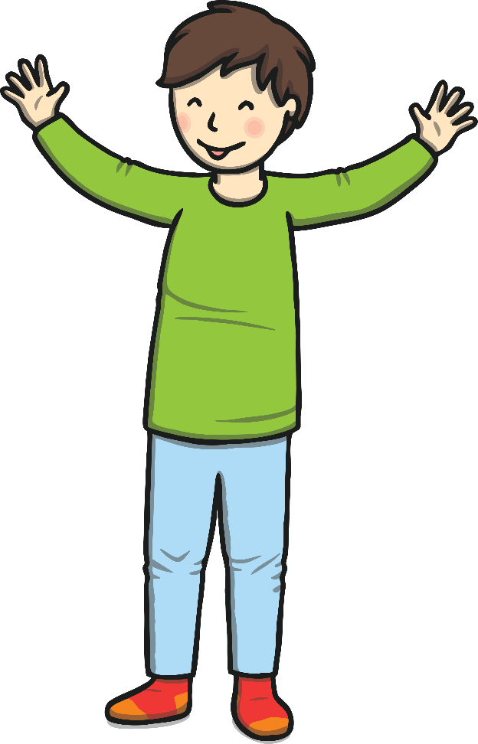
oy
Play Sound

Slide 9
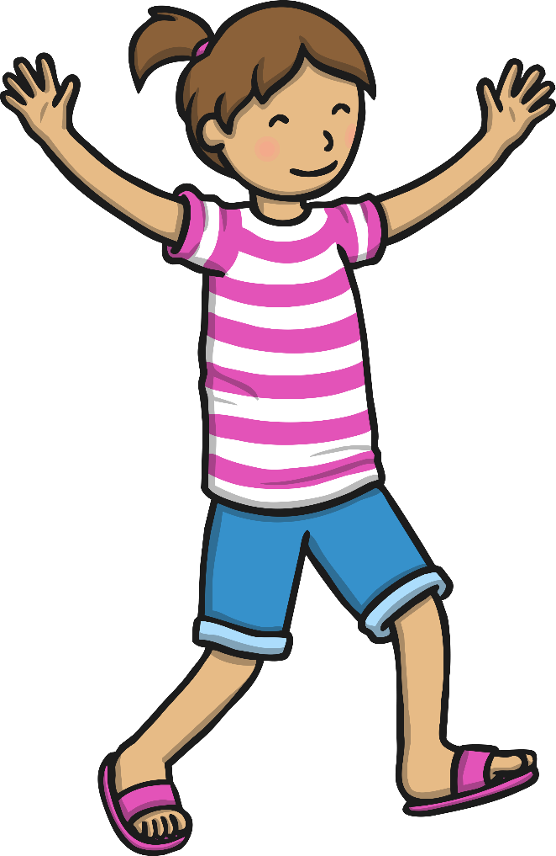
ir
Play Sound

Slide 10

ue
Play Sound

Slide 11
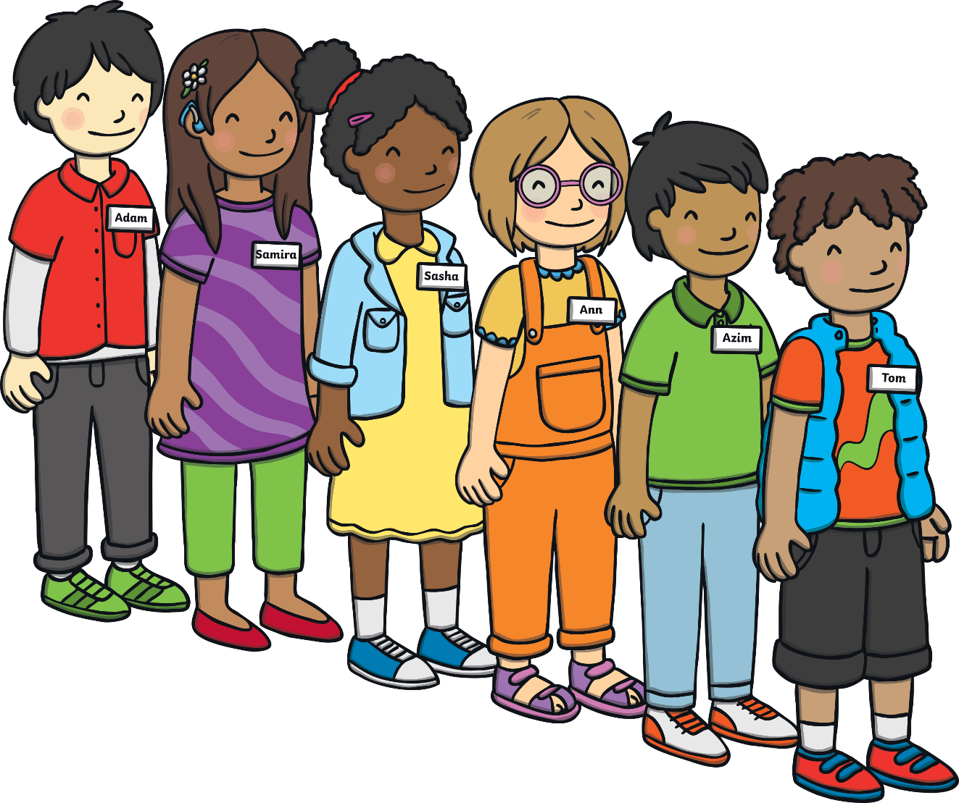
ue
Play Sound

Slide 12
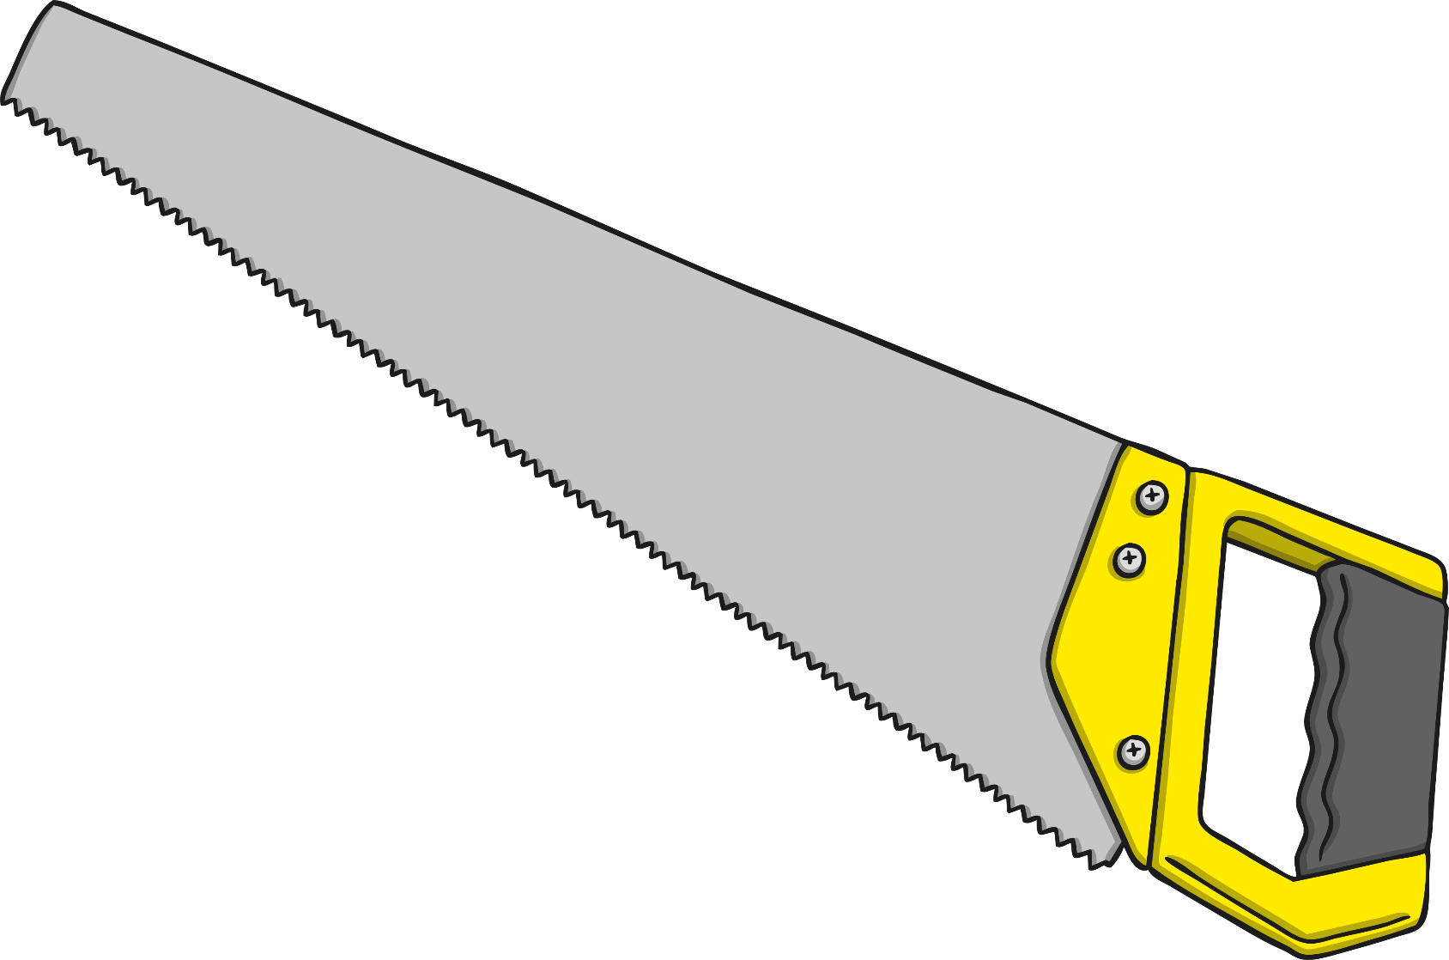
aw
Play Sound

Slide 13

wh
Play Sound

Slide 14
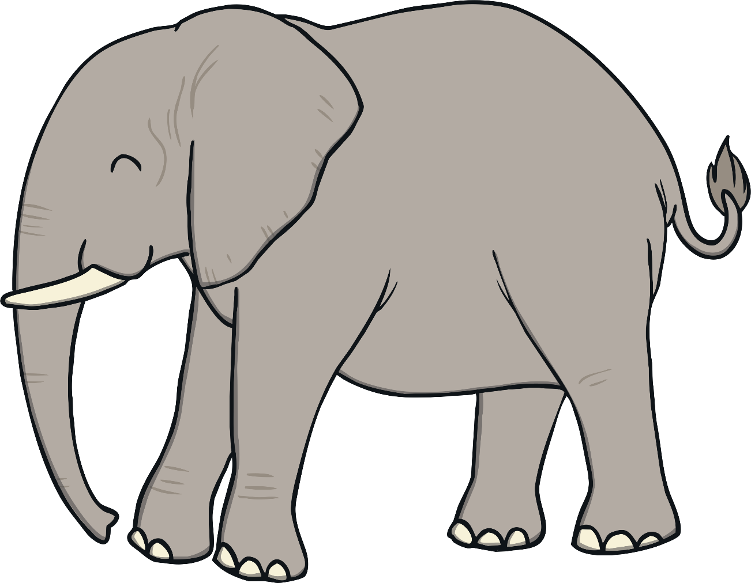
ph
Play Sound

Slide 15

ew
Play Sound

Slide 16

oe
Play Sound

Slide 17
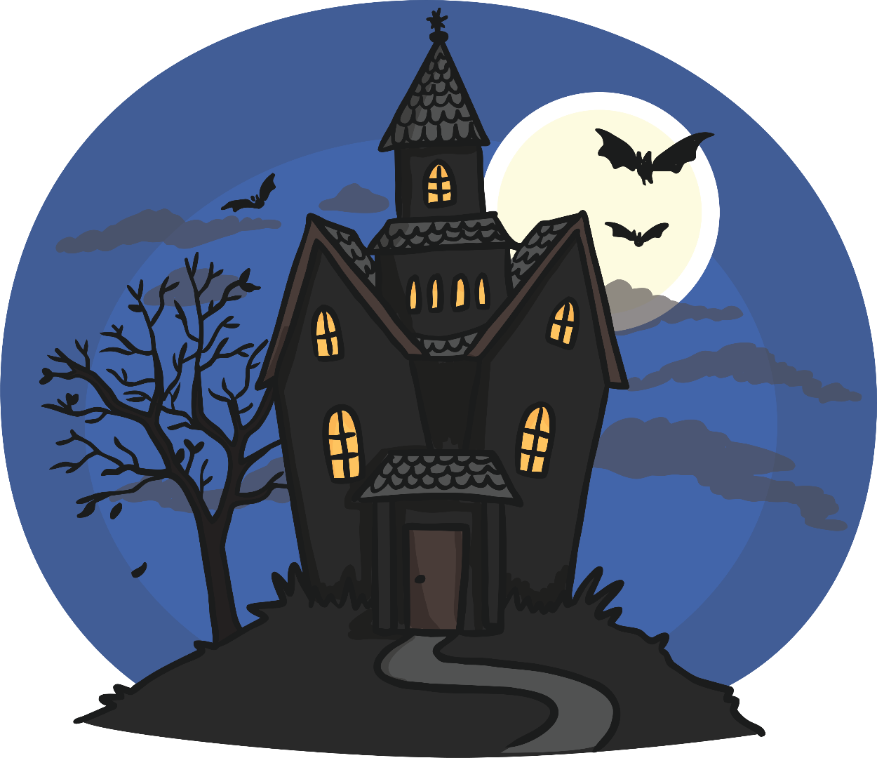
au
Play Sound

Slide 18
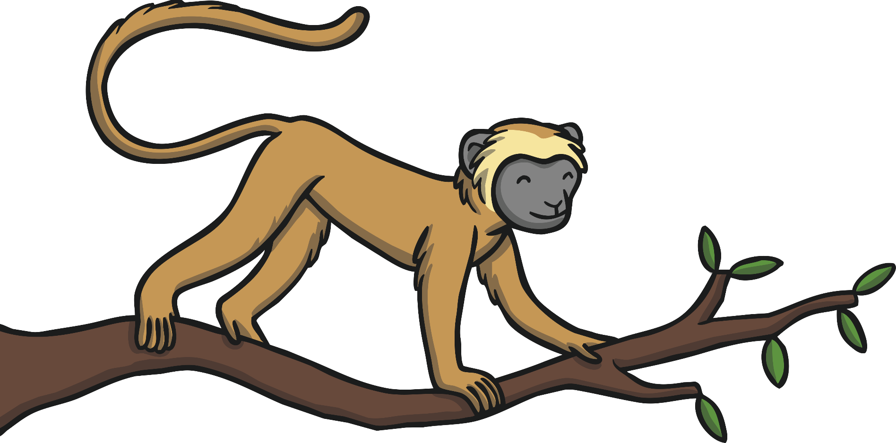
ey
Play Sound

Slide 19
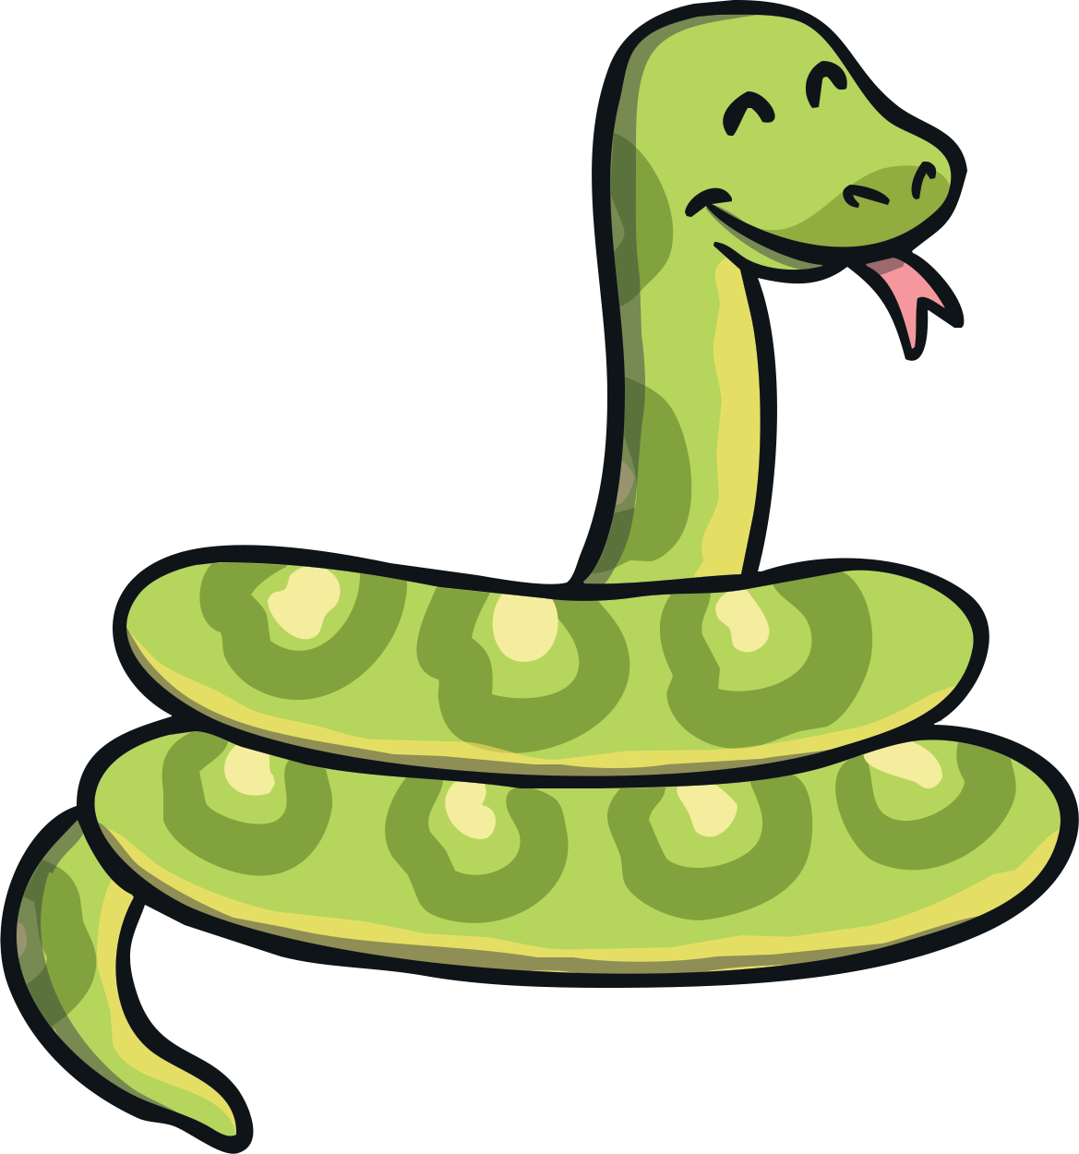
a-e
Play Sound

Slide 20
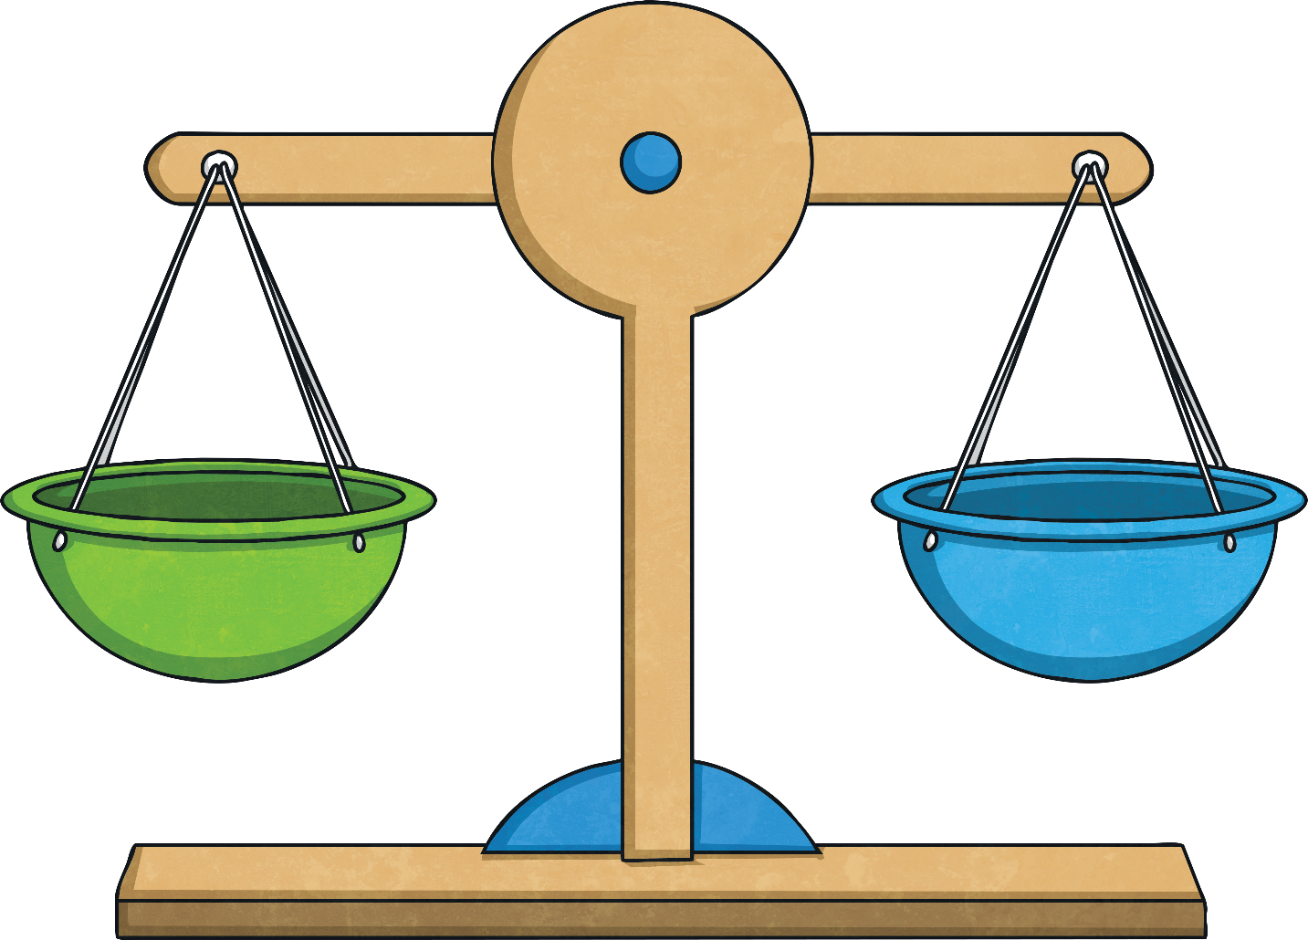
e-e
Play Sound

Slide 21
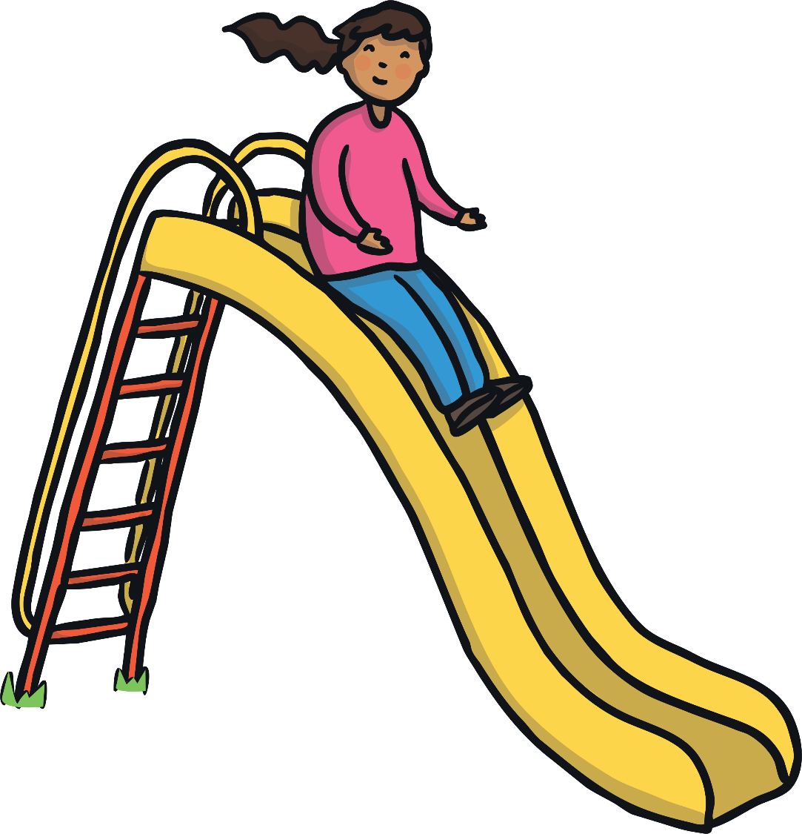
i-e
Play Sound

Slide 22

o-e
Play Sound

Slide 23
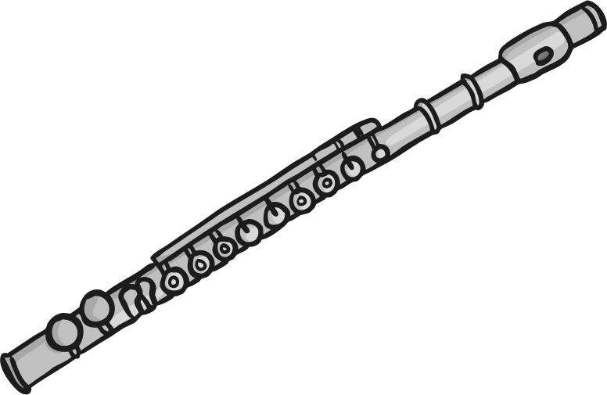
u-e
Play Sound

Slide 24
Today we are looking at the ow phoneme
The tricky words for spelling are … water, where, who,

Slide 25
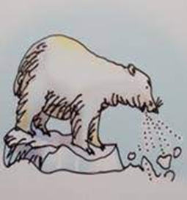
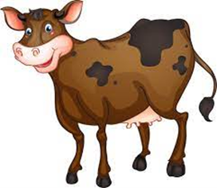
Phonics Play game… Acorn Adventures
brown cow
blow the snow

Slide 26


Sort the words…
brown
cow
frown
low
show
snow
bowl
owl
crown
window

Slide 27
Sort the words…
brown
snow
cow
bowl
frown
show
owl
low
crown
window

Slide 28
Read the sentences to your partner…
Is a brown owl at the window?
Did the cow put his food in a bowl?
Can a shadow be brown?

Slide 29

Handwriting – curly caterpillar letters

Slide 30
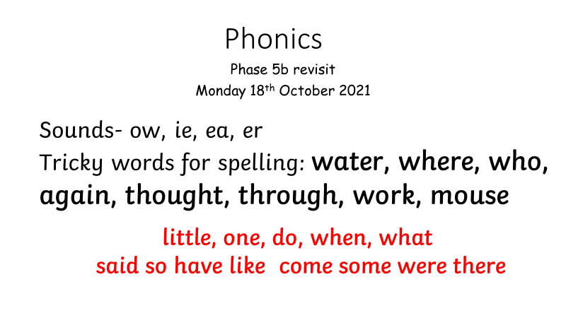
Phonics
Phase 5b revisit
Tuesday 19th October 2021

Slide 31
ay
Play Sound

Slide 32
ou
Play Sound

Slide 33
ie
Play Sound

Slide 34
ea
Play Sound

Slide 35
oy
Play Sound

Slide 36
ir
Play Sound

Slide 37
ue
Play Sound

Slide 38
aw
Play Sound

Slide 39
wh
Play Sound

Slide 40
ph
Play Sound

Slide 41

ew
Play Sound

Slide 42
oe
Play Sound

Slide 43
au
Play Sound

Slide 44
ey
Play Sound

Slide 45
a-e
Play Sound

Slide 46
e-e
Play Sound

Slide 47
i-e
Play Sound

Slide 48
o-e
Play Sound

Slide 49
u-e
Play Sound

Slide 50
ie – Acorn Adventures
pie, fried, cried, denied, replied,
chief, thief, shield, belief, shriek.
https://www.phonicsplay.co.uk/resources/phase/5/acorn-adventures?utm_source=pdf&utm_medium=text_link&utm_campaign=phonicsplay&utm_term=planning&utm_content=

Slide 51
(ie as in ee)
chief,

Slide 52
(ie as in ee)
thief,

Slide 53
(ie as in ee)
shield,

Slide 54
(ie as in ee)
belief,

Slide 55
(ie as in ee)
shriek.

Slide 56
Read the sentences with your partner…
Will a chief shriek with relief in a field?
A thief cried and denied his crime.
A priest and a chief ate fried pies.

Slide 57
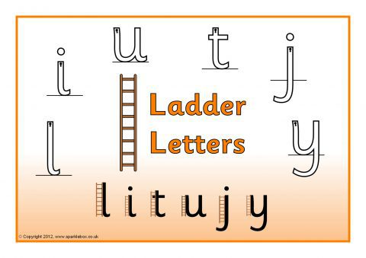

Slide 58
Phonics
Phase 5 revisit
Wednesday 20th October 2021

Slide 59
ay
Play Sound

Slide 60
ou
Play Sound

Slide 61
ie
Play Sound

Slide 62
ea
Play Sound

Slide 63
oy
Play Sound

Slide 64
ir
Play Sound

Slide 65
ue
Play Sound

Slide 66
aw
Play Sound

Slide 67
wh
Play Sound

Slide 68
ph
Play Sound

Slide 69
ew
Play Sound

Slide 70
oe
Play Sound

Slide 71
au
Play Sound

Slide 72
ey
Play Sound

Slide 73
a-e
Play Sound

Slide 74
e-e
Play Sound

Slide 75
i-e
Play Sound

Slide 76
o-e
Play Sound

Slide 77

u-e
Play Sound

Slide 78

Phase 5
Tricky Words

Slide 79
oh

Slide 80
their

Slide 81
people

Slide 82
Mr

Slide 83
Mrs

Slide 84
looked

Slide 85
called

Slide 86
asked

Slide 87
could

Slide 88
sea, meat, treat, steam, repeat, head, deaf, bread, feather, instead.

Slide 89
Read the sentences with your partner …
Is bread a treat or do you dread it?
Will a deaf cat bleat to get treats?
Can reading a book freak you out?

Slide 90
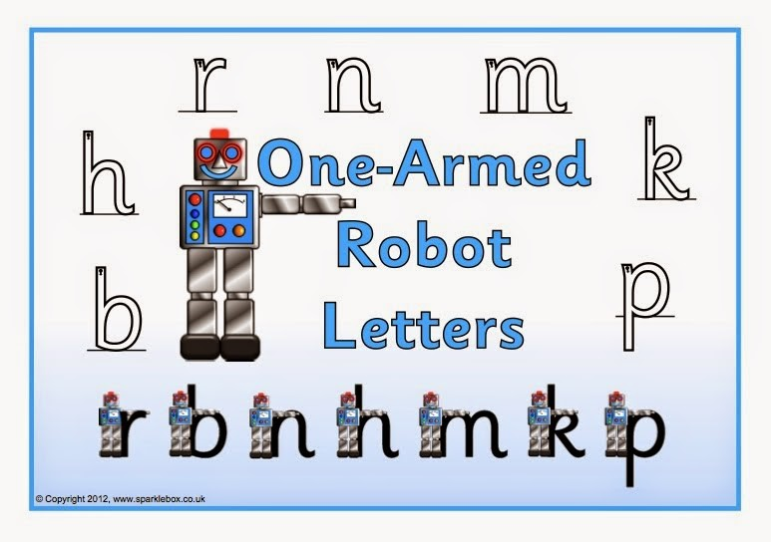

Slide 91
Phonics
Phase 5b revisit
Thursday 21st October 2021

Slide 92
ay
Play Sound

Slide 93
ou
Play Sound

Slide 94
ie
Play Sound

Slide 95
ea
Play Sound

Slide 96
oy
Play Sound

Slide 97
ir
Play Sound

Slide 98
ue
Play Sound

Slide 99
ue
Play Sound

Slide 100
aw
Play Sound

Slide 101
wh
Play Sound

Slide 102
ph
Play Sound

Slide 103
ew
Play Sound

Slide 104
ew
Play Sound

Slide 105
oe
Play Sound

Slide 106
au
Play Sound

Slide 107
ey
Play Sound

Slide 108
a-e
Play Sound

Slide 109
e-e
Play Sound

Slide 110
i-e
Play Sound

Slide 111
o-e
Play Sound

Slide 112
u-e
Play Sound

Slide 113
u-e
Play Sound

Slide 114
er
letter,
hammer,
ladder,
feather,
boxer,
herbs,
stern,
jerk,
germ,
her.

Slide 115
Read the sentences to your partner …
Can a farmer grow herbs?
Did a boxer hit a fern with a hammer?
Can a stern rocker get up a ladder?

Slide 116


