Slide 1
We hope you find the information on our website and resources useful.
This resource contains links to external video websites.
These websites often have autoplay features meaning that other videos will play after the video you are watching finishes. You should disable this feature before using the video in any classroom or similar setting. Twinkl assumes no responsibility for the contents of linked websites. The inclusion of any link in this resource should not be taken as an endorsement of any kind by Twinkl of the linked website or any association with its operators. We have no control over the availability of the linked pages. If the link is not working, please let us know by contacting TwinklCares and we will try to fix it, although we can assume no responsibility if this is the case.
Please be aware, clicking these buttons will take you to an external video website:
click here

Slide 3
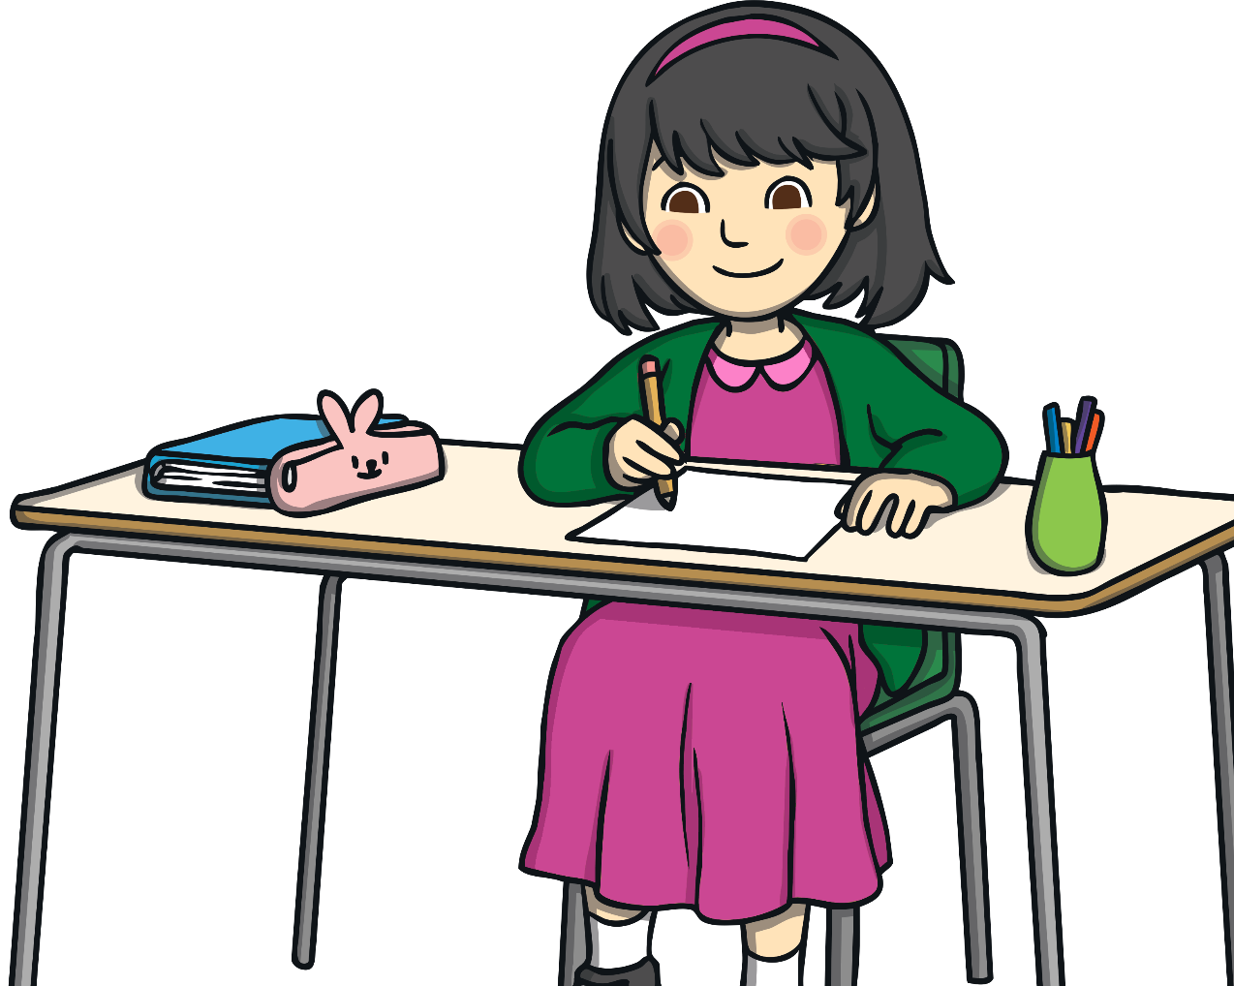
What is Poetry?
Poetry is a style of reading and writing.
It is imaginative writing, written by anybody.
People choose to write poetry about many different
things. It is a way to express thoughts and feelings
about something in a creative way.

Slide 4
What is Poetry?
Poetry tries to connect with the reader so they understand the writer’s thoughts and feelings.
Poems can be written in many different
ways - they can be short or long, sad or
fun, real or imagined, structured and unstructured, rhyming or not.
The writer has the freedom to
write in any way they feel
will best express their
thoughts and feelings.

Slide 5
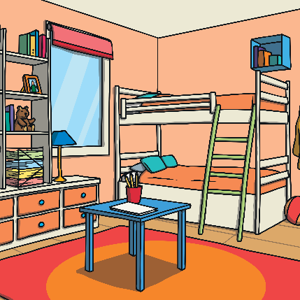
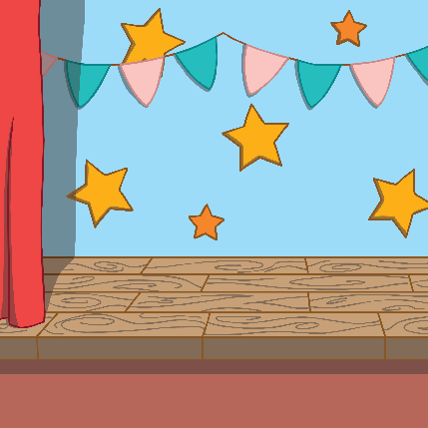
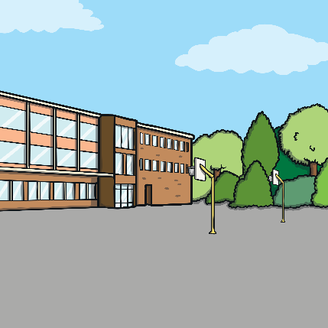
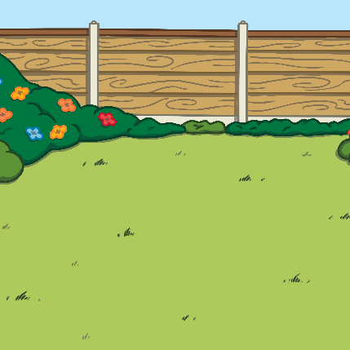
What is Performance Poetry?
Performance Poetry brings the poetry words to life through actions.
Poetry can be performed anywhere. Can you think of any places?
a bedroom
a stage
a playground
a garden

Slide 6

How Can You Perform Poetry?
When performing poetry, the reader will play with the words. It’s fun to experiment with the different words and make the poem come to life:
You may read some words loudly in a booming voice.
You could read some words quietly, whispering softly.
You may read a poem quickly, racing through
the words.
You could read the poem slowly, taking your
time with every word.
What about mixing it up? The poet might
perform using all of these styles.

Slide 7
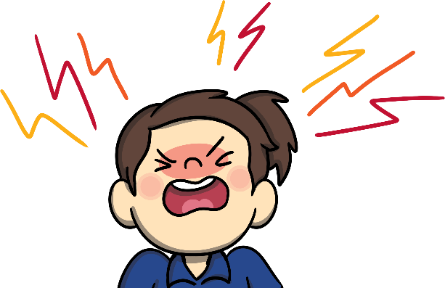
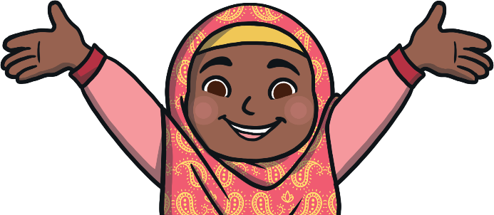

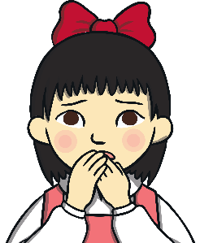

The Tone of the Poem
Is it a happy poem?
Is it a sad poem?
Is it an angry poem?
Is it a confusing poem?
Is it a tense poem?
Is it an exciting poem?
When the emotion of the poem has been chosen, it will make the poem easier to be understood. It’s important that the tone of the poem is clear.

Slide 8

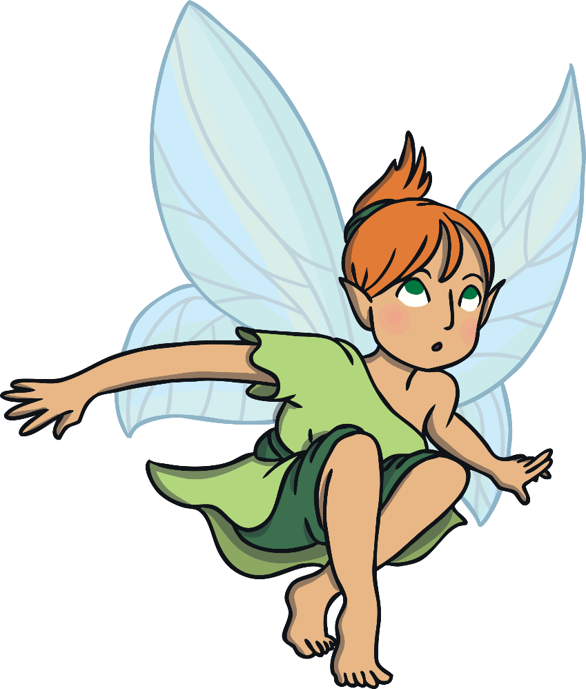

Characters in the Poem
Some poems are read as a character. How would that character sound using your voice?
The character might be a monster - how would the monster sound?
The character might be a fairy - how would
the fairy sound?

Slide 9
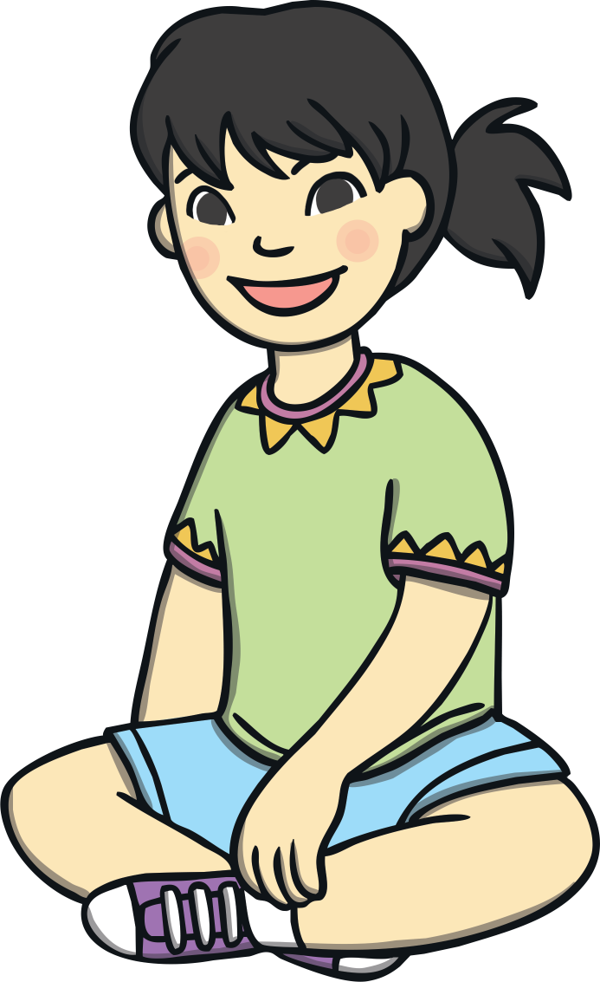
Actions
You can even use your body to perform poems:
standing - you could be in a huge park,
in space or in a tight space;
sitting - you could be sat on a very tall chair, on a dinosaur or on a rollercoaster;
laying down - you could be looking up at
the stars or clouds in the sky.

Slide 10
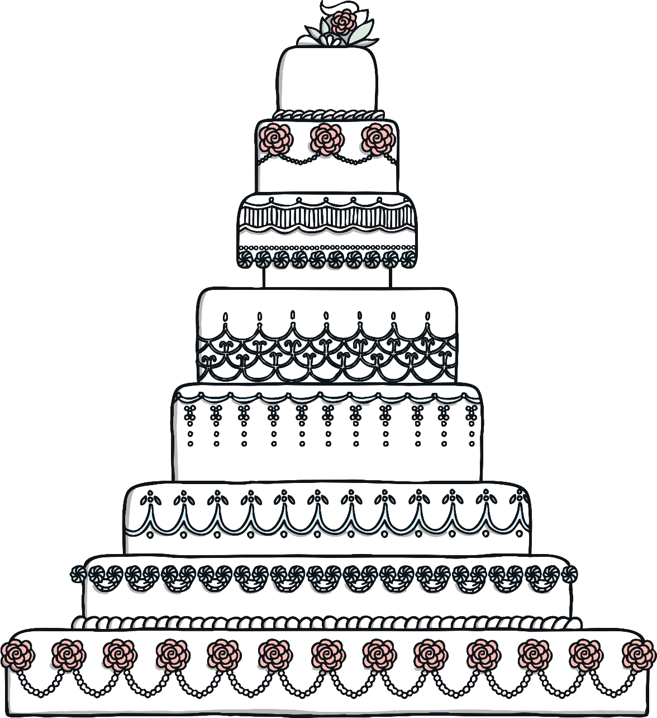
Actions
Using your body to tell the poem helps the
listener to see the world you are creating
in your poem.
Just using simple actions, such as whisking
a huge cake mix, is exciting to see when
you’re reading a poem about how you
made the biggest cake in the world.

Slide 11
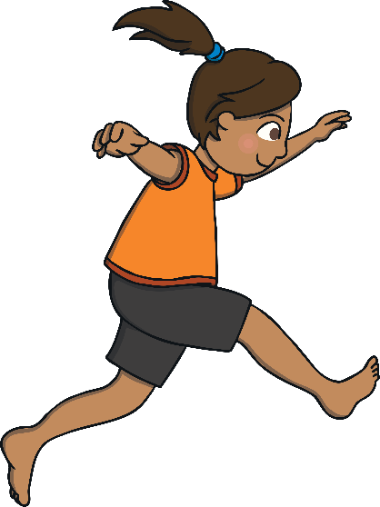
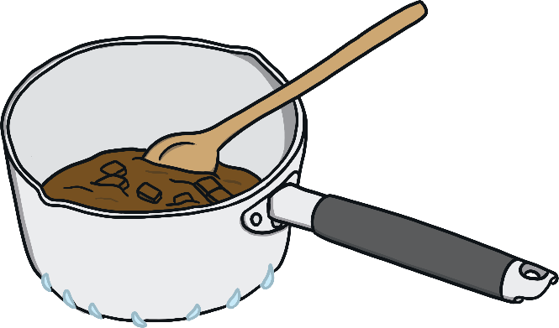
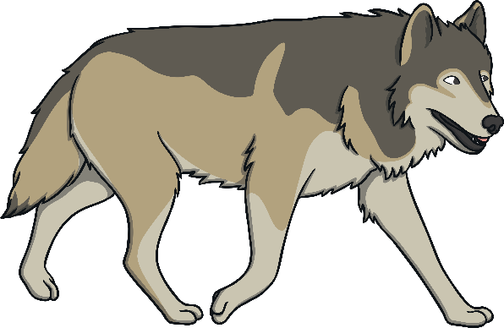

Actions
Actions can be as simple as small gestures. This could be pointing to objects, gentle flicks of the wrist or miming with your hands.
Imagine acting out some of these actions as part of your Poetry Performance.
Licked the thick chocolate off the spoon
Leapt over the huge rock
Sniffed the bone buried in the ground
Crept past the
hungry wolf

Slide 12
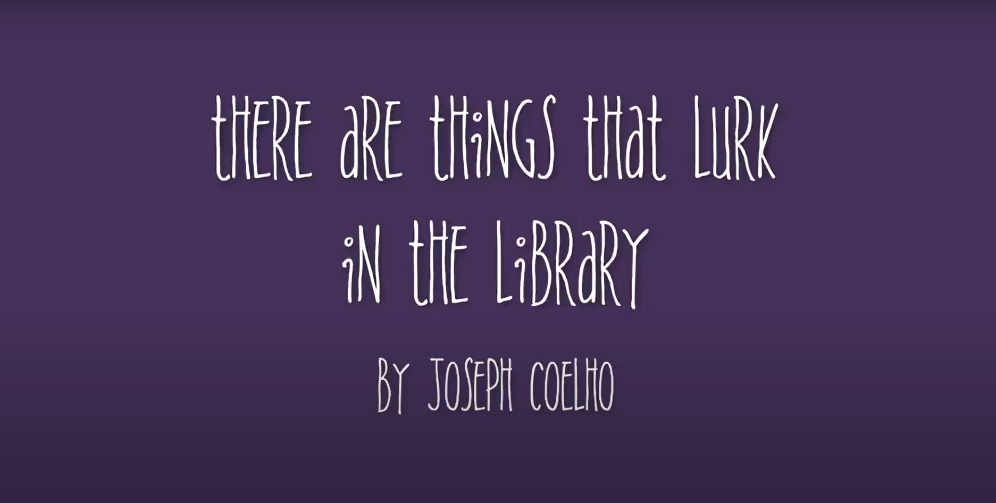
Performance Poetry
Watch this poem by Joseph Coelho and see if you can recognise any of the features you have learnt.
click here

Slide 13
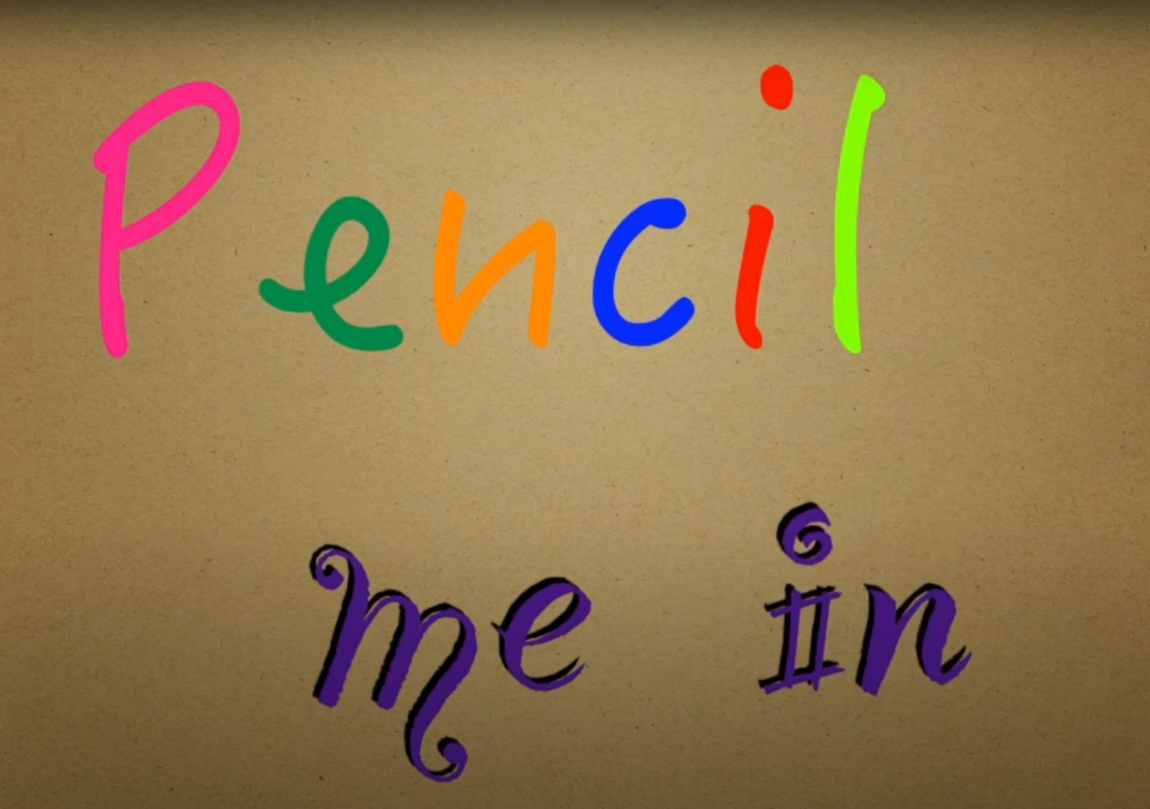
Performance Poetry
Watch this poem by Benjamin Zephaniah and see if you can recognise any of the features you have learnt.
click here

