Slide 2
https://www.youtube.com/watch?v=iyy4uDB9-zc
Multiply Your Love

Slide 3
Do all Christians celebrate Harvest in the same way?
Discuss last week's learning of the Christian festival of Harvest. Ask if they think Christians only live in England? Do you think Harvest is the same in all countries?
Discuss other foods that could be harvested and there for when would other countries celebrate the harvest?

Slide 4
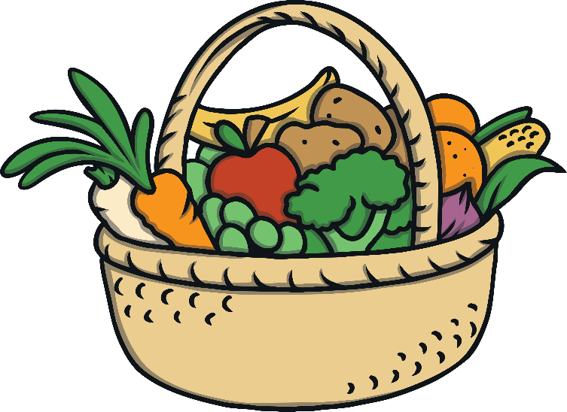
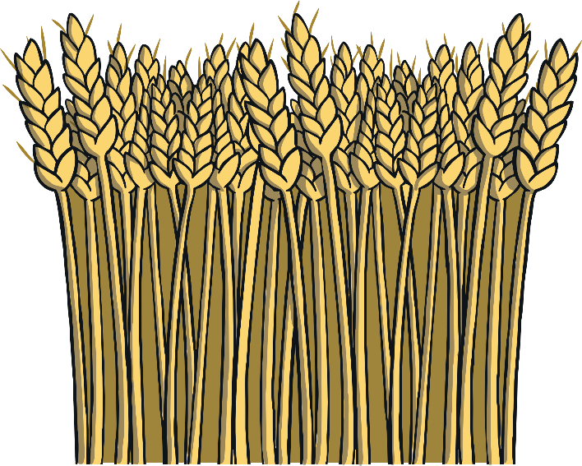
Harvest Festivals
Harvest festivals are celebrations of the food that grows on the land.
They happen at different times of the year around the world and are held when crops are harvested.
Read on to learn how harvests are celebrated around the world.

Slide 5
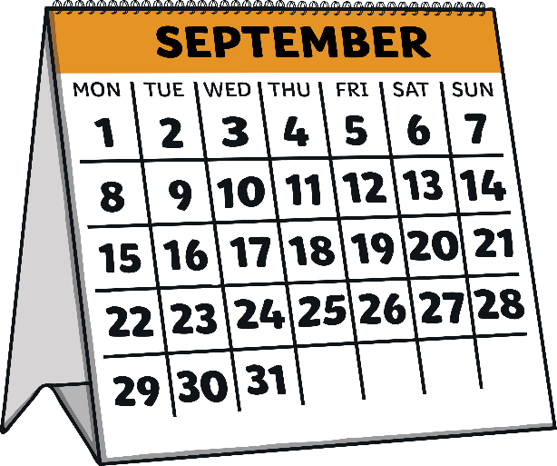


Britain
In Britain, harvest festival is usually celebrated near the end of September.
People sing songs, pray and sometimes
go to church.
Food is often collected in baskets to give to people in need.

Slide 6
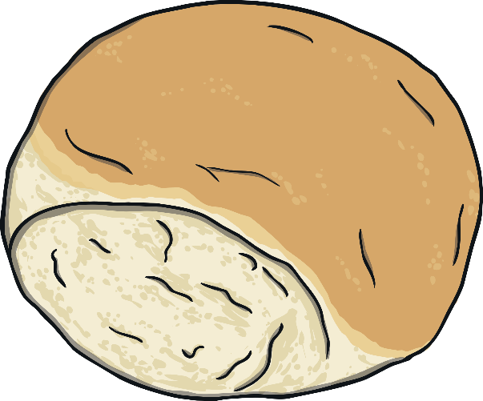
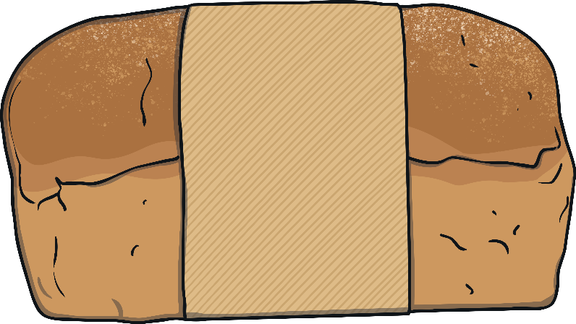
Britain (Scotland)
In Scotland, some people celebrate a wheat harvest called Lammas.
People make bread from the first wheat harvest and take it to church to eat.

Slide 7
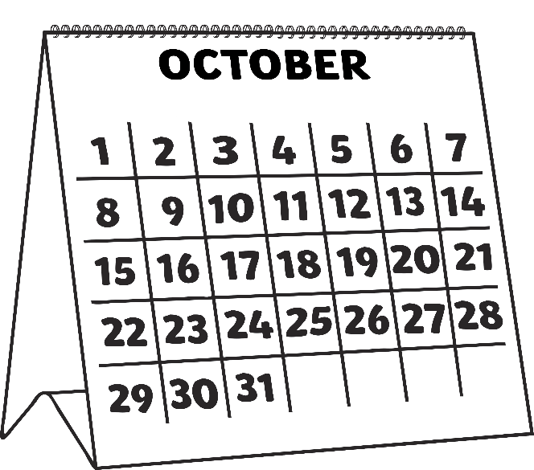
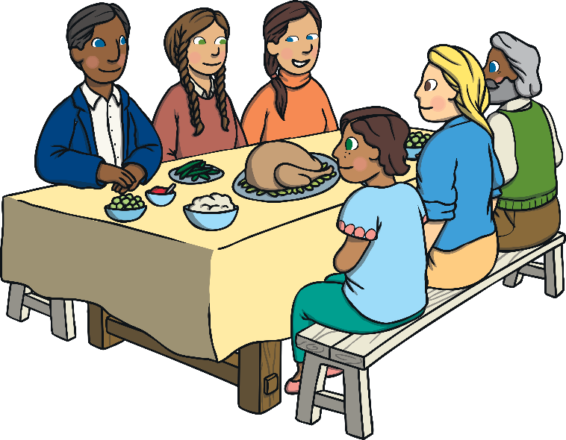
America and Canada
In America and Canada, harvest celebrations are called Thanksgiving.
Thanksgiving is in October or November.
People celebrate by having a family dinner with lots of different foods, like roast turkey with lots of vegetables.

Slide 8


Africa
In West Africa, there is a celebration called The Festival of Yams, which celebrates the yam harvest. The festival usually takes place in August.
Yams are a vegetable, similar to a sweet potato.
People celebrate by dancing and sharing the yams with
the village.

Slide 9
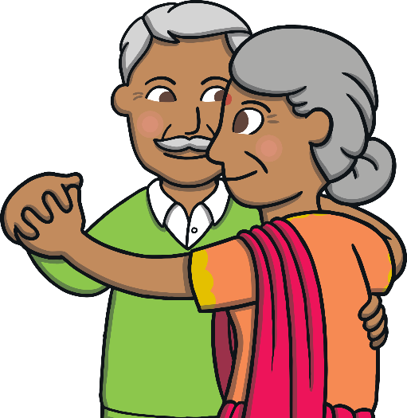
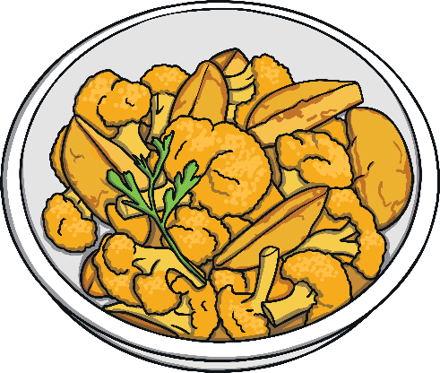
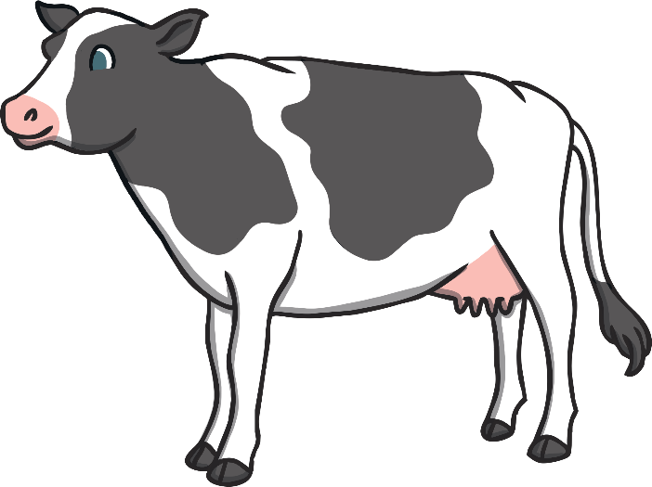
India
In India, there are many different harvest festivals because lots of different foods grow there.
The different crops are celebrated and shared, and sometimes cattle is worshipped too.
Many of the festivals are celebrated with family and friends. Food and drink are shared, new clothes worn and sometimes gifts are given.

Slide 10
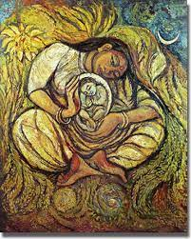
Dalit Madonna.
What can you see in the painting?
Discuss what you think this means.

Slide 11
Dalit Madonna.
It shows Mary and baby Jesus and is full of imagery of harvest - the main harvest, at Christmas (birth of Jesus) with gift of Jesus then all the other gifts that Christians believe God gives to them: fruit, vegetables, flowers etc

