Slide 1
Week 4 31.1.22
Statistics

Slide 2

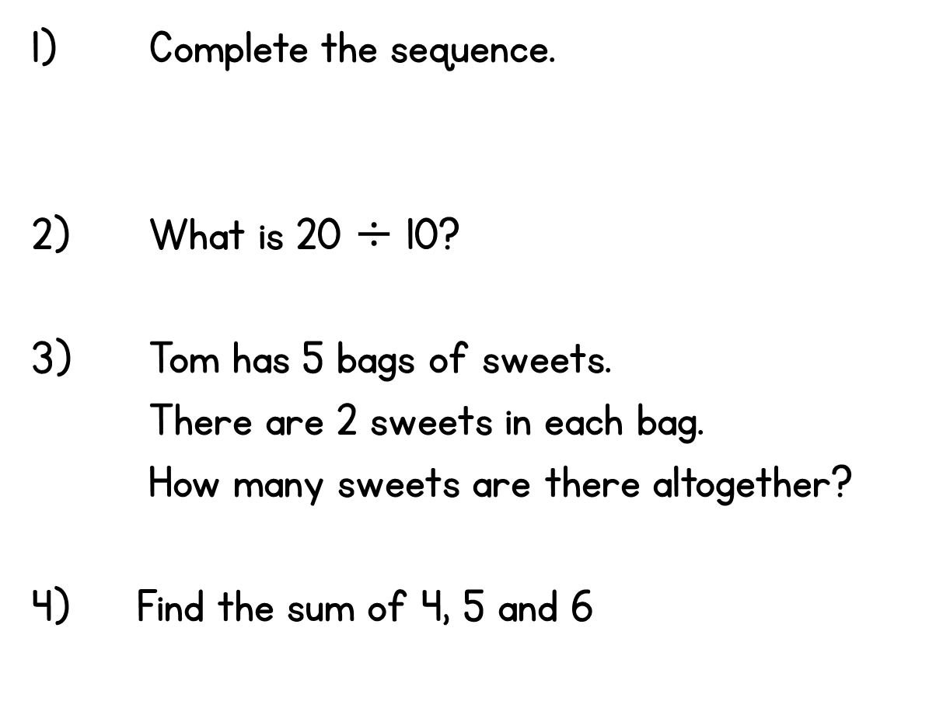
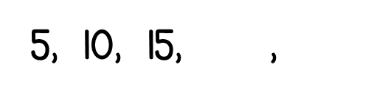
Year 2 | Week 3 | Day 1

Slide 3
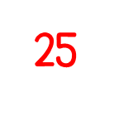




Year 2 | Week 3 | Day 1

Slide 4


Slide 6

How many is represented here?
1)
2)
3)

Slide 7
How many is represented here?
1)
2)
3)
20
20
7

Slide 8
Have a go at questions
1, 2 and 3 on the worksheet

Slide 9
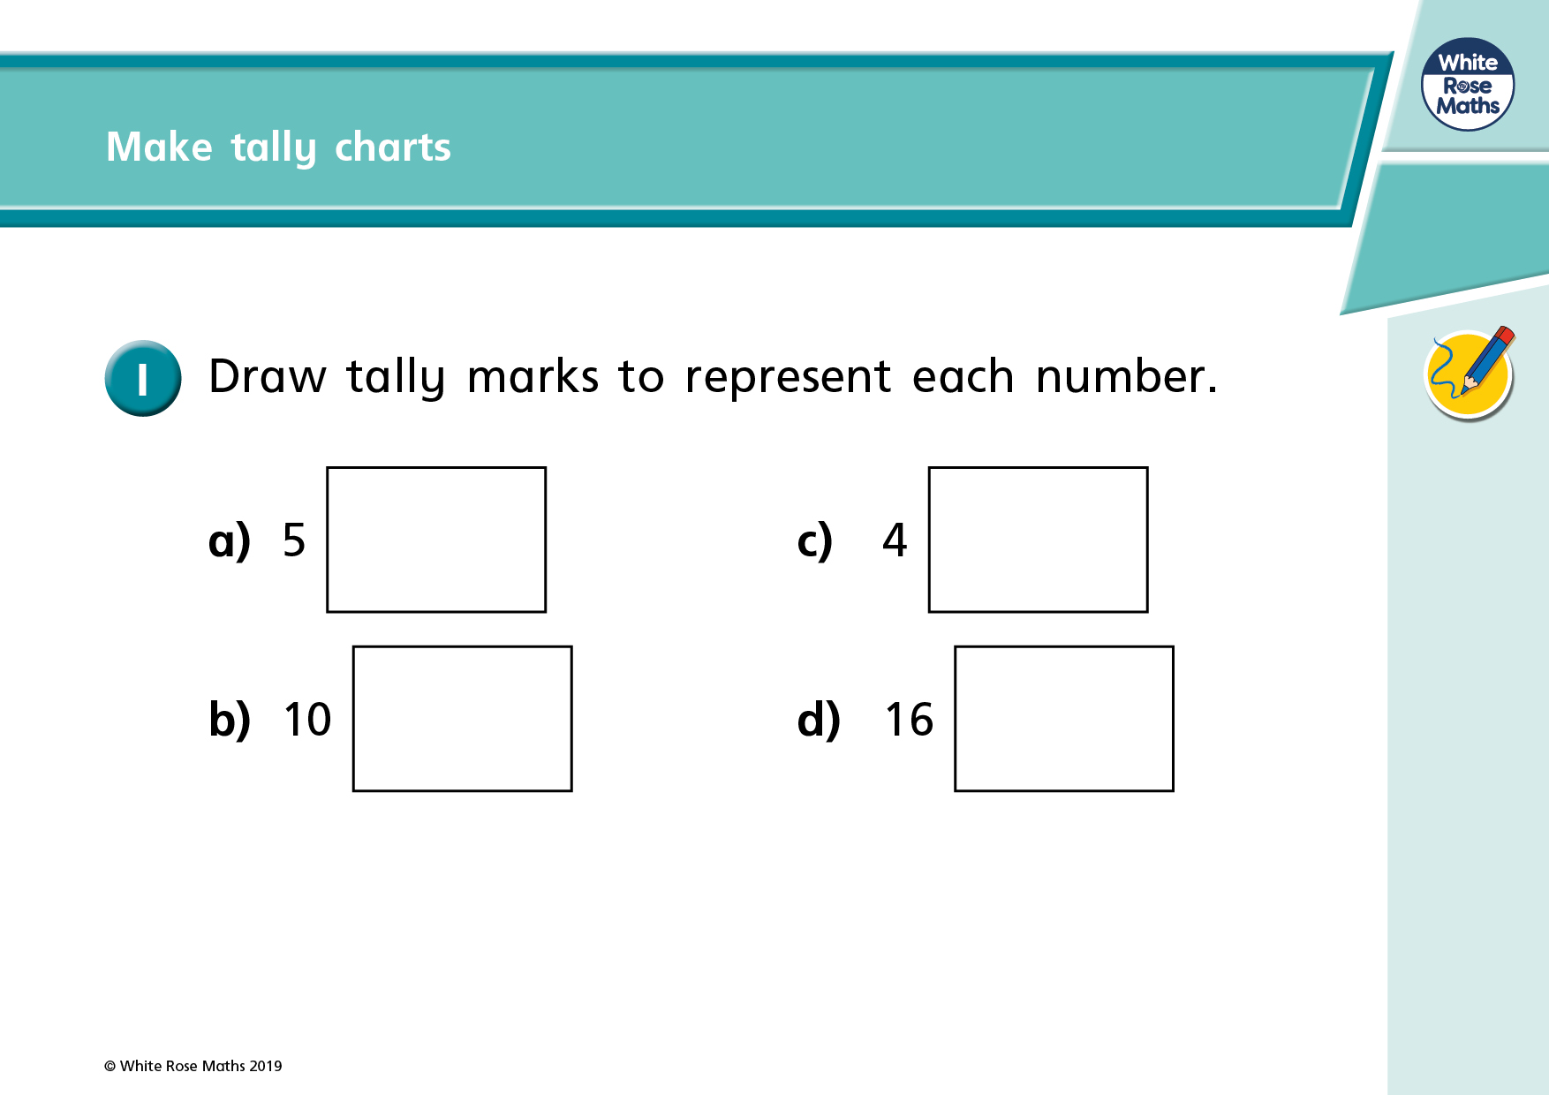

Slide 10
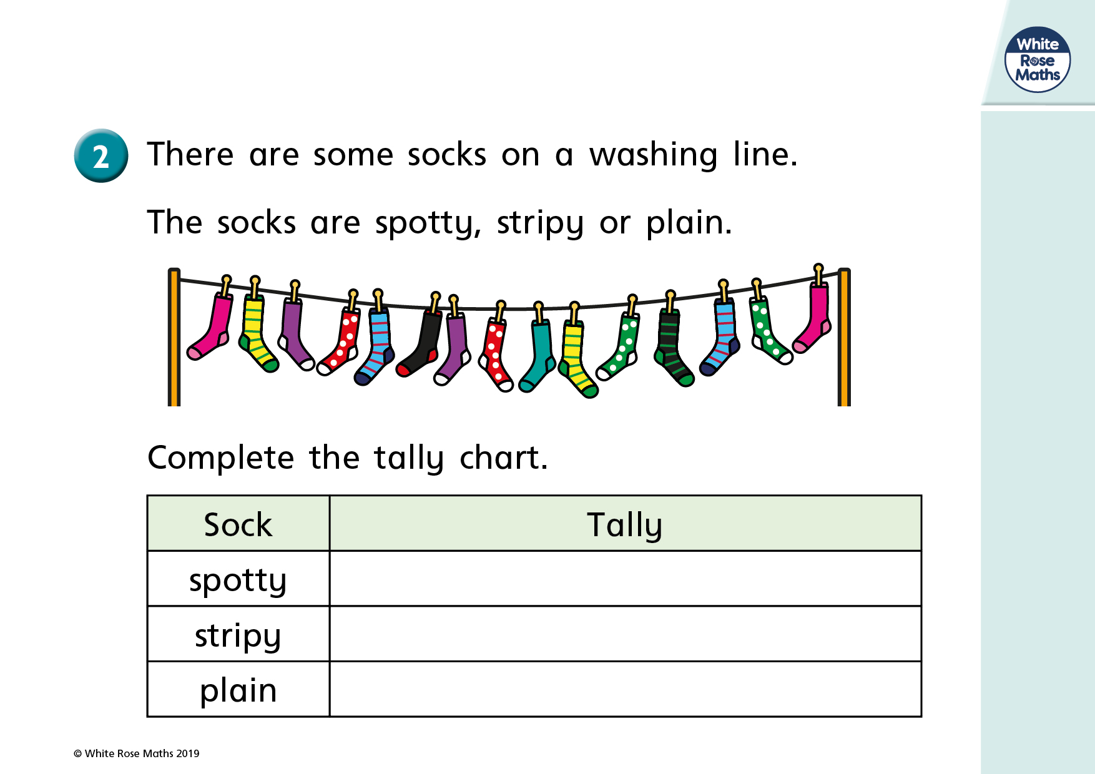

Slide 11
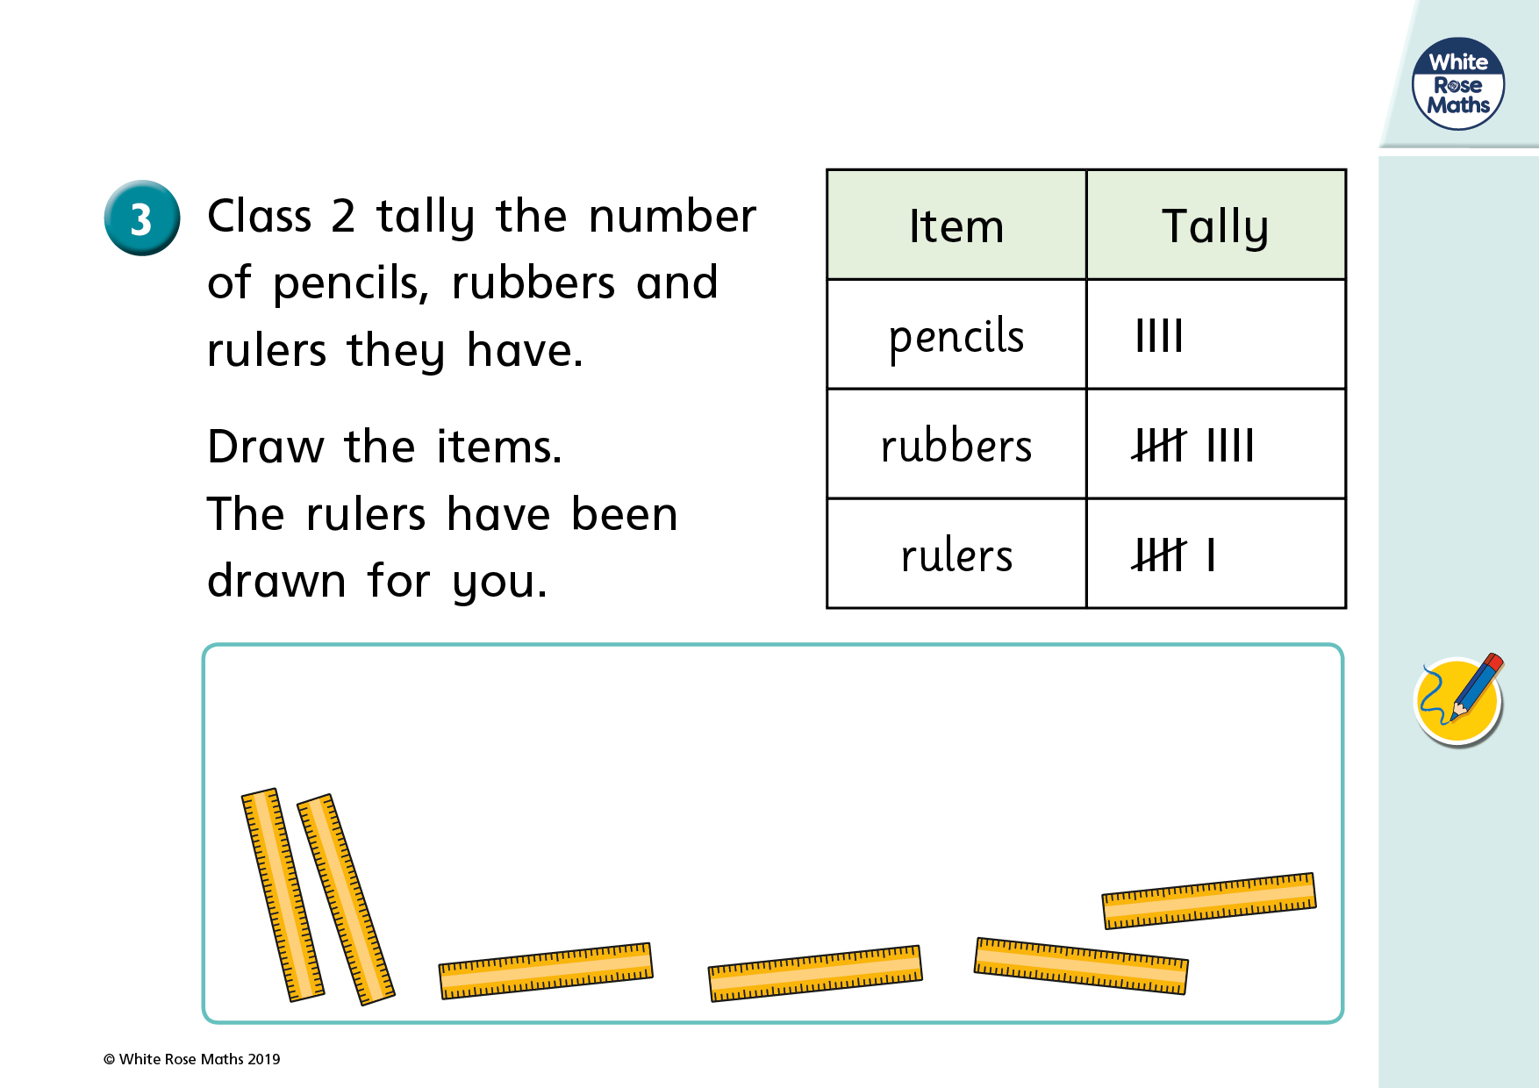

Slide 13
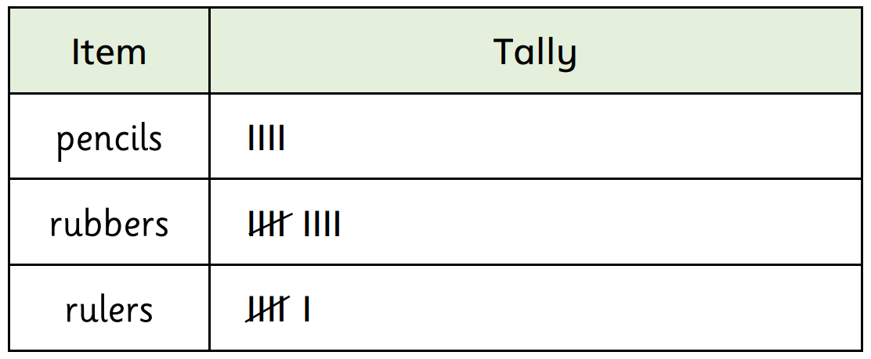




Have a
think

Slide 14





Animals | Tally | Total
Horses
Dogs
Chickens
Frogs
Sheep
1
2
7
4
9

Slide 15
Have a go at question
4 on the worksheet

Slide 16
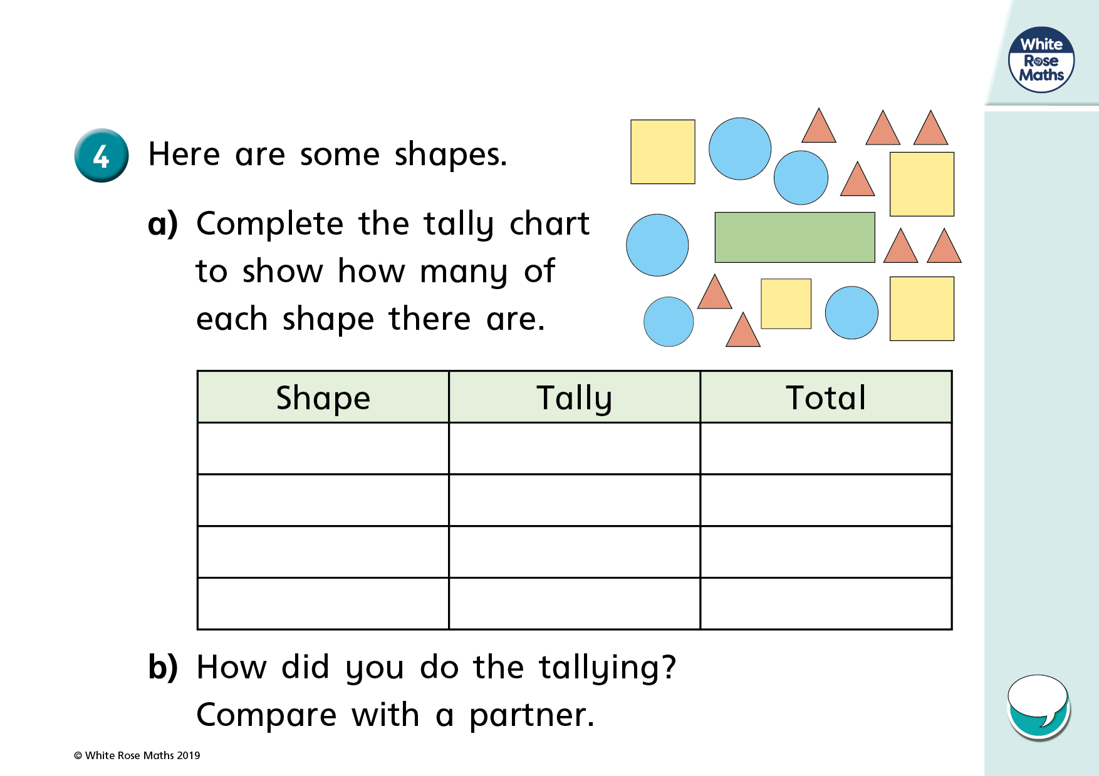

Slide 17





Have a think

Slide 18
Have a go at questions
5 and 6 on the worksheet

Slide 19
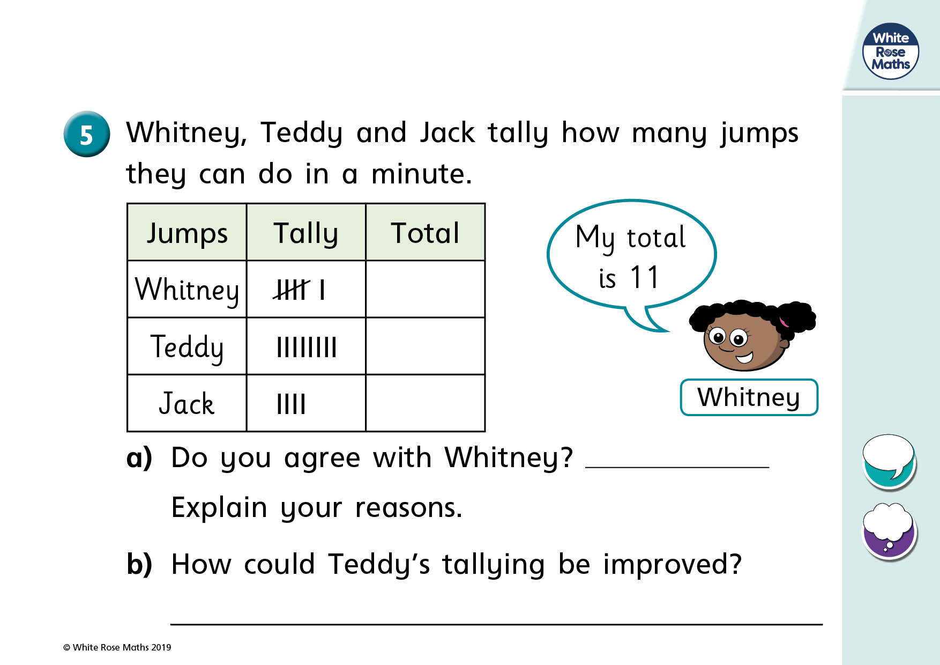

Slide 20
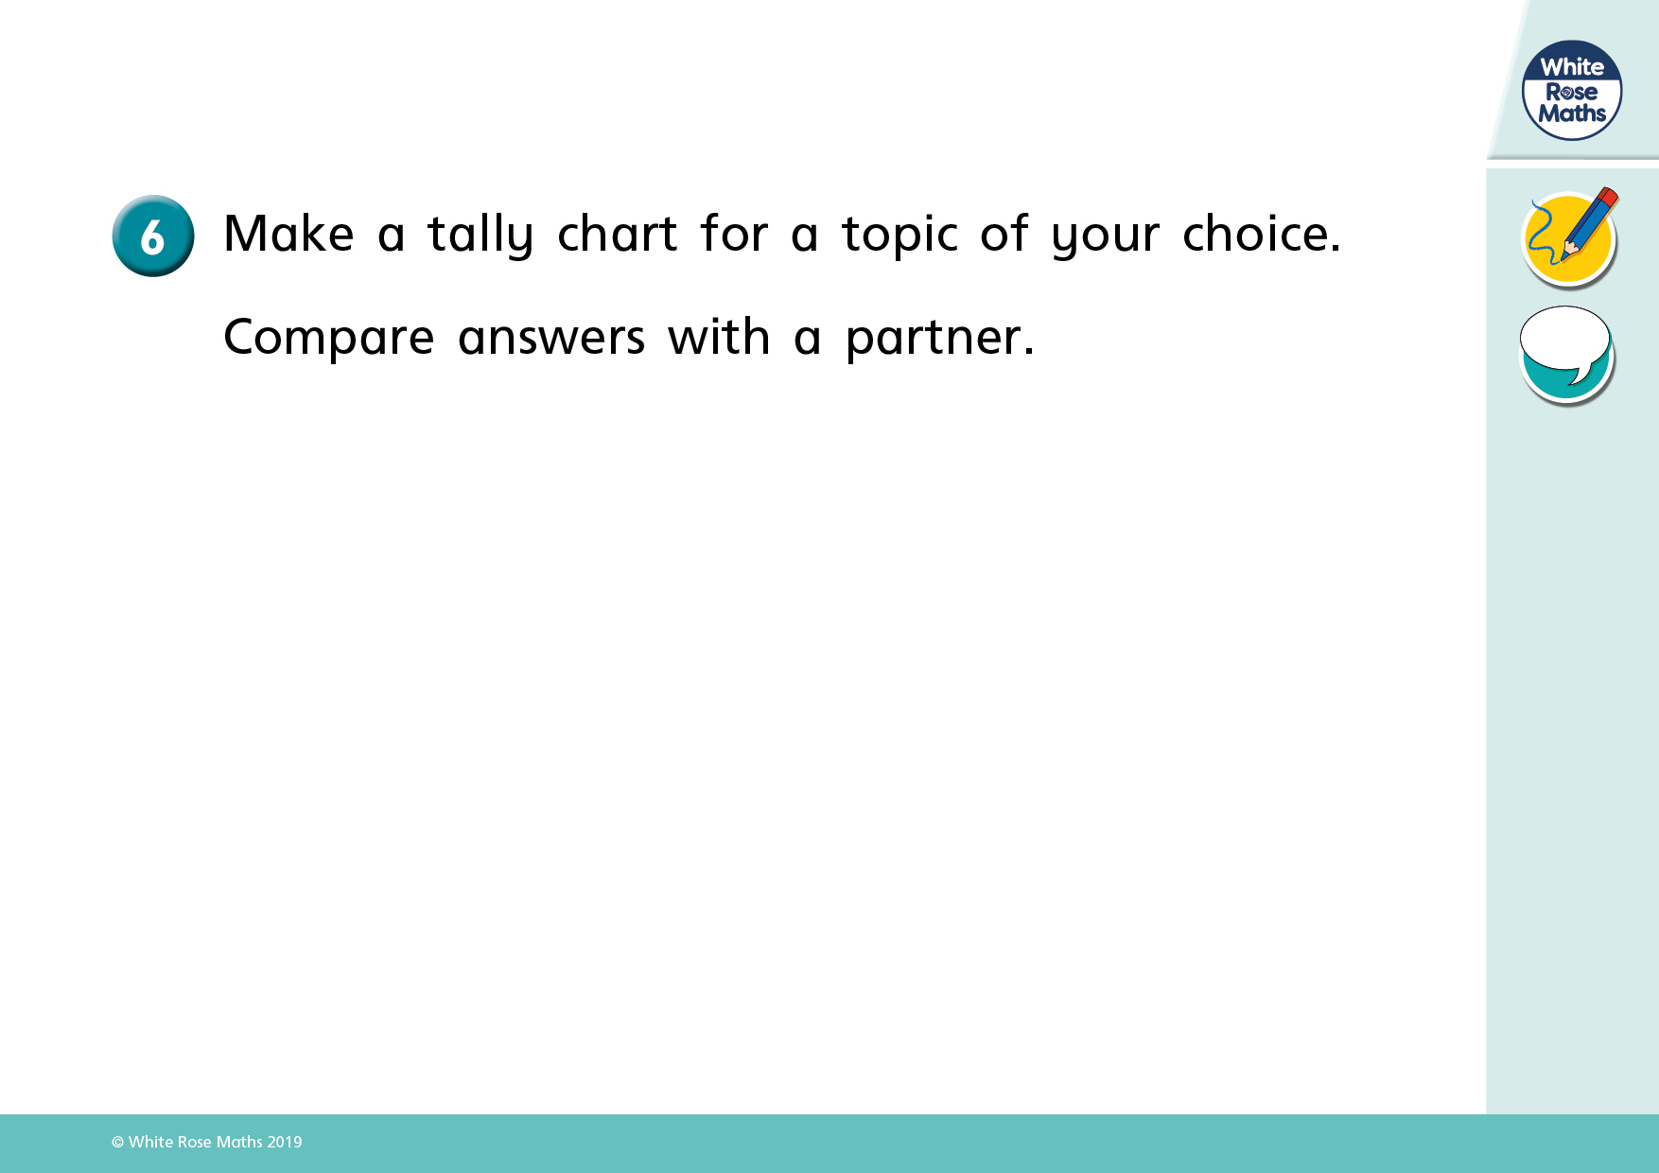

Slide 21
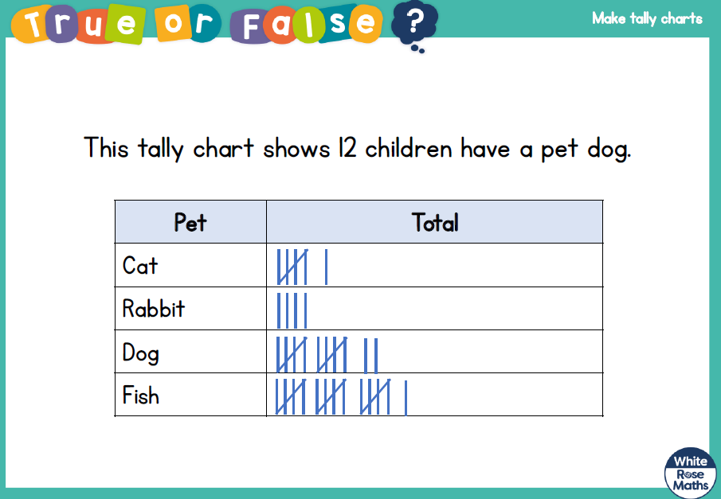

Slide 22
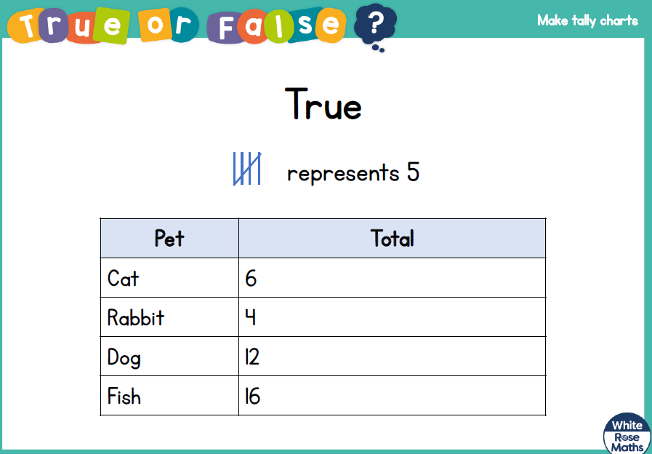

Slide 23
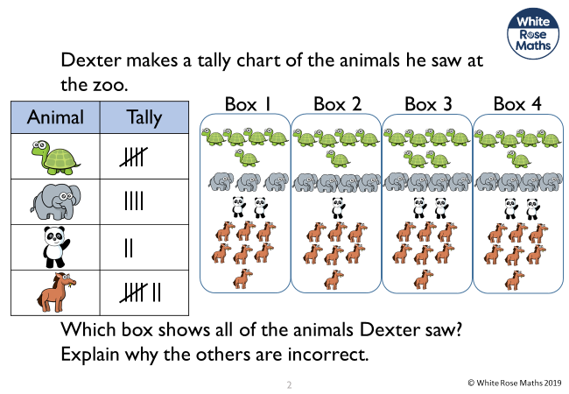

Slide 24
Class 1 and Class 2 were each asked their favourite ice-cream flavours.
Their results are shown in the tally charts.
What is the same? What is different?
Class 1
Flavour | Total
Vanilla
Chocolate
Strawberry
Mint
Class 2
Flavour | Total
Vanilla
Chocolate
Strawberry
Mint

Slide 25
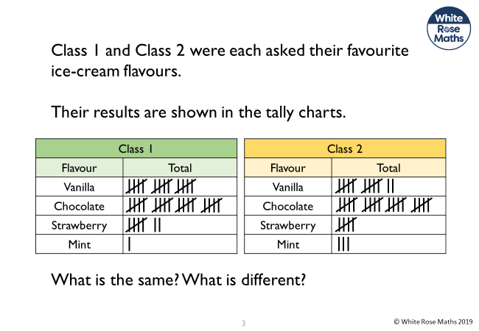

Slide 26
Tuesday 1.2.22

Slide 27
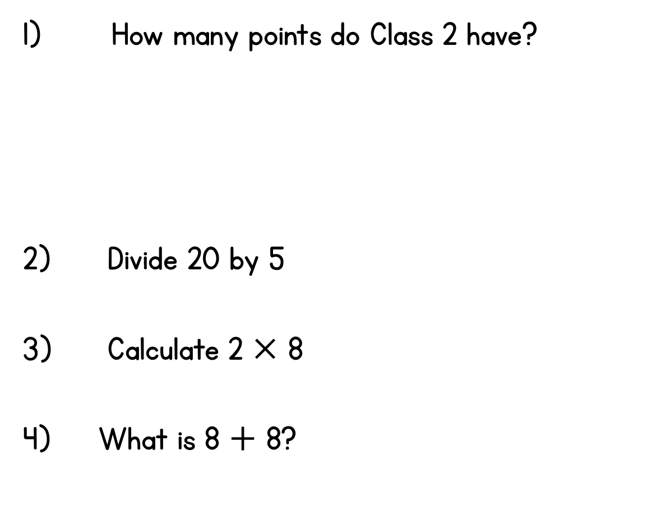
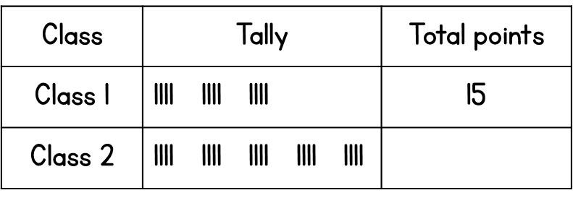
Year 2 | Week 3 | Day 2

Slide 28
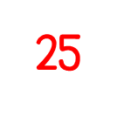



Year 2 | Week 3 | Day 2

Slide 29


Slide 31

How many does each tally represent?
a) b)
Draw tallies to show
a) 7 b) 11
3) Complete the tally chart.
Button Colour | Tally | Total
pink
blue
green

Slide 32
How many does each tally represent?
a) b)
Draw tallies to show
a) 7 b) 11
3) Complete the tally chart.
9
22
Button Colour | Tally | Total
pink
blue
green
3
6
4

Slide 34

Key $=$ 1 shape
Shape
Square
Triangle
Decagon
Trapezium

Slide 35
Have a go at questions 1 and 2 on the worksheet

Slide 36
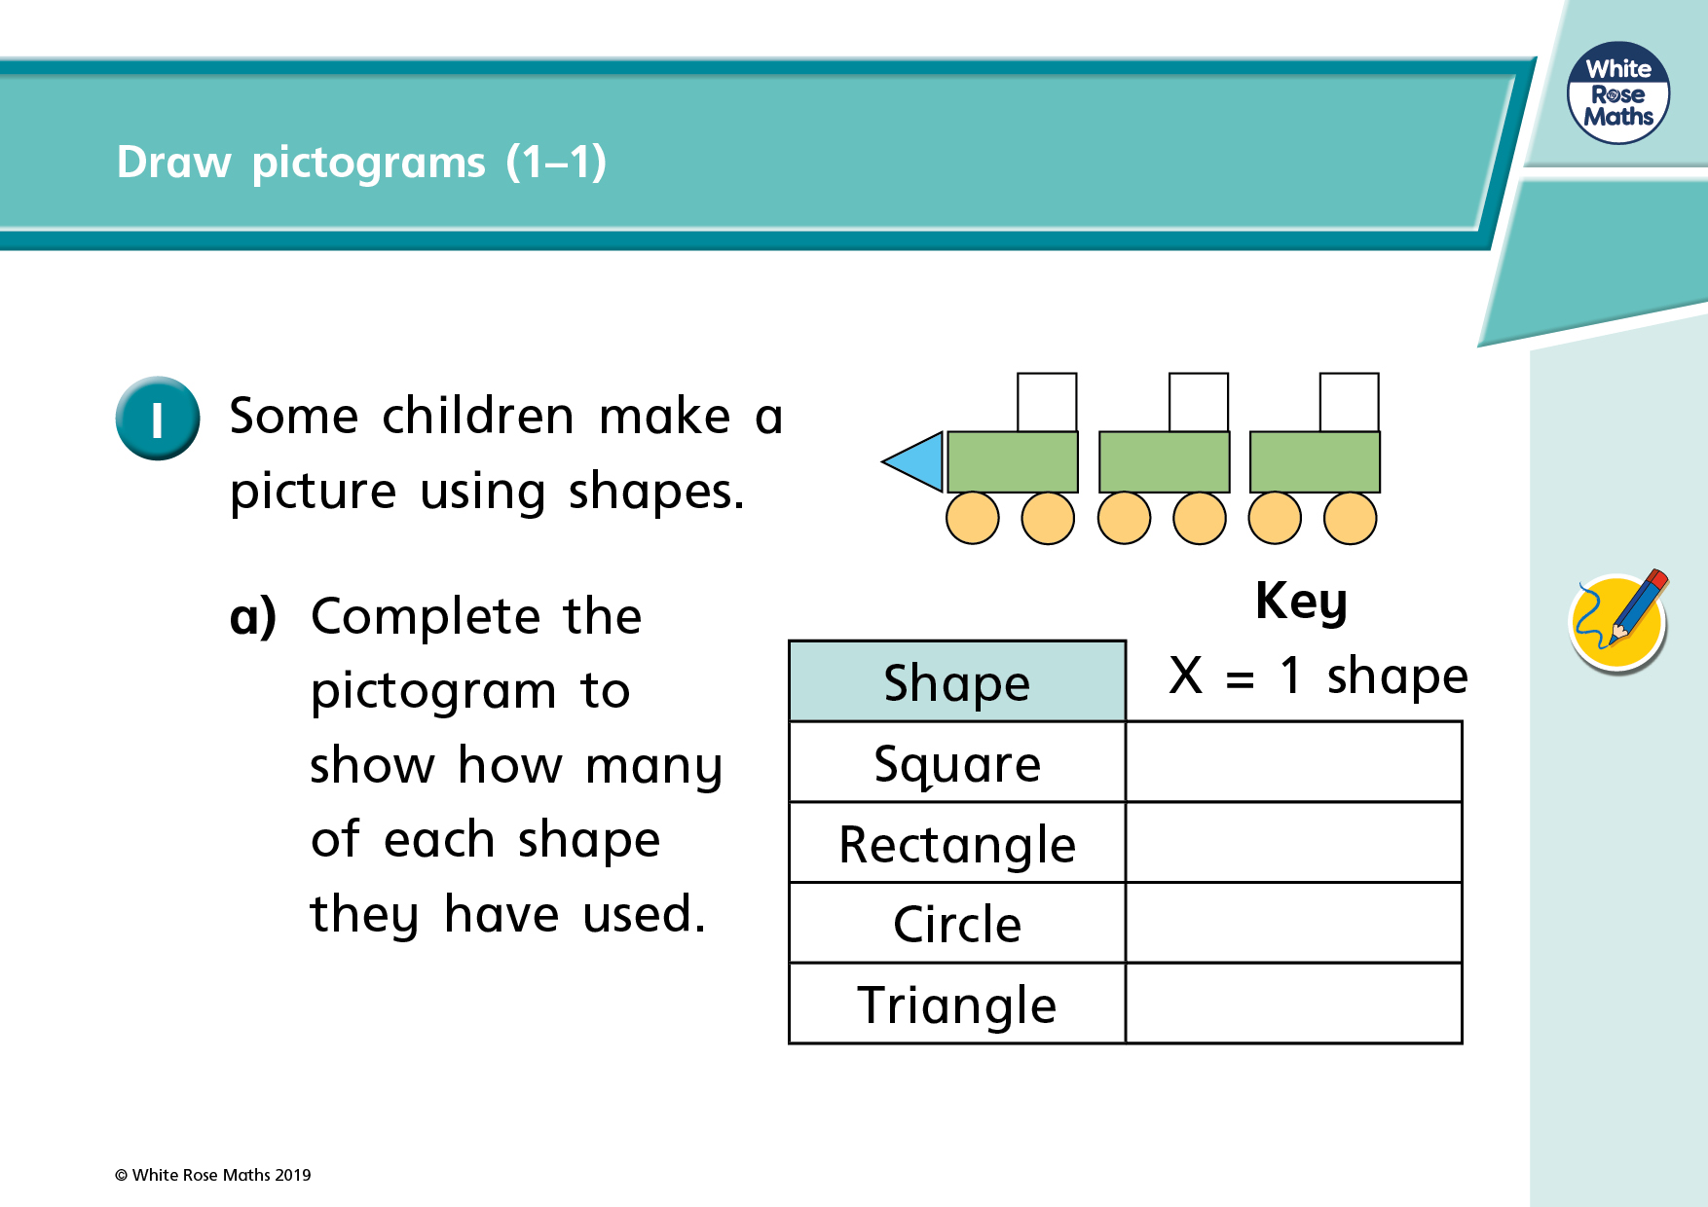

Slide 37
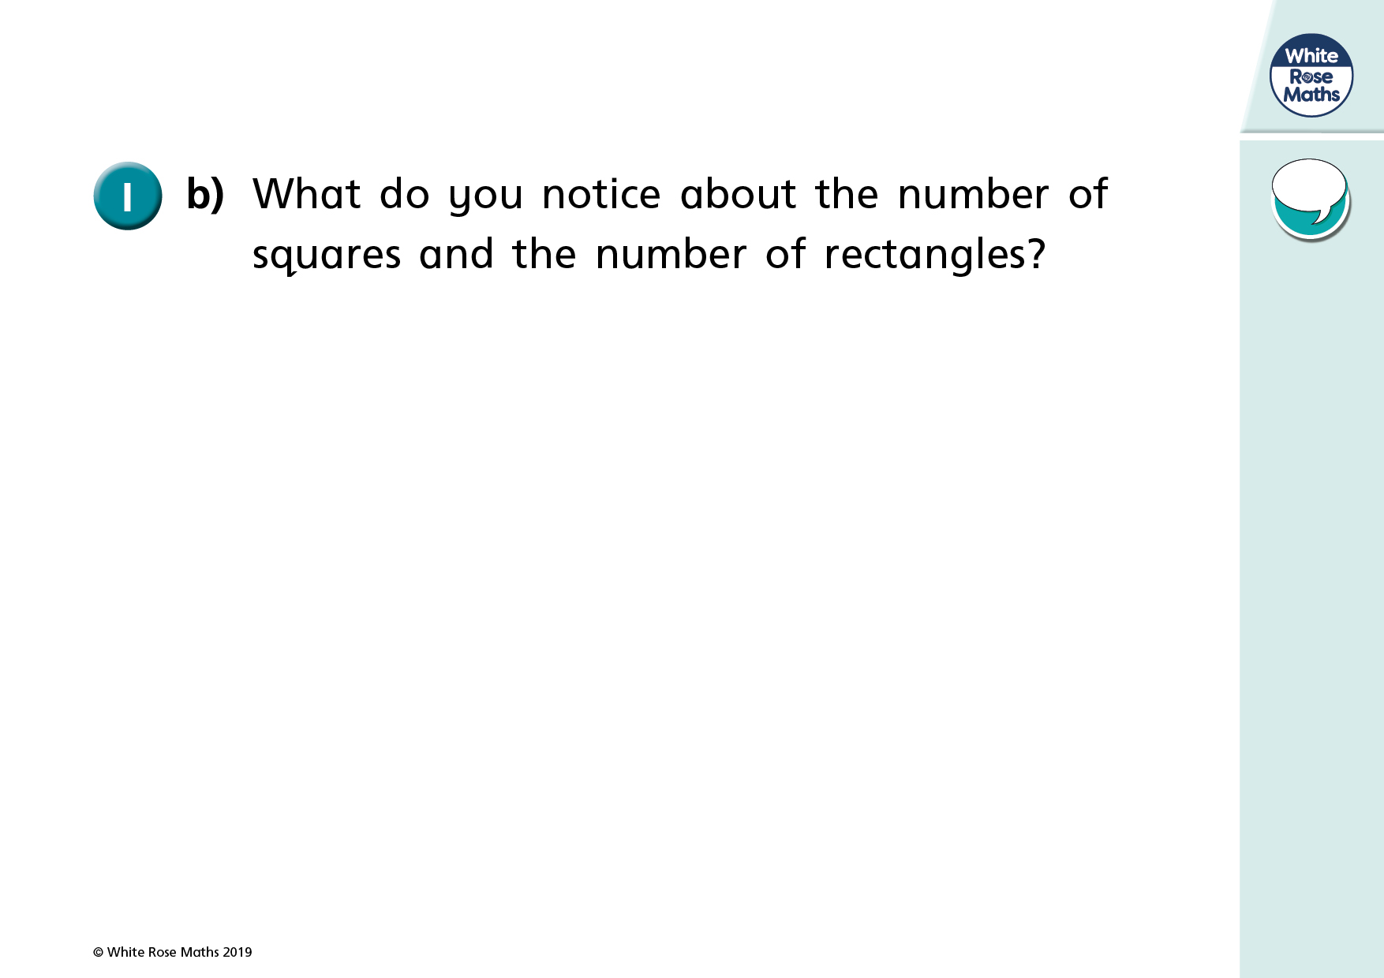

Slide 38
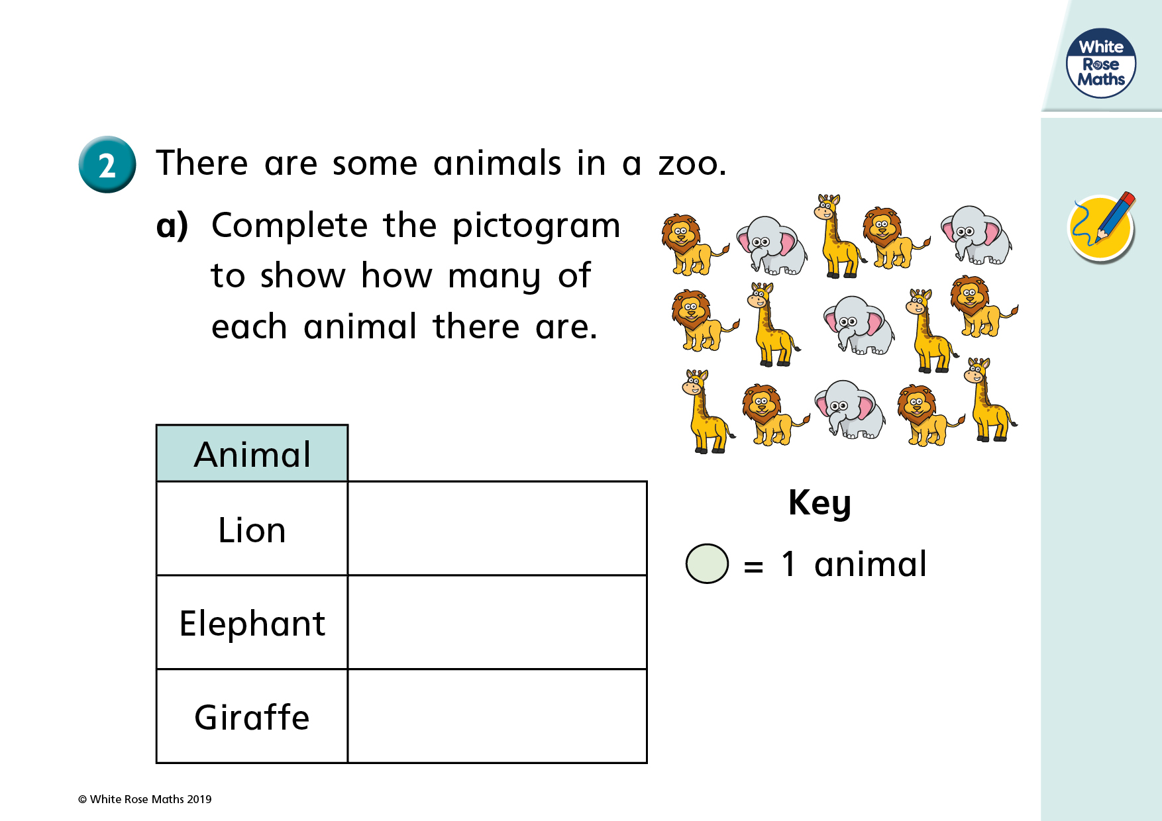

Slide 39
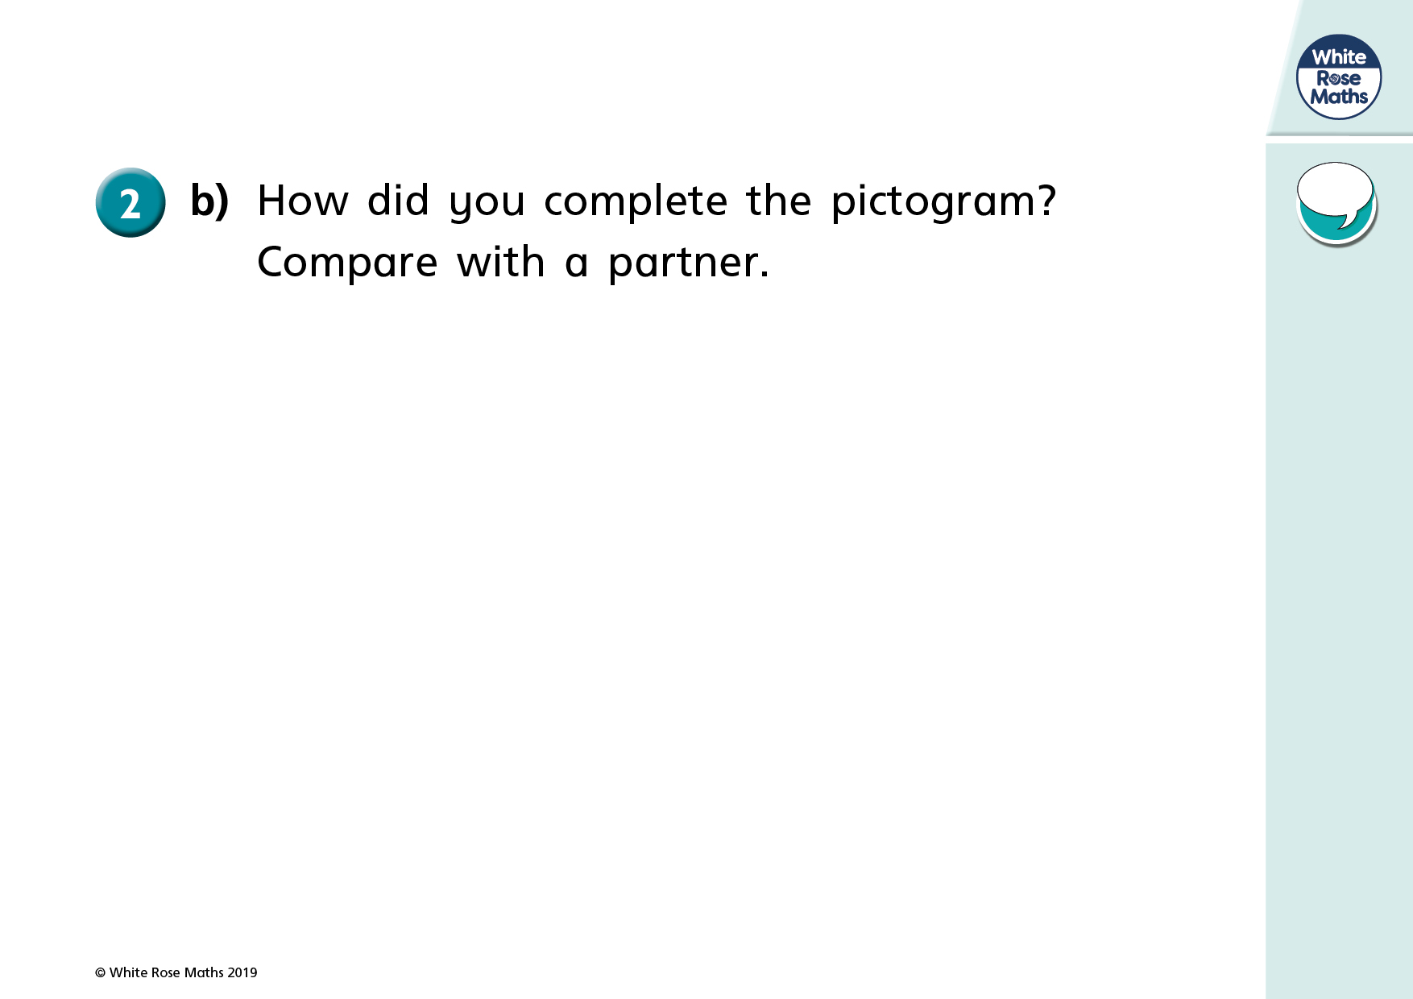

Slide 40

Day | Minutes spent reading
Monday | 3
Tuesday | 10
Wednesday | 8
Key $=$ 1 minute reading
Day
Monday
Tuesday
Wednesday
Have a think

Slide 41
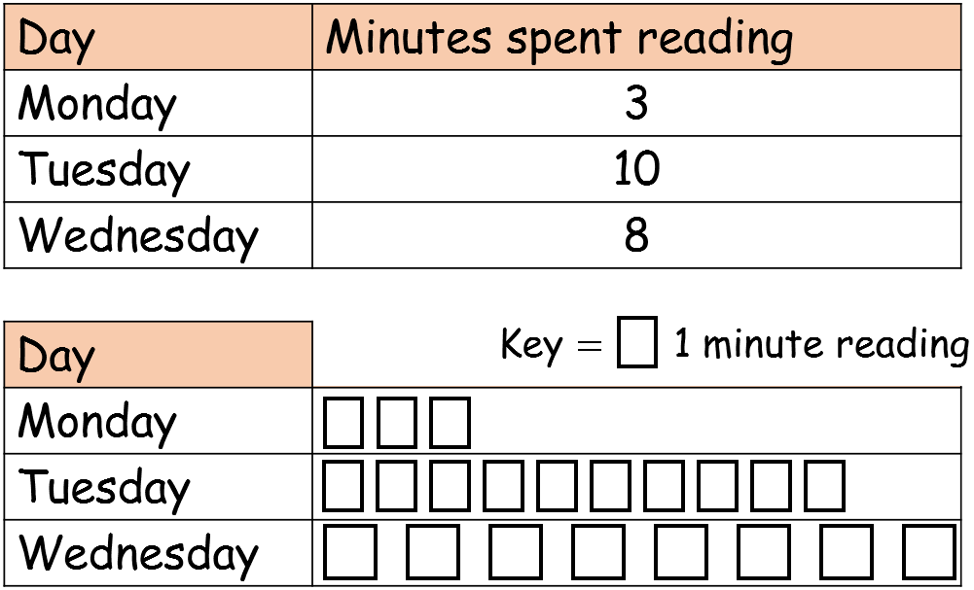
Key $=$ 1 minute reading
Day
Monday
Tuesday
Wednesday

Slide 42
Have a go at question 3 on the worksheet

Slide 43
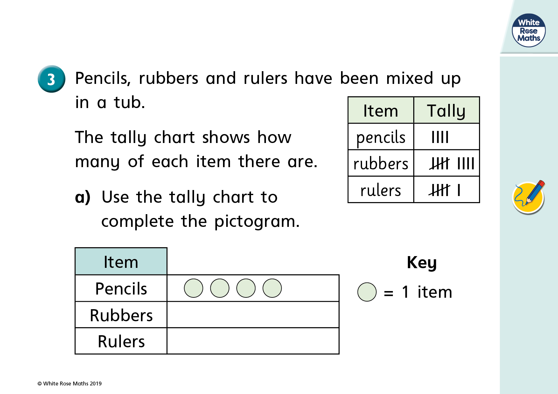

Slide 44
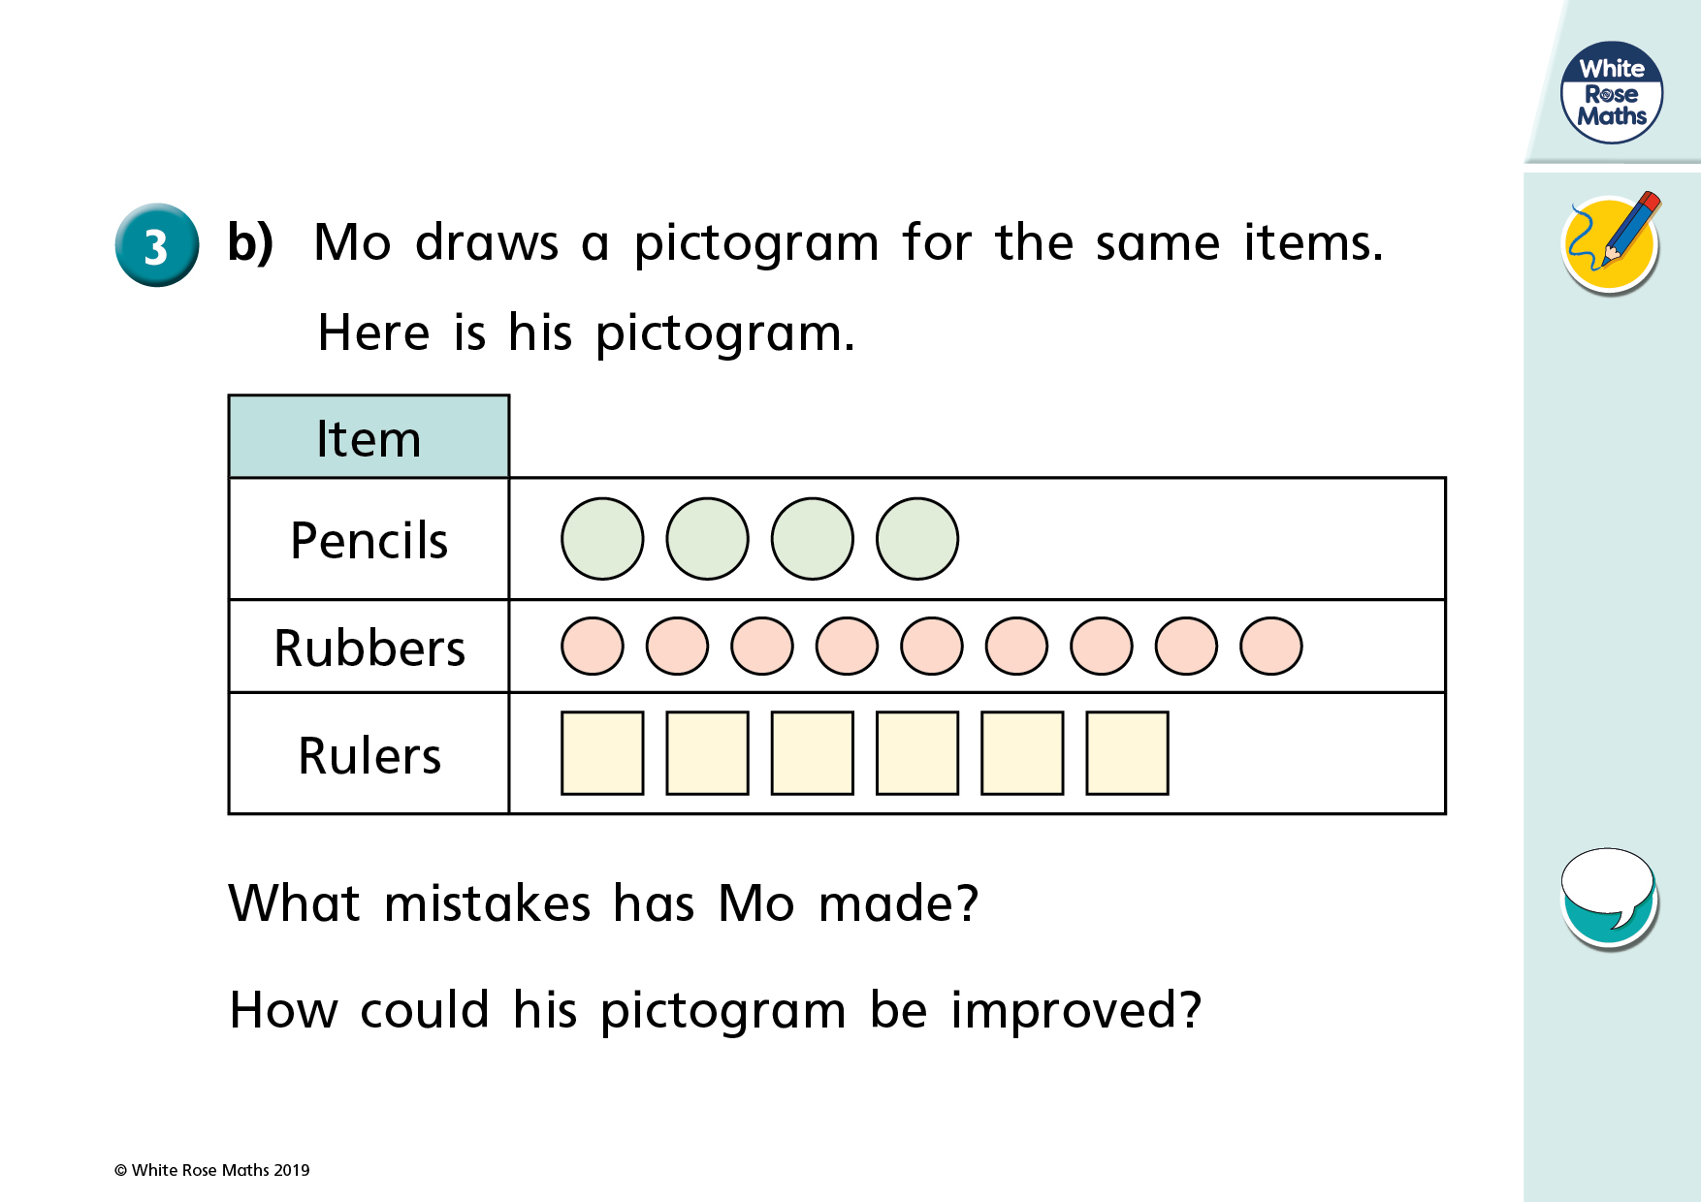

Slide 45



Key $=$ 1 relative called
Relatives
Grandmas
Uncles
Cousins
And twice as many uncles as grandmas!
We’ve called 5 grandmas!
We’ve been video calling our relatives
But one less cousin than uncles

Slide 46
Have a go at question 4 on the worksheet

Slide 47
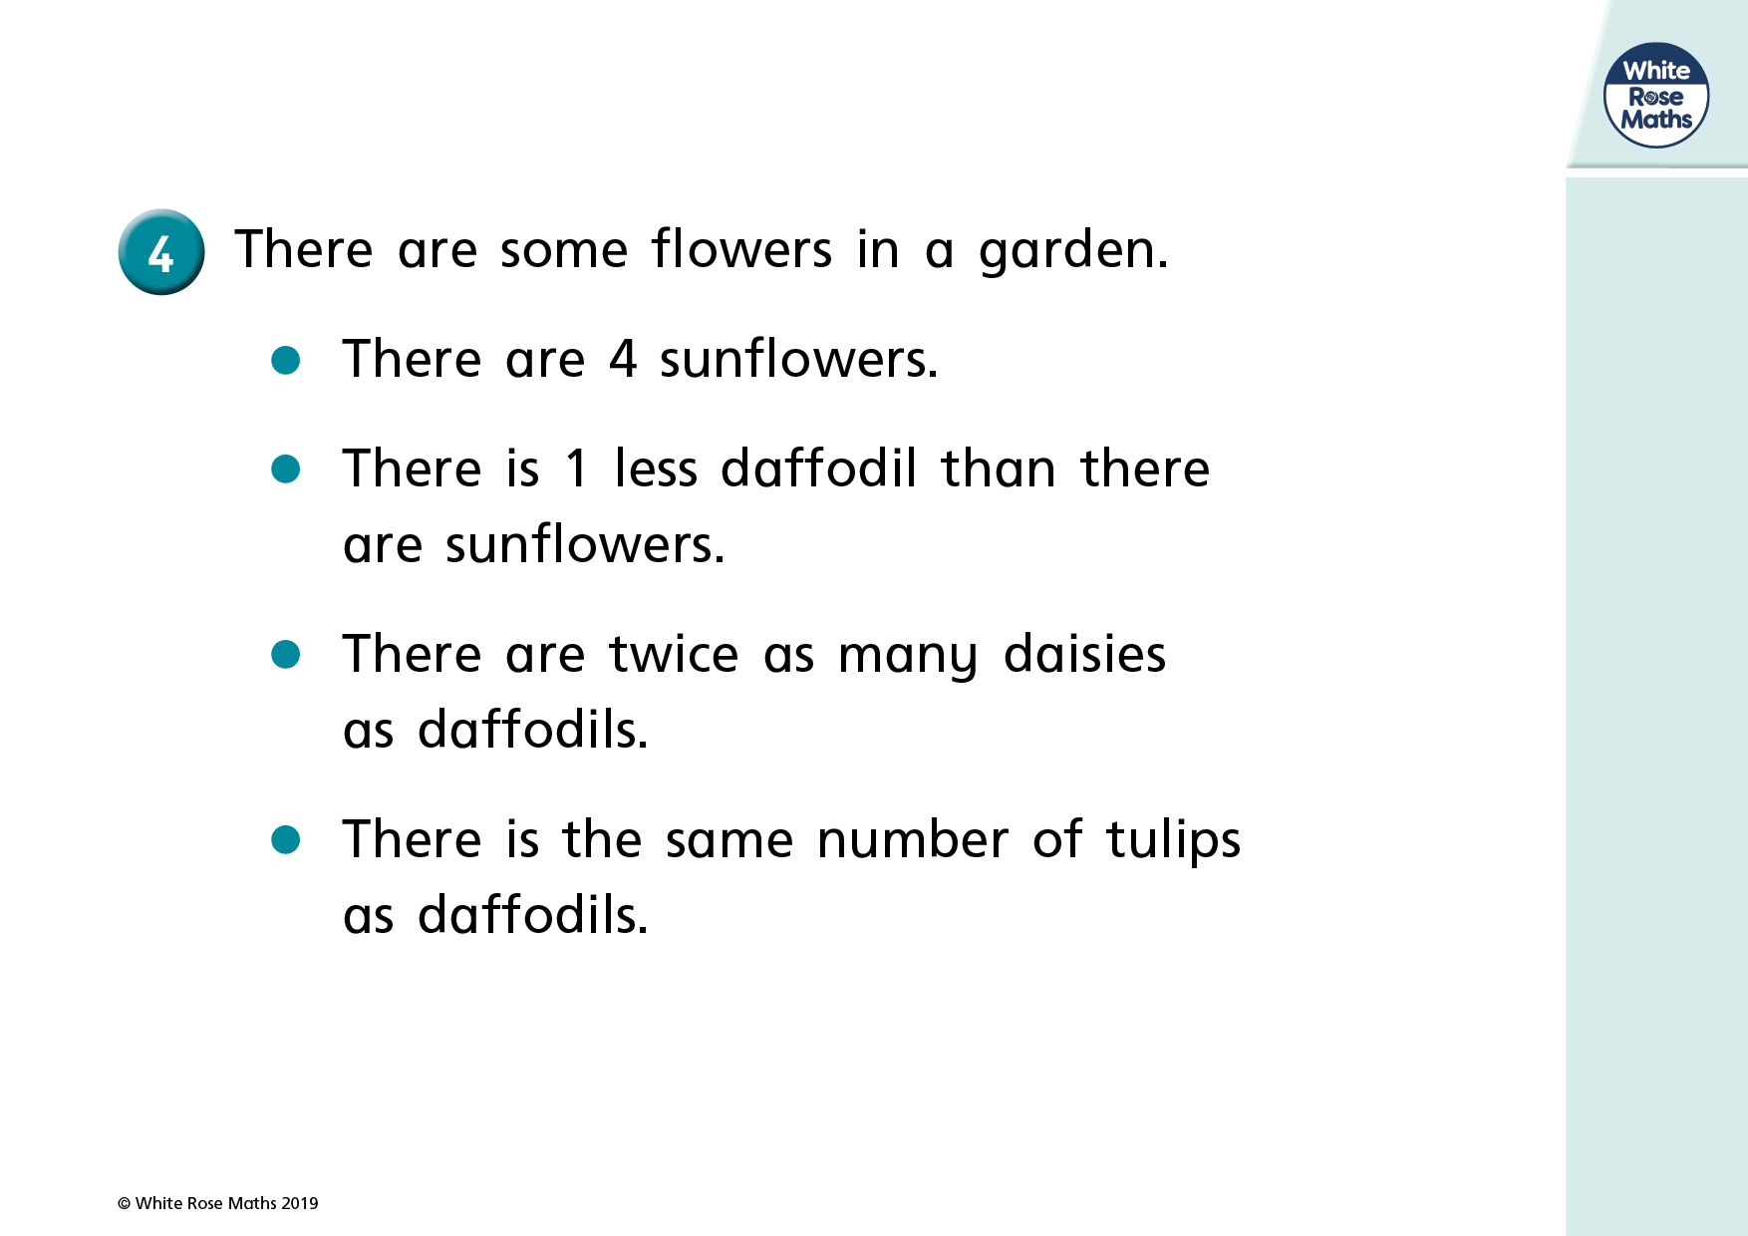

Slide 48
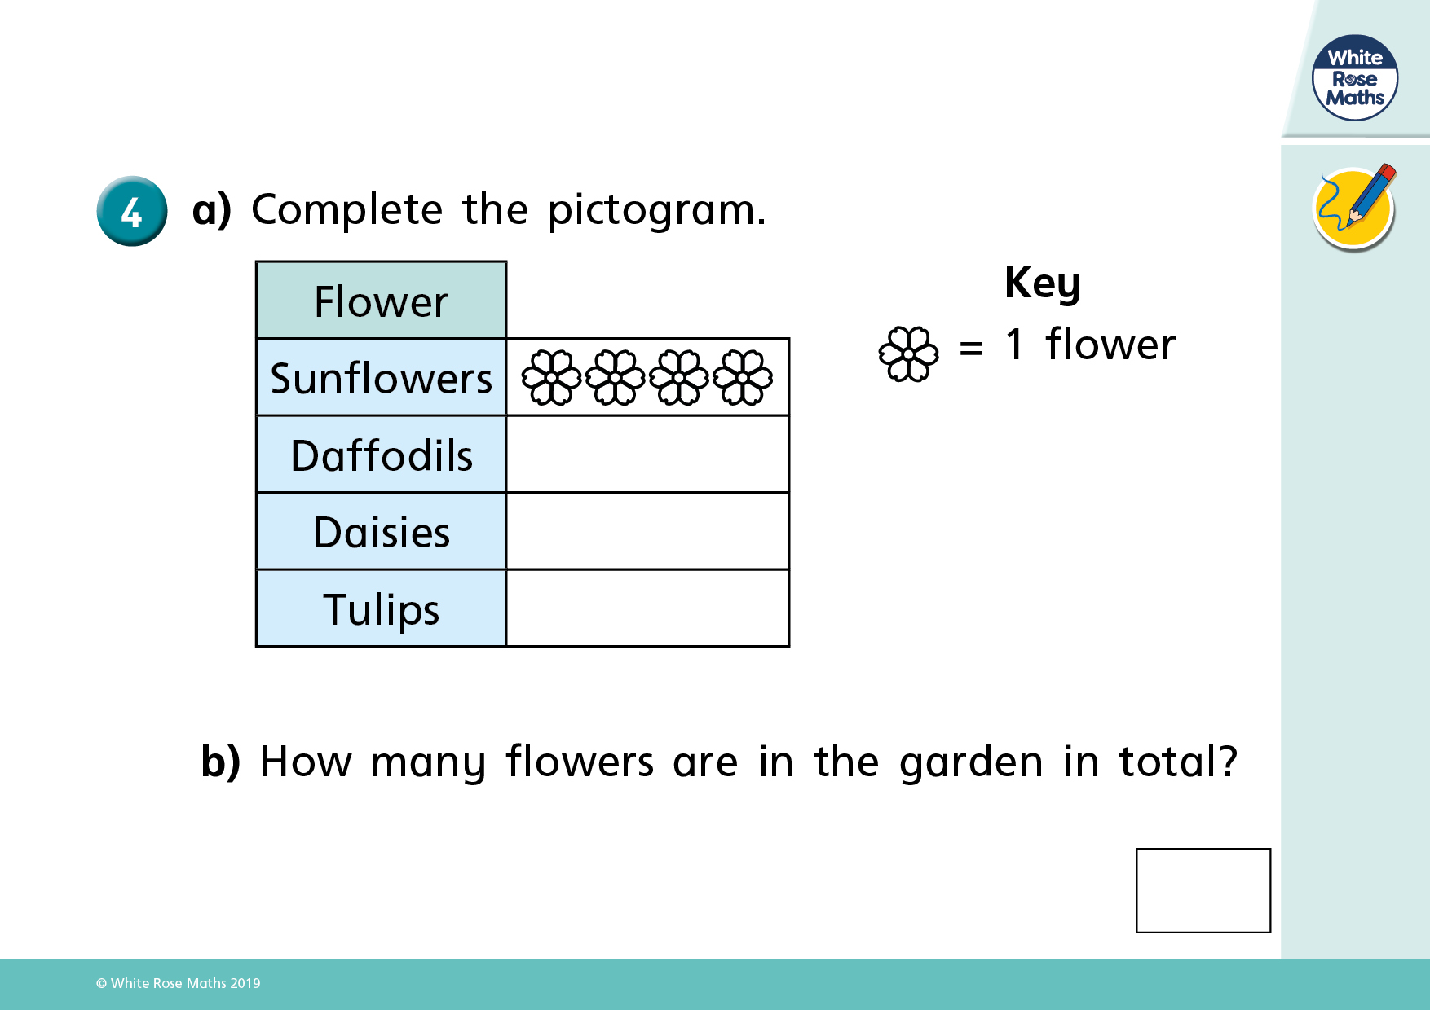

Slide 49
Here is a pictogram showing the number of counters each child has.
How could you improve the pictogram?
Dexter
Alex
Mo
Rosie

Slide 50

Use the clues to help you complete the pictogram.
More Caramel was sold than Bubblegum flavour, but less than Strawberry flavour.
Mint was the most popular flavour.
Vanilla was the least popular.
Can you find more than one way to complete the pictogram?
Flavour | = 1 ice cream | Total
Strawberry
Vanilla
Chocolate
Mint
Caramel
Bubblegum |  | 4

Slide 51
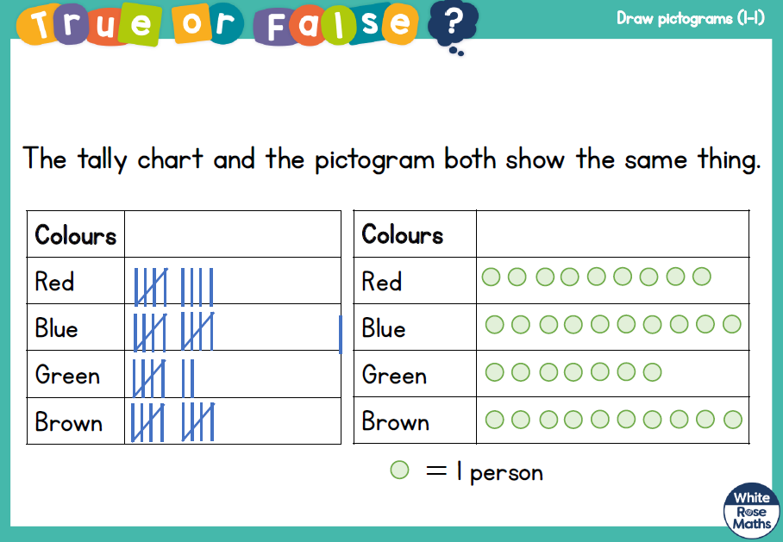

Slide 52
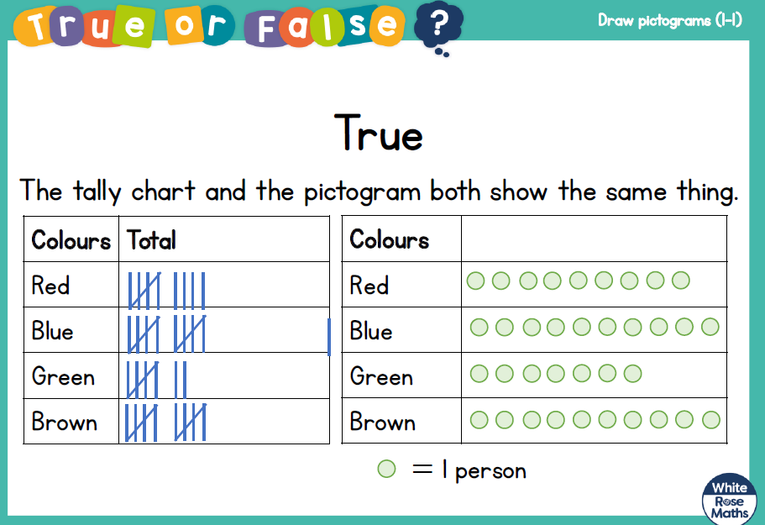

Slide 53
Wednesday

Slide 54
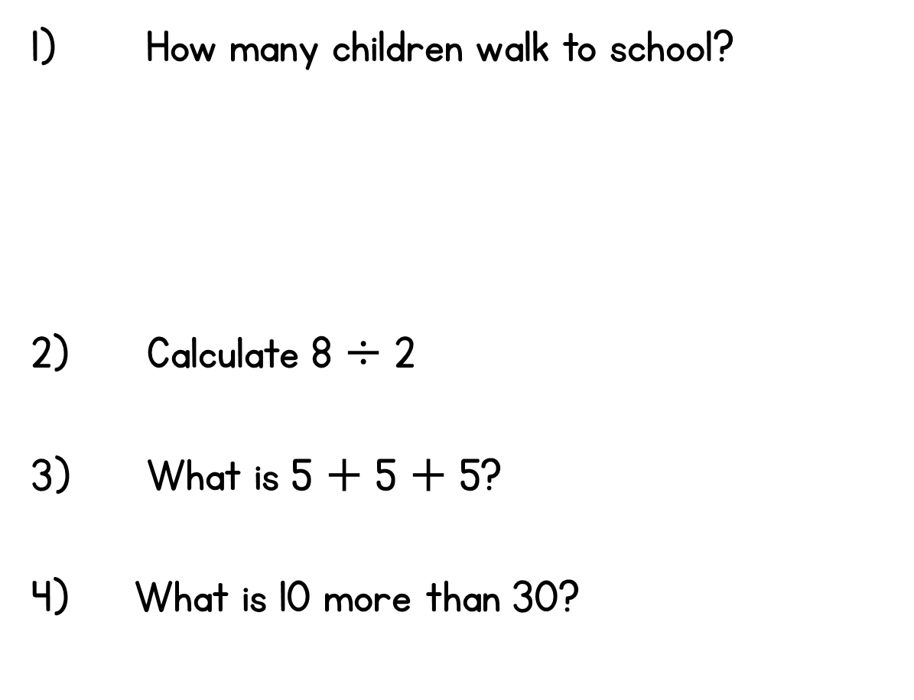
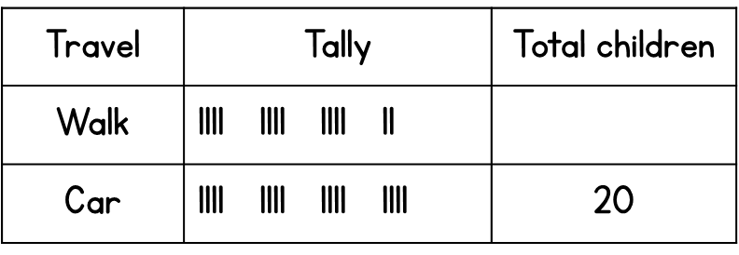
Year 2 | Week 3 | Day 3

Slide 55




Year 2 | Week 3 | Day 3

Slide 56


Slide 58
If asked to ‘find the difference’, which representation would help you?
a) b)
If asked, ‘how many more…’, which representation would help you?
a) b)

Slide 59
If asked to ‘find the difference’, which representation would help you?
a) b)
If asked, ‘how many more…’, which representation would help you?
a) b)

Slide 61


Day | Dogs seen
Monday
Tuesday
Wednesday
Thursday
Friday
Key $=$ 1 dog
How many dogs were seen on Wednesday?
_____ dogs
3
How many dogs were seen on Thursday?
_____ dogs
2
Have a think

Slide 62
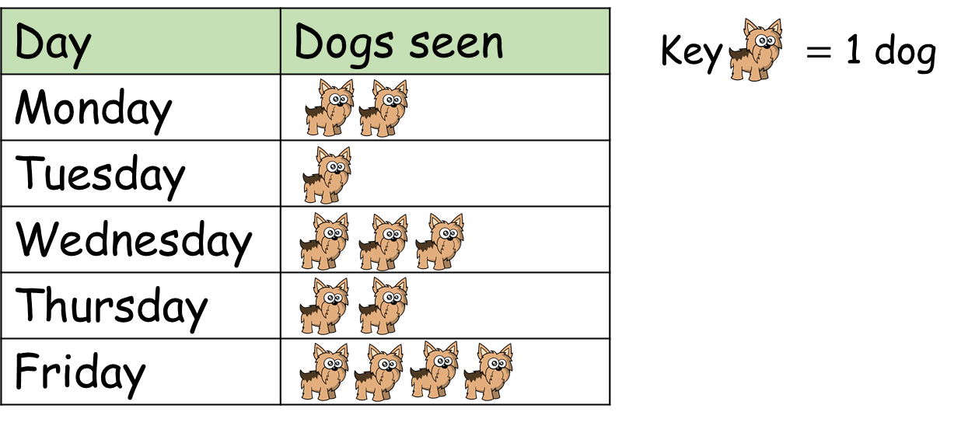
On which day were the fewest dogs seen?
Tuesday, only 1 dog.

Slide 63


How many more dogs were seen on Wednesday
than Tuesday?
I know an easier way to compare.
I will subtract to find the difference.

Slide 64

How many more dogs were seen on Wednesday
than Tuesday?
Tuesday
Wednesday
Key $=$ 1 dog
3 dogs were seen on Wednesday.
1 dog was seen on Tuesday.
3 $−$ 1 $=$ 2
2 more dogs were seen on Wednesday than Tuesday.
I can use the pictogram to compare.
I can see there are 2 more dogs on Wednesday.

Slide 65






Player | Goals scored
Alex
Jack
Mo
Rosie
Whitney
Key $=$ 1 goal
I scored 6. That’s the most goals!
Jack scored 1 goal.
What do you notice?
19 goals were scored altogether.
Mo scored 2 more goals than Whitney.
Have a think

Slide 66

Game 1
Key $=$ 1 point
Game 2
Player | Points scored
Ron
Amir
Player | Points scored
Ron
Amir
How many points did Ron score overall?
Who scored the most points overall?
In which game were most points scored?
6 points
Amir
Game 1
Have a think

Slide 67
Have a go at the questions on the worksheet

Slide 68
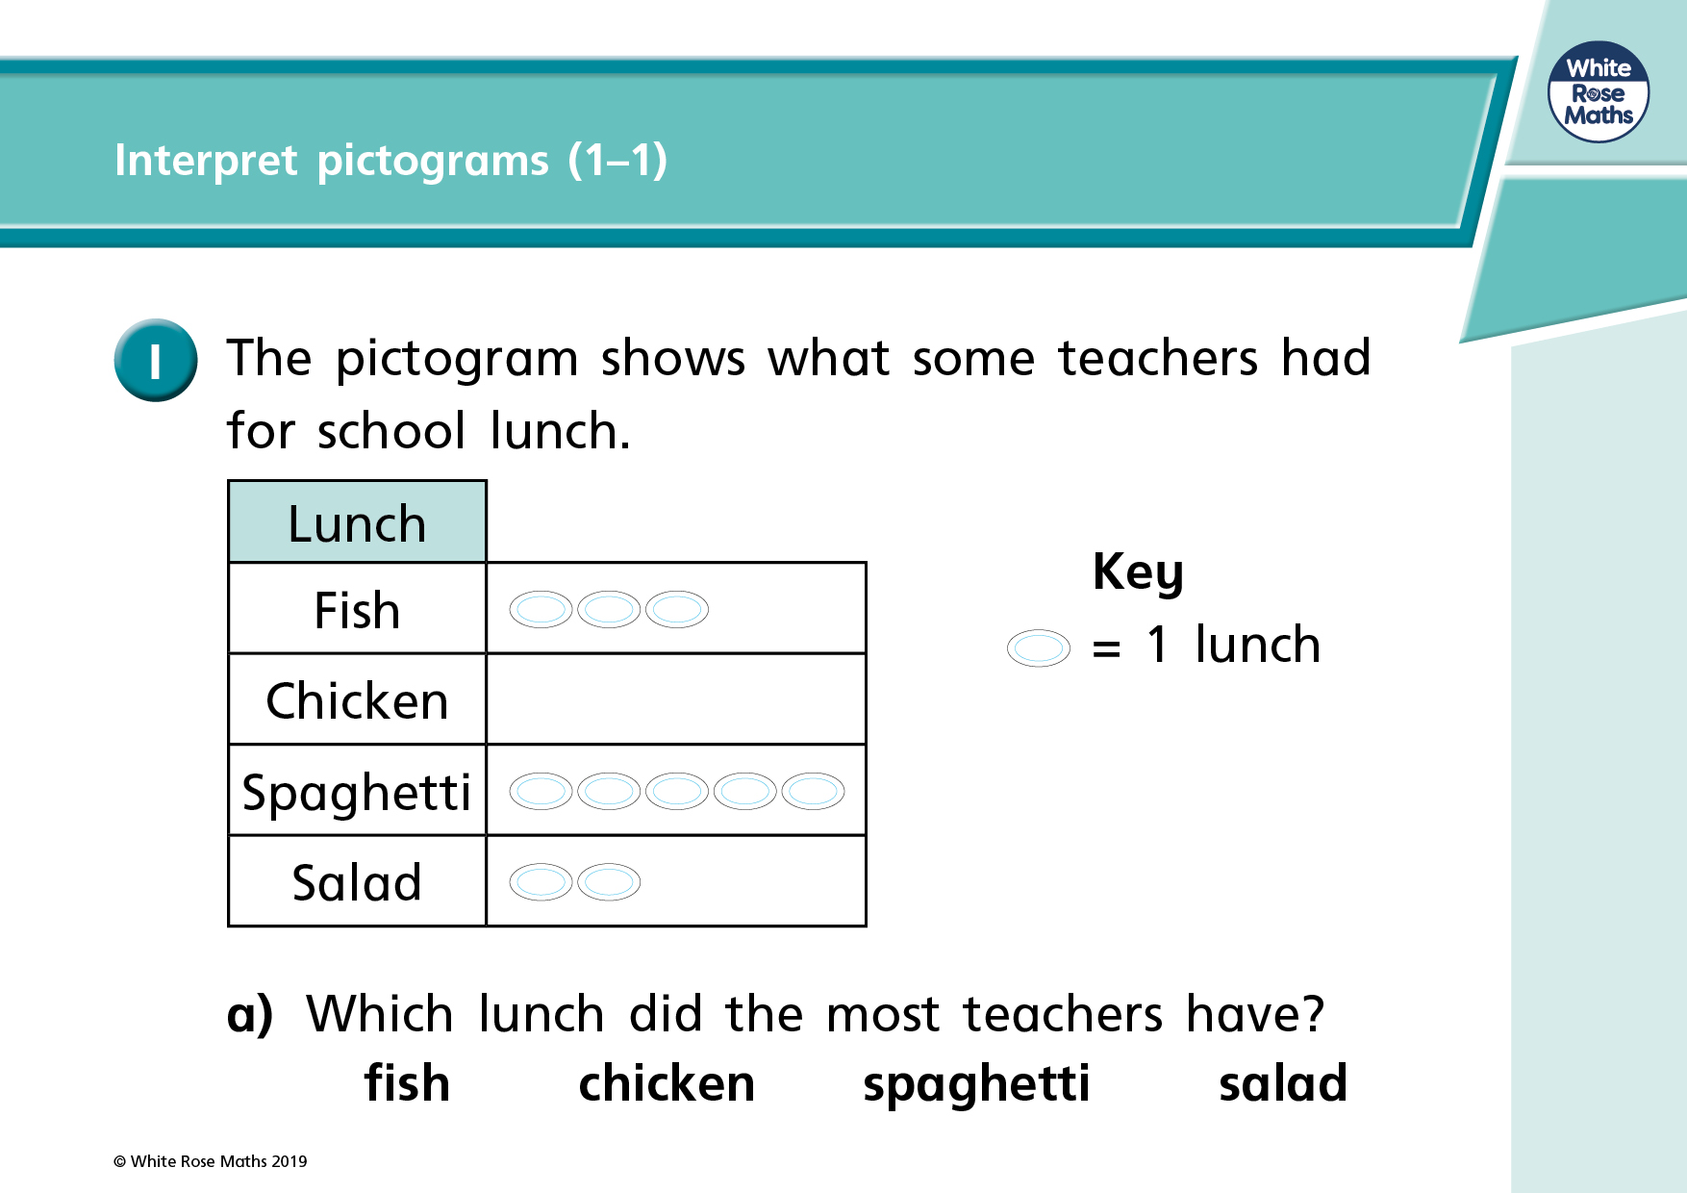

Slide 69
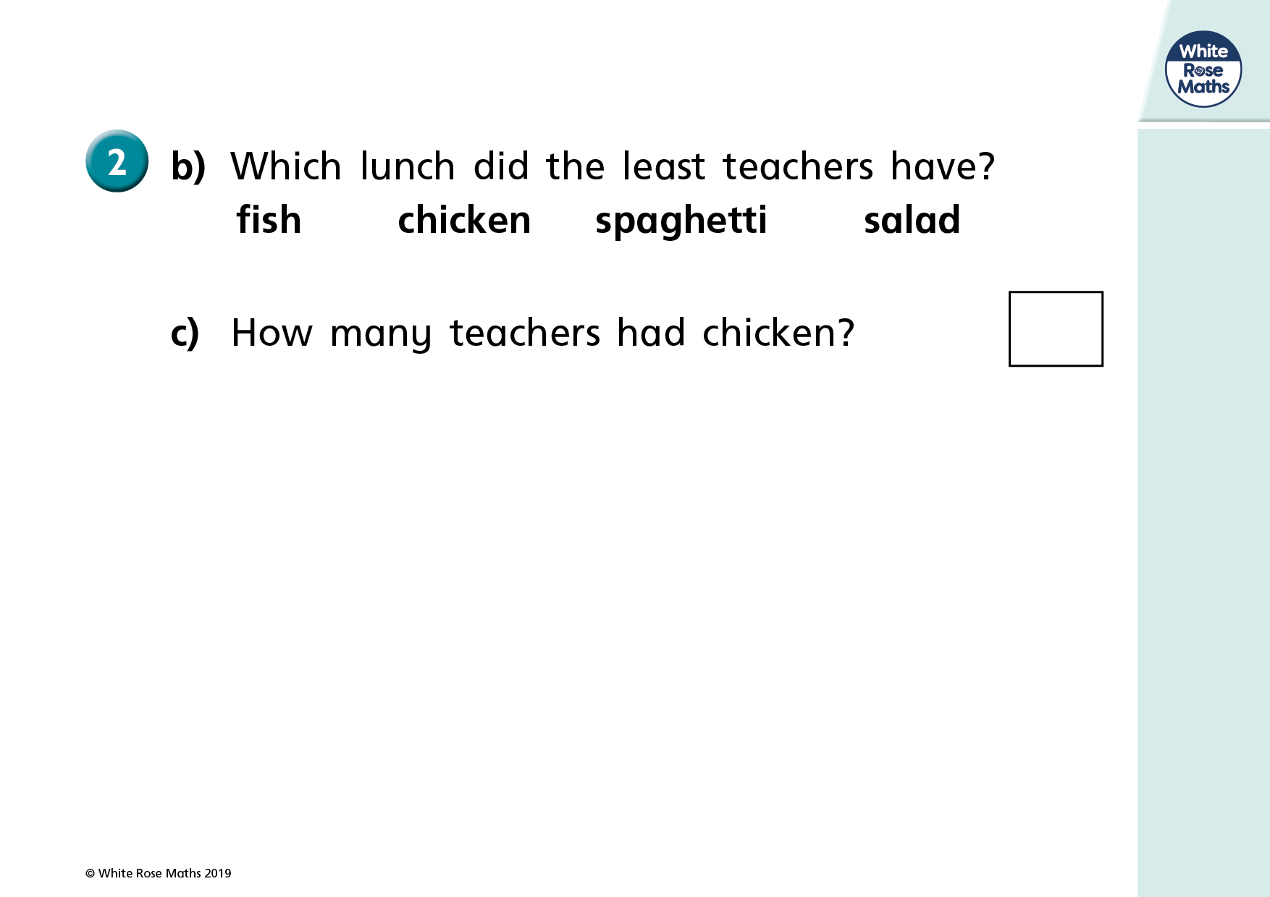

Slide 70
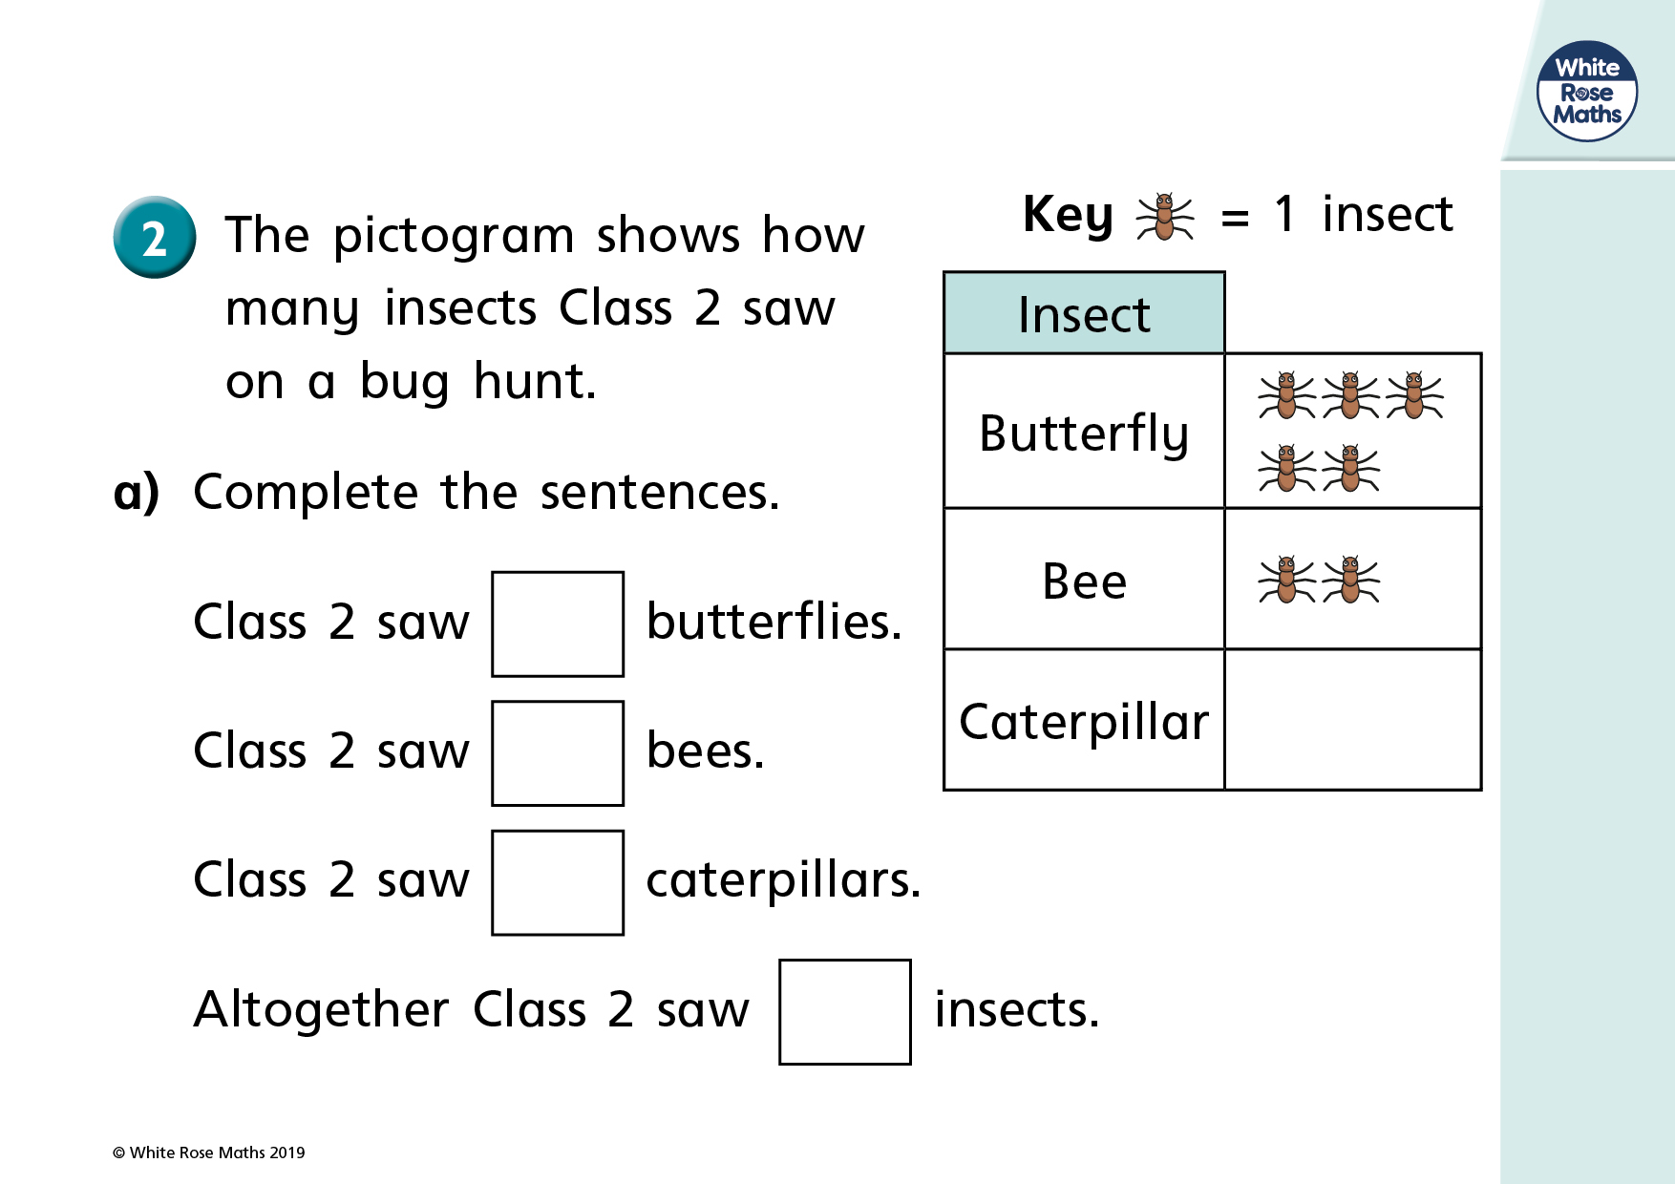

Slide 71
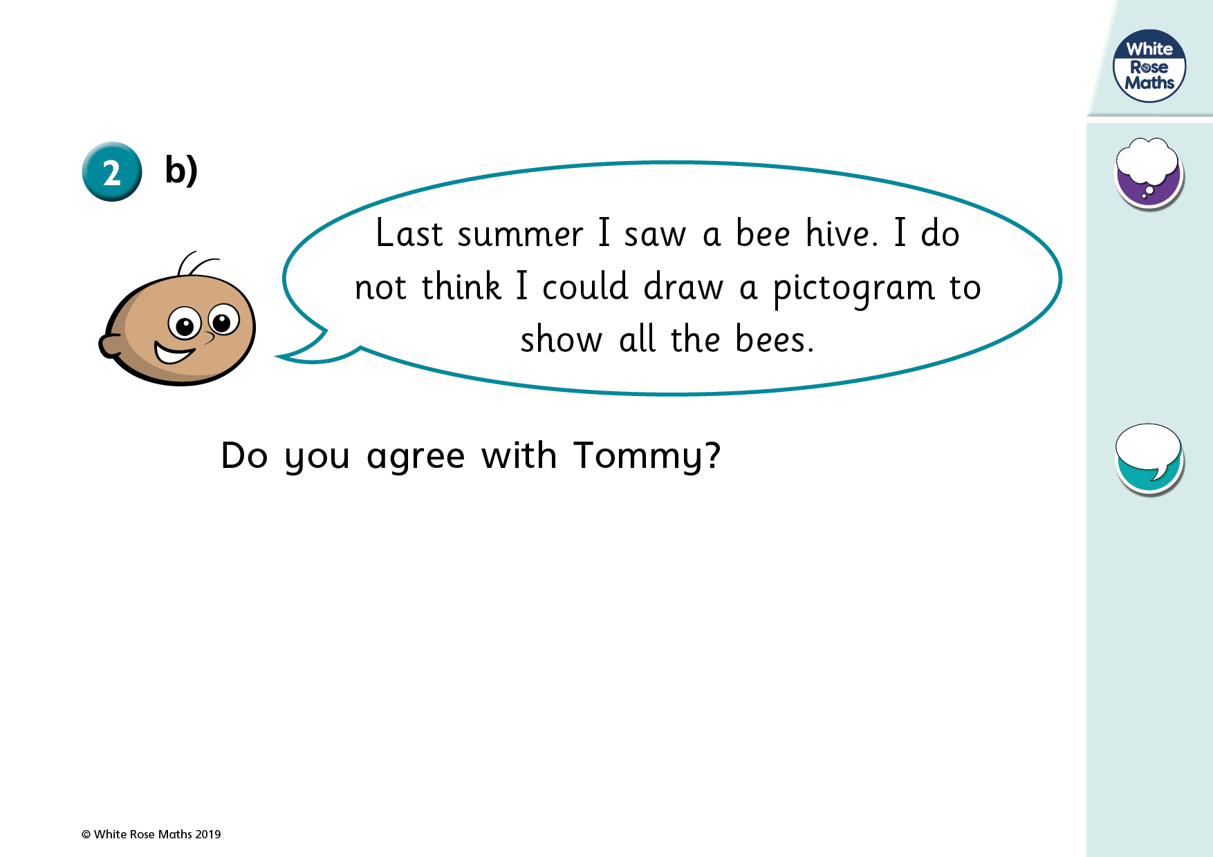

Slide 72
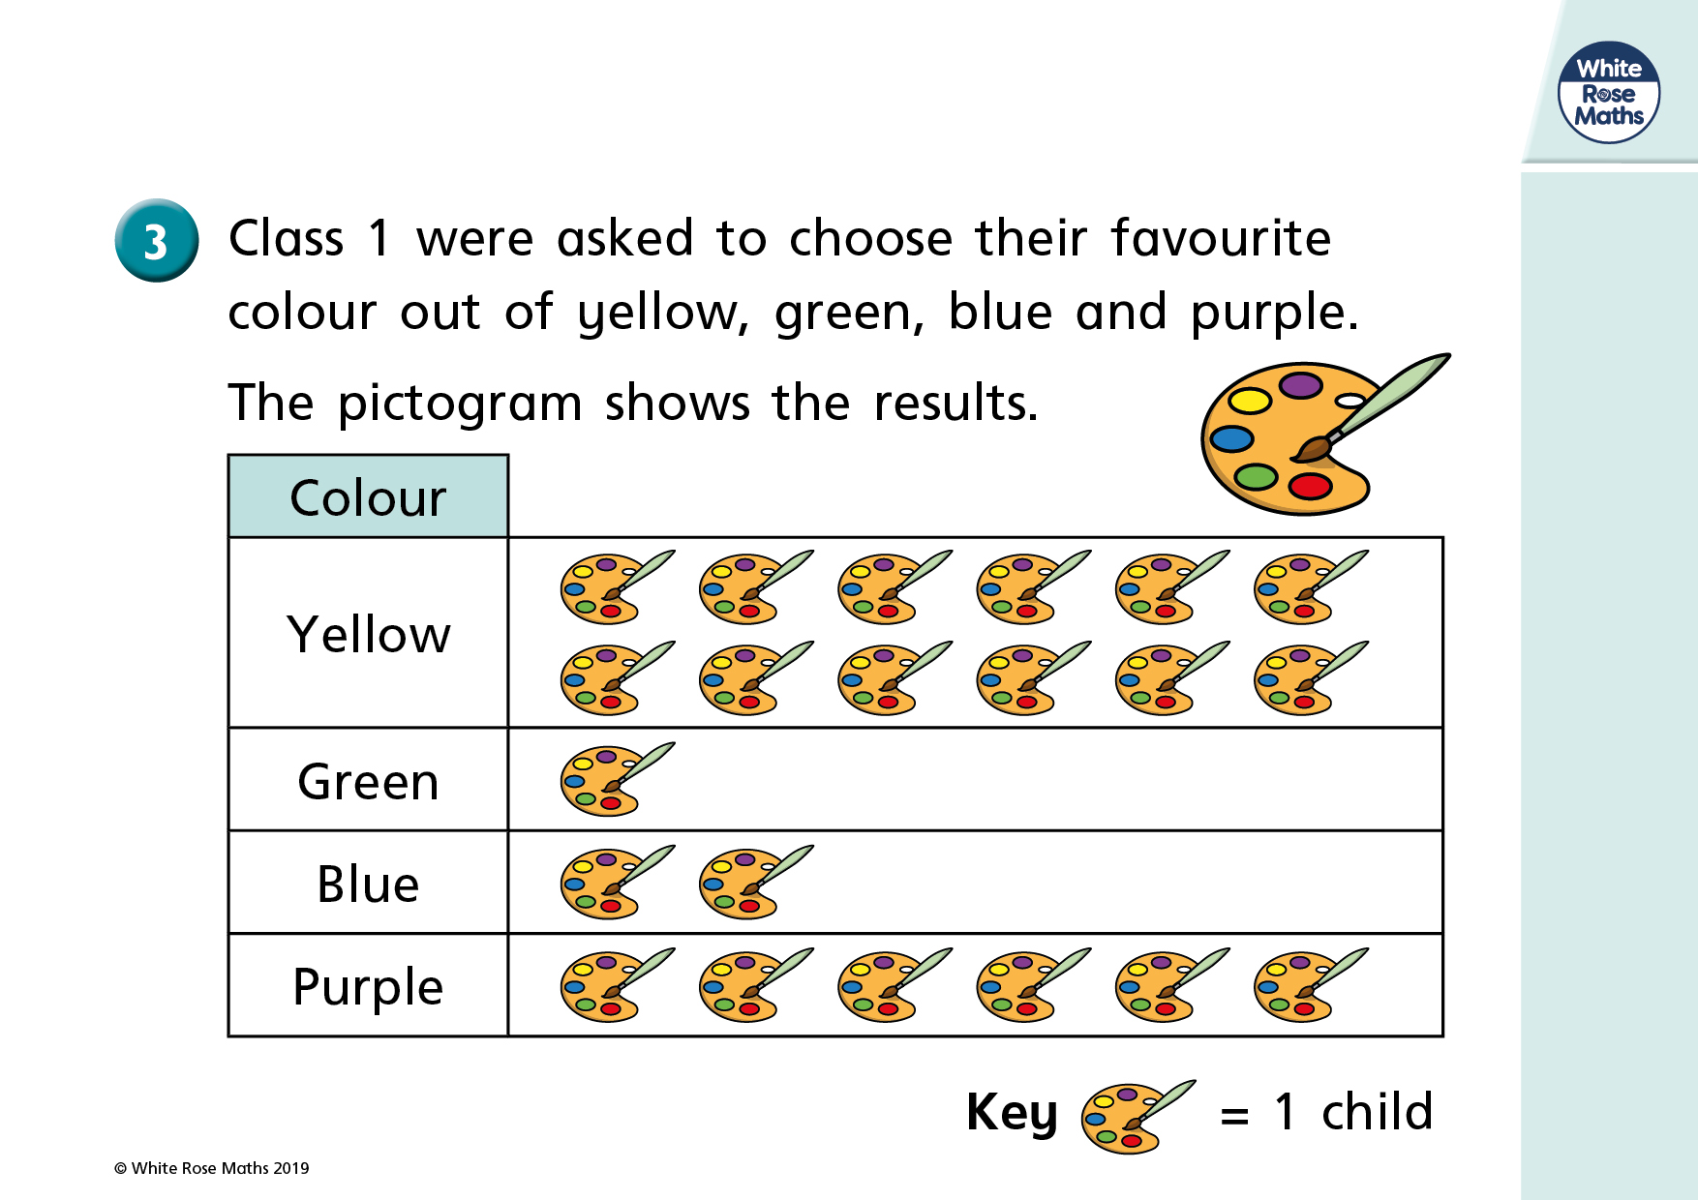

Slide 73
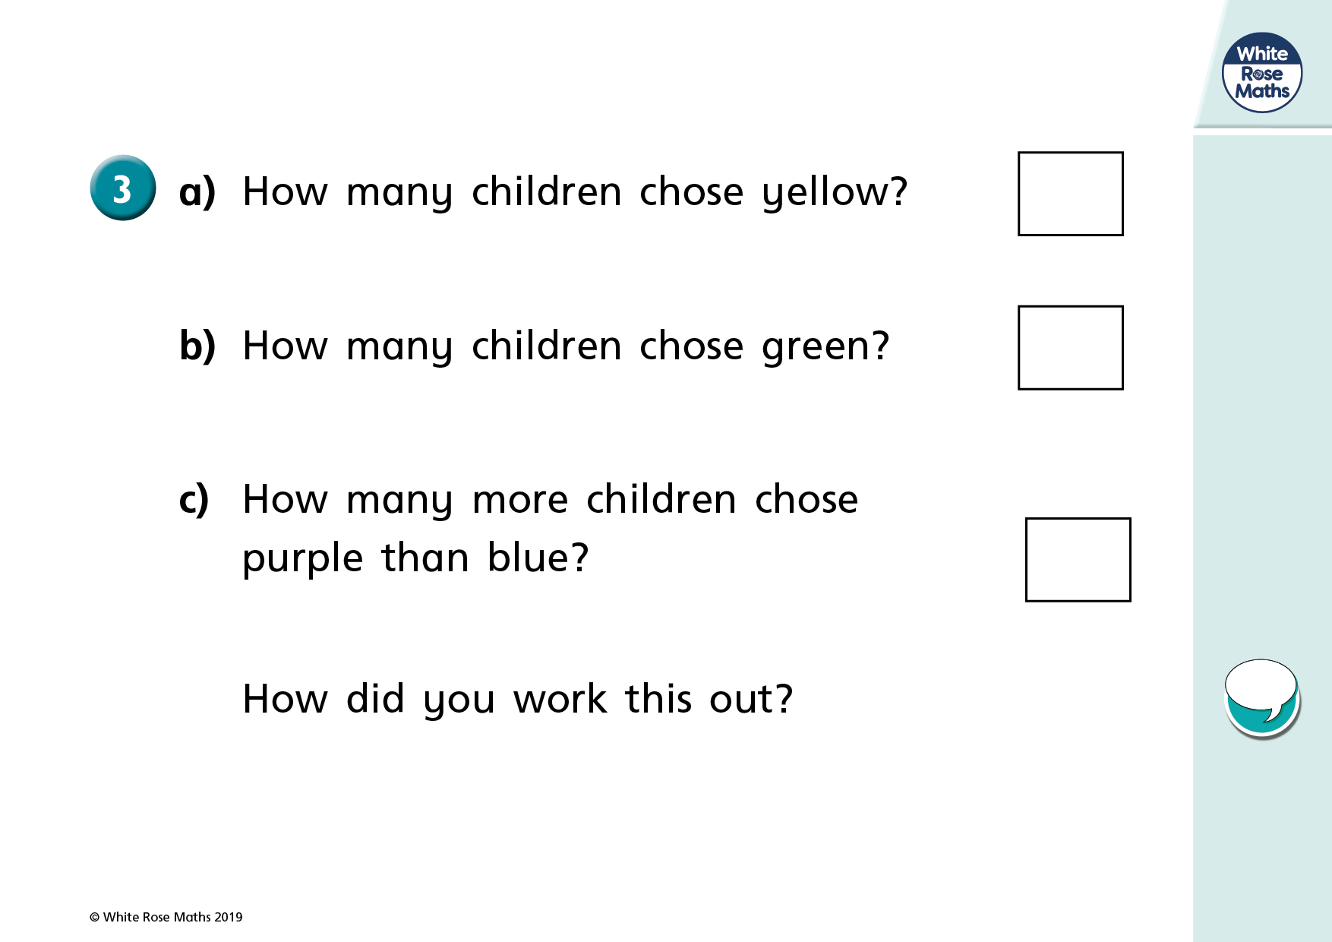

Slide 74
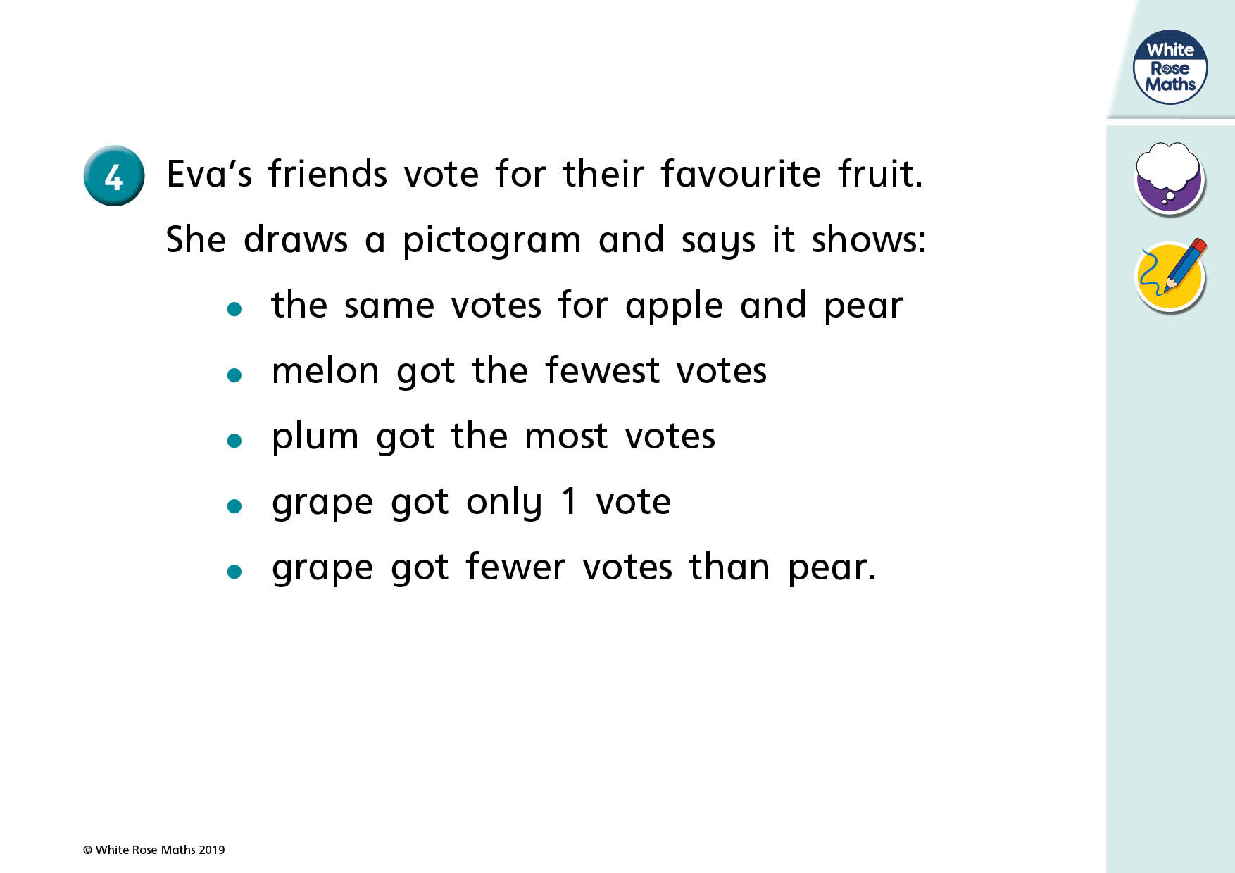

Slide 75
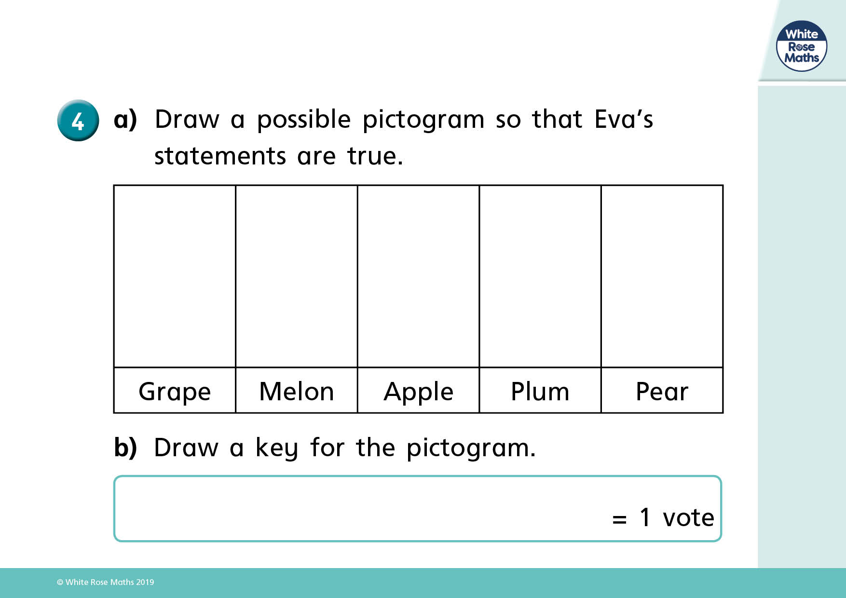

Slide 76

Here is a pictogram.
Do you agree with Eva?
Explain why and correct any mistakes
Blue
Red
Yellow
Green
The most popular colour sweet is green.

Slide 77




Jack and Whitney have carried out a traffic survey.
Who is right? Convince me.
Van
Bus
Bike
Lorry
Car
$=$ 10 vehicles
To find the total number of vehicles I need to count the symbols. There are 16 and a half vehicles.
Whitney
If I add the number of lorries and bikes together then it will be equal to the number of cars
Jack

Slide 78
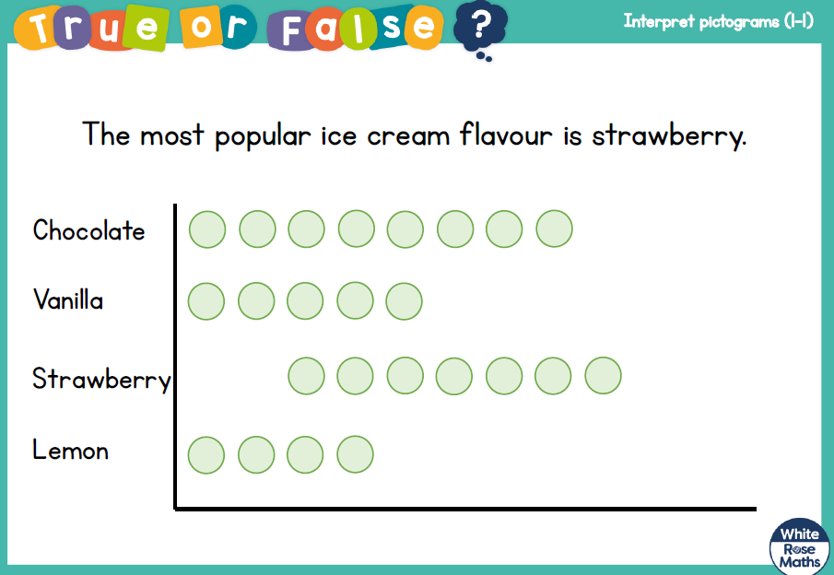

Slide 79
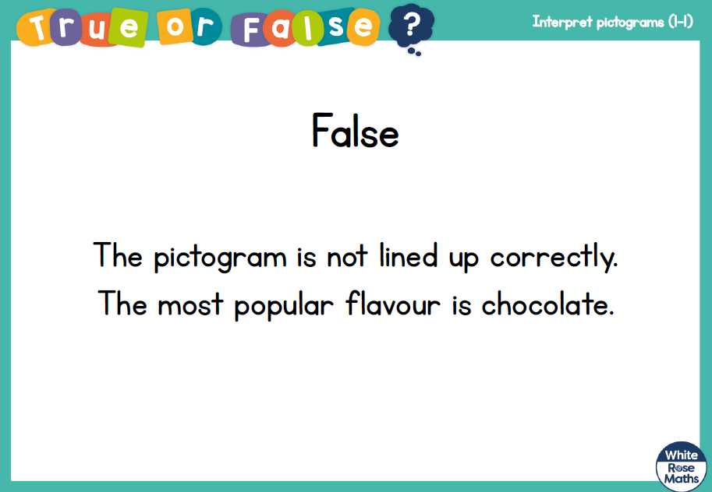

Slide 80
Thursday
Interpret charts

Slide 81
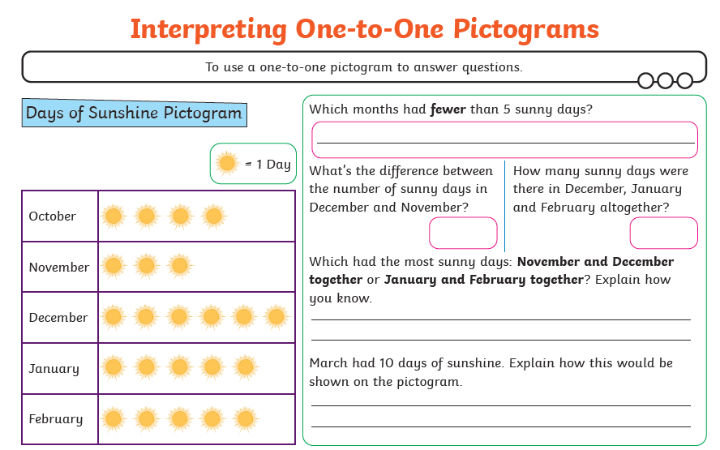

Slide 82



Justify
If the staff needed to pick one day to have off during the week, which would be the best day and why?
Convince me
There are more ice-creams sold at the weekend than during the rest of the week
True or False (Why?)
Three ice creams were sold on Tuesday
$=$ 2 ice creams
Mon | Tues | Wed | Thur | Fri | Sat | Sun

Slide 83
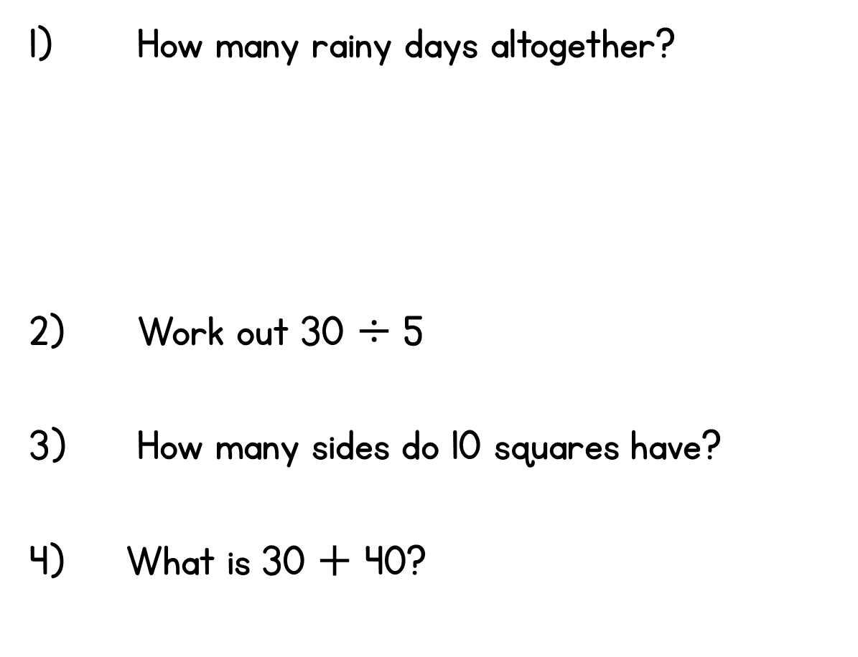
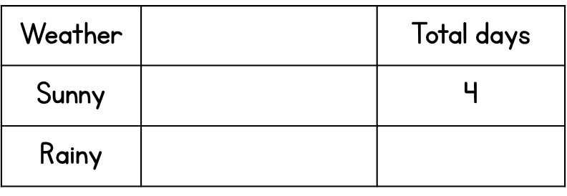
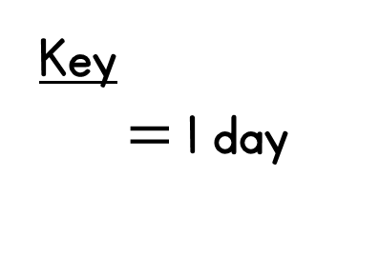
Year 2 | Week 3 | Day 4

Slide 84

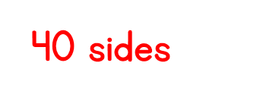
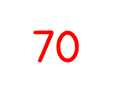
Year 2 | Week 3 | Day 4
3

Slide 85
Friday

Slide 86
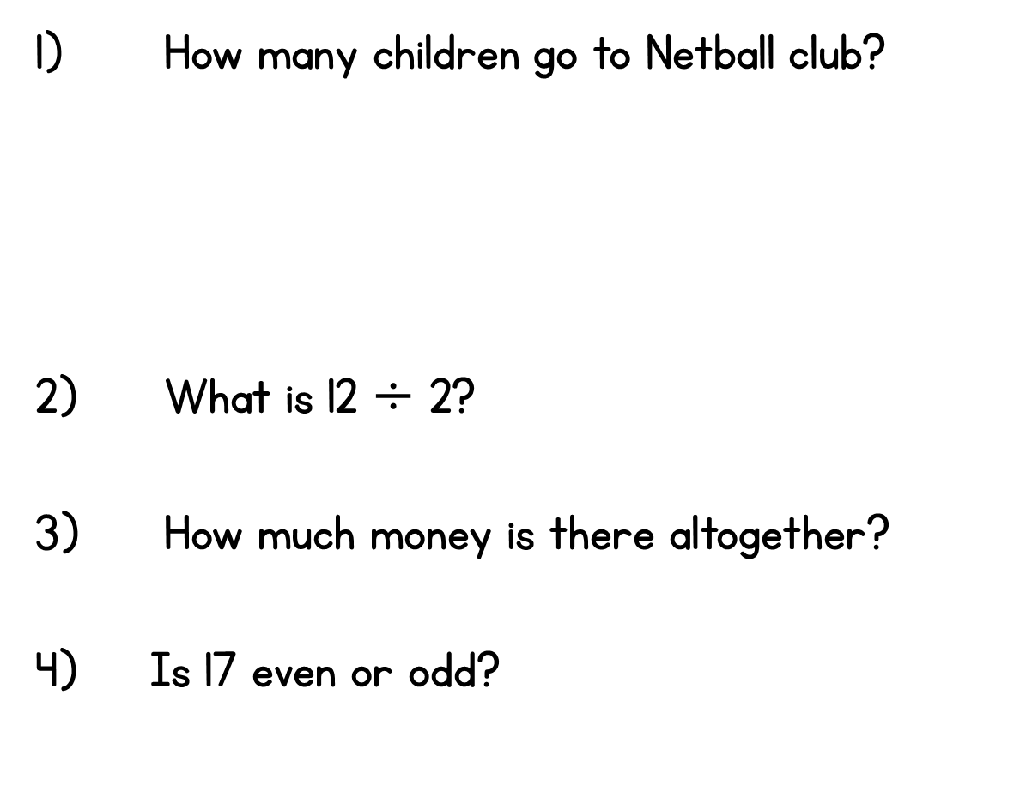
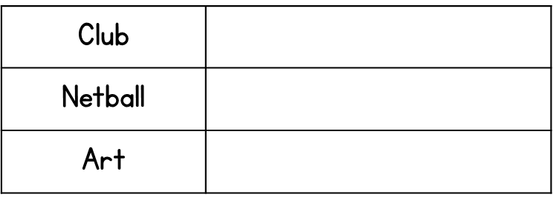
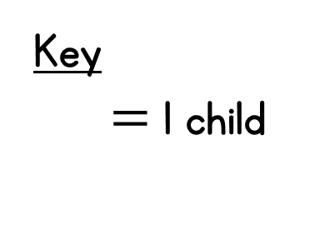

Year 2 | Week 3 | Day 5

Slide 87




Year 2 | Week 3 | Day 5

Slide 90


Week 1
Annie
Eva
Ron
Mo
Week 2
Annie
Eva
Ron
Mo
Key $=$ 1 piece of fruit
Who ate the most pieces of fruit in week 1?
Who ate the least fruit overall?
What was the difference in amount of fruit between week 1 and week 2 for Ron?
Did Ron have the biggest difference?

Slide 91
Week 1
Annie
Eva
Ron
Mo
Week 2
Annie
Eva
Ron
Mo
Key $=$ 1 piece of fruit
Who ate the most pieces of fruit in week 1?
Who ate the least fruit overall?
What was the difference in amount of fruit between week 1 and week 2 for Ron?
Did Ron have the biggest difference?
Mo
Ron
0
No, Annie had a difference of 5

Slide 93
Have a go at question
1 on the worksheet

Slide 94


Slide 95


Slide 96


Slide 97





Slide 98


?
10
Key $=$ __ relatives called
Relatives
Grandmas
Uncles
Cousins
And twice as many uncles as grandmas!
We’ve called 20 grandmas!
The whole class have been video calling our relatives
But five fewer cousins than uncles

Slide 99


10
Key $=$ __ relatives called
Relatives
Grandmas
Uncles
Cousins
Have a think
10
5
Key $=$__ relatives called
Relatives
Grandmas
Uncles
Cousins
Notes:
What do you notice about the two pictographs?

Slide 100
Have a go at question 2 on the worksheet

Slide 101


Slide 102


Slide 103


Day | Minutes spent reading
Monday | 20
Tuesday | 25
Wednesday | 10
Thursday | 15
Friday | 30
Saturday | 55
Sunday | 45
10
Have a
think
Key = ________ minutes
5
Key = ________ minutes

Slide 104

Key $=$ 10 minutes
Monday
Tuesday
Wednesday
Thursday
Friday
Saturday
Sunday
Have a think
On which day did Alex read the most and by how much?
Saturday, by 10 minutes

Slide 105
Have a go at question 3 on the worksheet

Slide 106


Slide 107


Slide 108

Here are three tables of data.
Which set of data could you display using the block graph?
Which could use the pictogram?
Which could use the tally chart?
Explain your reasoning.
Block diagram
Pictogram
Tally chart
Data Set 1
Data Set 2
Data Set 3
Team | Goals scored
A | 20
B | 32
C | 27
D | 16
Player | Points
1 | 20
2 | 65
3 | 80
4 | 45
Name | Score
Ron | 20
Eva | 12
Amir | 6
Mo | 16

Slide 109


Slide 110


