Slide 1
Whole Class Reading
Monday 31st January 2022

Slide 2
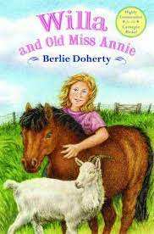
Willa and old Miss Annie
After reading pages 1 and 2
What will happen?
Who is Joshua?
How will they all become friends.

Slide 3
Willa and old Miss Annie
Read 5 page
Who is lost?
What is ‘Joshua’?

Slide 4
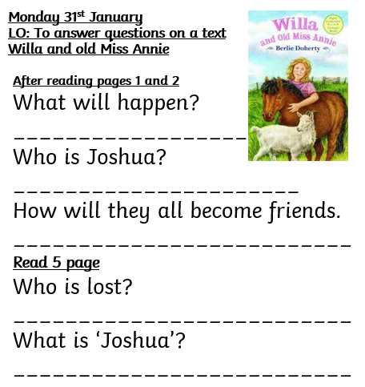
Monday 31st January
LO: To answer questions on a text
Willa and old Miss Annie
After reading pages 1 and 2
What will happen?
______________________
Who is Joshua?
______________________
How will they all become friends.
__________________________
Read 5 page
Who is lost?
__________________________
What is ‘Joshua’?
__________________________

