Slide 2
Pre- Tasks
Where is the nearest tunnel or bridge to your school?
What is it made from?
What goes over it and under it?
Look at lots of different pictures of bridges.
Describe their shape and the obstacles they cross.
https://www.youtube.com/watch?v=oVOnRPefcno

Slide 3

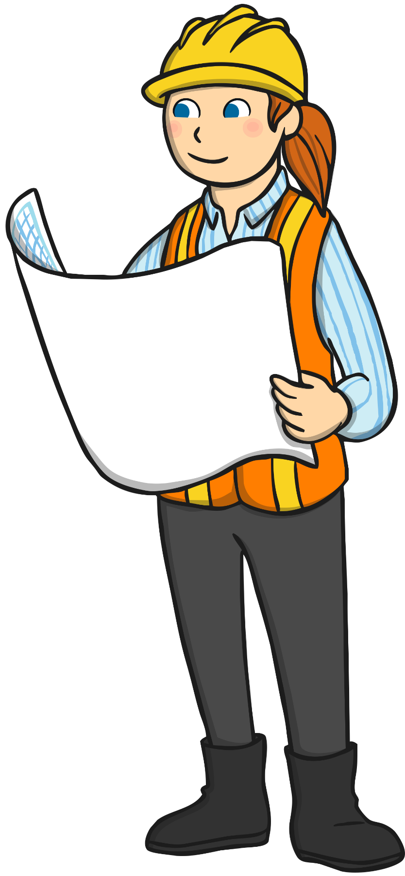
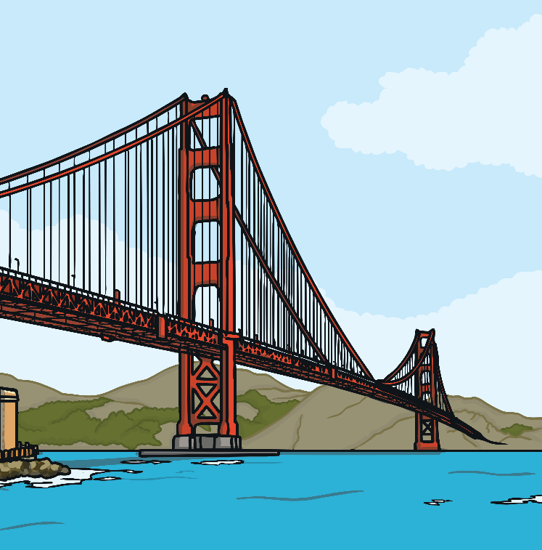
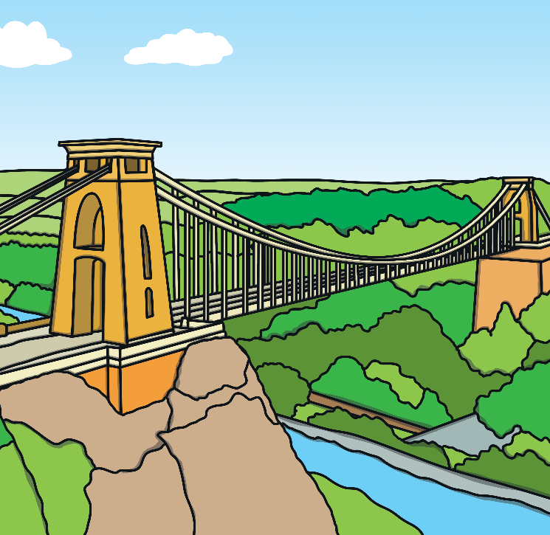
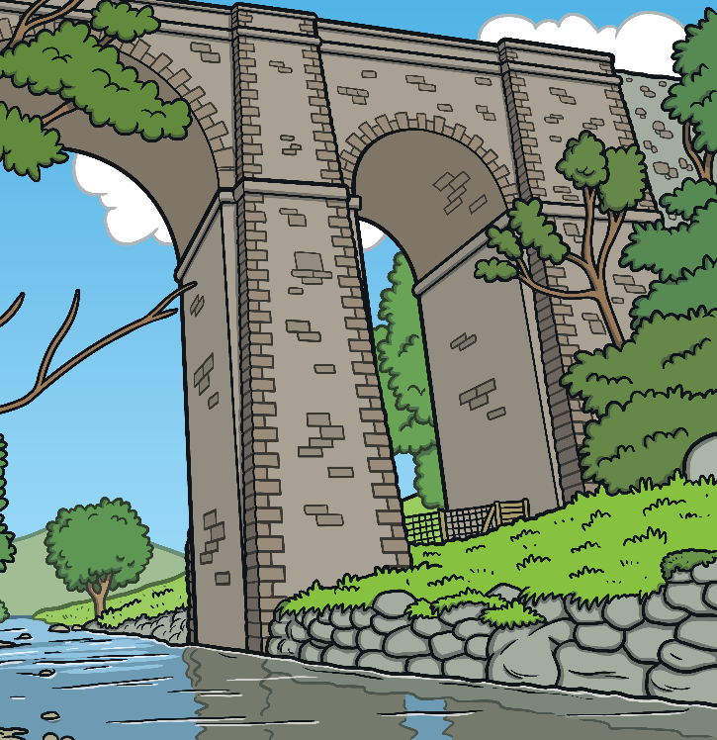
Why Are Bridges So Strong?
Experts called engineers design and build bridges so that they can carry heavy things like trucks, cars and trains across them.

Slide 4
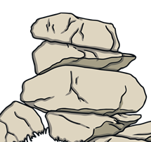
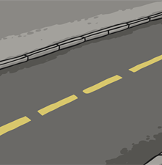
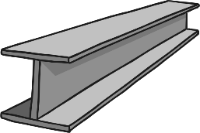
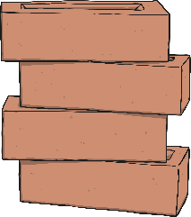
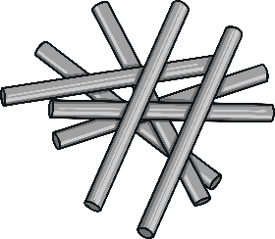
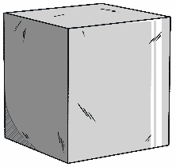
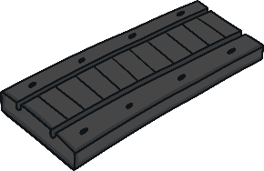
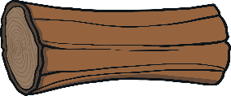
Bridges are made of:
Steel
Concrete
Stone
Asphalt
Iron
Timber
Aluminium
Rubber

Slide 5
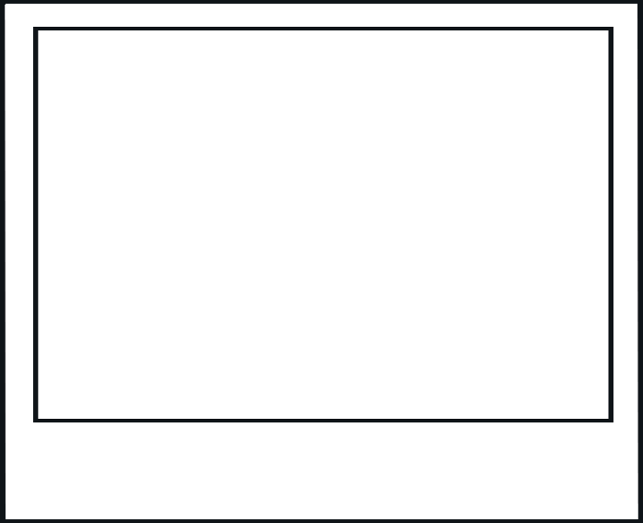
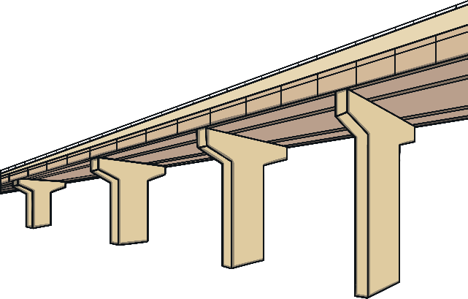
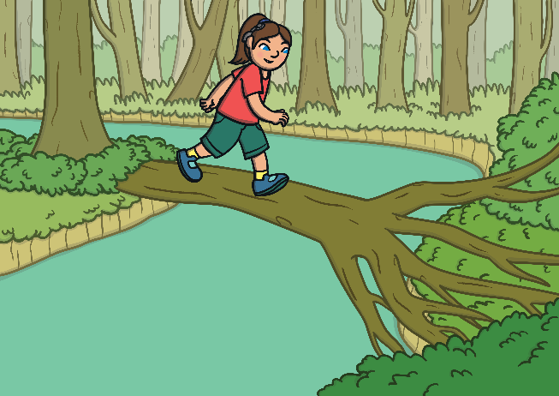
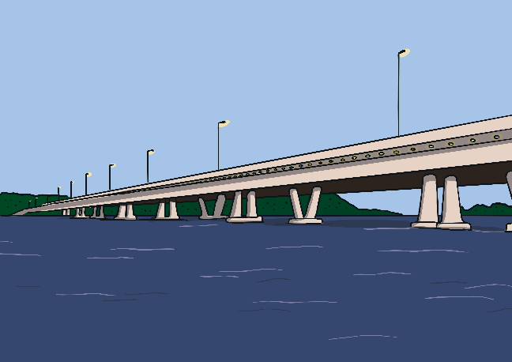
A Beam Bridge
A simple bridge that is only supported by piers.
The further apart the pier, the weaker the bridge.
You could make a beam bridge by putting a log across a stream of water.

Slide 6
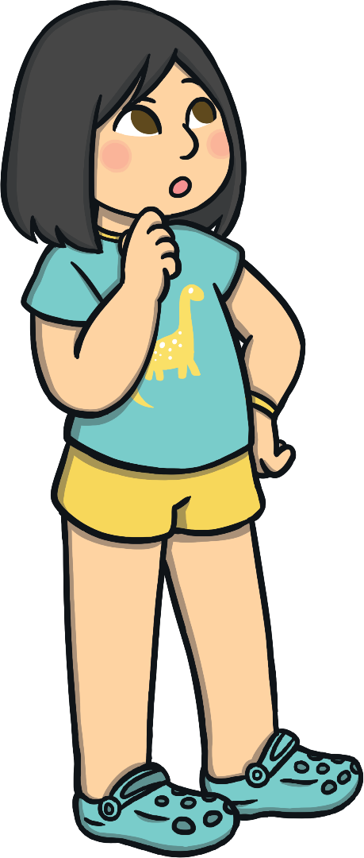
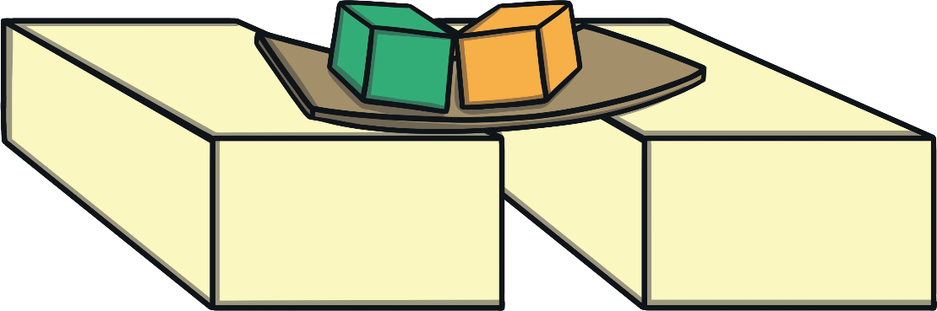
How Do We Build Bridges?
What would happen if we put too much weight on a beam bridge?
Build a bridge out of blocks and cardboard and see what happens when you add more weight on top.
Test it out:

Slide 7
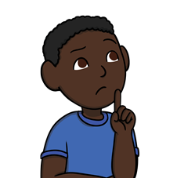
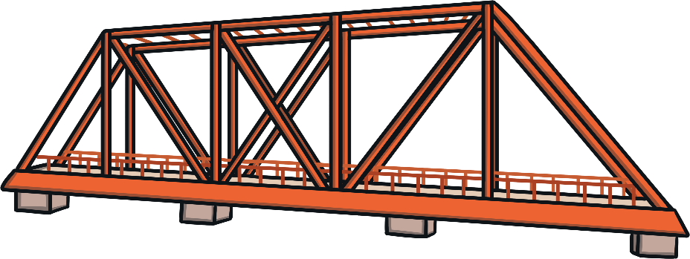
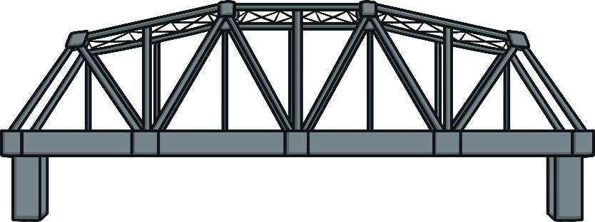
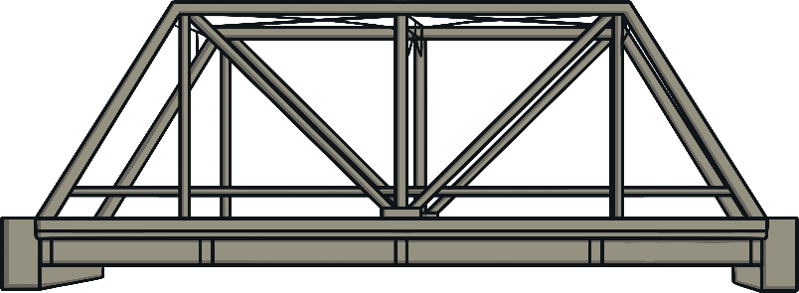
How Do We Build Bridges?
How can we make our bridges stronger?
What do you notice about the shapes in these bridges?
They all have triangles.
This is called a Truss Bridge.

Slide 8


Triangles Are Strong
If you put force on one side, it bends.
If you put force on the point, it keeps its shape.

Slide 9
Why Does a Triangle Keep its Shape?
Force is pushed down the sides.
The bottom gets stretched out.
Each side feels force but does not bend.

Slide 10
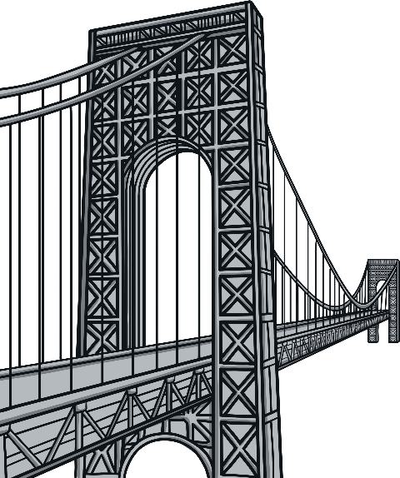
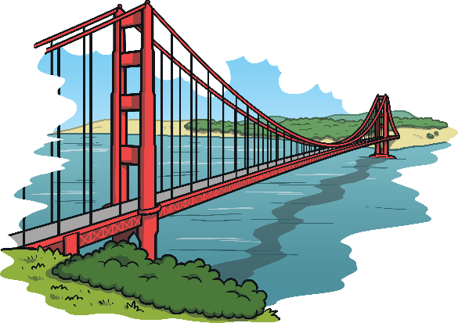
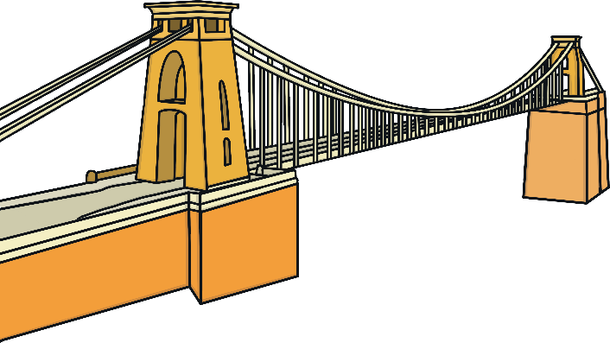
What If a Bridge Doesn’t Have Triangles?
What do you notice about the shapes in these bridges?
They have long cables and straight lines.
This is called a Suspension Bridge.

Slide 11
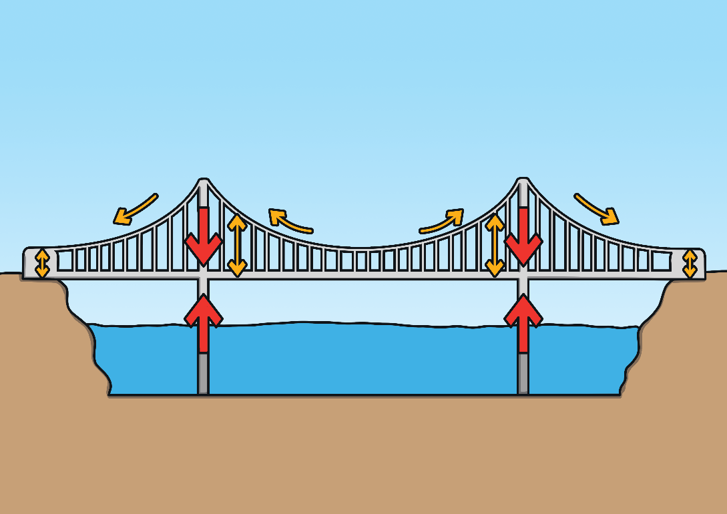
How Do We Build Bridges?
Suspension Bridges use a force called tension which means we pull it tight.
As the heavy cars and trucks drive along, the weight and force is spread out as the cables pull.

Slide 12
Knowledge
A bridge is a structure that carries a road, path or railway across an obstacle, such as water or a road.
There are many different types of bridge, including arch, beam, cantilever and suspension bridges.

Slide 13
To learn how we can make weak, flexible materials stronger and more rigid by changing their shape.
Key vocabulary
bend
bridge
flexible
fold
rigid
roll
strong
twist
weak

Slide 14
Be Engineers!
You have been given a piece of newspaper.
Think of as many words as you can that describe the paper and its properties. Write the words on sticky notes.
Try and stand the piece of newspaper on its end. What happens? Now roll the paper into a tube and stick the edge down with some tape. Try standing the tube of newspaper up on its end. Why does the tube stand up but not the paper?
How else can you change the shape or size of the newspaper? Try folding, bending, twisting and crumpling it.
Can you fold it to make a zig-zag shape?
Look at the words you wrote down to describe the piece of newspaper.
Do the words still apply to your new shapes?

Slide 15
Challenge
Read the children the story of the Three Billy Goats Gruff.
Place a single sheet of newspaper over a gap between two desks.
Show the children what happens when you put a small world or model goat on the newspaper bridge.
Ask them why they think the newspaper makes a bad bridge.
Challenge the children to think about how they could change the newspaper to make it strong enough to hold one or more goats.
Children should use only four sheets of newspaper to create their bridge. Make sure that the gap between the desks is always the same.
Talk to children about their plans as they work.
Ask them what they are doing and help them to clarify their approach.
Set a time limit for the exercise.

Slide 16
What have you found out?
Different materials have different properties. Newspaper, for example, is weak, flexible and can be torn. We can make it stronger by folding it into a concertina, rolling it into a tube, layering, crushing and twisting.
A concertina is a way of folding paper to create small triangles that sit next to each other.
Triangles do not bend easily and any force spreads across several points instead of just one.
We see these triangles in corrugated cardboard, where they provide support and strength.
Tubes are also strong, especially when they stand on their end and when we use them with other tubes.

