Slide 2
How Does It Move?
Look at this toy car. When you push it, how does it move??

Slide 3
How Does It Move?
When you push the toy car, the wheels turn, which is how the car can move. Do you think all the wheels turn at the same time and at the same speed?

Slide 4
Wheels and Axles
The wheels on the toy car move at the same time and speed because each pair of wheels is attached to a pole called an axle. Real vehicles, such as cars and vans, also have axles.

Slide 5
Wheels and Axles
On toy cars, if a wheel isn’t directly attached to an axle, it will need to be secured in place so it doesn’t move from side to side.
If you are making your own toy car, wheels can be secured with a washer on either side. You could even use small pieces of modelling clay either side of the wheel if you don’t have any washers.
washers
washers

Slide 6
Wheels, Axles and Chassis
An axle needs to be attached to the chassis (said ‘shah-see’). A chassis is the frame upon which the rest of the vehicle is built.
In this picture, the chassis is an upside down shoebox lid. Holes have been made on each side of the box and the axles have been threaded through.

Slide 7
Wheels
If you were creating your own toy vehicle, what could you use for your wheels?
Here are some ideas:
wooden wheels
wheels from plastic brick toys
cotton reels

Slide 8
Axles
If you were creating your own toy vehicle, what could you use for your axles?
Here are some ideas:
wooden dowel
straw
cotton bud

Slide 9
Chassis
If you were creating your own toy vehicle, how could you attach the axles to the chassis?

Slide 10



Purpose of a Vehicle
The materials you use and the design of your vehicle will depend on what the vehicle needs to do and where it will be travelling.
Will it be transporting people or something else? Will it need to travel at high speeds? What kind of ground will it travel on?

Slide 11
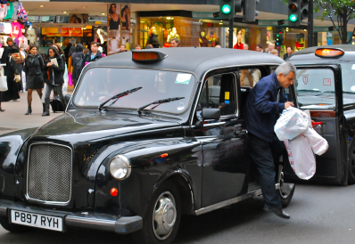
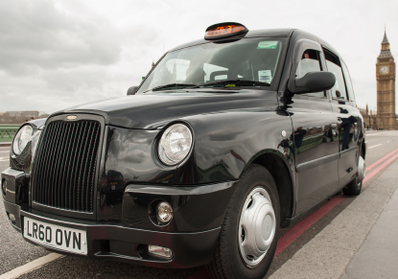
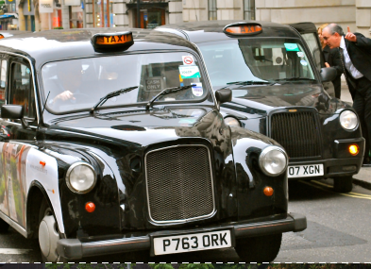
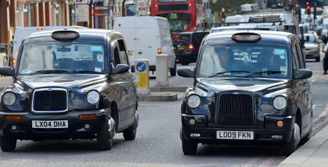
What Will Your Taxi Look Like?
Once you’ve designed the wheels, axle and chassis, it is then time to think about what your vehicle will look like.
https://www.youtube.com/watch?v=tMEJE6Xbg9Q

Slide 12
Design a London Taxi
LO: To design purposeful, functional, appealing products for themselves and other users based on design criteria.
Look carefully at the London taxi picture cards.
‘What is a taxi?
How many wheels and axles do they have?
Why is there a sign on the front?
Where do the passengers sit?’
Your task is to design a model London taxi which can move and has either fixed or moving axles.
Talk about your ideas, think about how you could change or improve the London taxi design.

Slide 13
Essential Design Criteria
As a class, choose and record at least three essential design criteria that all our taxis must have…
Maybe …
two axles and four wheels,
headlights,
Sign
Colour … black?
a roof,
seats for at least two passengers.

Slide 14
Resources
Here are the materials that we have to use…
cardboard boxes,
card,
dowel rods,
rubber bands,
wheels,
washers,
other craft materials.
When you have explored the materials, complete the London taxi design recording sheet to begin planning your designs.

Slide 15
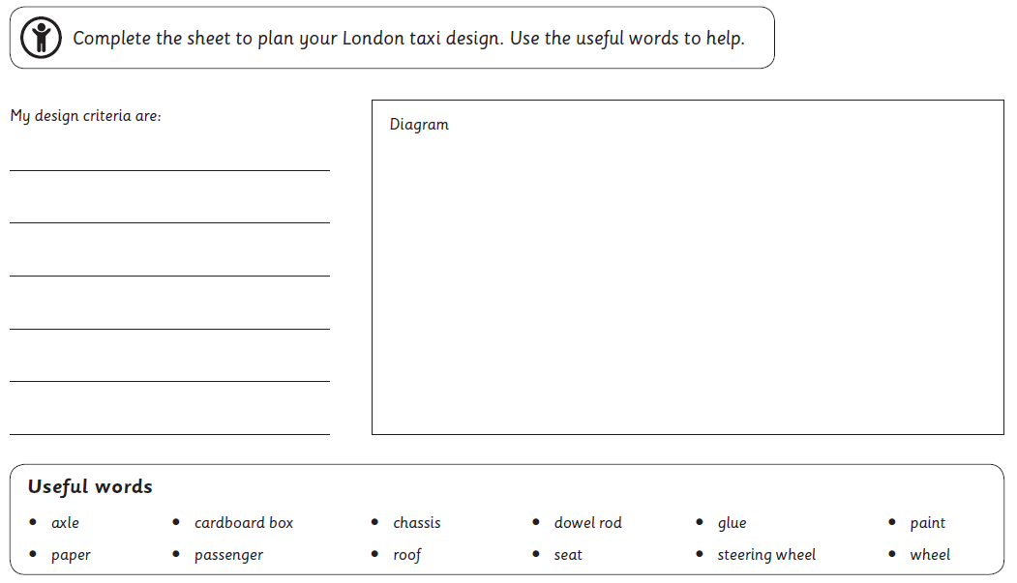
Design your Taxi!

Slide 16
Make your Taxi!
LO: To explore and use mechanisms like wheels and axles in their products.
Provide the materials and tools for the children to make and decorate their London taxis.
Demonstrate how to use the tools safely, then ask the children to use their design sheets as a guide as they create.
Provide plenty of adult supervision and encourage adults to ask questions about the use of axles and wheels, and help the children solve any problems they encounter.
Encourage the children to test their models as they work, to make sure they move smoothly and freely.
At the end of the session, ask the children to take a photograph of their finished London taxi.

Slide 17
Evaluate your Taxi
LO: Evaluate their ideas and products against design criteria.
Knowledge
Get into small groups with adult support. Share for a few minutes your finished London taxi
Can you demonstrate how you have met the essential design criteria and explain what went well and any problems you encountered?

Slide 18
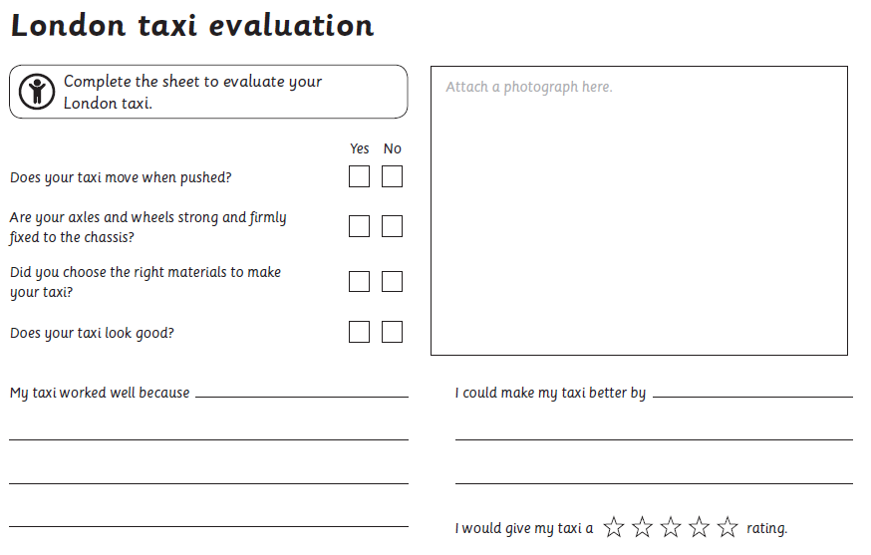
After the discussion, give each child a printed photograph of their completed London taxi and a London taxi evaluation sheet.
Ask them to stick a photograph HERE and then work through the evaluation, answering the questions and describing what went well and what improvements they could make to their taxi.

