Slide 1
Tuesday 19th October 2021
Re-read the story with the children echoing at times want you have said .
Discuss what the characters might be thinking and felling throughout the seasons

Slide 2
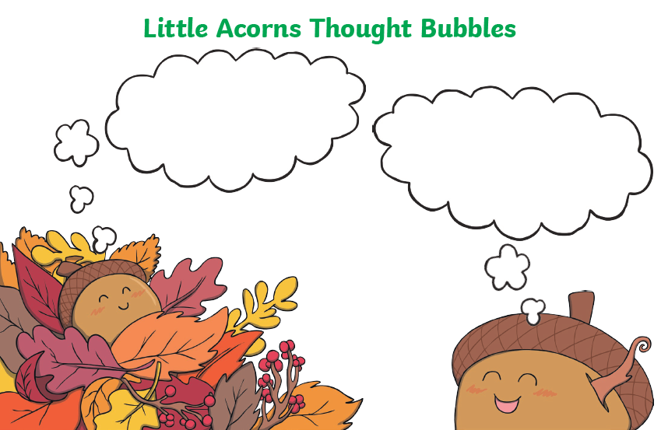
Tuesday 19th October 2021

Slide 3
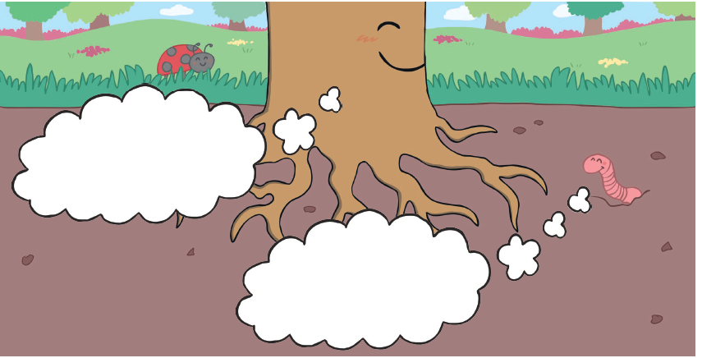

Slide 4
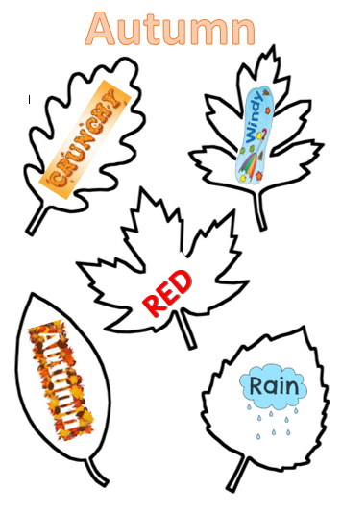
English –
Create a Calligram Poem using the words that you have been practising to draw and write linked to
Autumn

