Slide 2
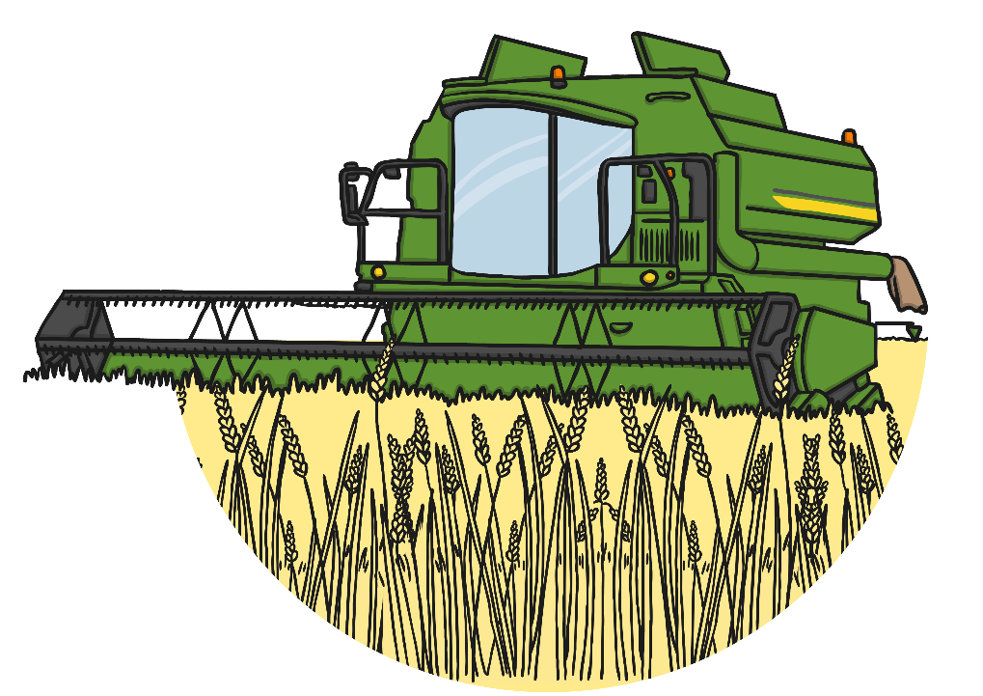
What Is Harvesting?
Harvesting is the process of gathering in crops.
Harvest time is the period of time which it takes to gather in all the crops.
Plants and crops are planted in the spring, they grow bigger over the summer and are ripened by the sun. By autumn, the food is ready to be harvested. Most Harvest Festivals take place in September or October.
https://www.youtube.com/watch?v=5d2Mft72CXg

Slide 3
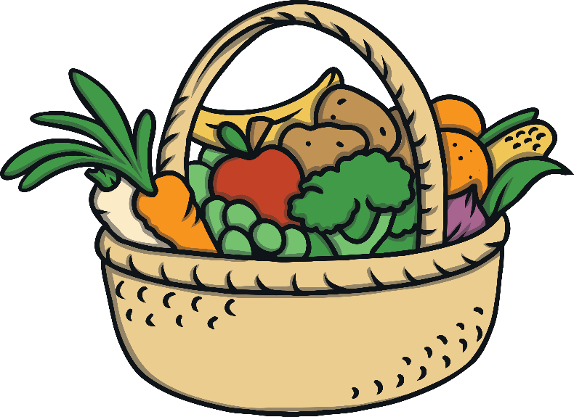
What is Harvest Festival?
A harvest festival is a celebration of the food that is grown on the land.
Celebrations giving thanks for our food, happen in many countries
around the world.
In Britain, harvest festivals are often
celebrated in churches by bringing baskets
of food to give thanks to God. People enjoy
singing, praying, listening to stories and
decorating the church.

Slide 4
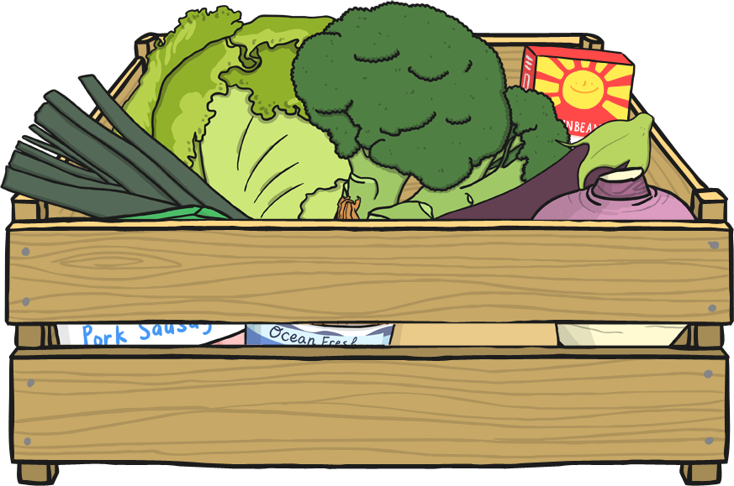
Harvest in the Past
In the past, it was not as easy to find food in the winter. It was important that farmers brought the harvest in before the cold winter came so that there was enough food until the spring.
    Now, we bring food in from all around the world. Fruits and vegetables are available for us to buy at all times of the year.
  Harvests all around the world allow us to enjoy different foods at any time of year.

Slide 5
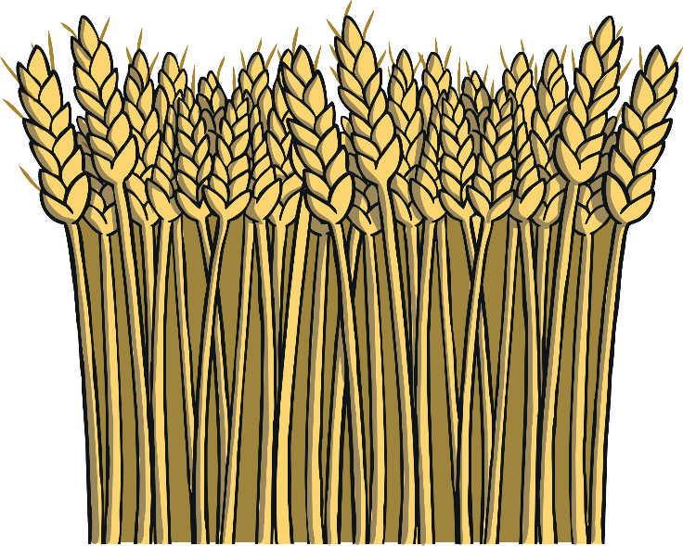
Why is Harvest Celebrated?
Harvest is celebrated to give thanks for the crops,
which have been safely harvested.
Christians thank God for the food during harvest.
Christians believe God made the world and everything in it.
Christians also thank God for the variety of food
and everything that helps the food to grow.

Slide 6
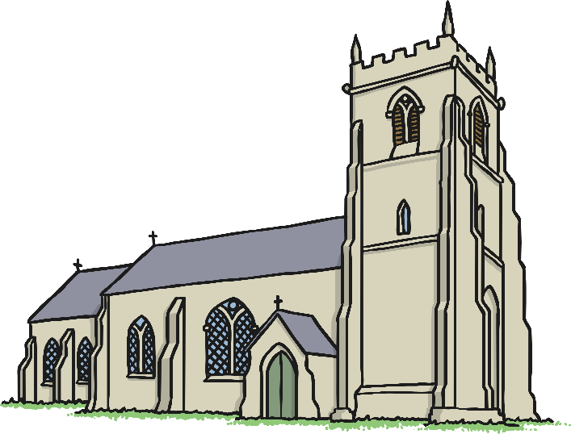
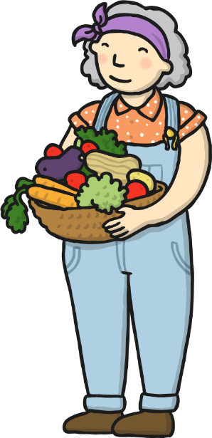
Harvest Festivals
Christians celebrate the harvest by going to Church and taking part in a Harvest Festival. Some schools also hold Harvest Festivals.
During a Harvest Festival Christians thank God for the safe harvest of the food.
Christians take fruit and vegetable gifts to the service and sing harvest hymns. All the food collected then gets given to those in need of it.
https://www.bbc.co.uk/programmes/p0114rn0

Slide 7
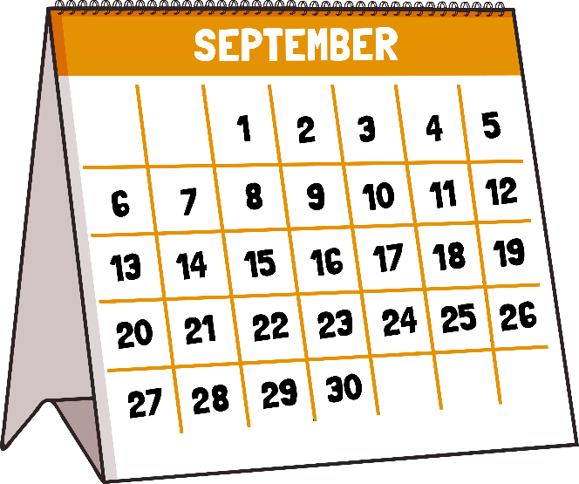
When is Harvest Festival?
In Britain, harvest festivals are traditionally held on or near the Sunday of the harvest moon.
This is the full moon that happens closest
to the autumn equinox (around the 23rd September).
This is usually in September, although in some years it is October.

Slide 8
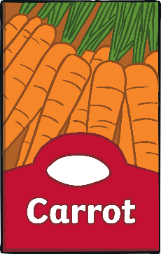
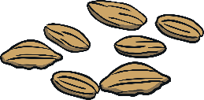
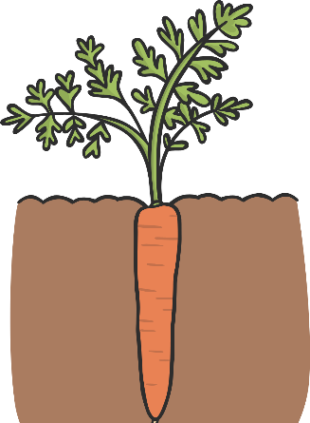
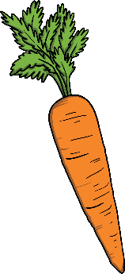
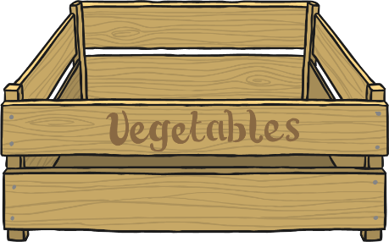
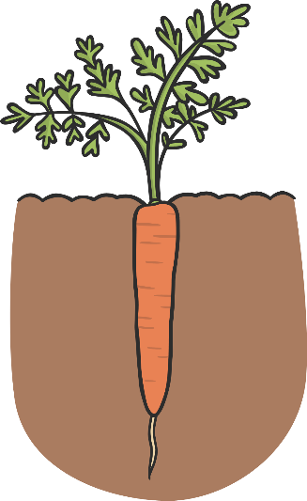
How Do We Harvest Our Food?
Before we can harvest our food, we need it to grow.
The seeds are planted and the food begins to grow.
The plants grow bigger and if they have fruit, it starts to ripen.
When the plants are ready to be harvested, the farmer collects the grains, fruit and vegetables, ready for
us to eat.

Slide 9
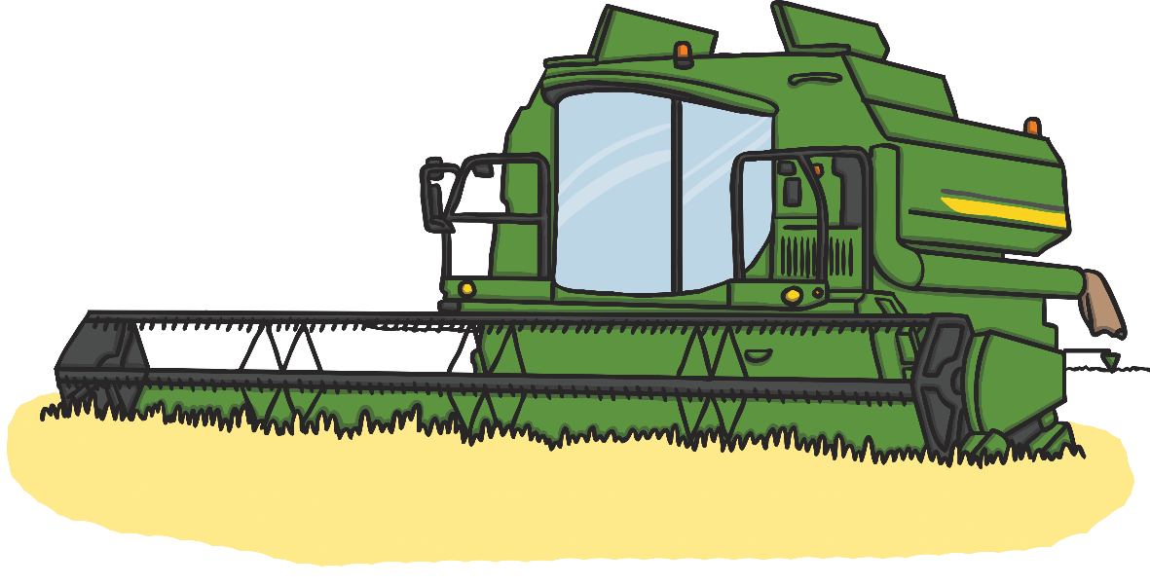
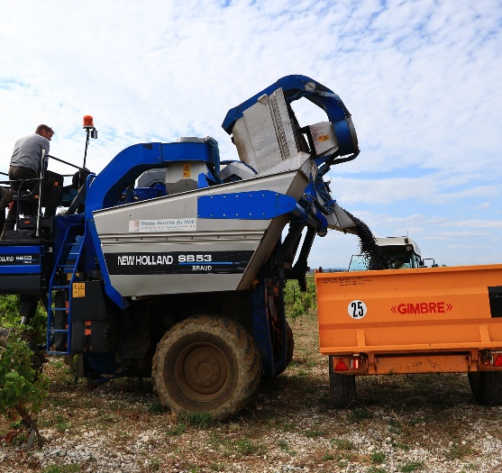
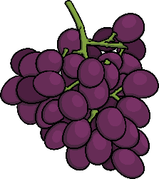
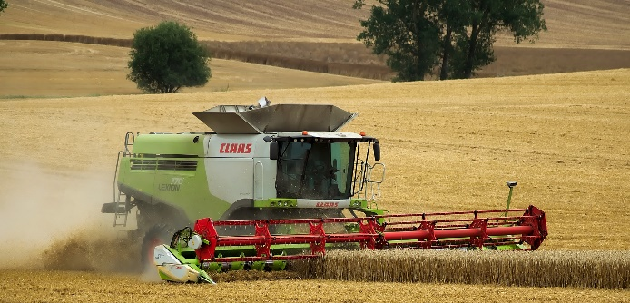
How Do We Harvest Our Food?
Machinery
Farmers use machinery to harvest some of their crops. The machines are big and able to harvest the grains, fruits or vegetables much quicker than by hand.
This wheat is being harvested using a combine harvester.
This machine is carefully harvesting grapes.

Slide 10
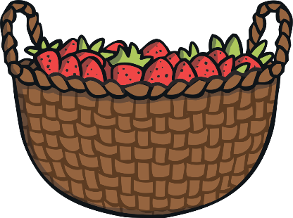
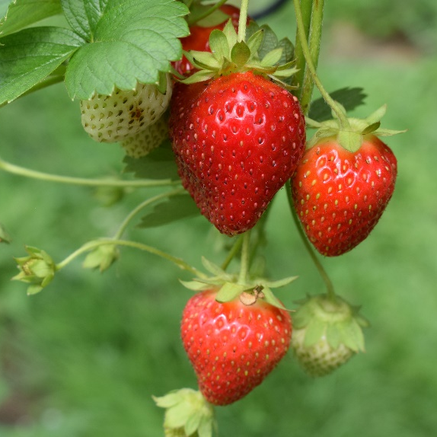
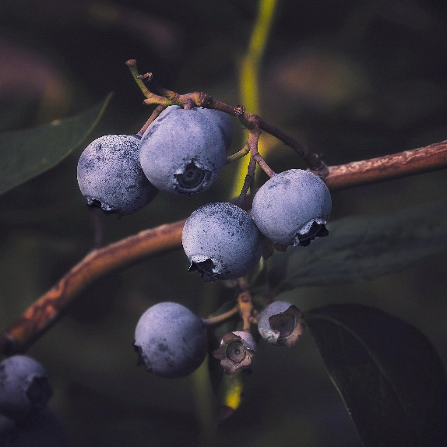
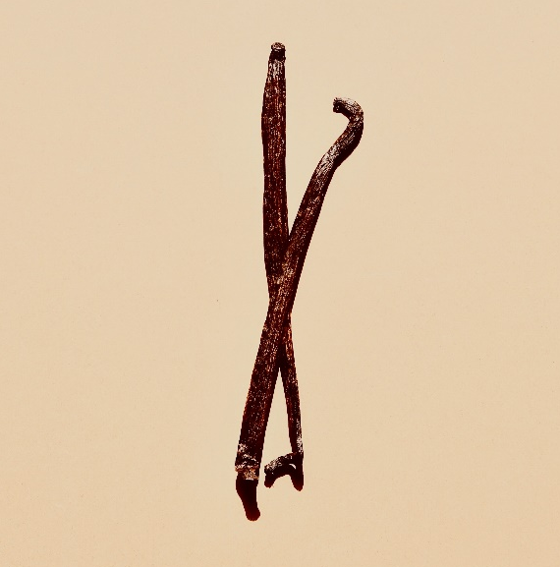
How Do We Harvest Our Food?
By Hand
Some fruits and vegetables are too delicate to be harvested by a machine. They need to be carefully picked and stored so that they don’t get damaged.
Strawberries
Blueberries
Vanilla

Slide 11
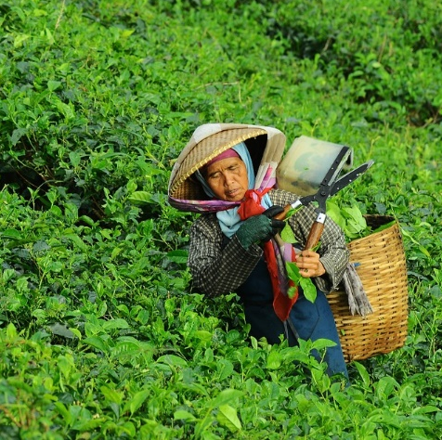
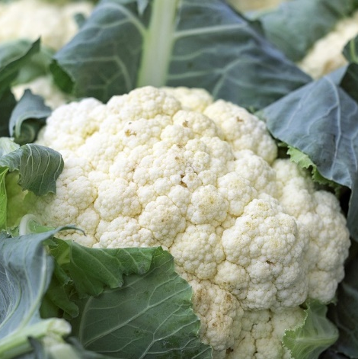
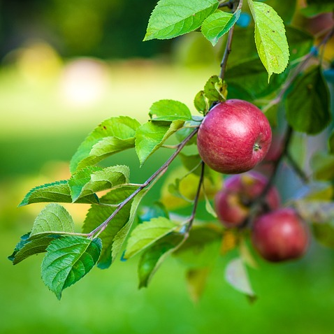
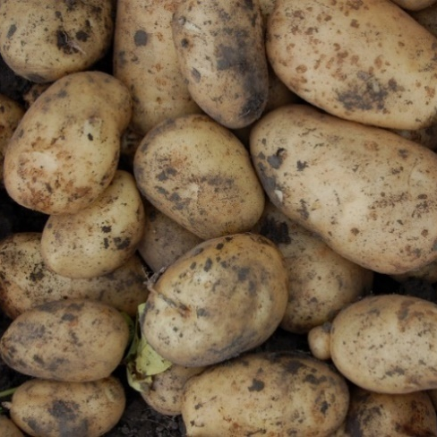
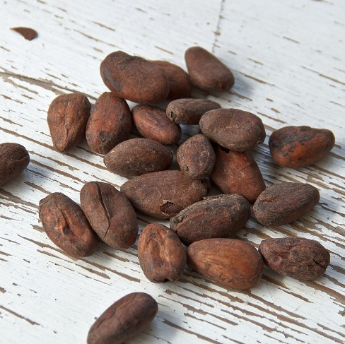
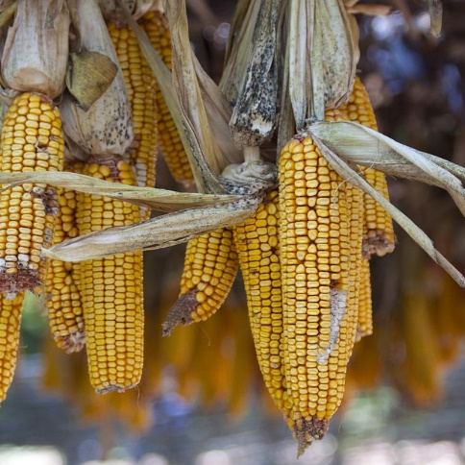
How Will These Foods Be Harvested?
Tea
by hand
Cauliflower
by machine
Apple
by machine
Potatoes
by machine
Cocoa
by hand
Corn
by machine

Slide 12

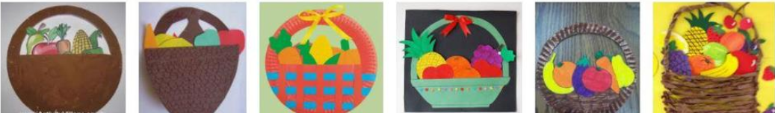
Harvest
Think about what you could put in you basket to give away to others who are less fortunate.
Discuss your ideas as you create your basket.

Slide 13
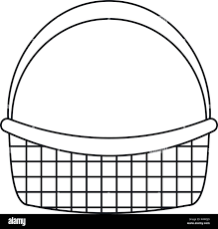

Slide 14
Next Steps:
How to Christians show gratitude during Harvest festival?

Slide 15
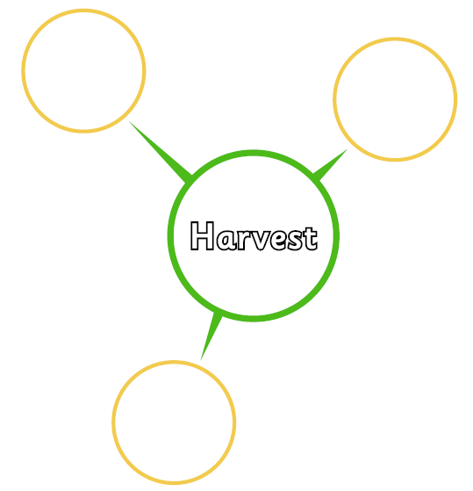
Reflection…
Why do Christians celebrate Harvest Festival?
How do Christians celebrate Harvest Festival?

Slide 16

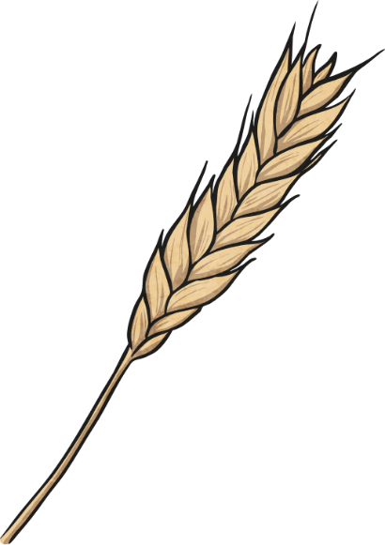
Harvest Produce Riddles
I am cut down at harvest time.
I am usually ground into flour.
I can then be used to make bread, pasta, cakes and biscuits.
What am I?
I am wheat!

Slide 17

Harvest Produce Riddles
I am picked from trees at harvest time.
I can be eaten raw or cooked.
I can also be made into juice.
What am I?
I am an apple!

Slide 18
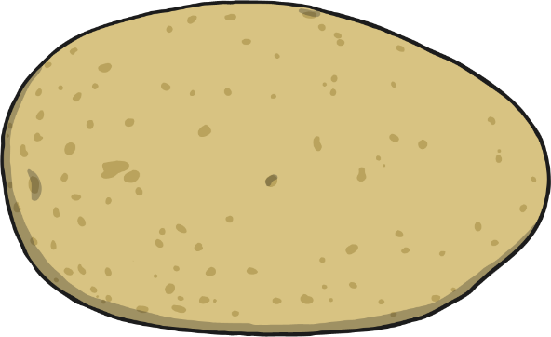
Harvest Produce Riddles
I am dug out from the ground at harvest time.
I can be cooked in lots of different ways.
I can also be made into chips and crisps.
What am I?
I am a potato!

