Slide 1
Science
Catapult investigation

Slide 2
To construct and test some catapults
To carry out simple comparative and fair test
To gather and record data to help in answering questions

Slide 3
The Engineering Design Process.
To make our catapults, we will use something that engineers utilize every day:
This is a circular, six-step plan that helps us create the best possible solution to a problem.
From NASA (who knows a thing or two about engineering),
Step 1: Ask (what problem are you trying to solve?)
Step 2: Imagine (what knowledge do you need to better understand the problem?)
Step 3: Plan (draw or write out a plan including amount of materials needed)
Step 4: Create (build a prototype)
Step 5: Experiment (test your prototype and see how it works)
Step 6: Improve (how can you make the prototype better?)

Slide 4
Materials List
While this is the list of materials we used for our catapult, your materials may vary.
Rubber bands (the more the merrier!)
Hot glue guns and glue sticks
Scissors Popsicle/craft sticks
Straws Paper clips Mini marshmallows
Pipe cleaners Cups Markers Bottle caps,
Paper Bowls Tapes (scotch, masking, and/or duct)

Slide 5
ASK: Our task is to make a catapult using the materials we have on hand, but how will we do this?
IMAGINE: What do catapults look like? How have people made them with household materials?
PLAN: Choose just a couple of your best ideas to sketch out in more detail and decide on which one you want to make.
CREATE: Build your catapult based on your plan.
TEST: Test your design to see how well it works. How far and how accurately can your catapult fire the projectile? What parts are working well, and what could use tinkering?
IMPROVE: Based on your test results, what about your design could be improved and why? What might you change to make it better? Let’s build a second version!

Slide 6
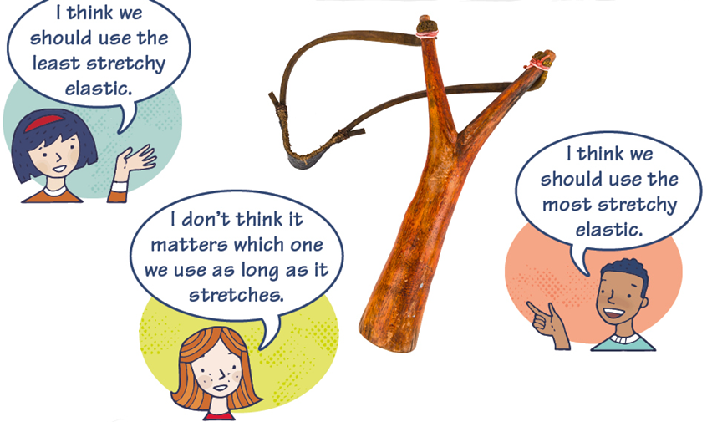
Who do you agree with …

Slide 7
Watch the video …
https://www.youtube.com/watch?v=aAuN5ZnL4yE
Catapult
https://www.youtube.com/watch?v=68ZGM8l0OZY
Wooden sling shot
https://www.youtube.com/watch?v=wCxFkPLuNyA
Paper sling shot

Slide 8
Task
Build a catapult .
Who can make the missile go the furthest distance?

Slide 9
Imagine
What’s a catapult?
What’s a sling shot?
What’s a missile?
How are we going to record results?

Slide 10
Plan
Which design are you going to try and why ?
Draw and label materials

Slide 11
Create
Build your idea

Slide 12
Test
Give your catapult or sling shot a try
Does it work well?
If it doesn’t what are you going to try ?
How will you adapt it and change it?

Slide 13
Improve
Make any changes you need!
Ready for the grand final!
Whose missile will go the furthest?
Measure the length they go!

