Slide 1
Reading
Week 4 – Non-Fiction

Slide 2
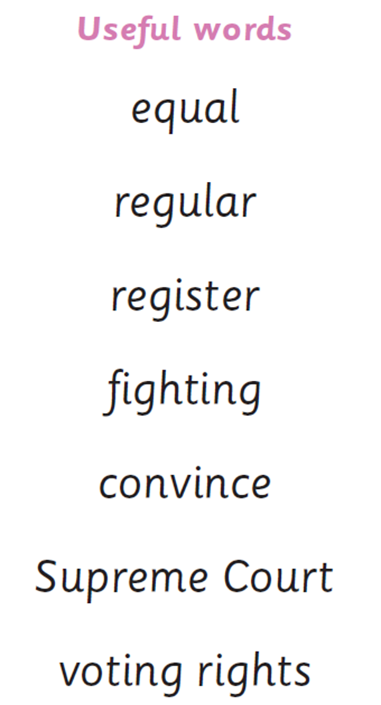
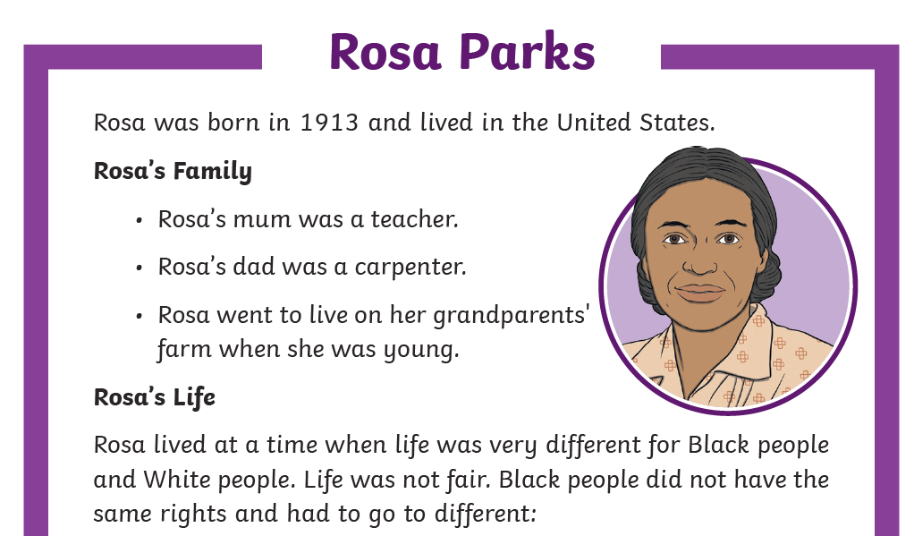
Tuesday 25th January 2022
LO: To understand features of non-fiction texts
LO: To discuss texts read to them
Information Texts

Slide 3
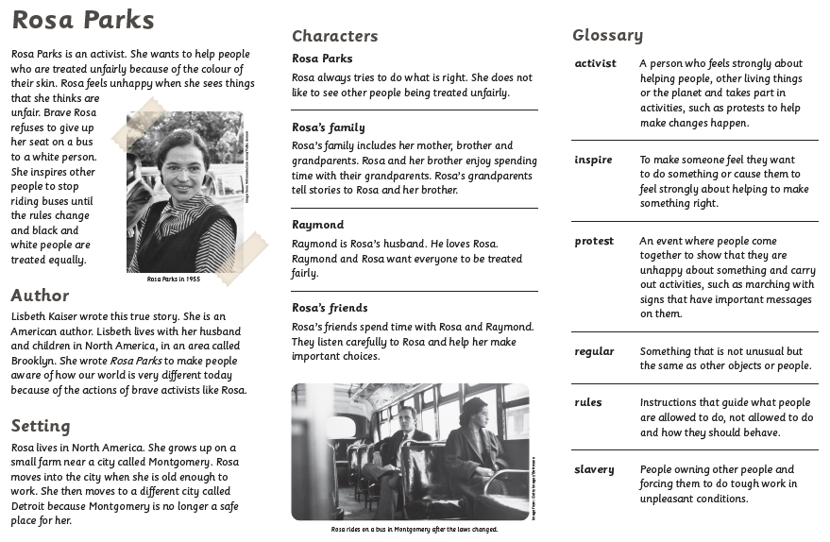
Tuesday 25th January 2022
LO: To understand features of non-fiction texts
LO: To discuss texts read to them

Slide 4
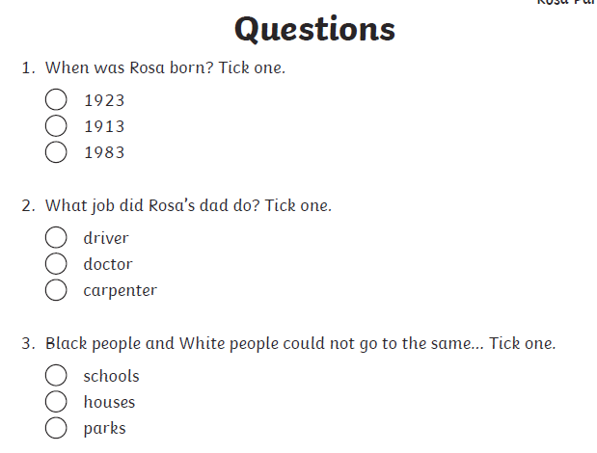
Wednesday 26th January 2022
LO: To answer questions on a text

Slide 5
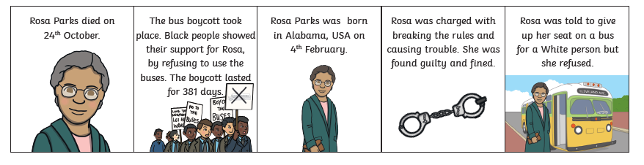
Thursday 27th January 2022
LO: To read non-fiction text and explain understanding

