Slide 2
Consonant or Vowel?
Sort the letters of the alphabet into two groups: consonants and vowels.
a
b
c
d
e
f
g
h
i
j
k
l
m
n
o
p
q
r
s
t
u
v
w
x
y
z
Consonants
Vowels
b
c
d
f
g
j
h
k
l
m
a
e
i
o
u
n
p
q
r
t
y
s
v
w
x
z

Slide 3
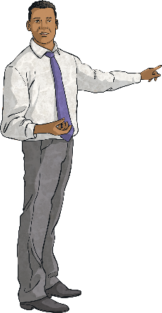



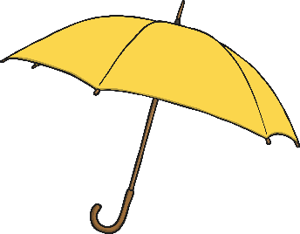

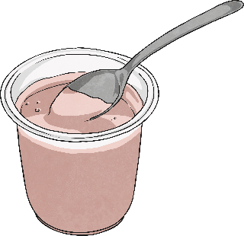
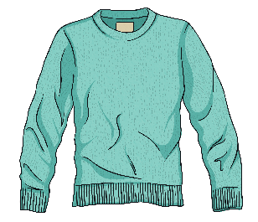

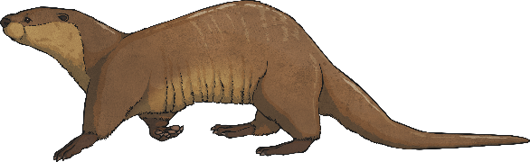
Sort the Words!
Words starting with a consonant
Words starting with a vowel
teacher
jumper
laptop
book
yoghurt
egg
apple
otter
umbrella
icicle

Slide 4
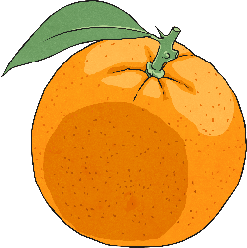
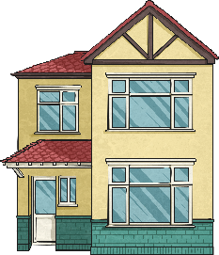
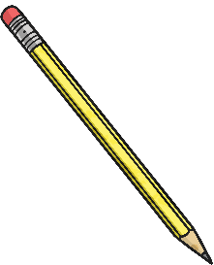
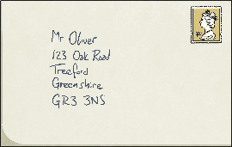
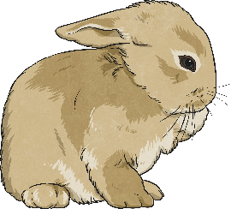

‘a’ or ‘an’?
a
an
house
orange
a
an
pencil
envelope
a
an
rabbit
apple
Usually, we put ‘a’ before words that start with a consonant and ‘an’ before words that start with a vowel.

Slide 5
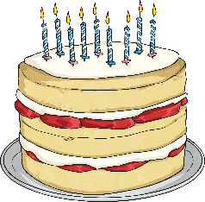
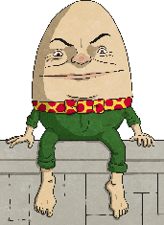

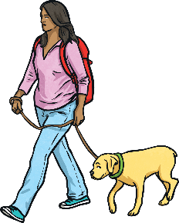
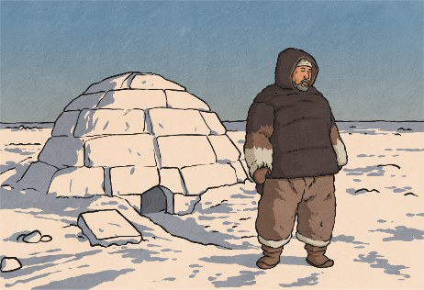
‘a’ or ‘an’?
Try these sentences – should it be ‘a’ or ‘an’?
a
Tomorrow, I am going to party.
Humpty Dumpty was egg.
I always have umbrella in my bag in
case it rains.
The dog was on lead.
You can make house out of snow,
which is called igloo.
an
an
a
a
an

Slide 6
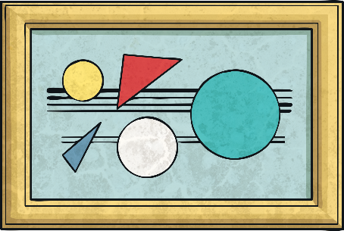
‘a’ or ‘an’?
Which sounds correct?
It was a unique painting.
It was an unique painting.
Although ‘unique’ starts with a vowel, the letter ‘u’ makes the ‘y’ sound, so ‘a’ is used instead of ‘an’.

Slide 7
‘a’ or ‘an’?
Which sounds correct?
It was a honest mistake.
It was an honest mistake.
Although ‘honest’ starts with a consonant, the letter ‘h’ makes the short ‘o’ sound, so ‘an’ is used instead of ‘a’.

Slide 8
‘a’ or ‘an’?
Listen to the sound at the start of the underlined word.
Does it make a vowel sound or a consonant sound?
an
It took hour to get to the zoo.
I have to wear uniform to school.
We flew to universe far, far away.
I would love to ride on unicorn.
The king wanted heir to the throne.
It was honour to meet the Queen.
a
a
a
an
an

Slide 9
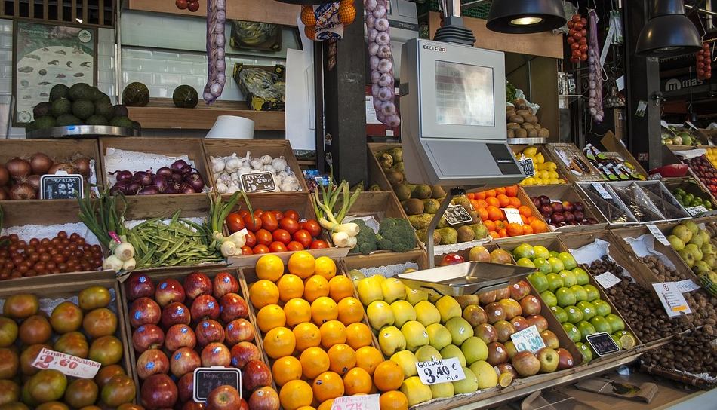
Can you decide whether ‘a’ or ‘an’ should go before these words?
Click on the hotspots to see whether you are correct.
×
10
a light
×
1
an avocado
a lemon
9
×
2
×
an onion
3
×
8
×
a tomato
a pear
a nut
4
×
7
×
×
5
an orange
an apple
a paper bag
6
×

Slide 10
‘a’ or ‘an’ Hunt
With a partner, collect five objects from the classroom.
Write a label for each object adding ‘a’ or ‘an’ in front of the word.
Read them aloud – does it sound right?
Join up with another pair and put your objects into two groups - those that use ‘a’ and those that use ‘an’.

Slide 11
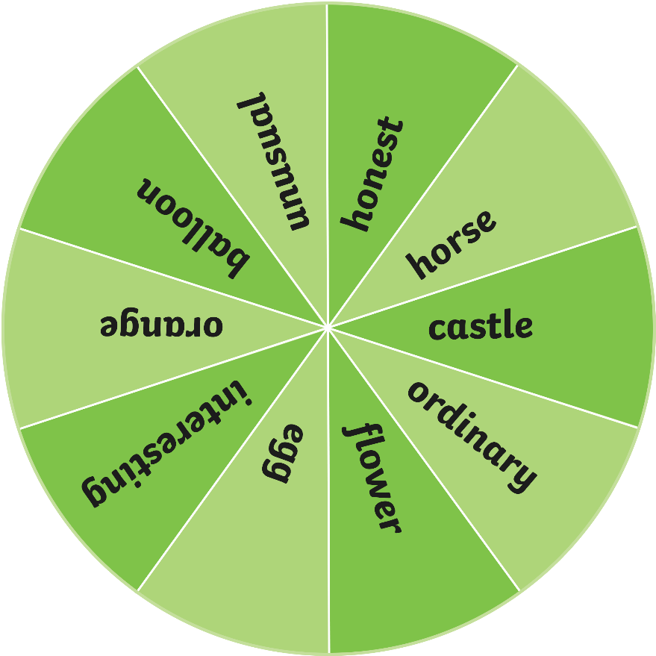
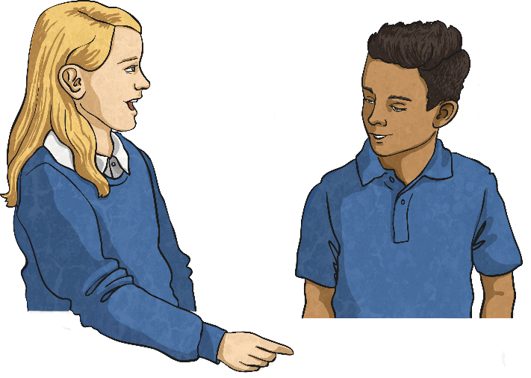
Spin the Wheel!
Spin the wheel to select a word.
Would you use ‘a’ or ‘an’ before the word?
On your whiteboards, write a sentence using the word with the correct choice of ‘a’ or ‘an’. Make your sentence as interesting as you can!
Spin

Slide 12
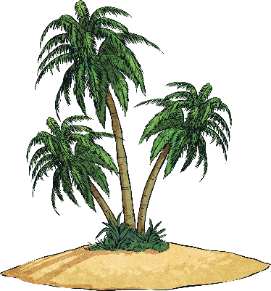
An Adventure To a Lost World
Can you spot the ‘a’ or ‘an’ mistakes in the following passage?
The waves lapped gently against the side of the boat, as a young boy and his faithful dog arrived at the shore of an small, deserted island. It was a island so small, that the boy could see right over to the other side from where he sat.
Jumping out of the boat into the shallow water,
his foot landed on an sharp shell.
“Ouch!” he yelped, startling his dog, who was sleeping
on a enormous blanket at one end of the boat.
Stretching to wake himself up, the dog looked at the boy
sleepily, before jumping into the clear, blue, sea.
They paddled to the shore and looked around at the island. In the centre was an huge palm tree as high as a ten storey building and surrounding it was an collection of every type of fruit tree imaginable.
Hungry from their journey across the sea, the boy began to ravenously eat the different fruits on offer.
He started with a apple, a banana, a orange and a whole bunch of juicy grapes, while his dog looked on, an look of jealousy on his face.
Can you spot the ‘a’ or ‘an’ mistakes in the following passage?
The waves lapped gently against the side of the boat, as a young boy and his faithful dog arrived at the shore of an small, deserted island. It was a island so small, that the boy could see right over to the other side from where he sat.
Jumping out of the boat into the shallow water,
his foot landed on an sharp shell.
“Ouch!” he yelped, startling his dog, who was sleeping
on a enormous blanket at one end of the boat.
Stretching to wake himself up, the dog looked at the boy
sleepily, before jumping into the clear, blue, sea.
They paddled to the shore and looked around at the island. In the centre was an huge palm tree as high as a ten storey building and surrounding it was an collection of every type of fruit tree imaginable.
Hungry from their journey across the sea, the boy began to ravenously eat the different fruits on offer.
He started with a apple, a banana, a orange and a whole bunch of juicy grapes, while his dog looked on, an look of jealousy on his face.

Slide 13
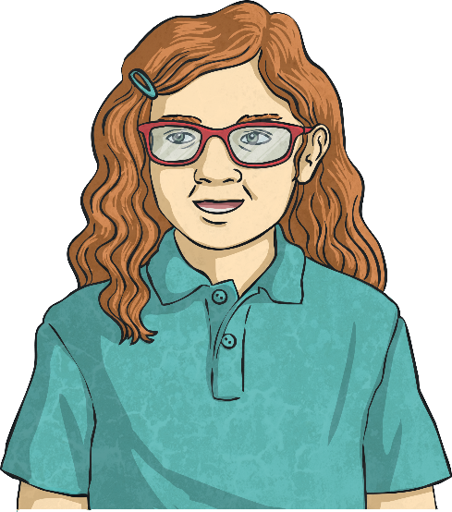
‘a’ or ‘an’ Word Search
How many words can you think of in two minutes that word need ‘a’ or ‘an’ before them?
‘a’
‘an’
Complete the table on your whiteboard.
Start
Time’s up!

Slide 14
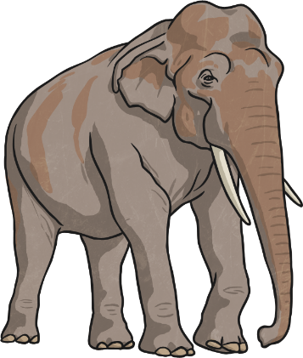
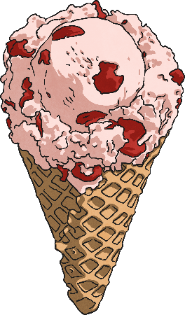

The, the Definite Article
What is different about these examples?
the book
The enormous elephant
the ice cream
We use ‘the’, the definite article, to show people what we are talking about specifically.

Slide 15



The, the Definite Article
See how adding ‘the’ changes these examples…
an orange
A book
a teacher
the orange
the book
the teacher

Slide 16
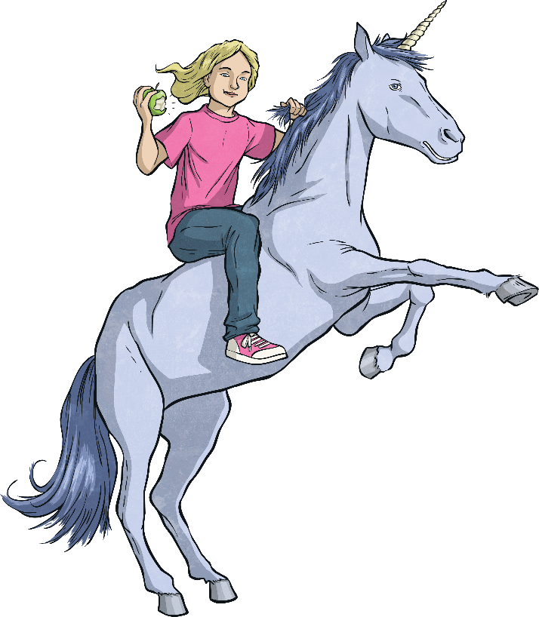
What do we know about using ‘a’ or ‘an’?
We use ‘a’ when the next word starts with a consonant sound.
We use ‘an’ when the next word starts with a vowel sound.
Say it aloud - does it sound right?
It was a unique painting of an honest girl riding a unicorn while eating an apple.

Slide 17
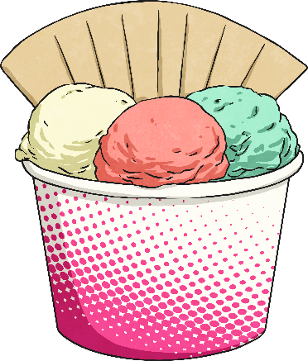
‘a’ or ‘an’ Quick Quiz
Take a quiz to see if you are an expert!
Which is correct?
a ice cream
an ice cream

Slide 18
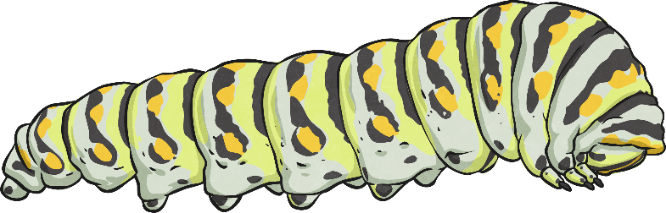
‘a’ or ‘an’ Quick Quiz
Take a quiz to see if you are an expert!
Which is correct?
a caterpillar
an caterpillar

Slide 19
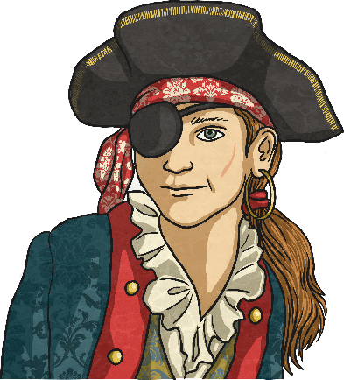
‘a’ or ‘an’ Quick Quiz
Take a quiz to see if you are an expert!
Which is correct?
Captain Jonas was a one-eyed pirate.
Captain Jonas was an one-eyed pirate.

Slide 20

‘a’ or ‘an’ Quick Quiz
Take a quiz to see if you are an expert!
Which is correct?
There was a enormous elephant at the zoo.
There was an enormous elephant at the zoo.

Slide 21
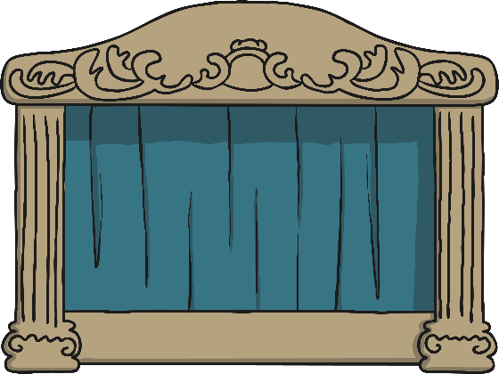
‘a’ or ‘an’ Quick Quiz
Take a quiz to see if you are an expert!
Which is correct?
The show lasted for a hour.
The show lasted for an hour.

Slide 22
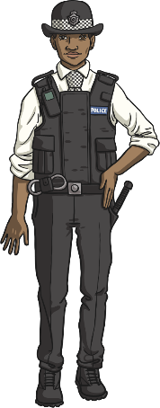
‘a’ or ‘an’ Quick Quiz
Take a quiz to see if you are an expert!
Which is correct?
The policewoman wore a uniform.
The policewoman wore an uniform.

