Slide 1
Introduction to Circuits

Slide 2






Starter: Symbols
Everyday we see lots of different symbols. What are these symbols and what do they represent?

Slide 3
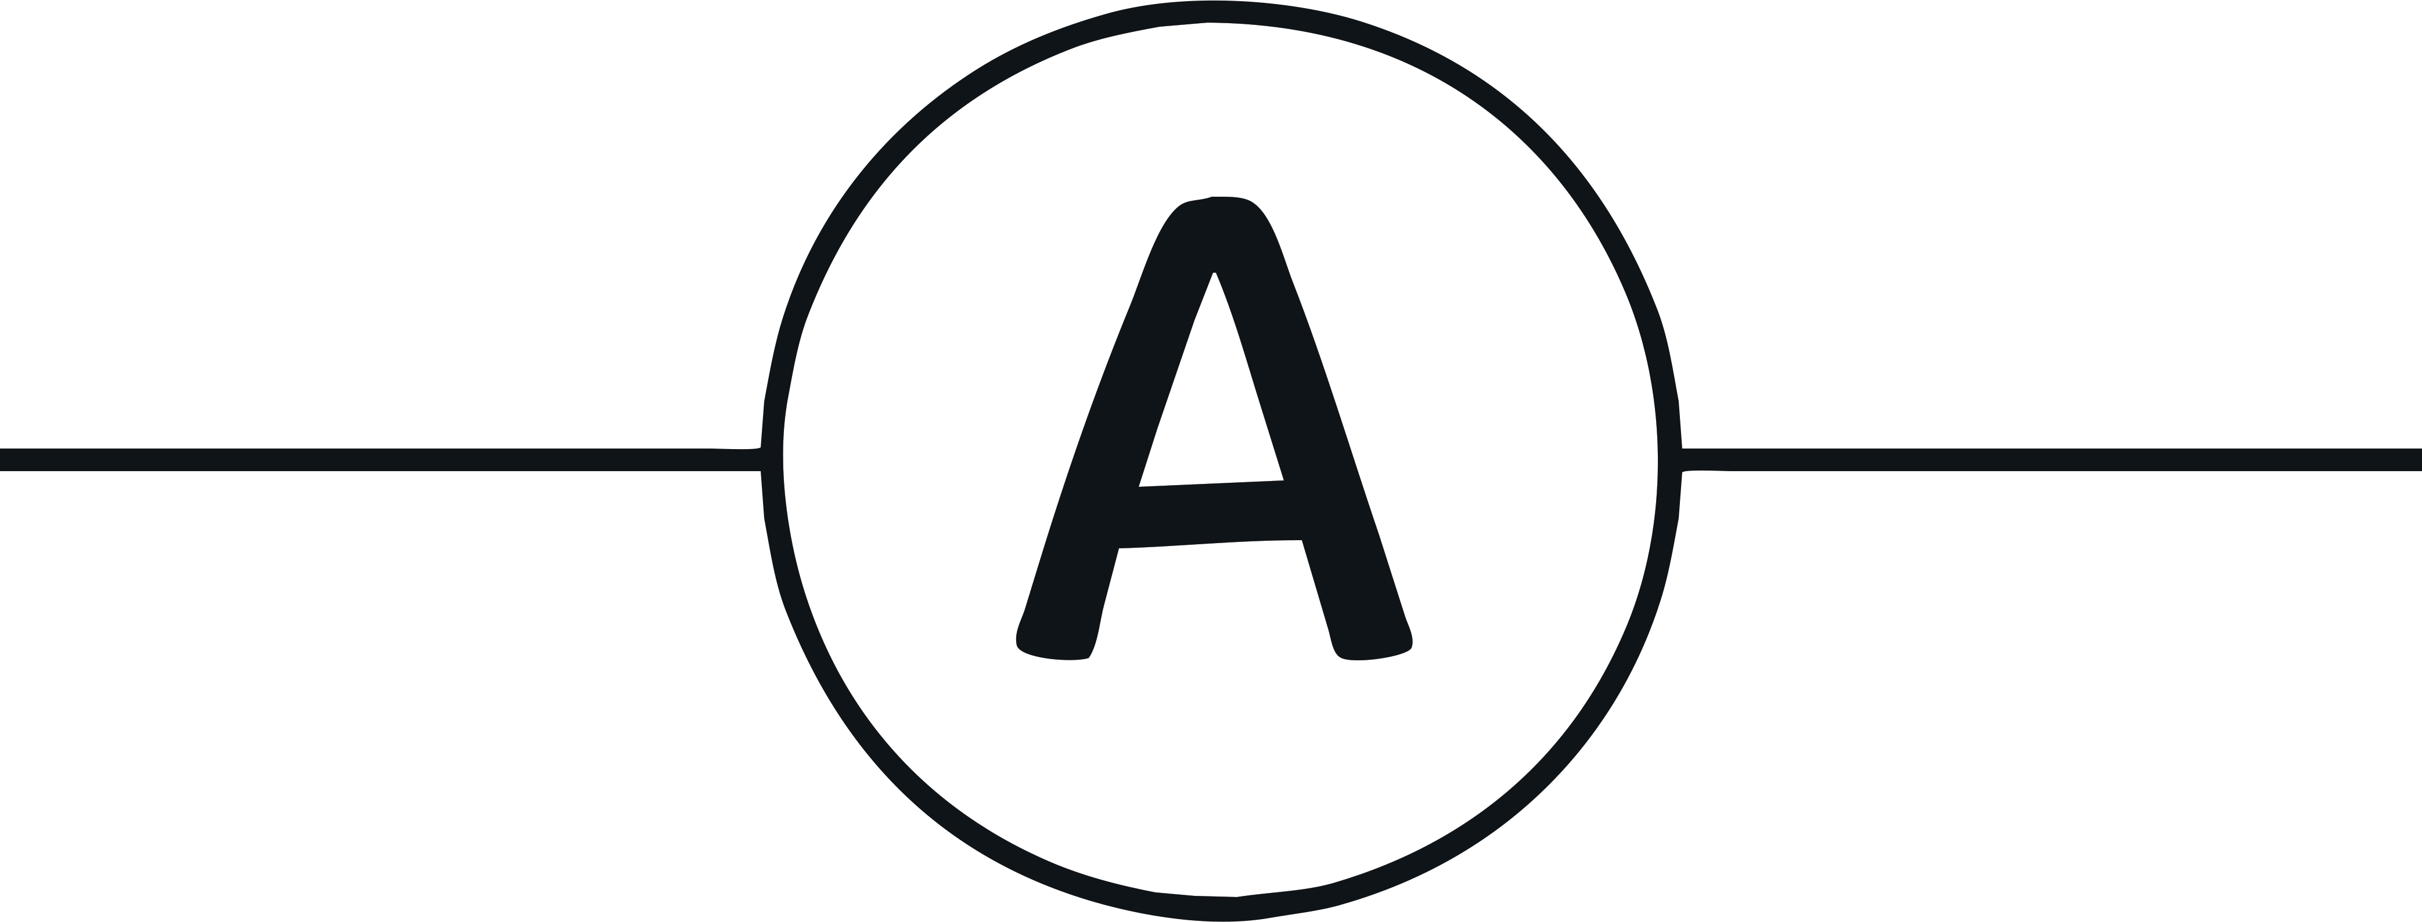

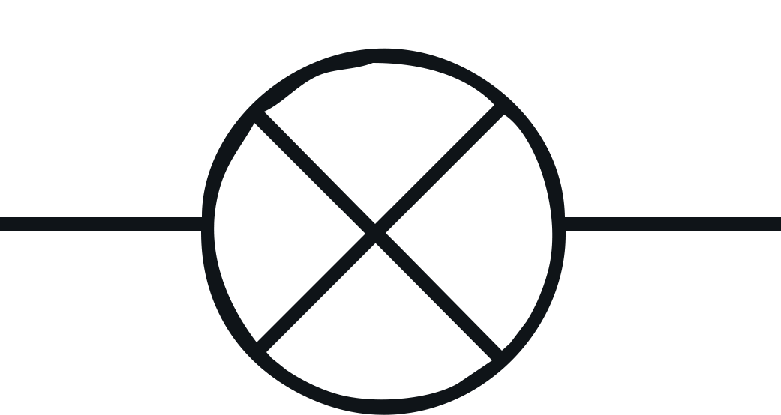
Scientific Circuit Symbols Quiz
Electrical circuits are often represented by circuit diagrams. Instead of
spending a lot of time creating very artistic drawings of circuits, we use
standard symbols that are much simpler. They are also easier to draw and
interpret.
The symbols represent
components such as a bulb,
ammeter, and voltmeter that can
be used in a circuit diagram.
Circuits can be drawn in a series
where one component comes after
the other or in parallel.

Slide 4
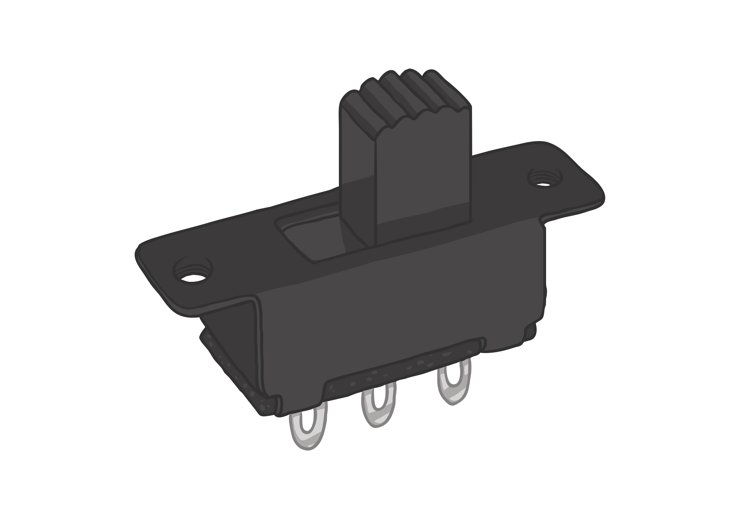

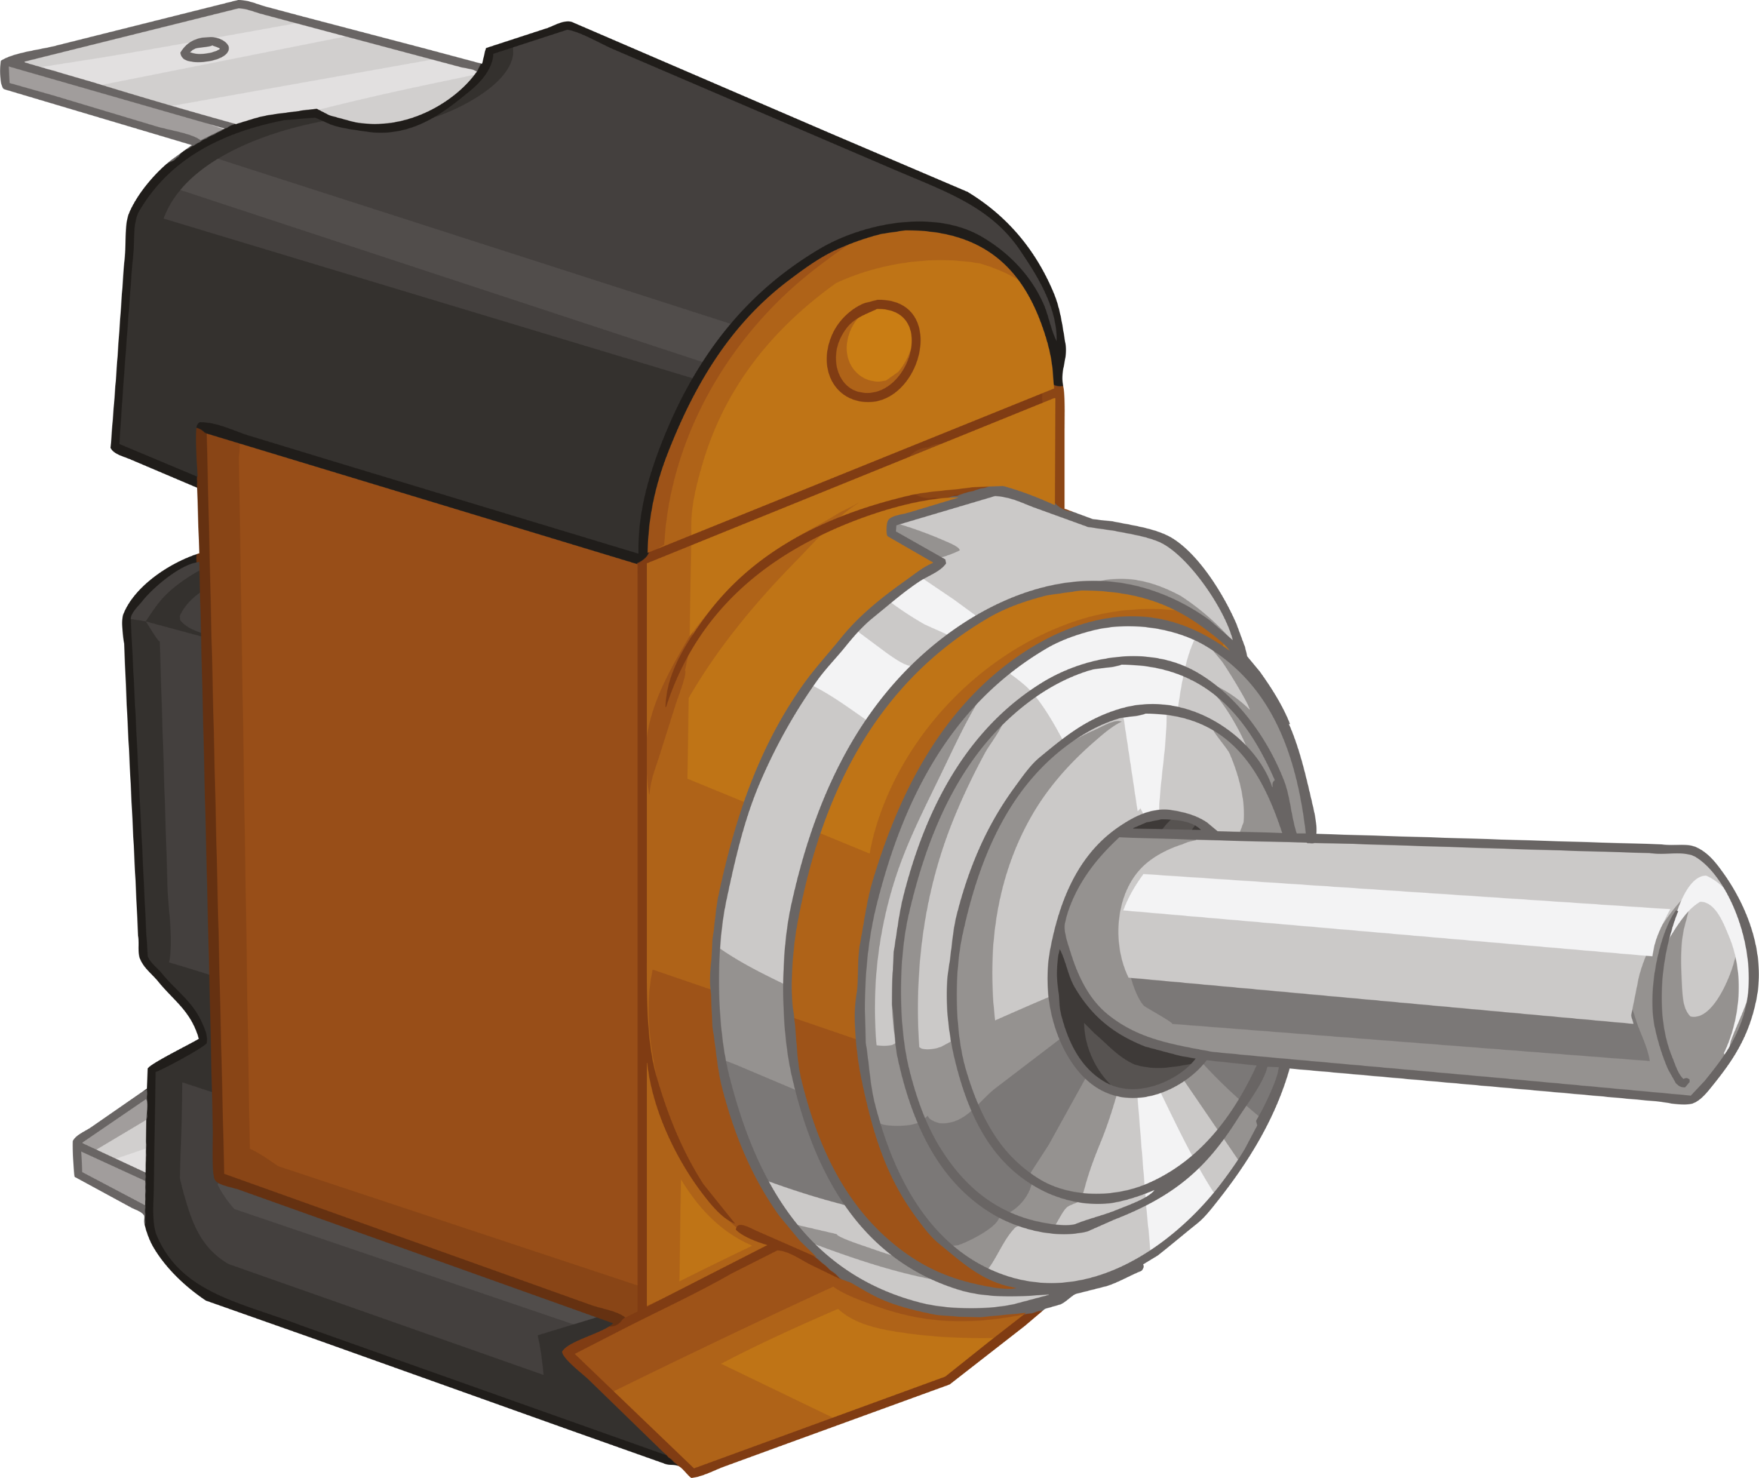
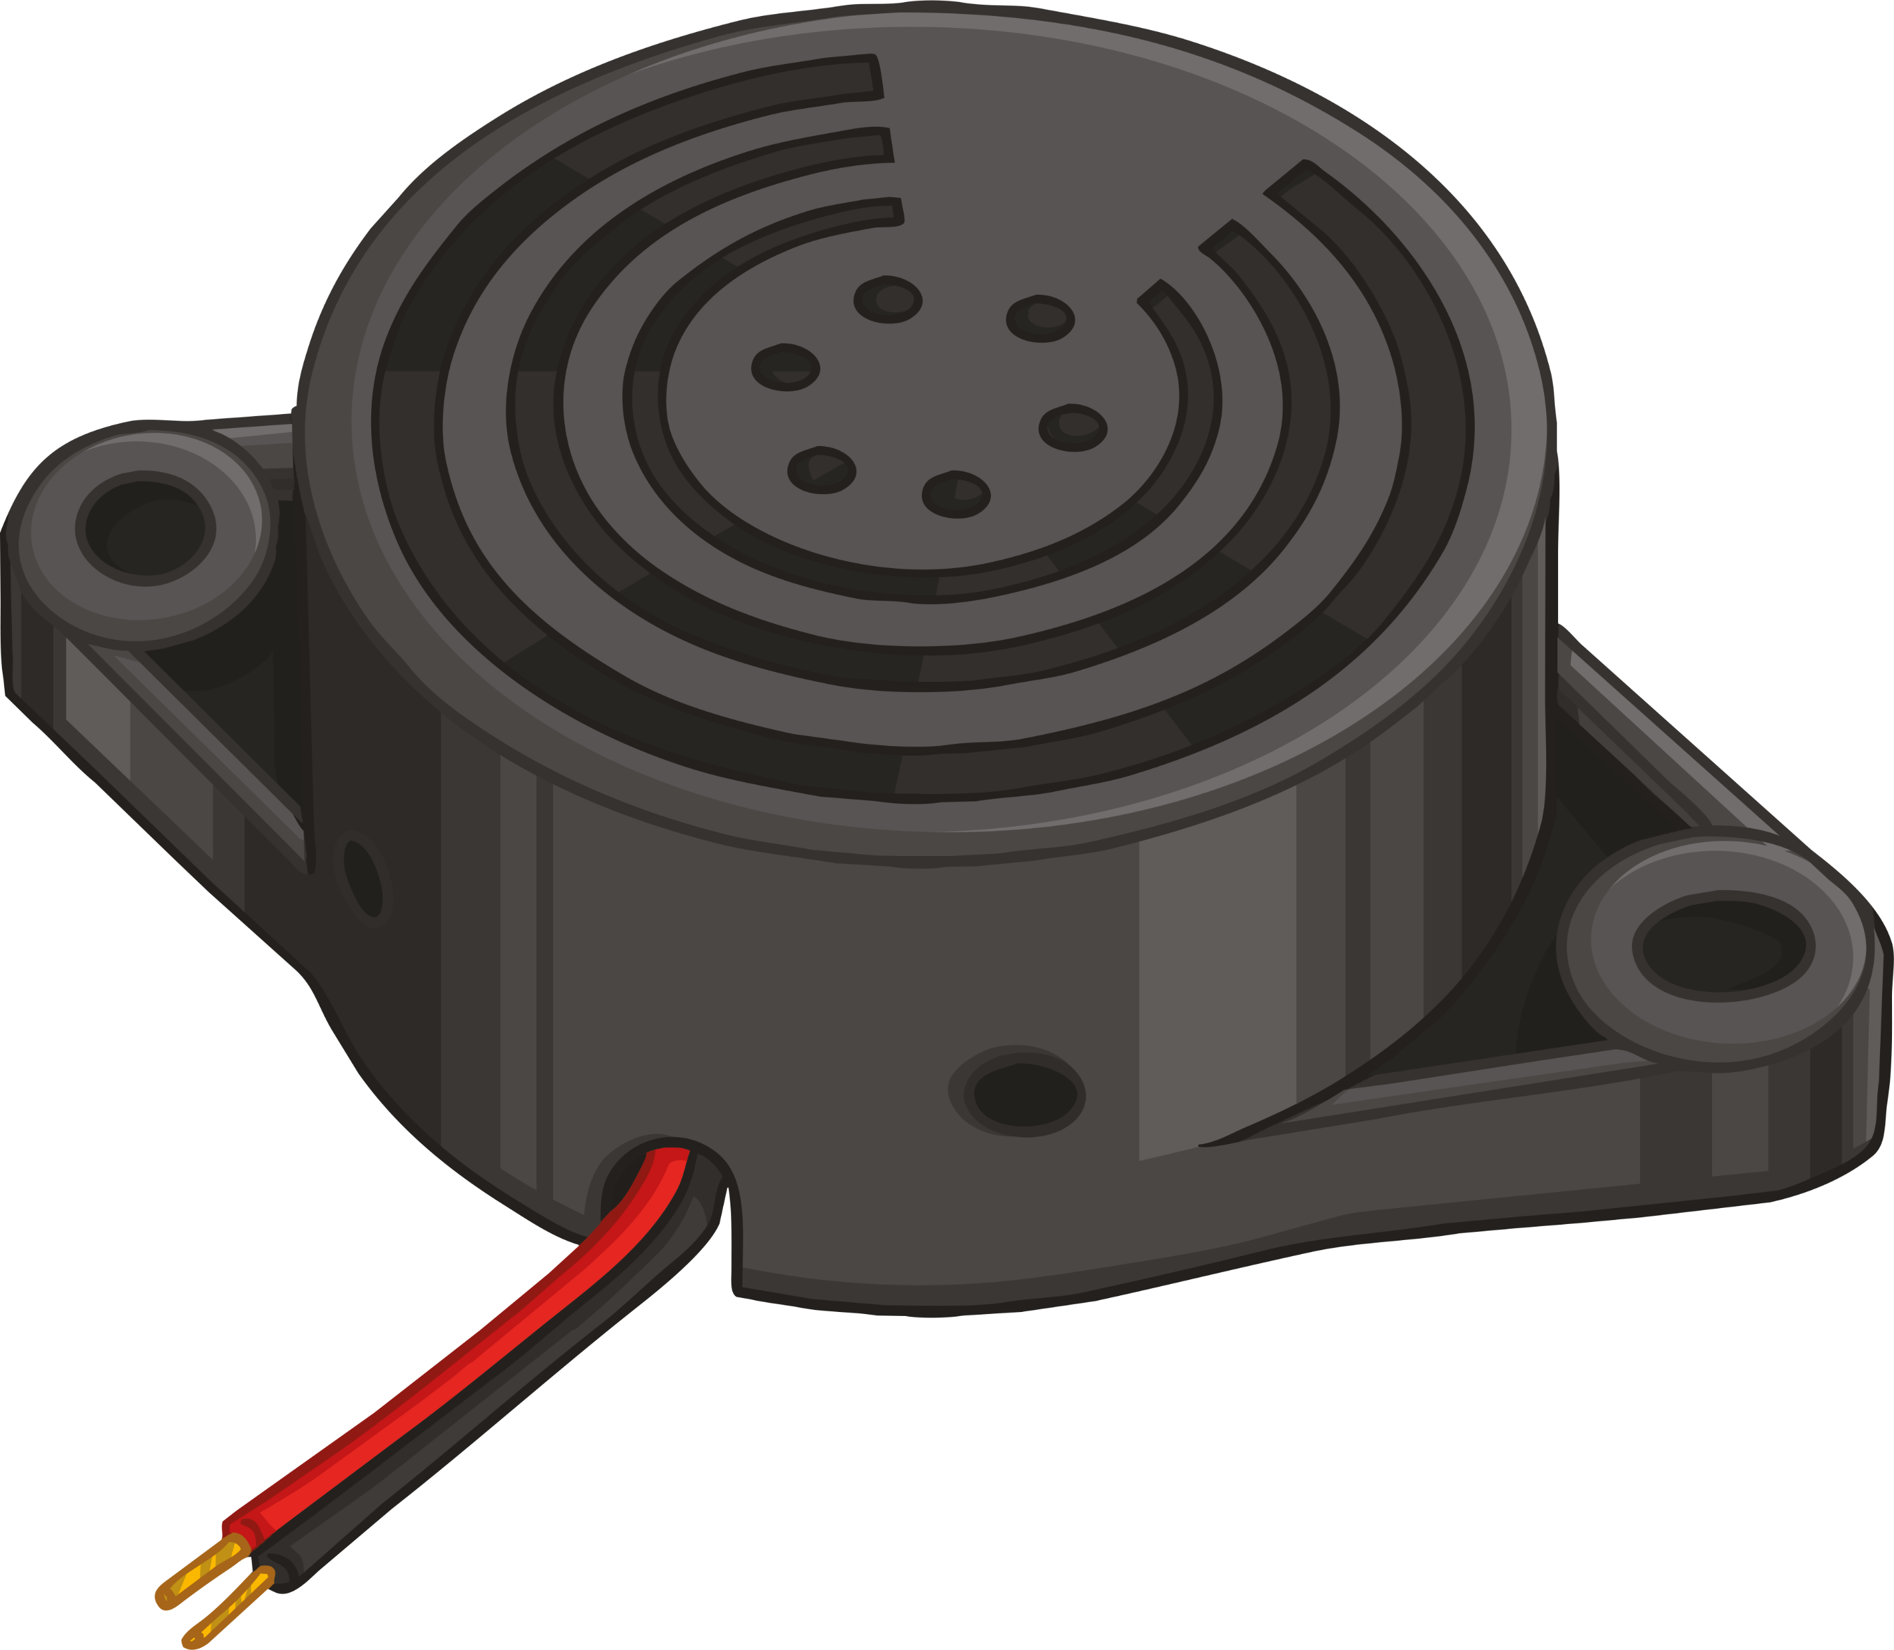


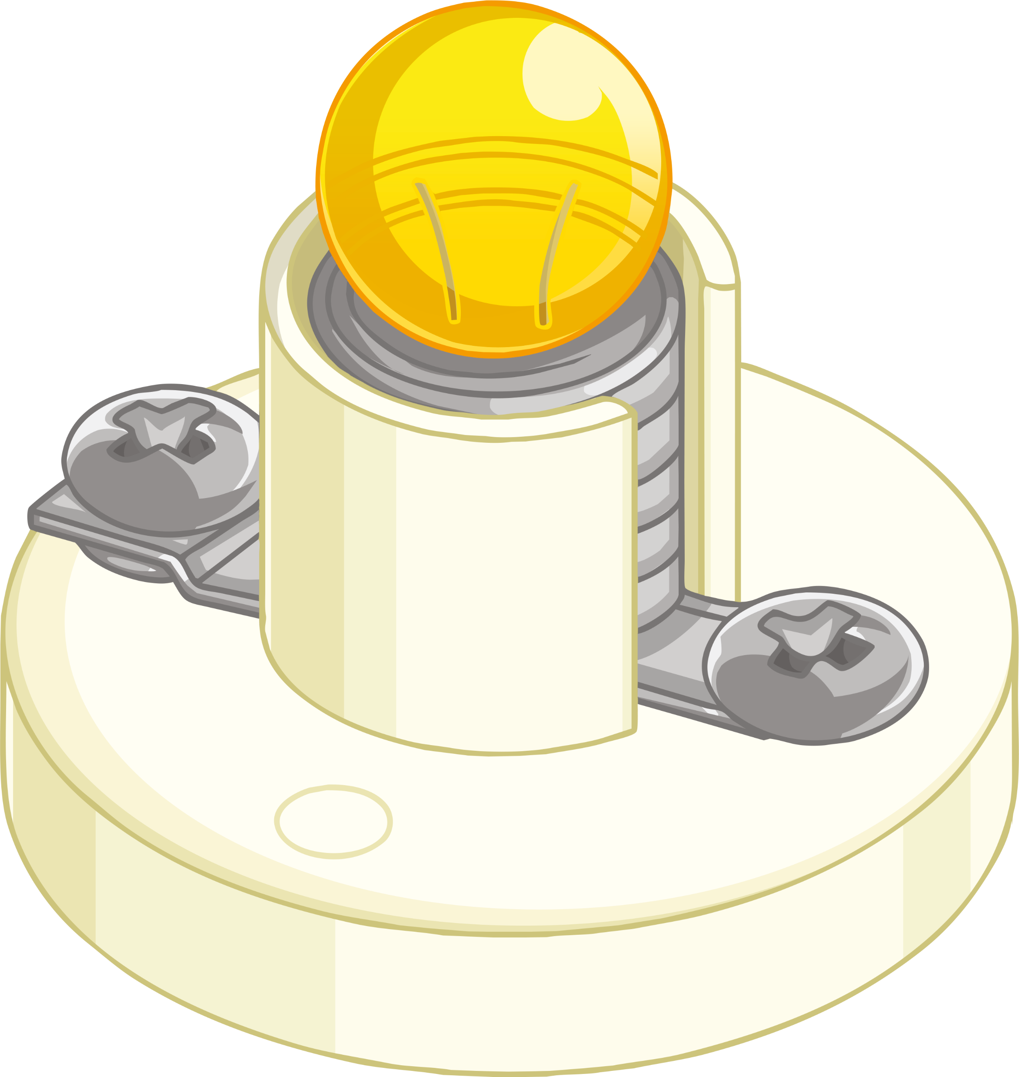
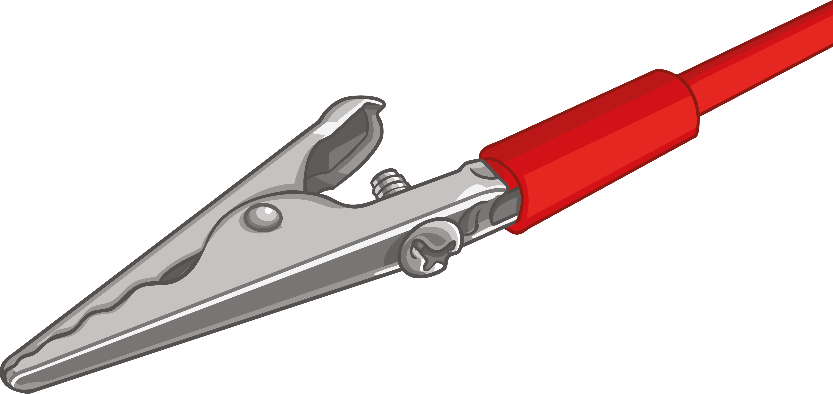
Scientific Circuit Symbols Quiz
Match the parts of a circuit with their scientific symbols.
(Sometimes there will be more than one symbol for a circuit part.)

Slide 5
Answers
Match the parts of a circuit with their scientific symbols.
(Sometimes there will be more than one symbol for a circuit part.)

Slide 6
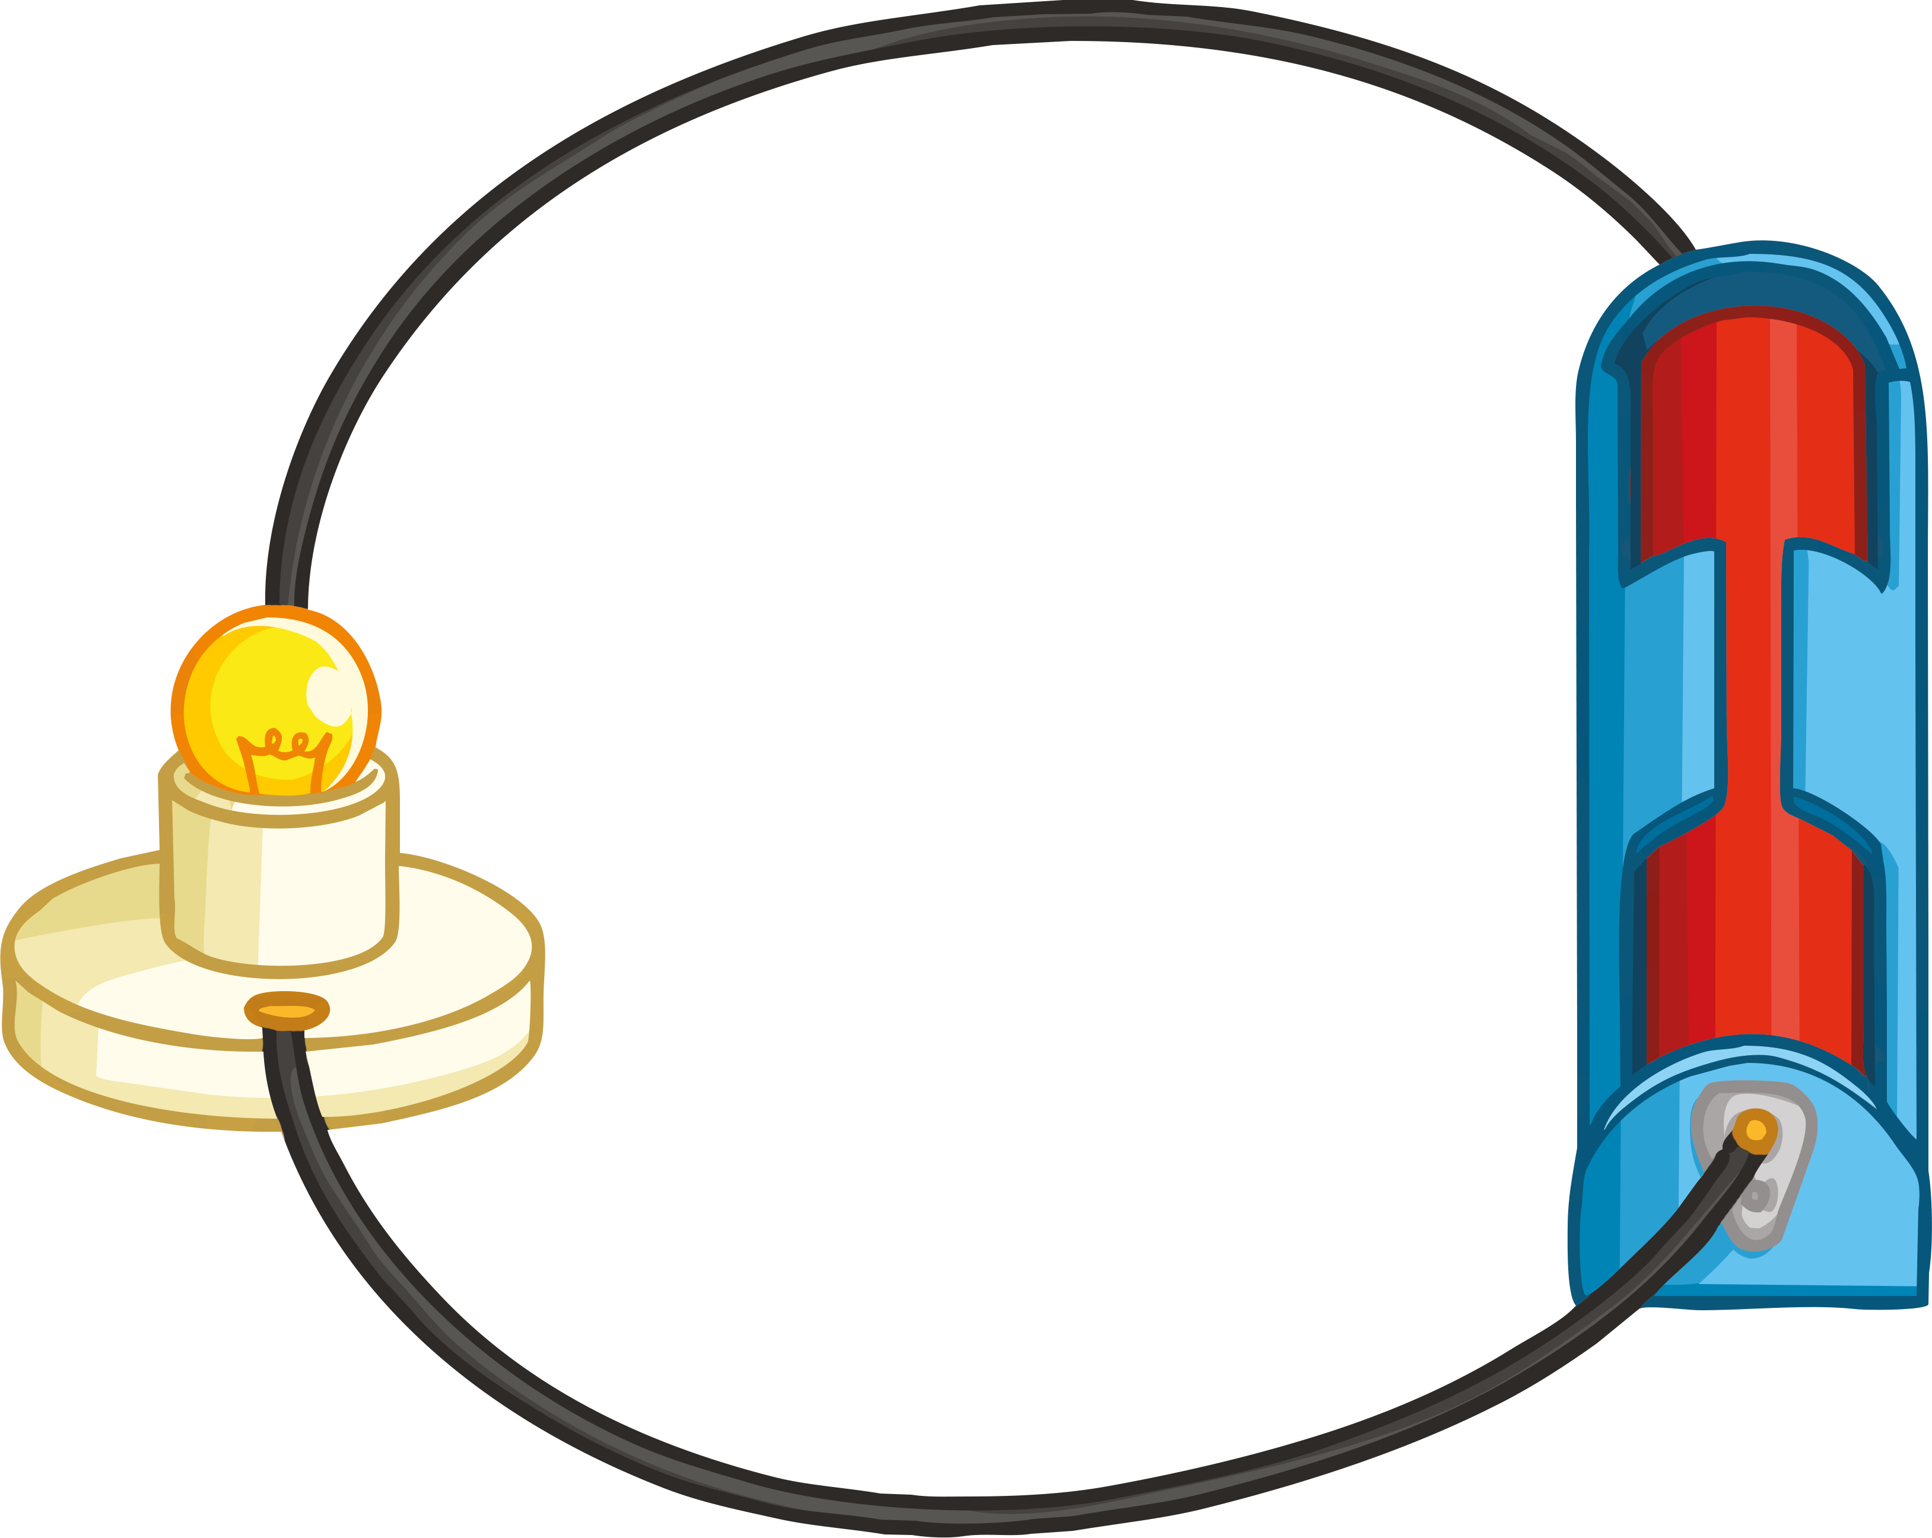
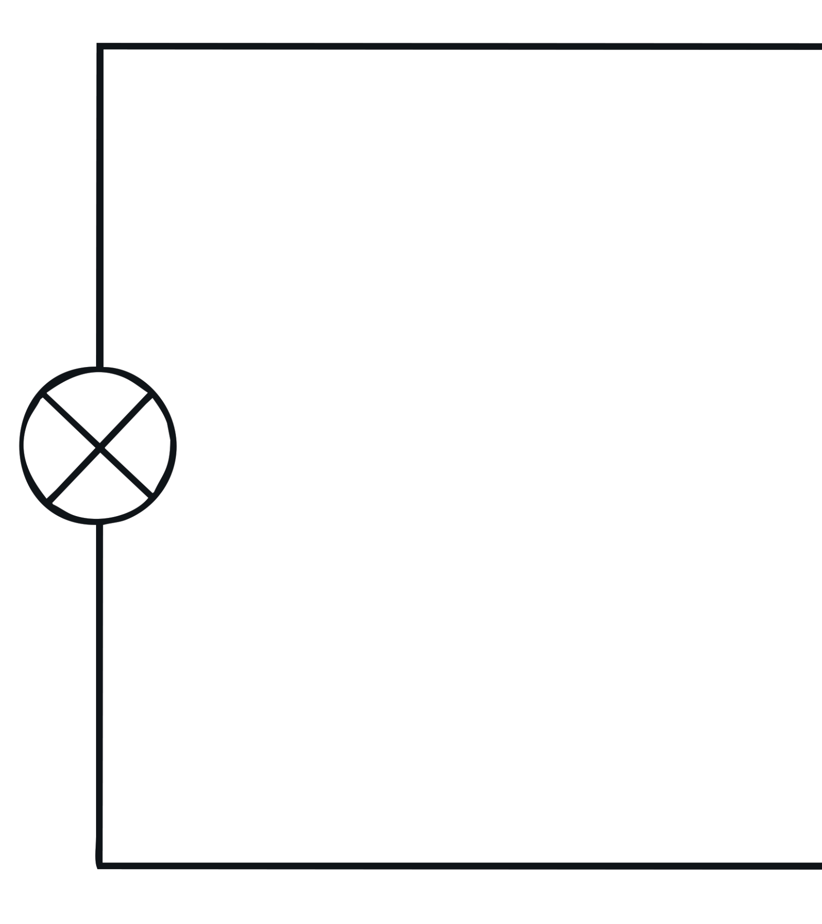
Circuit Symbol Diagrams
When drawing circuit diagrams, you must always follow these rules.
1. Always draw circuits using straight lines.
2. Use a pencil and a ruler to draw these lines.
How would you begin to draw the circuit below?

Slide 7
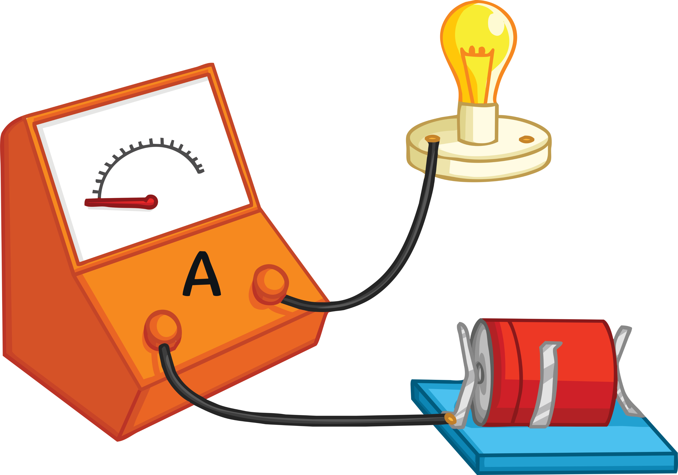
Check Your Understanding
Emily sets up an electric circuit.
In the diagram, the ammeter reading is zero.
What is wrong with this circuit?
Answer
The circuit is not closed. There is no connection between the light and the battery, so electricity cannot flow freely.

