Slide 1
History
Memorials

Slide 2
LO: To understand that a memorial is something made to remind people of a significant person or event.

Slide 3
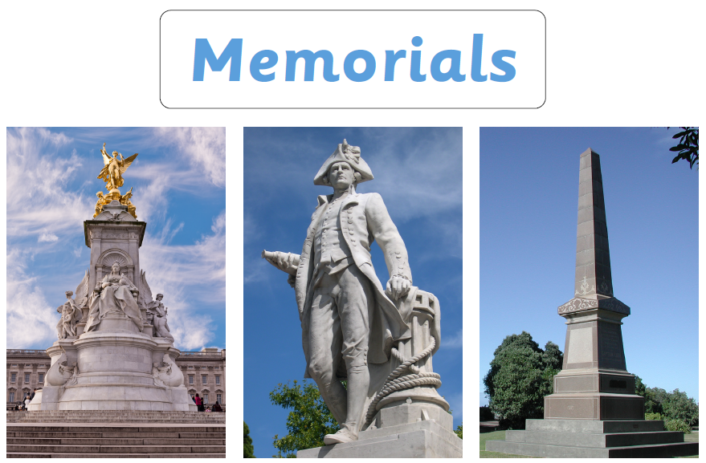

Slide 4
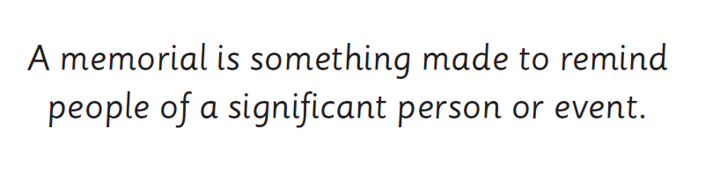

Slide 5
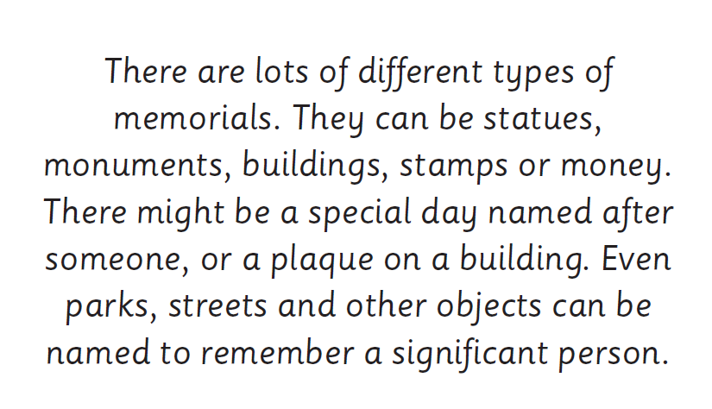

Slide 6
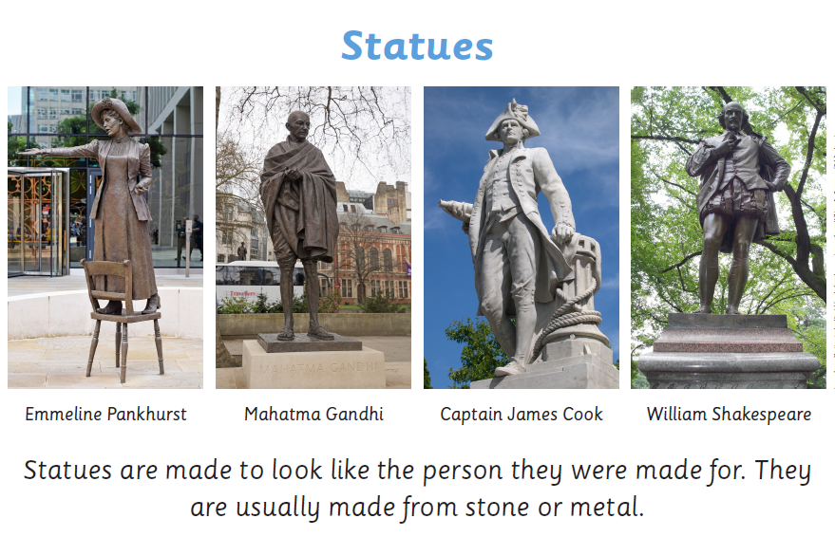

Slide 7
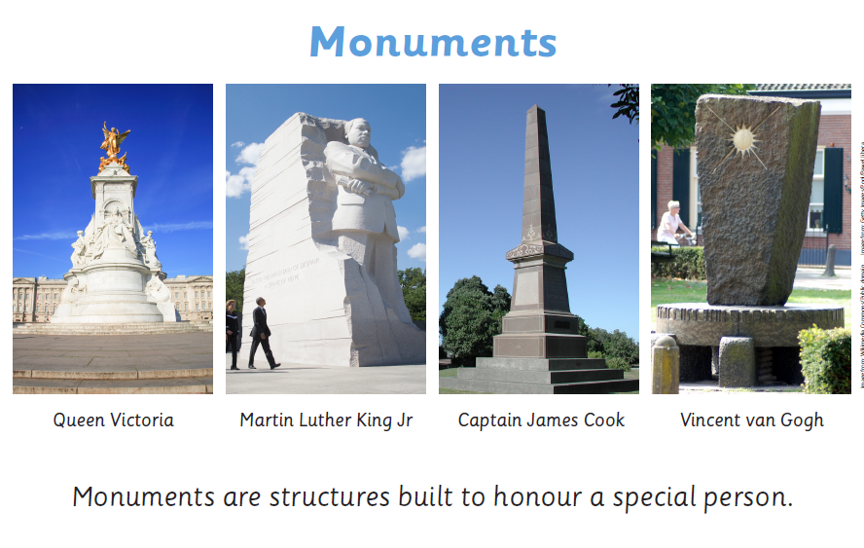

Slide 8
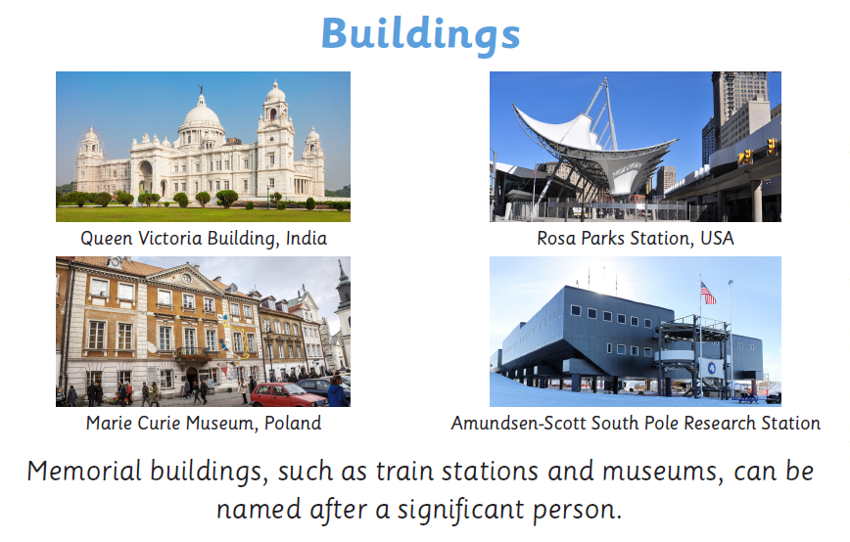

Slide 9
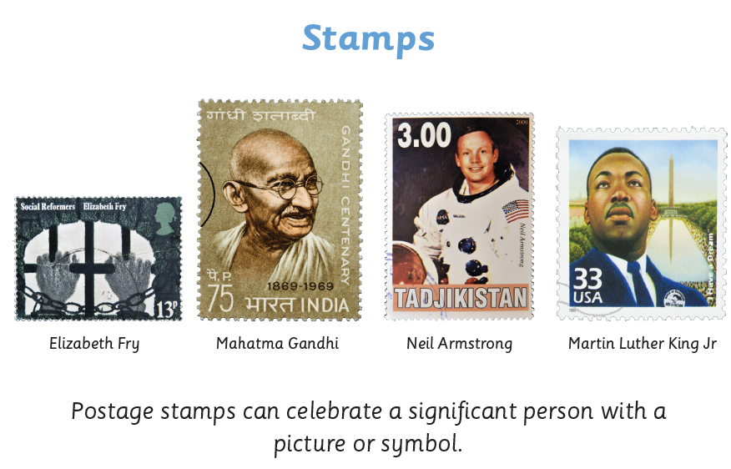

Slide 10
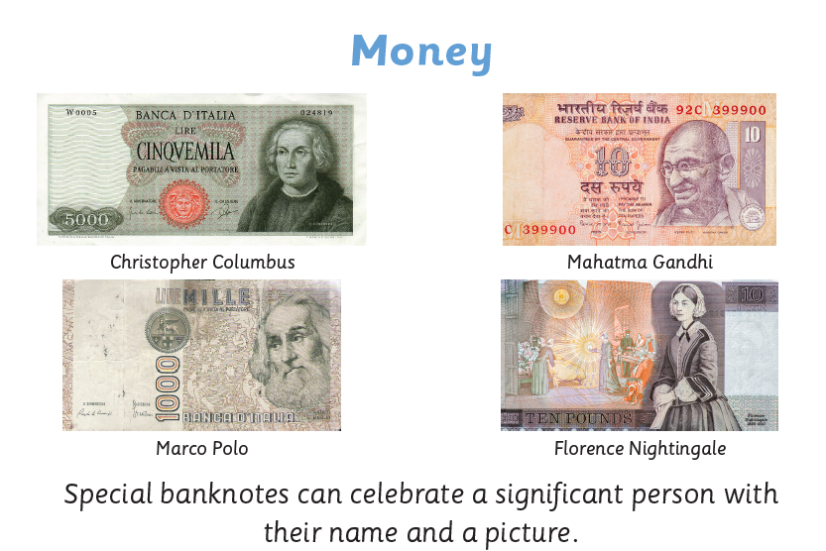

Slide 11
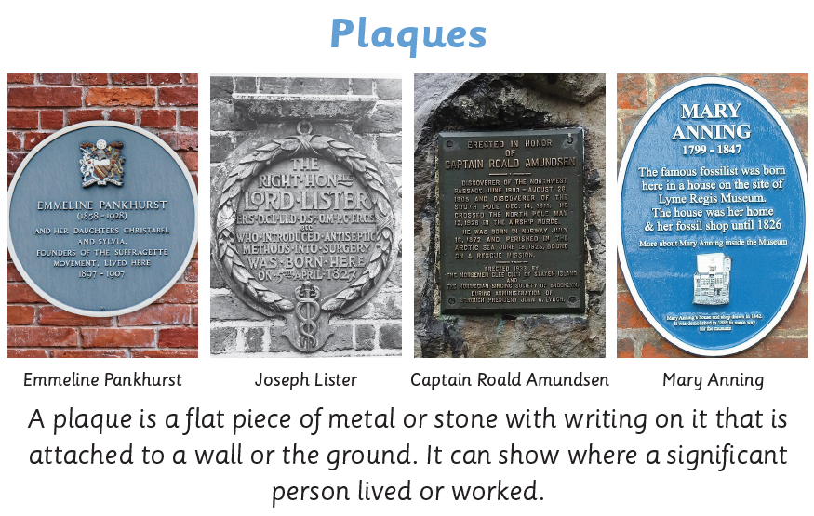

Slide 12
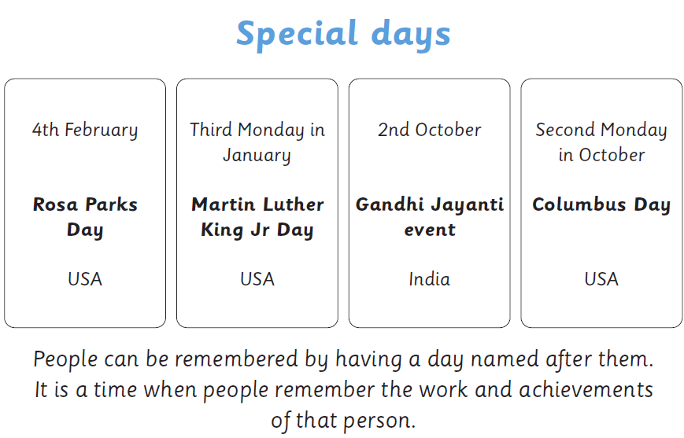

Slide 13
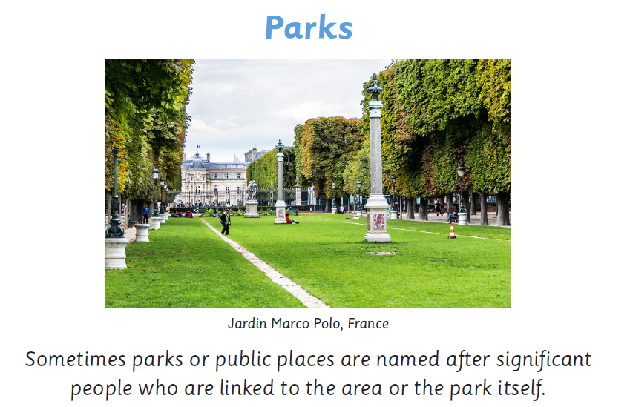

Slide 14
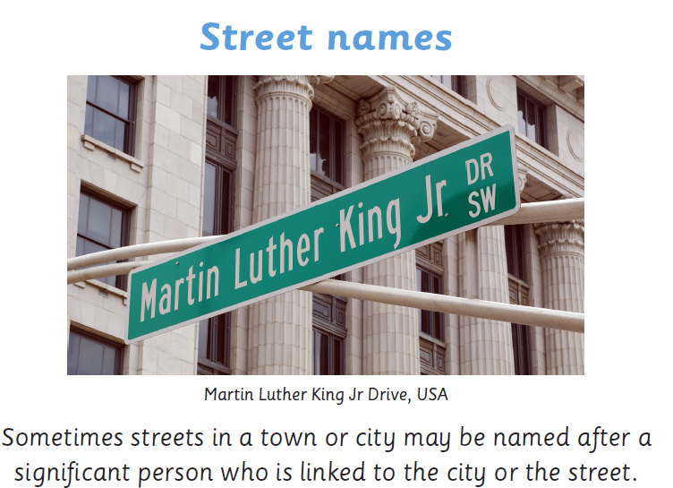

Slide 15
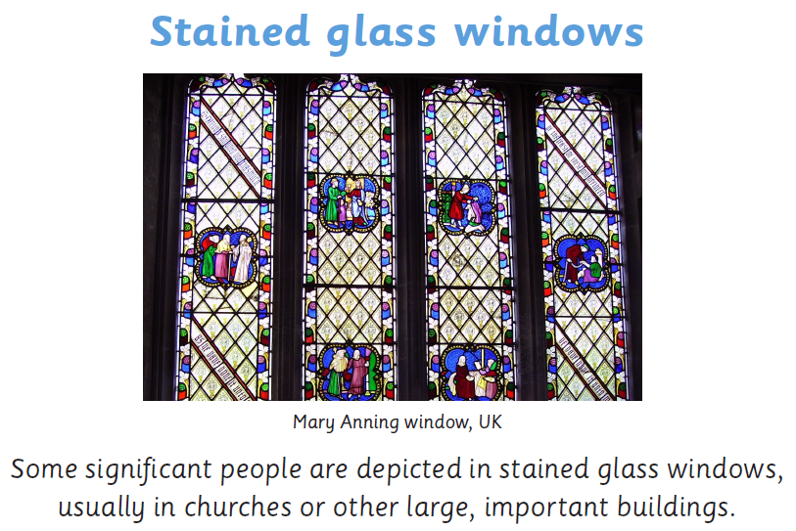

Slide 16
Can you design a new symbol for their community that suggests thanks, remembrance and respect?

Slide 17
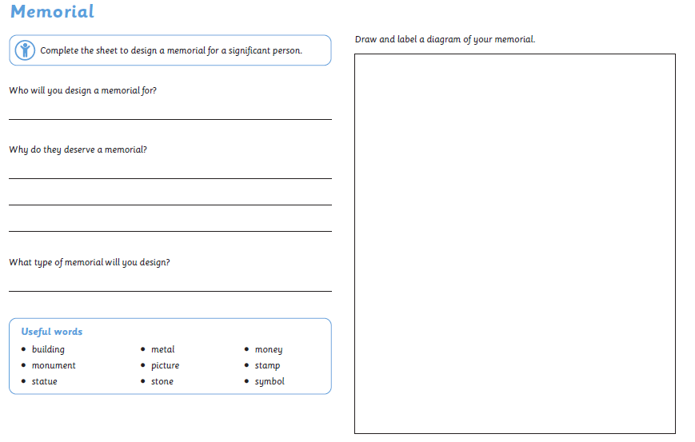
Notes:
Children to pick a significant person and draw a memorial for it.

Slide 18
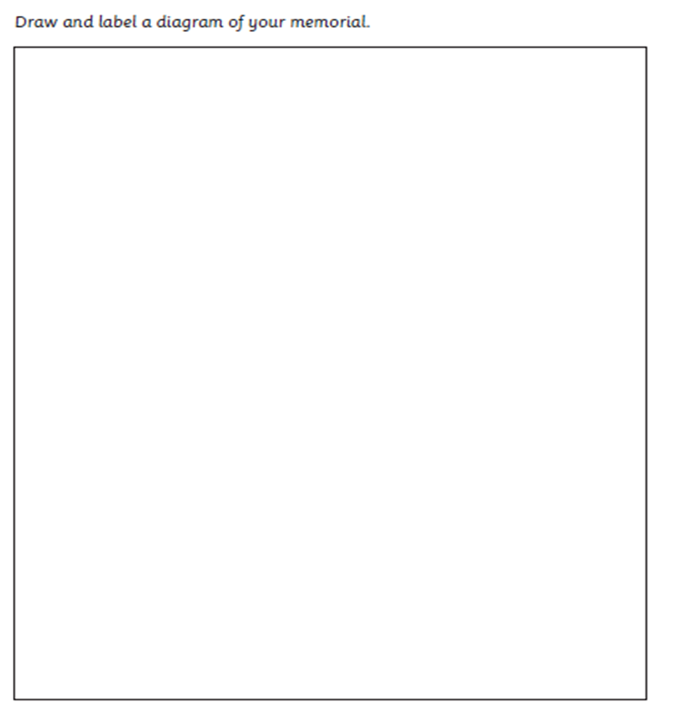

Slide 19
Next Step
How can significant people be remembered after their death?

Slide 20
Next Step
How can significant people be remembered after their death?
Next Step
How can significant people be remembered after their death?
Next Step
How can significant people be remembered after their death?
Next Step
How can significant people be remembered after their death?
Next Step
How can significant people be remembered after their death?

