Slide 1
Pilgrim Fathers
Thursday

Slide 2
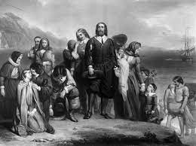

Slide 3
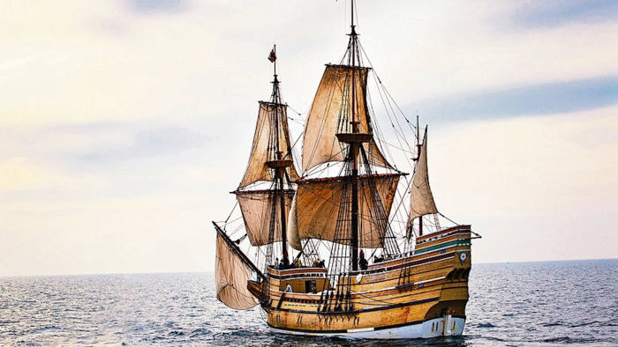

Slide 4
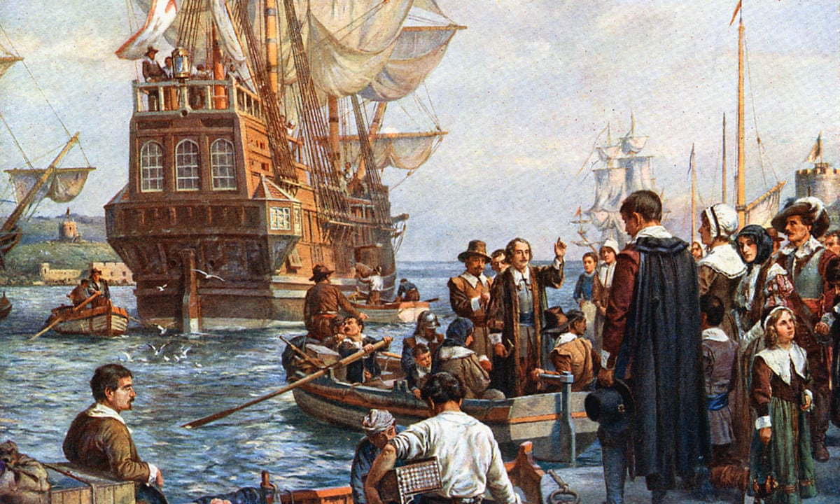

Slide 5
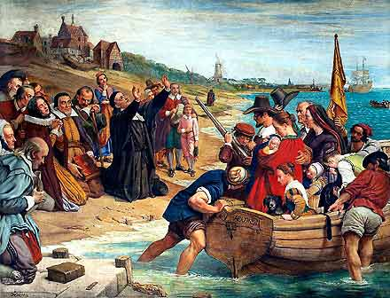

Slide 6
https://www.youtube.com/watch?v=P9kGbz-BfLI

Slide 7
https://www.youtube.com/watch?app=desktop&v=sDlOHKNSnnE

Slide 8
Task
Watch the videos of the Pilgrim Fathers. Adult to ask the children what they can recall (make notes on flipchart). Children to write sentences about Pilgrim Fathers and draw a picture of them.
The Pilgrim fathers…

Slide 9
Pilgrim Fathers
Friday

Slide 10
https://www.youtube.com/watch?v=qt0VWS0h40Y
Notes:
Video about boston

Slide 11
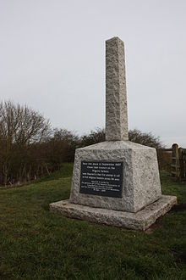
Notes:
The Pilgrim Fathers Memorial is located on the north bank of The Haven at the site of the former Scotia Creek, Fishtoft, seaward of Boston in Lincolnshire, England, and consists of a small granite obelisk mounted on a granite block. It commemorates the attempt at finding religious freedom in September, 1607 by the Scrooby Congregation, a group of English Separatist Protestants who left for Holland. They were precursors of the Pilgrims who later crossed the Atlantic to New England.
The men from Scrooby, Nottinghamshire,^{[1]} chartered a Dutch vessel to transport them to the Netherlands in 1607,^{[2]} but the attempt was thwarted when the captain betrayed them to the local authorities.^{[1]} They were arrested and taken by boat to attend a hearing by the magistrates in the Boston Guildhall, and they were imprisoned in the cells there for about a month.^{[1]}
In 1608, after their release, they made a second, this time successful, attempt from the Humber first arriving in Amsterdam. The Scrooby congregation moved to Leiden^{[3]} in 1609, before setting sail in 1620 for the New World via Southampton and Plymouth.^{[4]}

Slide 12
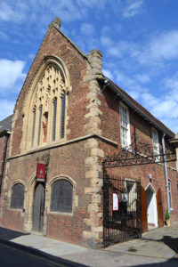
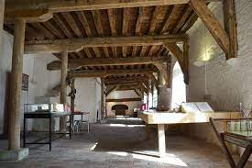
Notes:
The Pilgrim Fathers in Lincolnshire
During the reign of Queen Elizabeth I, Protestant non-conformist religious beliefs flourished in England. One such belief was that of the Separatists, a group of Puritans with strong Lincolnshire links – Gainsborough was at the heart of the Lincolnshire Separatist movement, while another group was based just over the border at Scrooby in Nottinghamshire.
Separatists wanted the freedom to worship God away from the constraints of the Church of England. When Elizabeth was succeeded by King James I in 1603, there was a clampdown on such groups – it became illegal not to attend church and the Separatist Movement was banned a year later.
Wanting to escape persecution, The Separatists decided to flee to The Netherlands – a far more tolerant Protestant country. In 1607, both the Gainsborough Separatists and the Scrooby Separatists travelled to Boston where boats were waiting to take them to Holland.
The Gainsborough Separatists successfully completed their journey, joining other English Separatists known as the Ancient Brethren in Leiden.
The Scrooby Separatists, however, were not so fortunate. Betrayed by their boat’s captain, they were intercepted at Scotia Creek, situated a few miles down river from Boston, where they were arrested and all their goods seized.
They were taken to Boston Guildhall, where they remained in the cells whilst awaiting trial at Lincoln. After several months in prison, they were released and returned home to Scrooby, penniless. Sympathisers eventually raised enough money to fund a second escape attempt, which this time was successful.
The American Dream
After living peacefully in Leiden for several years, in 1620 the Ancient Brethren decided to sail for America in search of a better life. They hired two ships; the Speedwell, which was to transport passengers, and the larger Mayflower, to carry supplies during the hazardous journey across the Atlantic.
It became obvious early on, however, that the Speedwell would be incapable of crossing the Atlantic, as it began to take in water off the coast of Devon. The passengers transferred to the Mayflower, which set sail from Plymouth on 6th September 1620 and landed in Massachusetts after an arduous two month voyage.
This small group of people became known as The Pilgrim Fathers, the founding fathers of America.
In the 1630s, another group of Lincolnshire Puritans left Boston for America. They founded a new settlement in Massachusetts and named it after their home town – Boston.
One of the most important of these settlers was The Reverend John Cotton, who was the very controversial Vicar of St. Botolph’s Church in Boston. The Reverend Cotton made many enemies by preaching his non-conformist views, regularly finding himself prosecuted at Lincoln’s Law Courts. In 1633, he sailed across the Atlantic to Boston, Massachusetts, and soon became spiritual leader of this church-dominated state. His influence increased further when he helped to draft the fundamental laws for the colony, which are still applicable today.

Slide 13
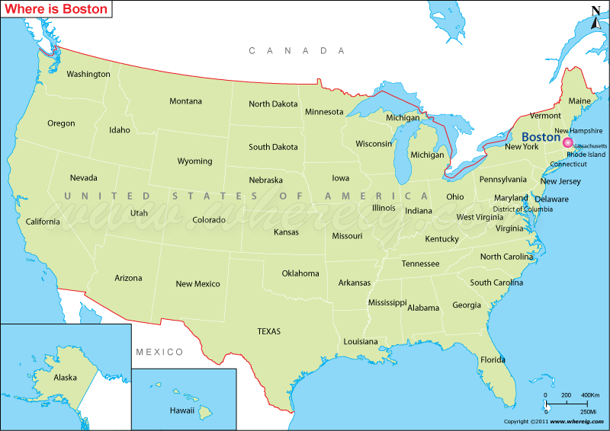

Slide 14
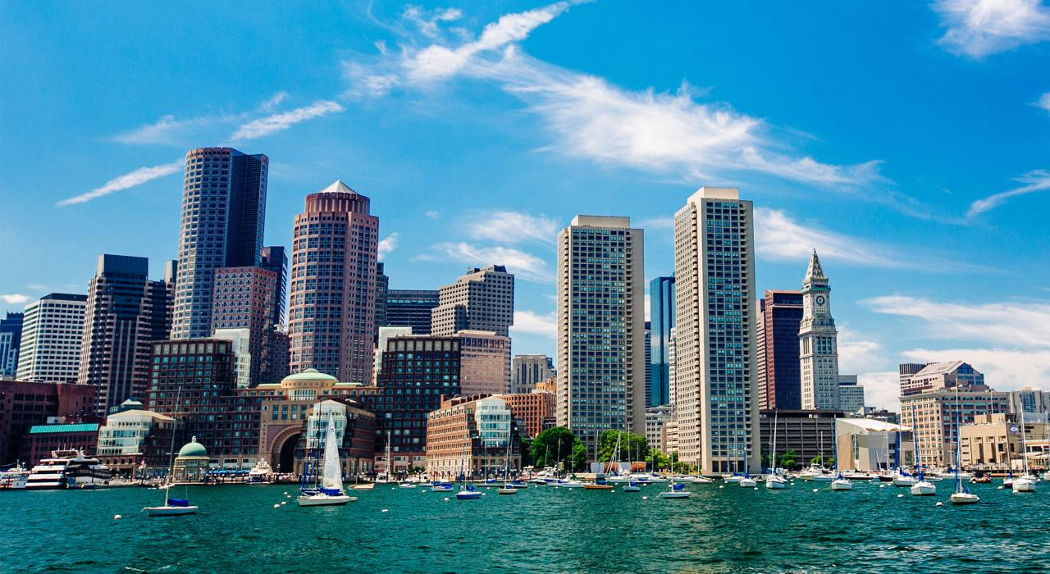

Slide 15
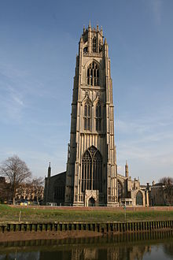
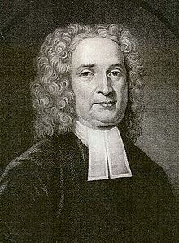
Notes:
St. Botolph's
https://en.wikipedia.org/wiki/John_Cotton_(minister)
In 1607, a group of pilgrims from Nottinghamshire led by William Brewster and William Bradford attempted to escape pressure to conform with the teaching of the English church by going to the Netherlands from Boston. At that time, unsanctioned emigration was illegal, and they were brought before the court in the Guildhall. Most of the pilgrims were released fairly soon, and the following year, set sail for the Netherlands, settling in Leiden. In 1620, several of these were among the group who moved to New England in the Mayflower.^{[citation needed]}
Boston remained a hotbed of religious dissent. In 1612, John Cotton became the Vicar of St Botolph's and, although viewed askance by the Church of England for his nonconformist preaching, became responsible for a large increase in Church attendance. He encouraged those who disliked the lack of religious freedom in England to join the Massachusetts Bay Company, and later helped to found the city of Boston, Massachusetts, which he was instrumental in naming. Unable to tolerate the religious situation any longer, he eventually emigrated himself in 1633

Slide 16
https://www.youtube.com/watch?v=mE9MgBslYLo
Illuminate festival

