Slide 1


Slide 3


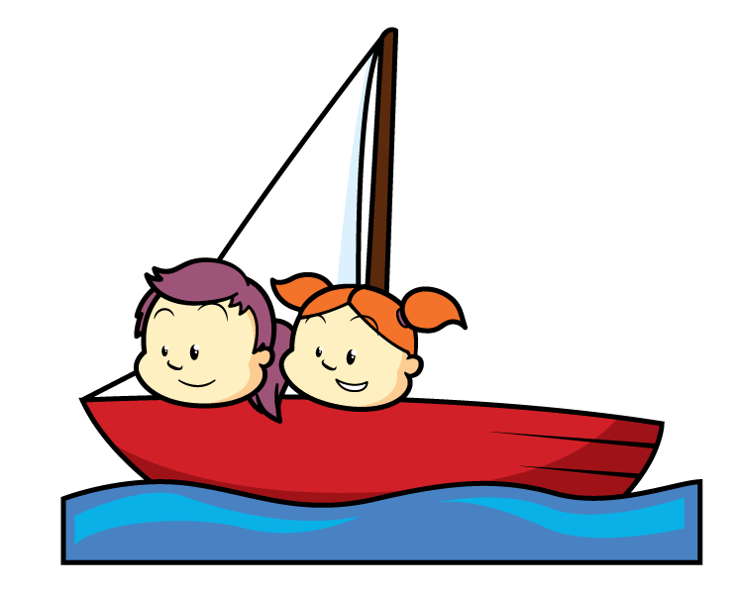
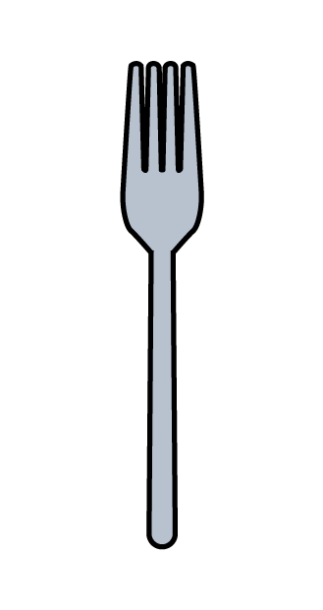



Have a think
How many?

Slide 4
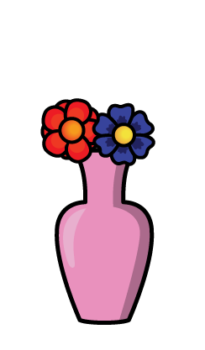




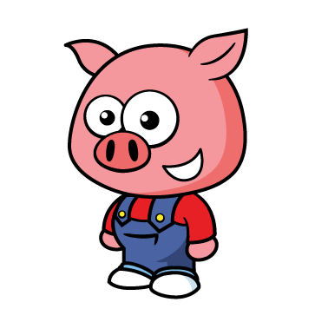


Have a think
Why count in 2s?

Slide 5
What can you find that you can count in 2s?

Slide 6







Have a think
Can you count in 2s
with your fingers?

Slide 7
Have a think
Try “Whisper… Shout”

Slide 8
Try “Whisper… Shout” with a partner.

Slide 9
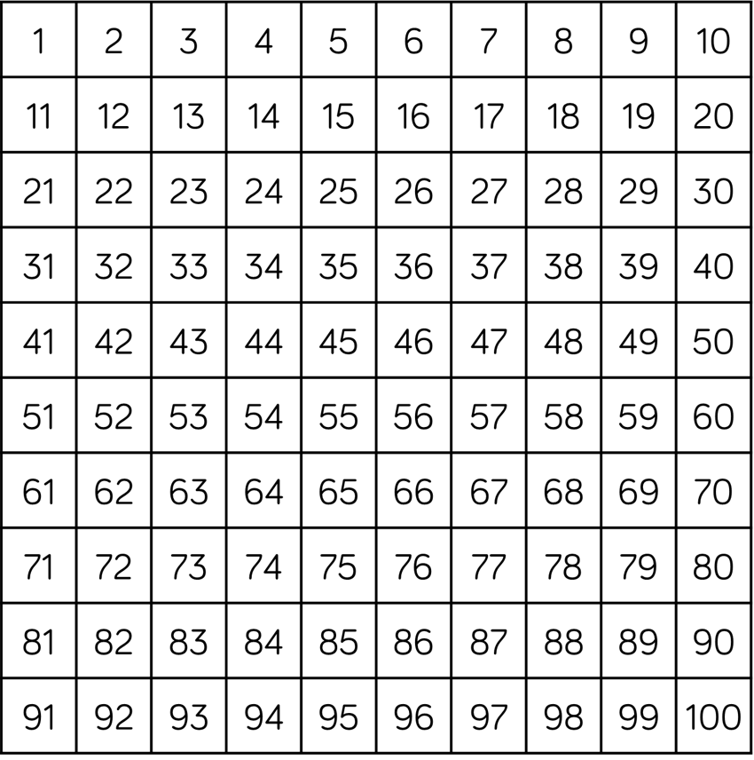
Have a think
What patterns can you see?

Slide 10

You can practice skip counting by 2 when you colour in a 50 chart

