Slide 1
Disclaimer/s
We hope you find the information on our website and resources useful.
Animations
This resource has been designed with animations to make it as fun and engaging as possible. To view the content in the correct formatting, please view the PowerPoint in ‘slide show mode’. This takes you from desktop to presentation mode. If you view the slides out of ‘slide show mode’, you may find that some of the text and images overlap each other and/or are difficult to read.
To enter slide show mode, go to the slide show menu tab and select either from beginning or from current slide.
You may wish to delete this slide before beginning the presentation.

Slide 3
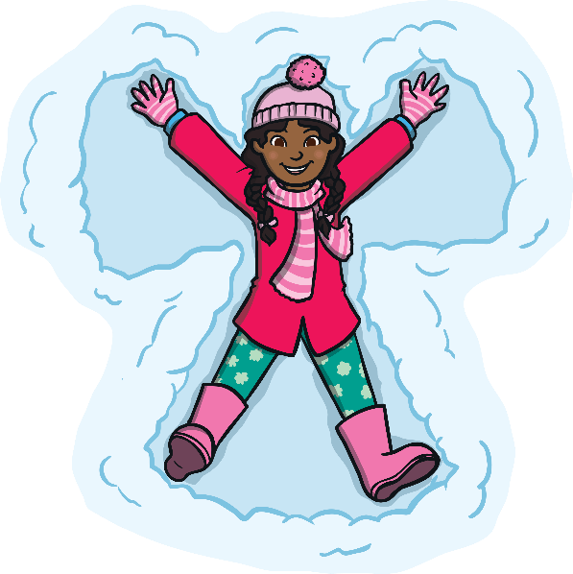
Click on a different question to take you to that page!
What is winter?
What weather will we see?
What do we see animals do?
What does winter look like?
What do people do differently?
What happens to the days?
What do people wear to adapt?
What happens to the plants?

Slide 4
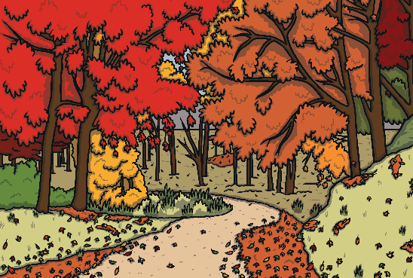
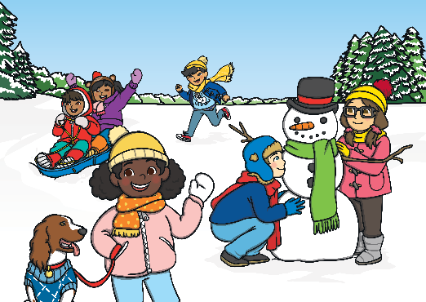
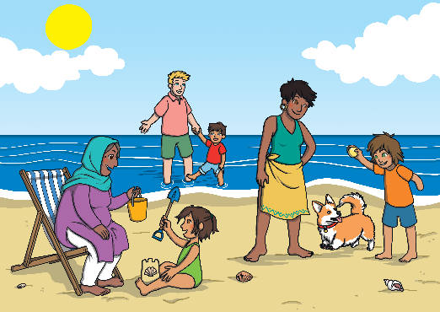
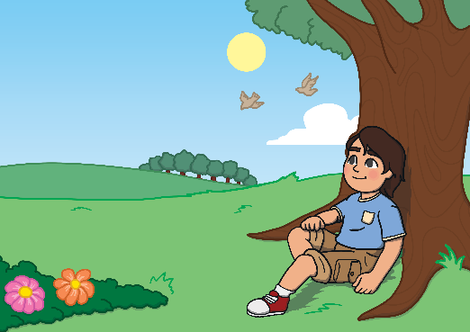
What Is Winter?
Winter is one of the four seasons.
Click on the winter season to see which months are in winter.
Autumn
Winter
Summer
Spring
December
January
February
Back

Slide 5
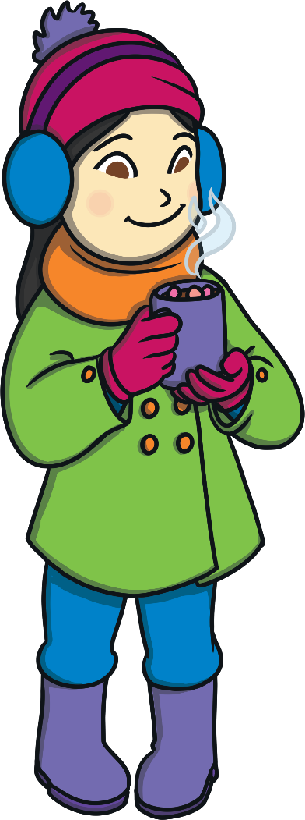
What Weather Will We See?
What has the weather been like this week?
What has the temperature been like?
As the season changes to winter, the temperature
begins to fall, which means it gets even colder.
We might notice…
more rain
frost and ice
hail and snow
Back

Slide 6
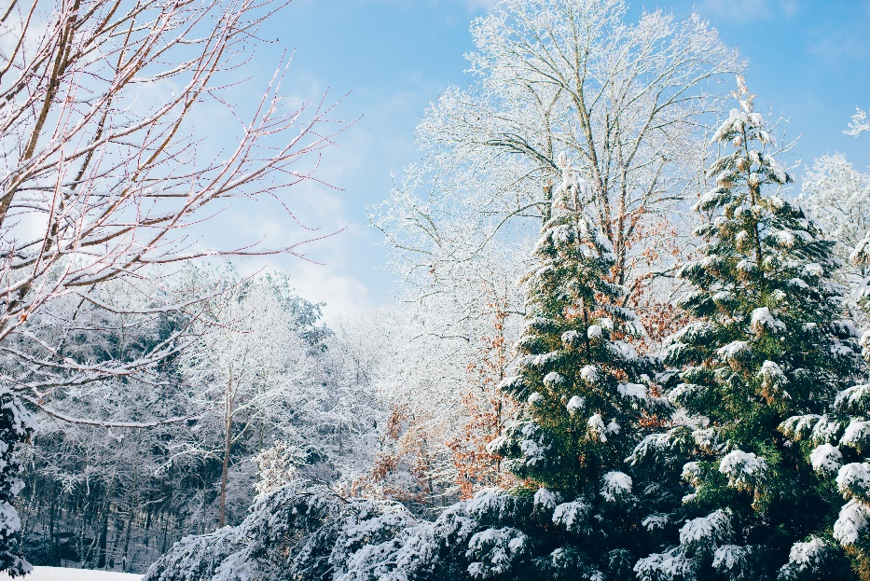
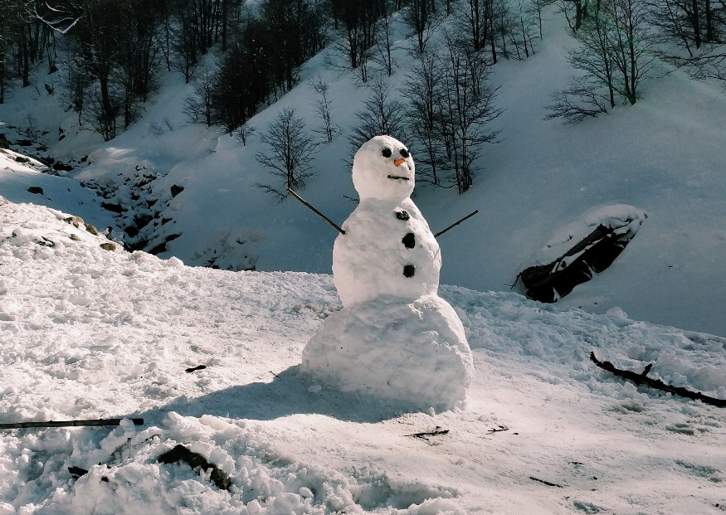
What Does Winter Look Like?
We might see more snow in winter or often picture
snow when we think about winter...
…but does it always snow in the UK in winter?
Does it have to snow to be winter?
Back

Slide 7
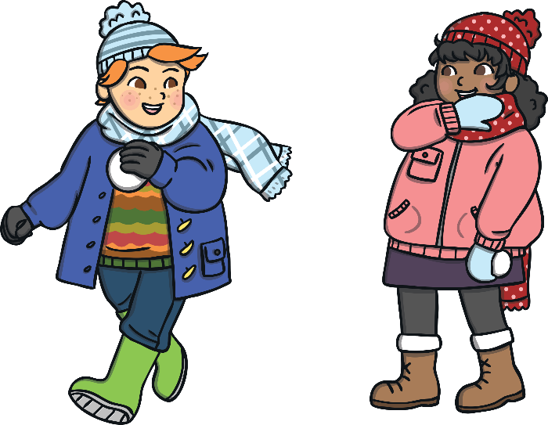
What Happens to the Days?
What have you noticed about the
time you have to play outside after
school recently?
We will notice:
that there are fewer hours of daylight;
that the nights last longer.
Winter has the least amount of daylight and the longest nights of all the seasons.
Month | Sept | Oct | Nov | Dec | Jan | Feb | Mar | April | May | June | July | Aug
Hours of sunlight | 13 | 11 | 9 | 8 | 8 | 10 | 12 | 14 | 15 | 16 | 16 | 14
Back

Slide 8
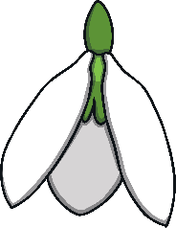


What Happens to the Plants?
Do the same flowers grow all year round?
We might notice:
that many trees lose their leaves
and their branches go bare;
that there are not as many flowers.
Back

Slide 9
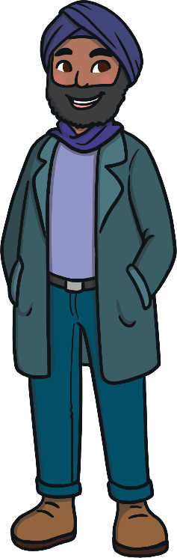
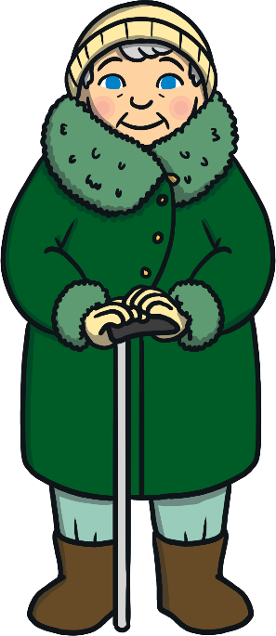
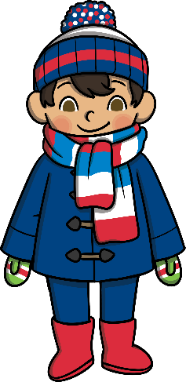
What Do People Wear to Adapt?
In winter, what clothes do you wear? How do you keep warm?
We often wear different things in winter
than we do in the spring and summer.
We might notice people wearing…
more layers of clothing
gloves, hats and scarves
coats
trousers
thicker jumpers
boots and wellies
Back

Slide 10
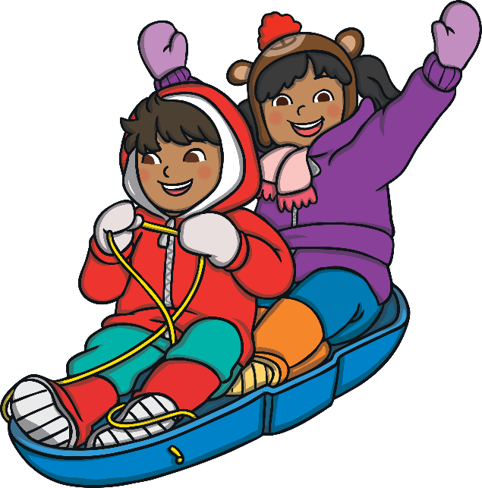
What Do People Do Differently?
In winter, what do you like to eat and drink?
What do you do more of?
We often eat, drink and do different things
in winter than we do in the spring and summer.
We might notice people:
skiing, sledging or snowboarding;
playing in the snow;
eating warming foods like soup;
drinking more hot drinks.
Back

Slide 11
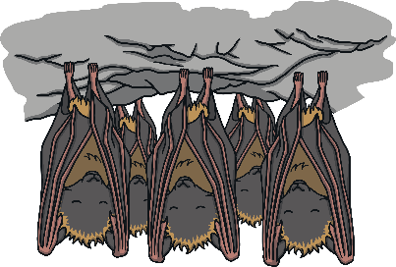
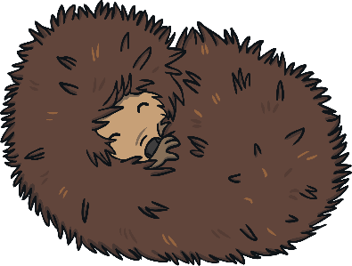
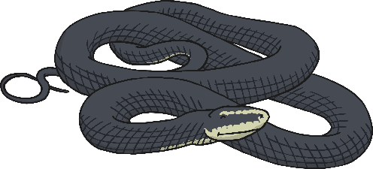
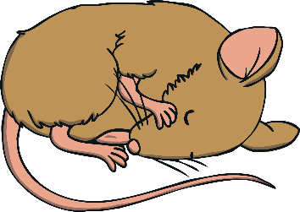
What Do We See Animals Do?
Animals cope with winter weather differently.
We might notice some animals hibernating for some, or all, of the winter.
Click on the pictures to name each one.
bats hibernate
adders hibernate
hedgehogs hibernate
doormice hibernate

Slide 12
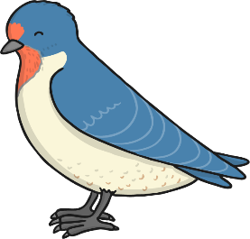

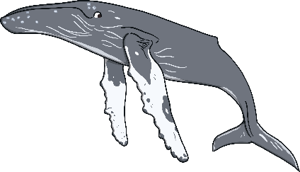
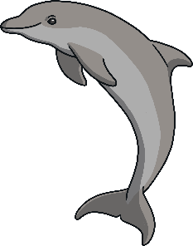
What Do We See Animals Do?
We might notice that other animals migrate (travel) to a warmer place.
Click on the pictures to name each one.
Lots of birds, like the swallow, migrate.
Some butterflies, like the monarch butterfly, migrate.
Most whales migrate.
Most dolphins migrate.

Slide 13
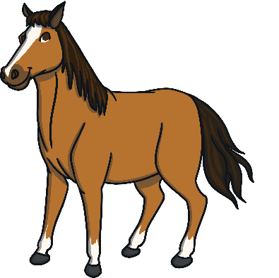
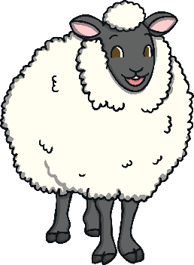
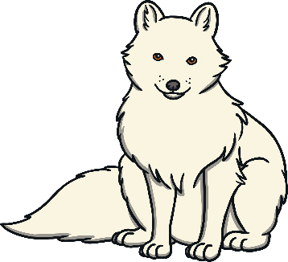
What Do We See Animals Do?
We might notice that some animals adapt by changing
their behaviour or their bodies.
Click on the pictures to name each one.
Exmoor ponies
adapt to winter conditions by growing an extra layer to their
brown coats.
Herdwick sheep
can survive harsh winters because
they have blizzard-proof fleeces.
Arctic foxes adapt
by changing the colour of their fur coats to match their surroundings in winter conditions.

