Slide 3
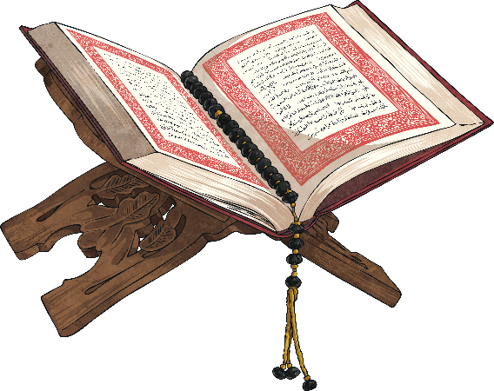
What is the Qur’an?
The Qur’an is the Islamic Holy book.
Muslims believe it is the direct word of Allah. Allah is the Arabic word
for God.
The word of God was revealed to the prophet Muhammed (pbuh) through the angel Jibril (Gabriel).
What Does the Qur’an Do?
The Qur’an teaches Muslims how to worship God.
It teaches Muslims how to live good lives.
It teaches Muslims how to treat other people.

Slide 4
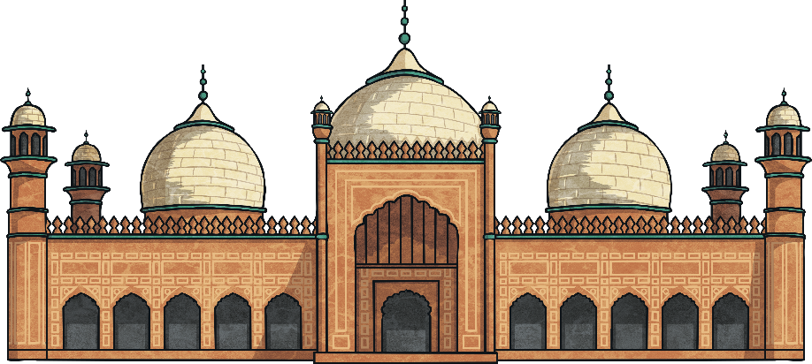
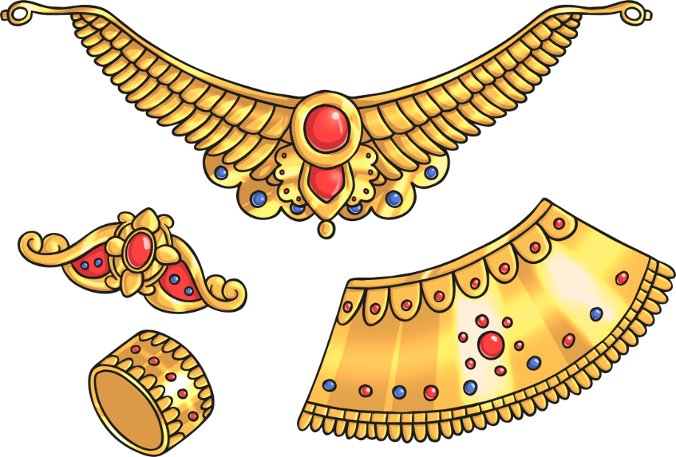
How is the Qur’an Part of Everyday Life?
The Qur’an is an essential part of everyday life for a Muslim, both at home and at the Mosque.
During daily prayers, times of illness and unhappiness the Qur’an is read and recited.
The Qur’an tells people to dress modestly. Many Muslim women wear long clothing and veils over their heads to cover as much of their body as possible. It says that men and boys should not wear silk or gold jewellery.

Slide 5
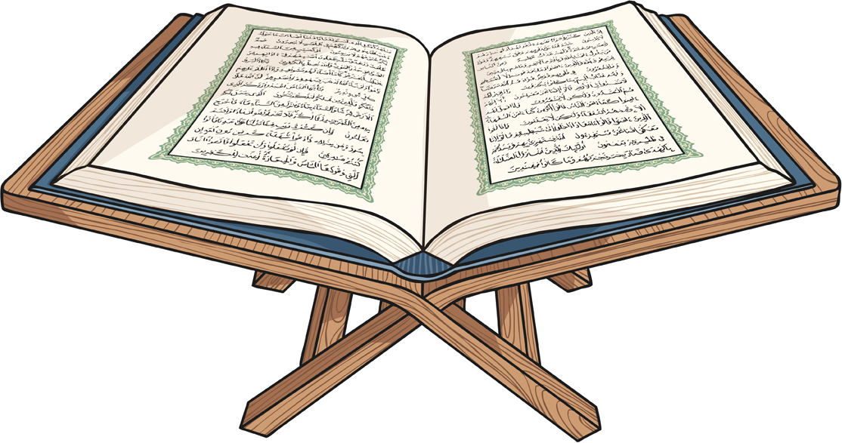
Hafiz
There are some Muslims who are called the Hafiz, they learn parts of the Qur’an by heart to recite to others.
Many Muslims do this today as a way of praise to Allah.
Hafiz are highly regarded and respected.

Slide 6
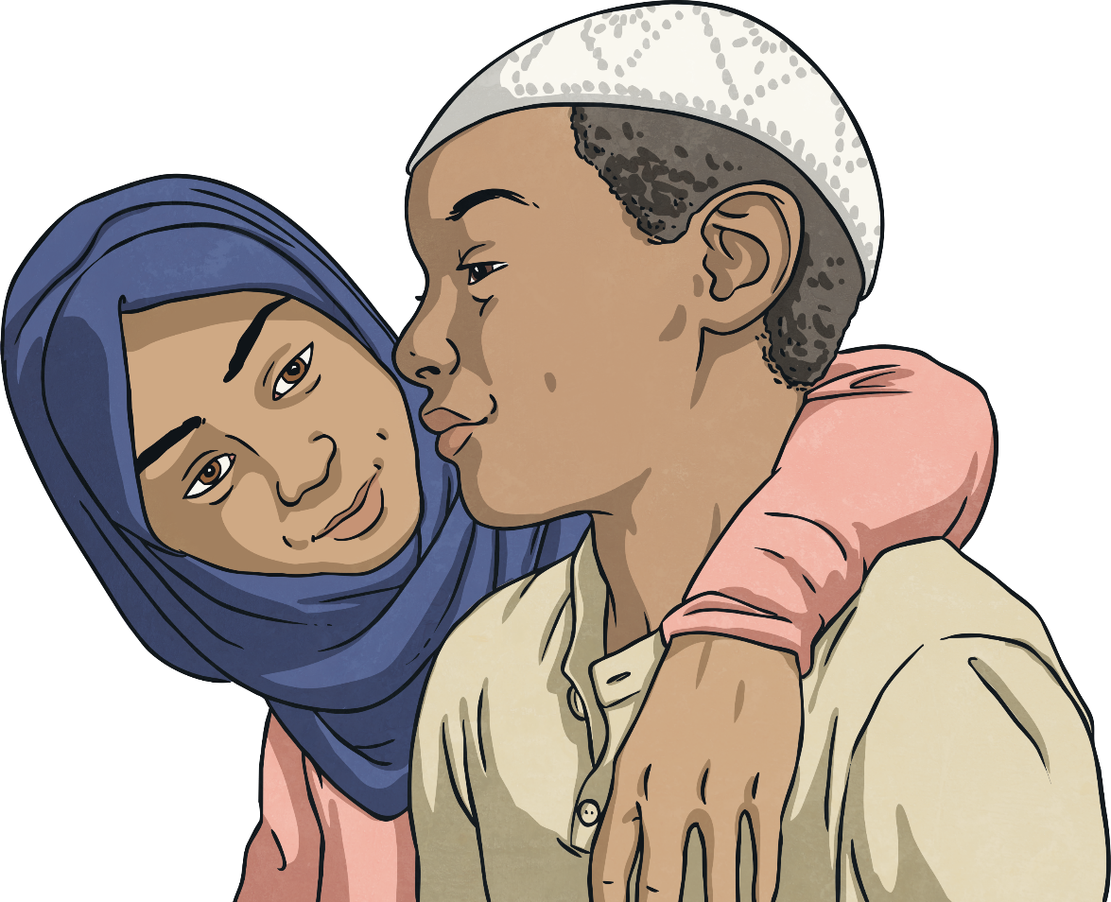
Islam
Islam is the world’s second largest
religion. It teaches that God is merciful,
powerful and unique and that people
can call on God when they are in need
and distressed. He is known as Allah.
It is believed that the last prophet
was Muhammad. Prophet
Muhammad is so important to
Muslims that whenever they say
his name, they also say 'Peace
be upon him', and when they
write his name they write it
but sometimes shorten it
to PBUH.
People who follow Islam are known
as Muslims. Muslims believe that
Islam has always existed and
was revealed to them through
a number of people called
prophets.
Did you know…? The word prophet means ‘messenger’.

Slide 7
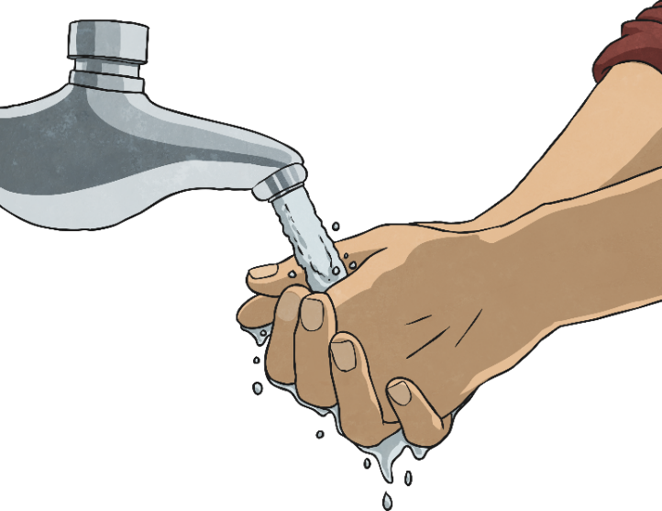

The Qur’an
The Qur’an, which is written in Arabic, is the scripture of Islam. Muslims believe it was revealed by God to a number of prophets and that it is the word of God. It provides guidance to teach people right and wrong.
Anyone who handles or touches the Qur’an has to follow certain rules. They must be clean and wash in special ways called ablutions.

Slide 8
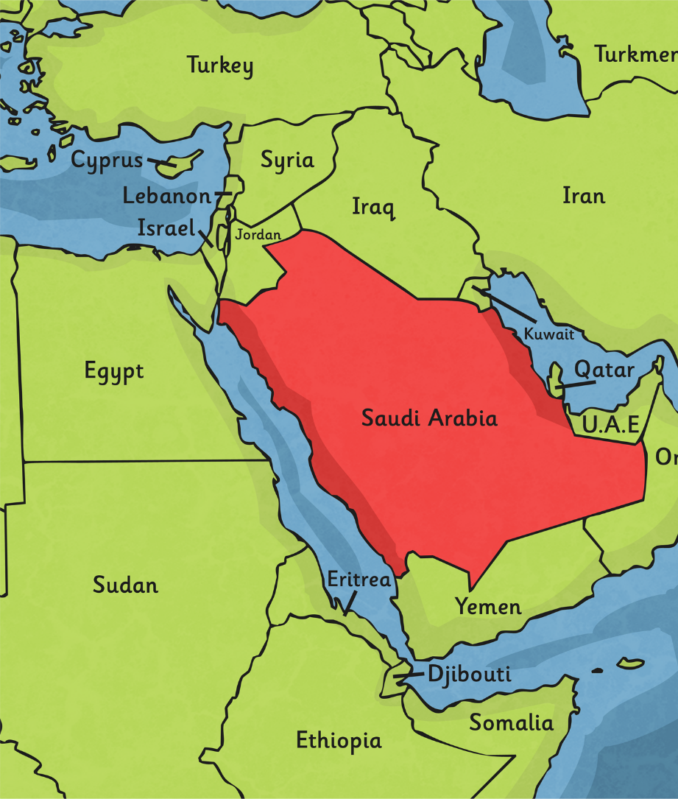
The Revelation of the Qur’an
Muhammad was born in Mecca in Saudi Arabia in AD 570. He worked as a merchant and became known for his honesty. He was a deeply spiritual person and would often meditate on Mount Hira.
In AD 610, he was meditating in a cave on Mount Hira when the Angel Gabriel appeared to him. The angel spoke to him.
The angel said the word ‘Allah’ and Muhammad began to recite words which he believed came straight from God. This was his first revelation from God.

Slide 9

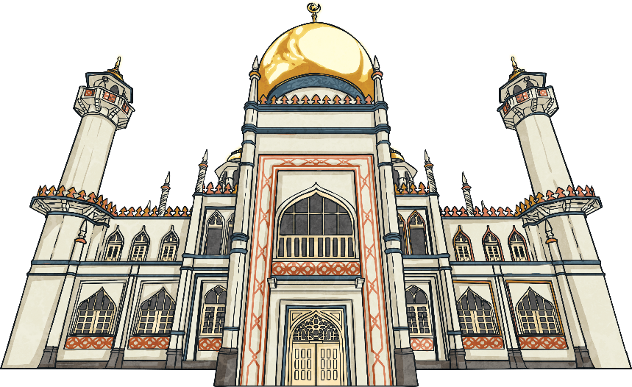
Prophet Muhammad
Over the next 22 years, Muhammad received revelations from God. These revelations were written down as the Qur’an. From that time, Muhammad was known as Prophet Muhammad and he preached about the revelations for the rest of his life. He is recognised as the founder of Islam.
Prophet Muhammad believed God had chosen him to preach what had been revealed to him and tell the world.
The principle message is that there is no God but Allah and that life should be lived in submission to Allah.

Slide 10
What Do We Say after We Mention His Name?
Whenever we mention or hear our beloved Prophet Muhammad's name, we always follow with, “Peace and blessings be upon him.”

Slide 11
The Last Messenger of Allah
Allah sent Prophet Muhammad (peace and blessings be upon him) as the last messenger to teach Islam to everyone.
Allah sent down the Qur'an to Prophet Muhammad (peace and blessings be upon him) through angel Jibreel/Gabriel (peace be upon him).
The Qur'an was first sent down to Prophet Muhammad (peace and blessings be upon him) when he was 40 years old.

Slide 12
What Was Prophet Muhammad like?
Prophet Muhammad (peace and blessings be upon him) was a very honest and kind person.
Everyone loved him, even before he became a prophet people used to call him 'The honest, the faithful.'
Prophet Muhammad (peace and blessings be upon him) taught people the Qur'an and that there is only one God, Allah, who created everything.

