Slide 1


Slide 3
1) What number comes next? 9, 10, 11, ___
2) What number comes next? 20, 19, 18, __
3) Which number is sixteen? 61 or 16
4) Find the mistake
11, 12, 13, 41, 15, 16

Slide 4
1) What number comes next? 9, 10, 11, ___
2) What number comes next? 20, 19, 18, __
3) Which number is sixteen? 61 or 16
4) Find the mistake
11, 12, 13, 41, 15, 16
12
17
14

Slide 6









How many?
10
11
12
13
14
15
16
17
18
19
10
11, 12, 13, 14, 15
10, 11, 12
10 11, 12, 13

Slide 7




How many?
Have a think
10
11
12
13
14
15
16
sixteen
eighteen
fourteen
eleven

Slide 8
Have a go at question 1 on the worksheet

Slide 9






Look at how many ways I can show 12!
Have a think
Which one is not correct?

Slide 10





Have a think
Pick a number between 11 and 20
How many ways can you
build your number?

Slide 11
Have a go a question 2 on the worksheet

Slide 12
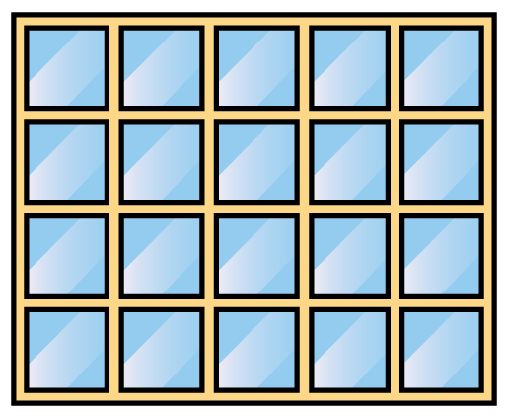
How much is 20?

Slide 13
Have a go a question 3 on the worksheet

Slide 14
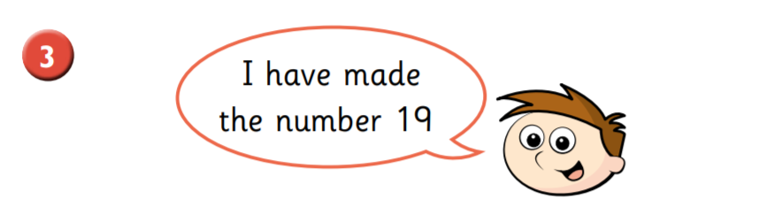
10
11, 12, 13, 14, 15, 16, 17, 18, 19
11, 12, 13, 14, 15, 16, 17, 18

