Slide 1


Slide 2
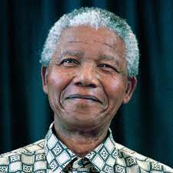
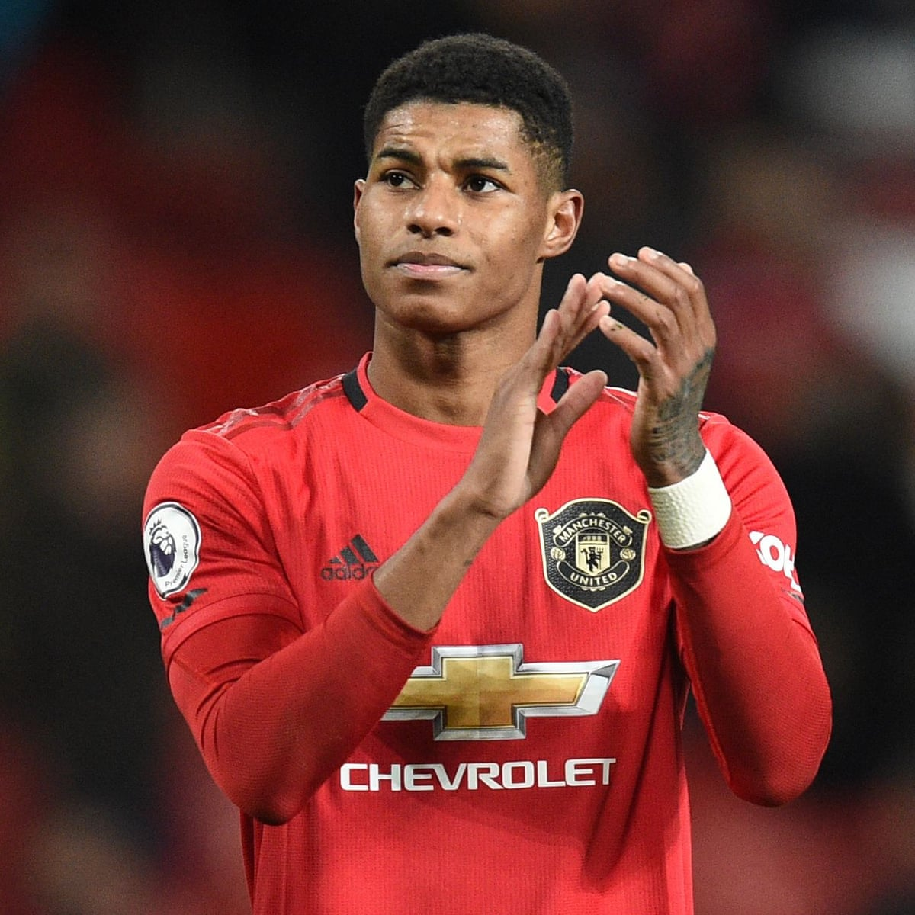
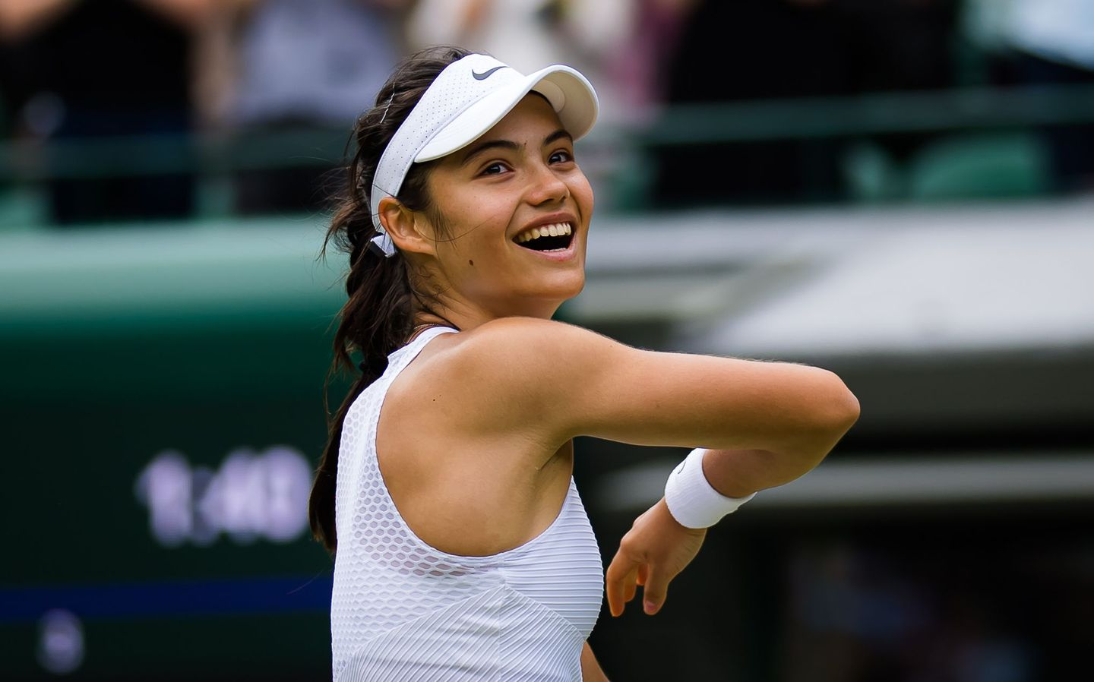
What is a role model?

Slide 3
What makes a good role model shine?

Slide 4


Slide 5
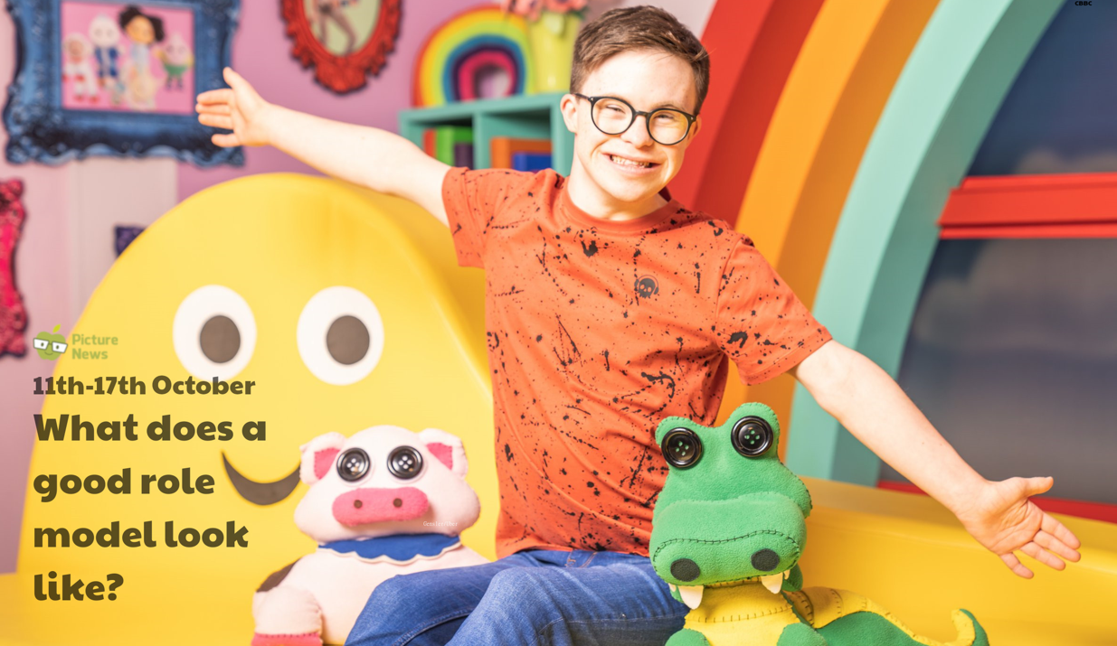
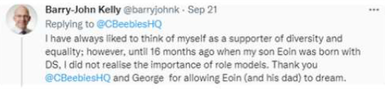
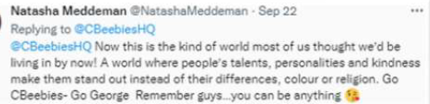

Slide 6
Brave
Courageous
Hardworking
Respectful
Dedicated
Positive

Slide 7


Slide 9
Can you think of any other role models?

Slide 10
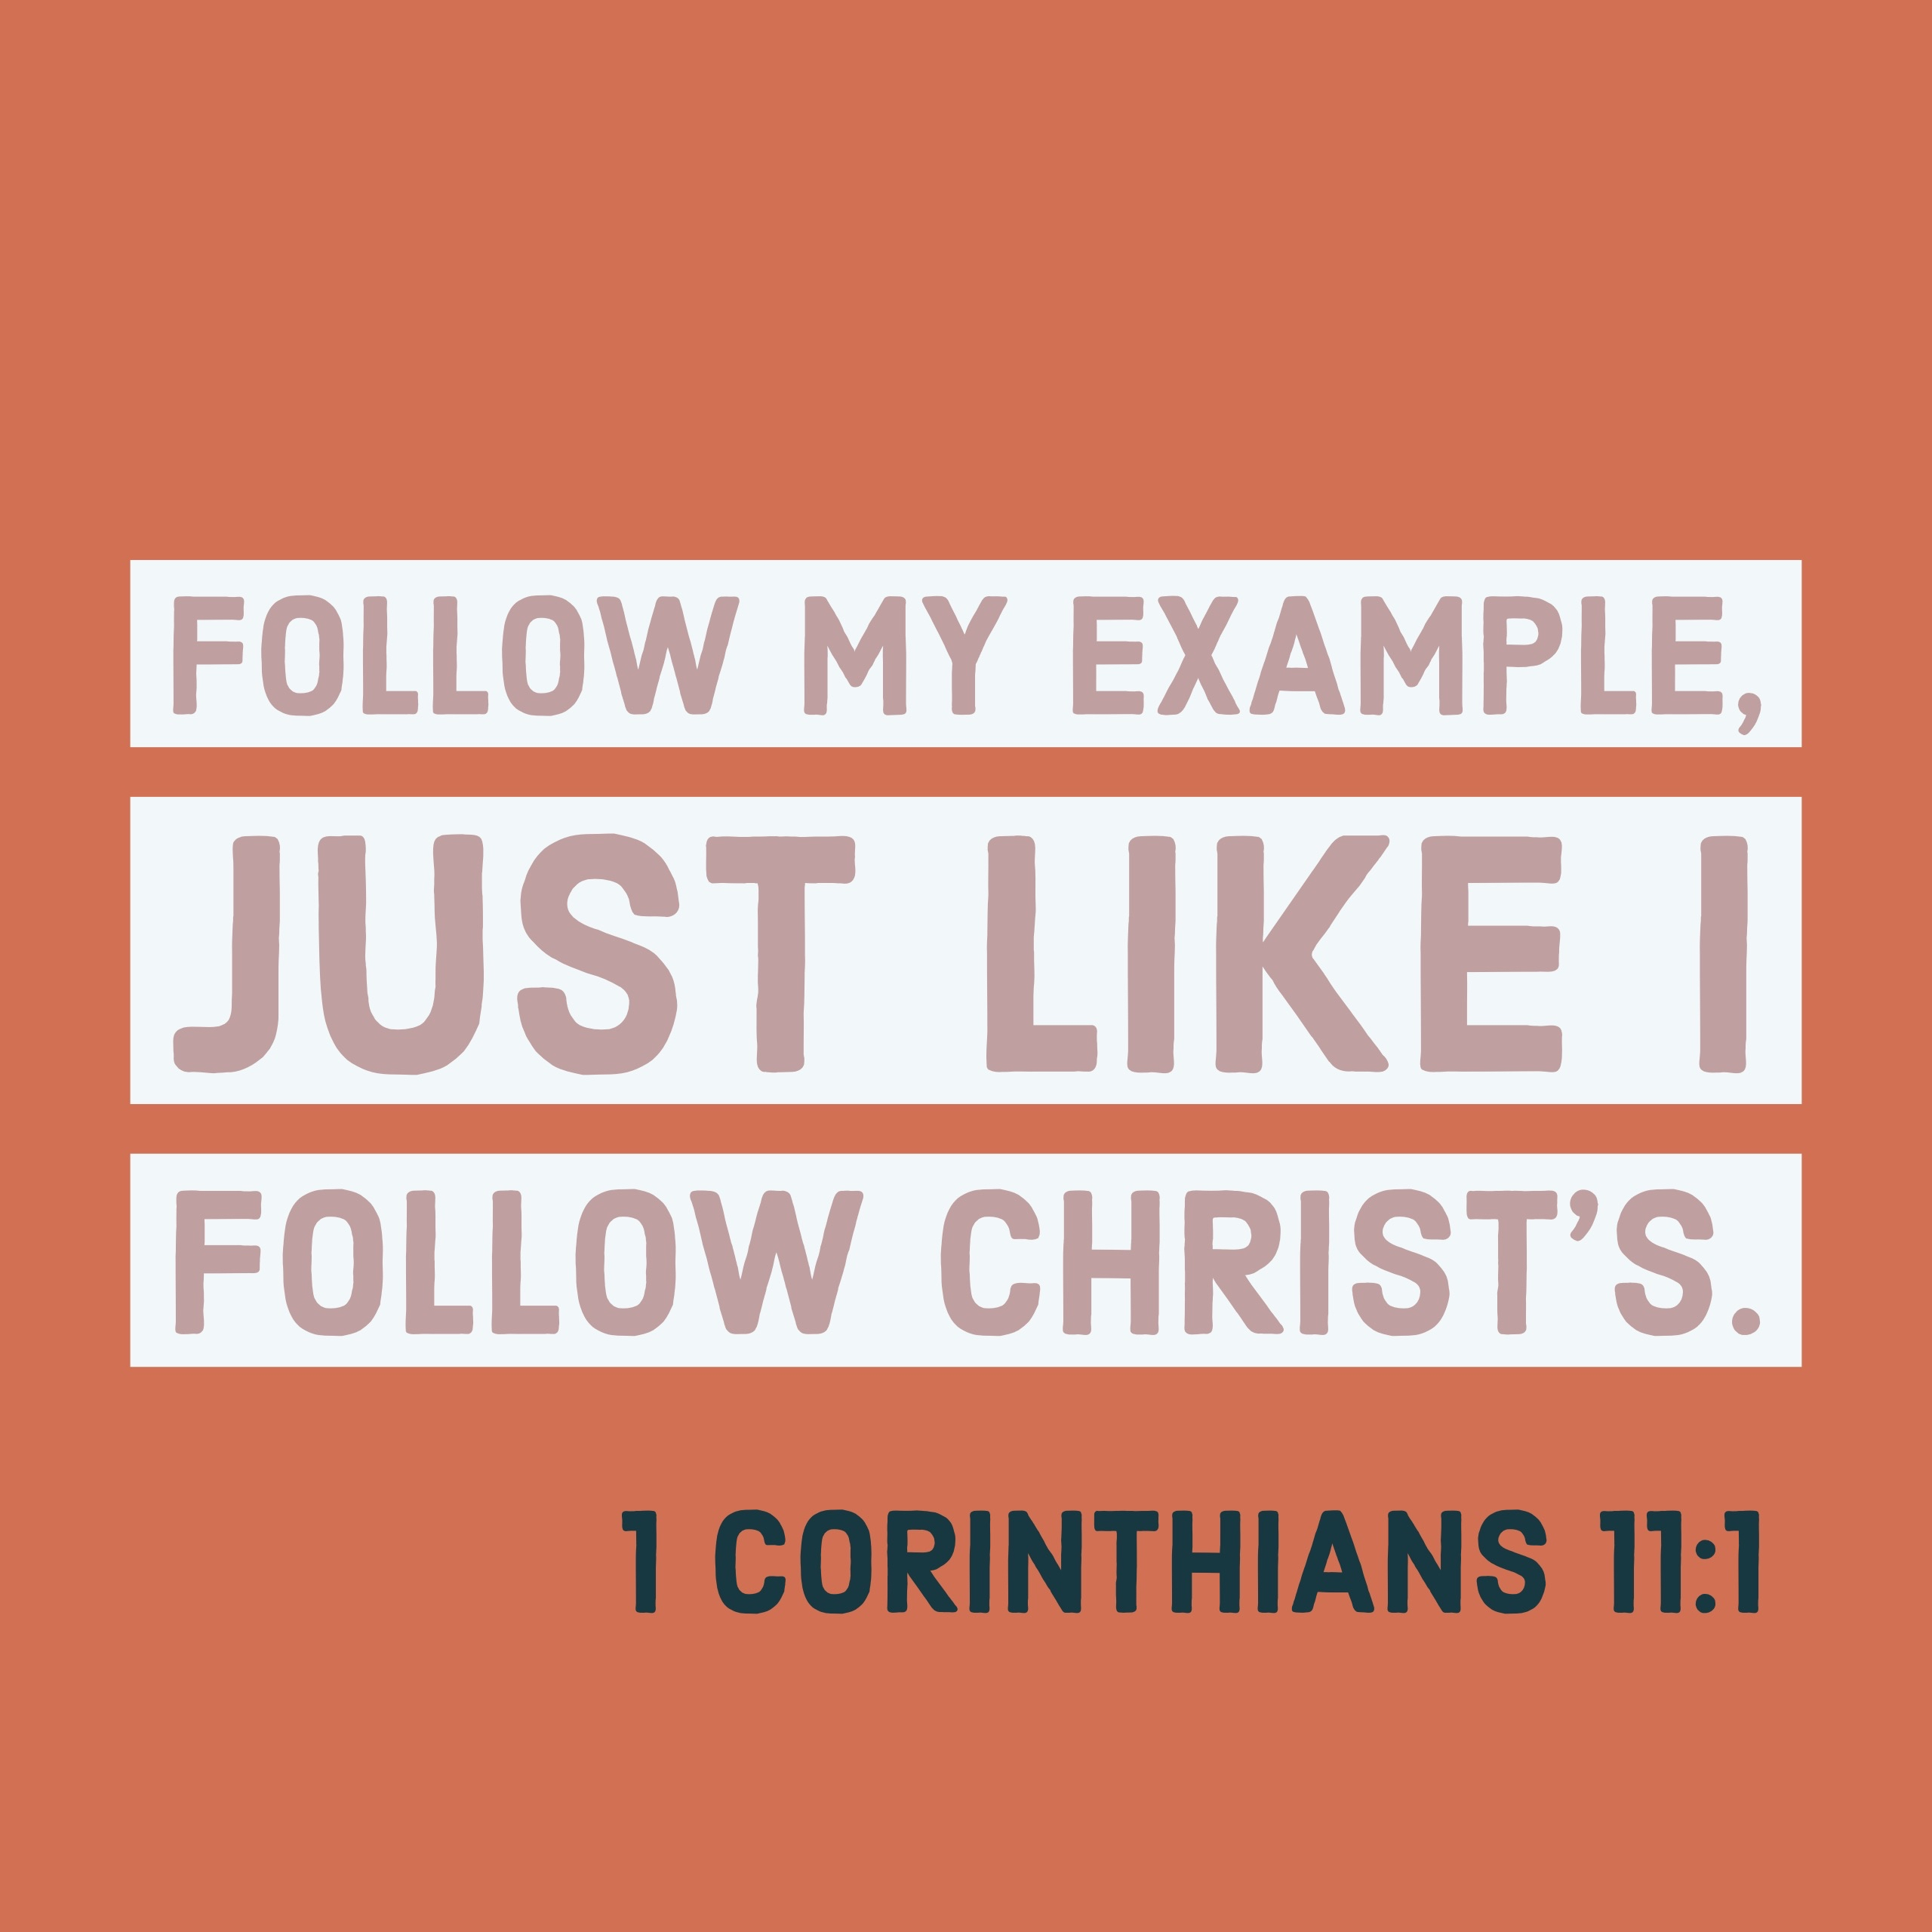


Slide 11
Jesus taught us to stand up and look after children, women, the sick, the poor, the rejected and the lost. He taught us to treat everyone equally and to celebrate diversity.
If we try and be more understanding like Christian’s teach us Jesus was, then we can offer more opportunities to people just like George to follow their courage and become amazing role-models.

Slide 12
Reflection
How are you going shine today and be more like George? How can you be the best you and be a role model?

Slide 13
Lord Jesus, we thank you that in you we have the perfect role model. We thank you for your wisdom, bravery, and courage. We ask that you help us to be courageous, to be the best version of ourselves and to seek help when we need it so that we can all be a great community that supports each other. We ask that you help us stand up to poverty, to discrimination and to injustice. We pray that you equip us to become more like you. Amen

