Slide 1
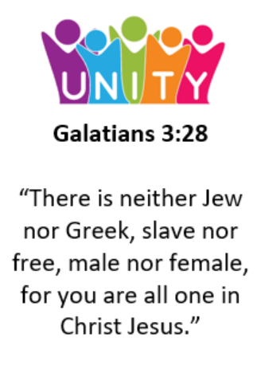
BLACK HISTORY MONTH

Slide 2
Divider slide 2
What is Black History Month?
?
?
?
?
Notes:
Ask the children if they have heard of Black History Month before. Why might it be needed?
Explain that people often don’t know much about the history of Black people in Britain and across the world. That’s because some people think that white people’s lives are more important. We know that’s not true and that it’s important to hear lots of different people’s stories. That’s why we’re celebrating Black History Month – to give us a chance to focus on learning about Black people’s stories and lives. And that’s just what we’re going to be doing in this assembly.

Slide 3
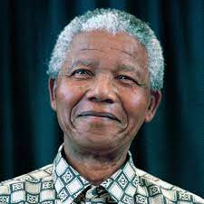
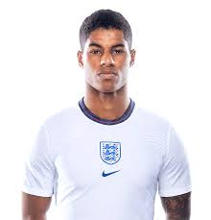
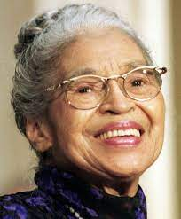
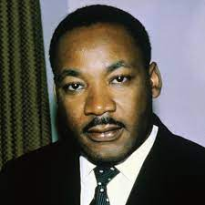

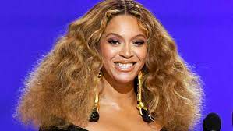
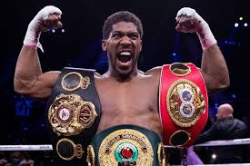
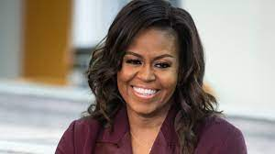
Black History Month was launched in February 1970 in the United States.
It was originally formed to recognise the contributions that Afro-Americans made to society throughout American history.
Britain adopted the movement in October 1987, launching it into schools in London.

Slide 4
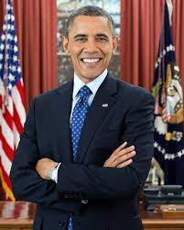
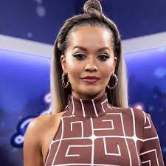
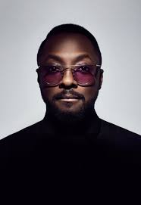
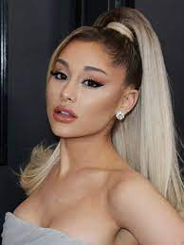
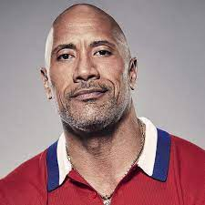
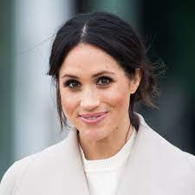
In October 2020, the Black Lives Matter movement raised the profile of Black History Month.
It is officially recognised by governments in the UK, Ireland, Canada, the Netherlands and the United States.
Throughout this month, the achievements and influence of black people from all cultures and countries around the world are being celebrated widely in schools and colleges, museums, libraries and galleries.

Slide 5



Slide 6


Slide 7
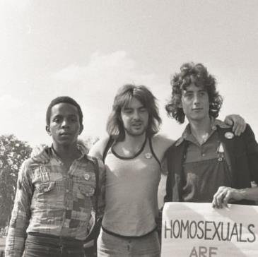
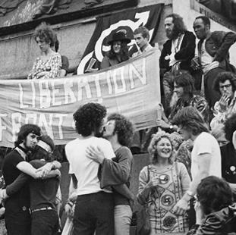
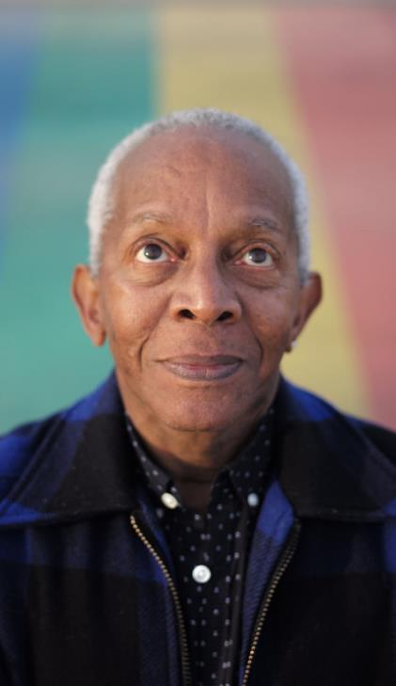
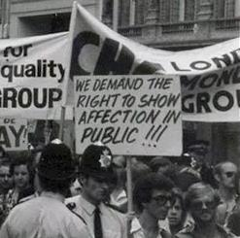
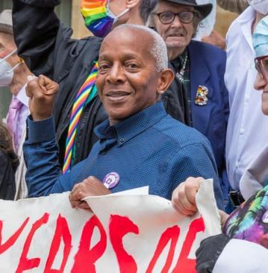
Infographic slide – style 2
Ted Brown
What clues do the pictures give you about him?
?
?
?
?
Notes:
Introduce Ted Brown – from the photos, can the children spot any clues that show who he is or what he was involved in?

Slide 8
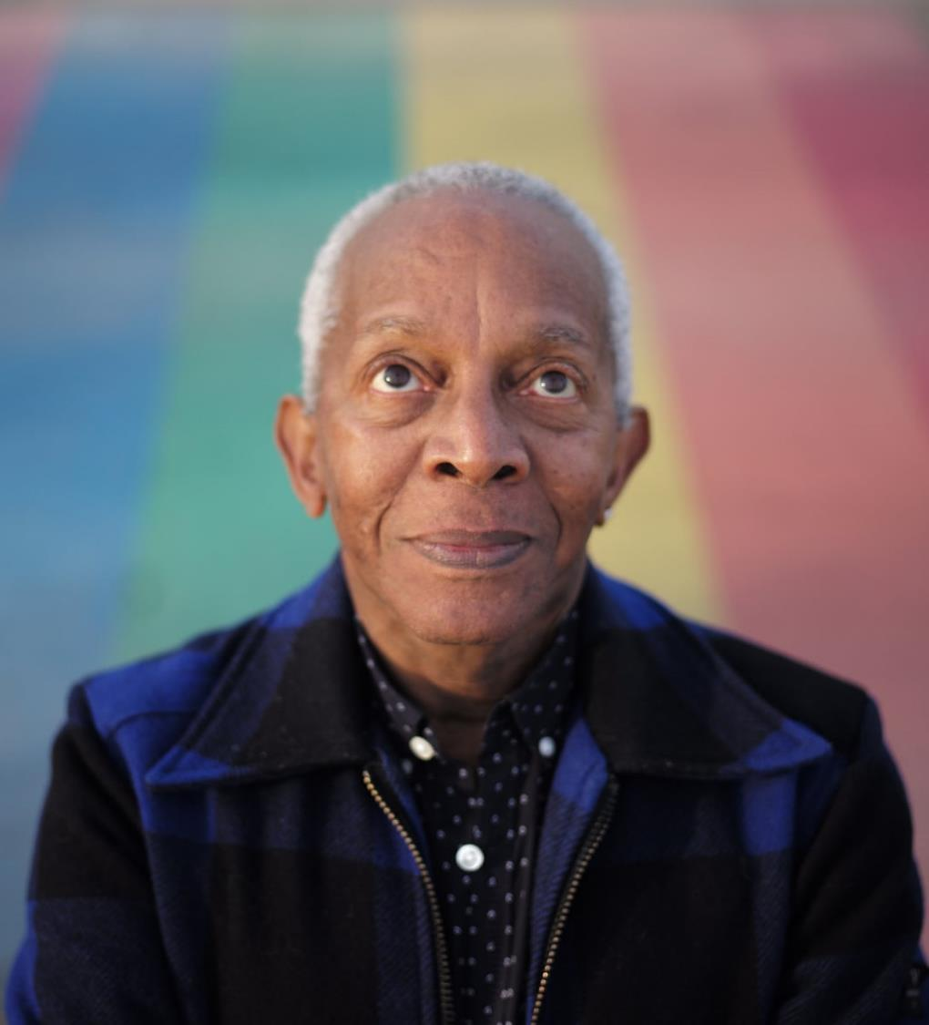
Quote and image slide 1
Ted Brown
He helped organise protest marches in London.
He and his friends were asking for LGBTQ+ people to be treated fairly.
They were inspired by an organization called The Black Panthers.
Notes:
Introduce Ted Brown – in the 1970s he organised lots of protest marches in London. In the 1970s, LGBTQ+ people were treated very unfairly. Ted and his friends were asking for LGBTQ+ people to be treated fairly. That means treating someone fairly whether they fall in love with a man, a woman or a non-binary person and treating them fairly whether they are trans or not. Ted and his friends were in a group called The Gay Liberation Front. This group was inspired by an organization called The Black Panthers.
(For teacher background knowledge see https://galop.org.uk/about/history/)

Slide 9
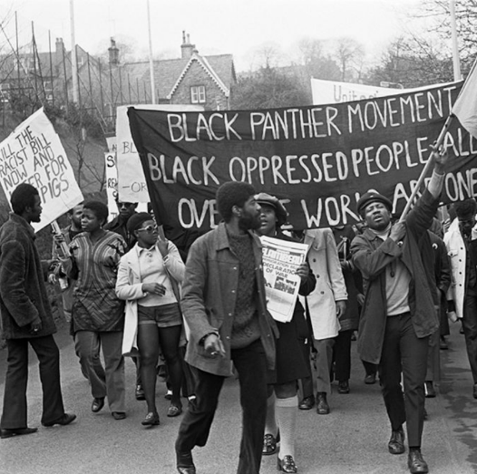

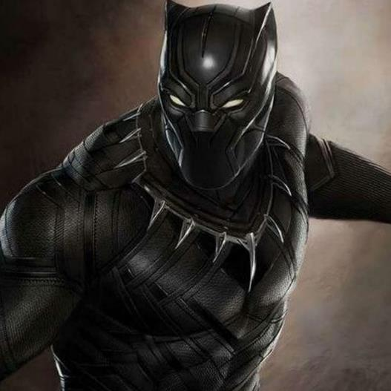
Infographic slide - style 1
The Black Panthers, not The Black Panther.
The Black Panthers
Black Panther
Notes:
The Black Panthers came first! It is thought that the person who invented the Marvel Black Panther character was inspired The Black Panthers’ logo.

Slide 10
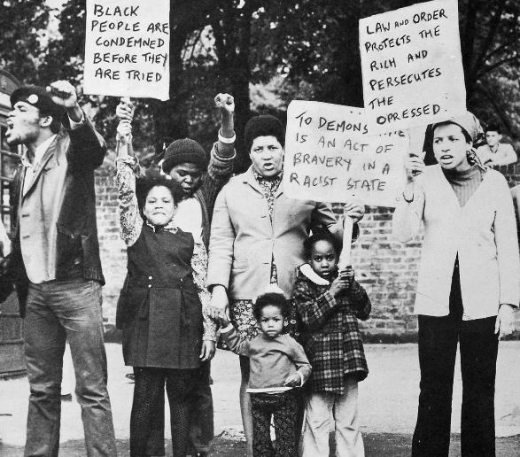
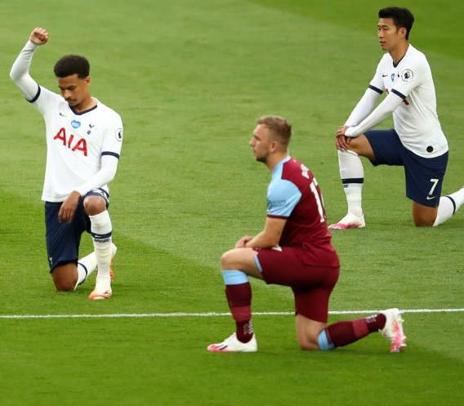
Infographic slide - style 1
What is racism?
The Black Panthers wanted everyone to be treated fairly.
Notes:
Ask children: What is racism? Have you heard this word before?
Explain that The Black Panthers wanted everyone to be treated fairly.
Explain that racism is when people are treated unfairly because of the colour of their skin.
In the past racism was widespread and it impacted every part of someone’s life.
Sadly racism does still exist and we all have a part to play in saying no to racism. Explain that when footballers taking the knee before football matches, that is a protest against racism.
(For teacher background knowledge, see: https://library.oapen.org/handle/20.500.12657/22310)

Slide 11
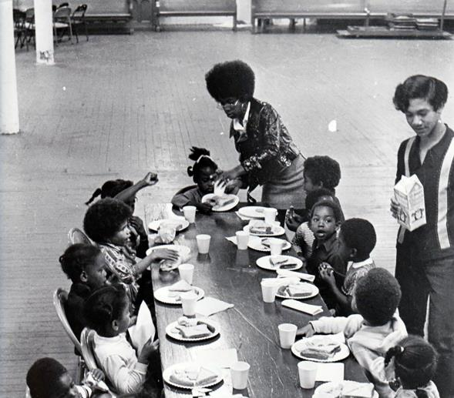
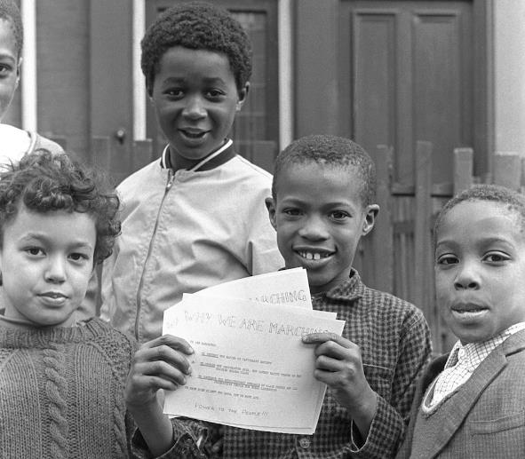
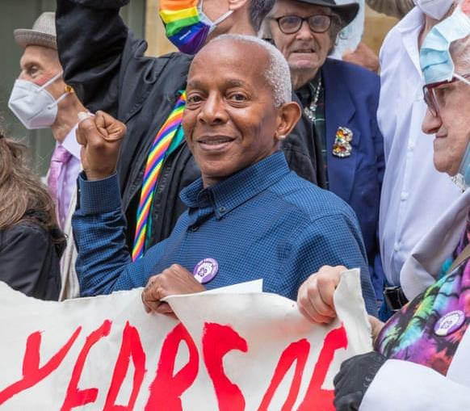
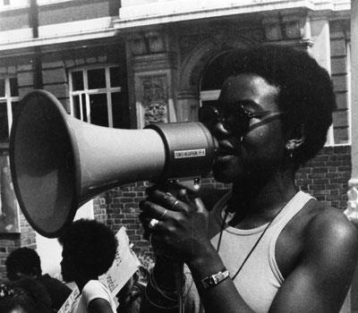
Infographic slide - style 1
What did the Black Panthers do?
Free breakfast
Learning
Protesting
Notes:
Explain that The Black Panthers worked to make the world a fairer place. They wanted children to go to school with food in their tummies, so they gave free breakfasts. They wanted people to learn about Black History, so they taught people about it. They wanted Black people and People of Colour to be treated fairly, so they organised protests and spoke out against racism.

Slide 12
Quote and image slide 1
Be like Ted
Ted Brown wants the world to be a fairer place.
What will you do to make the world a fairer place?
Notes:
Ted Brown remains committed to addressing all forms of injustice and discrimination, but particularly racism, homophobia, biphobia and transphobia. He wants to make the world a fairer place.
Ask the children to reflect on what they will do in their daily life to make the world a fairer place.

Slide 13
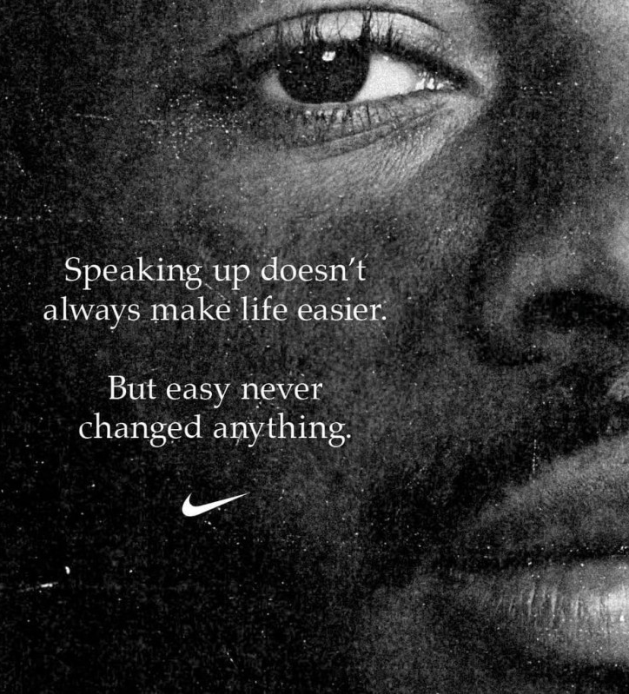


What does Nike say?

Slide 14



