Slide 1
Should Disposable facemasks be banned?
Luke 10:30-37
The good Samaritan – “Go and do likewise.”

Slide 2
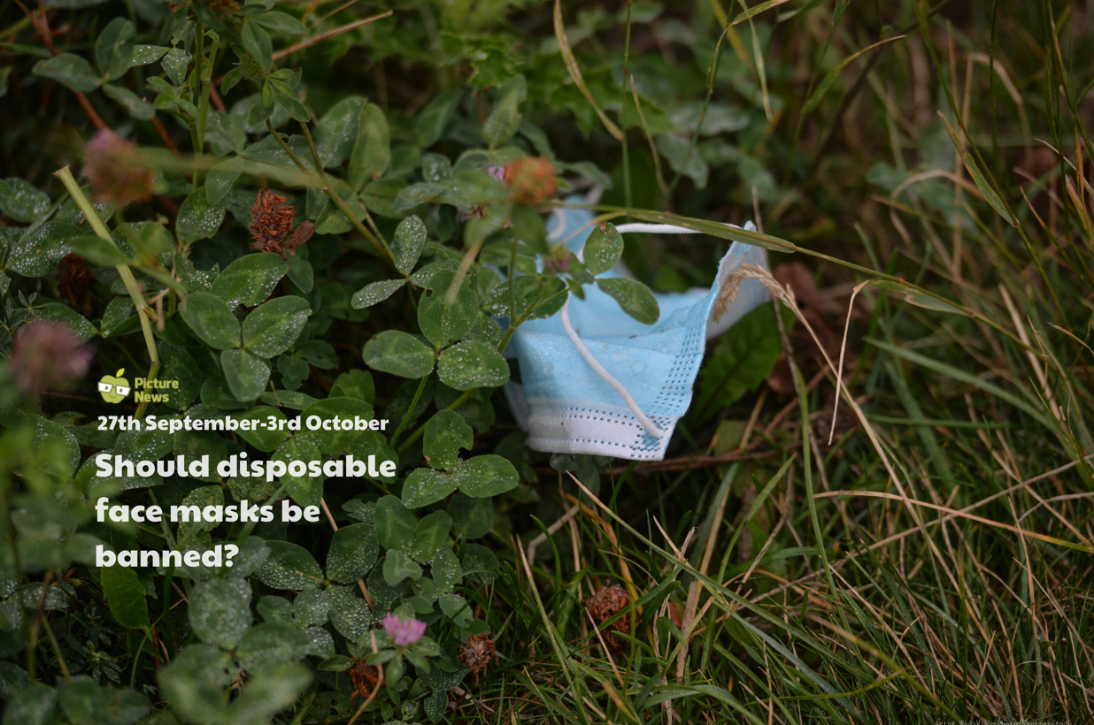

Slide 3
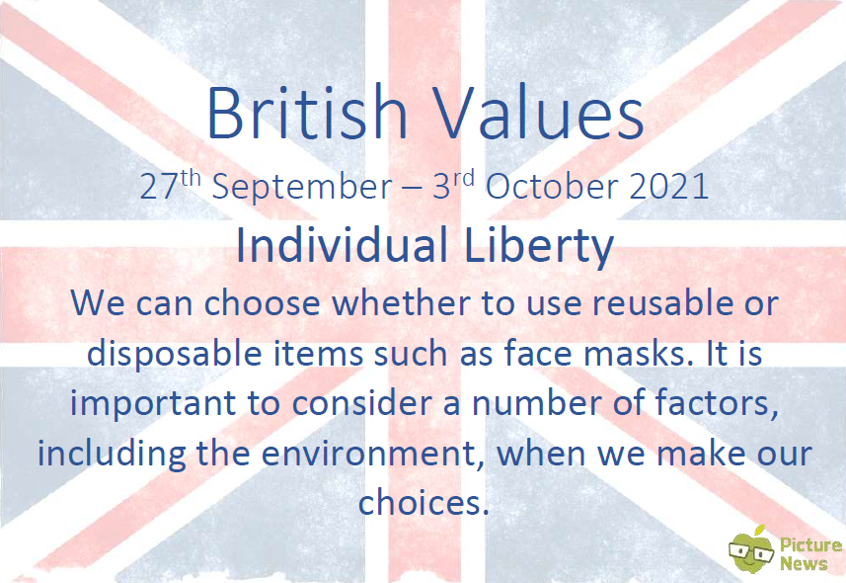

Slide 4
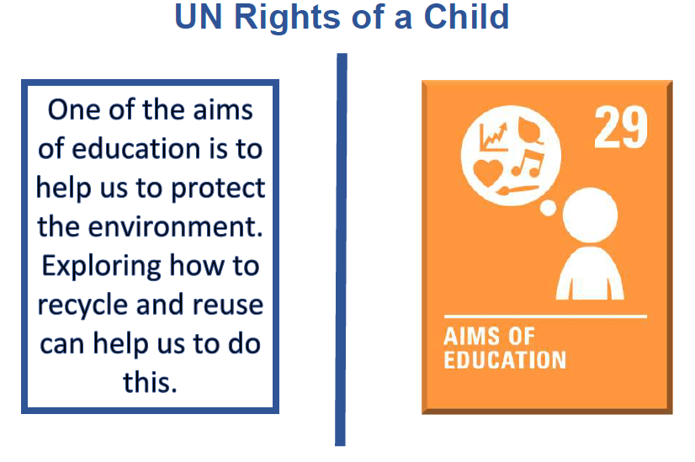

Slide 5
I wonder what the staff will do when they have finished with their mask?

Slide 6
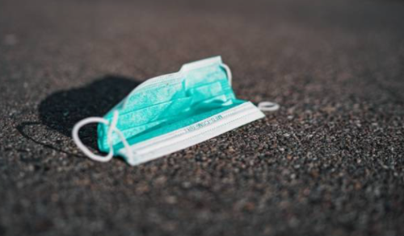
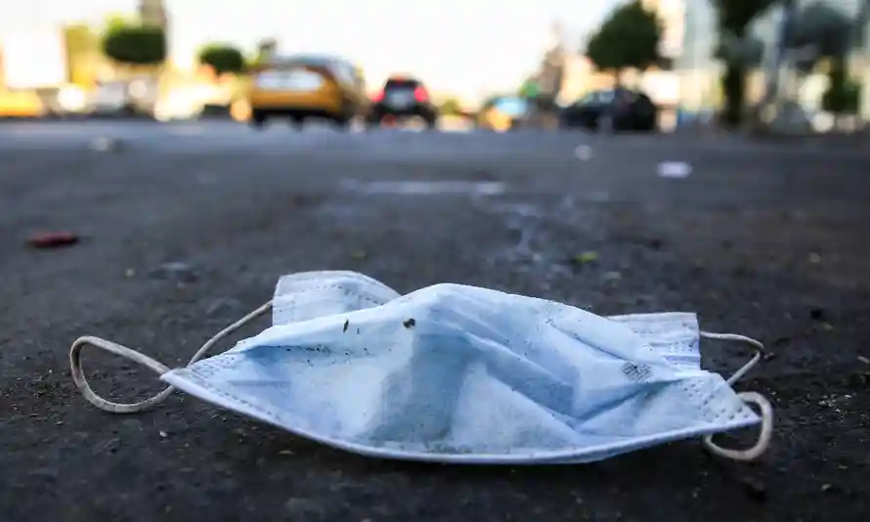
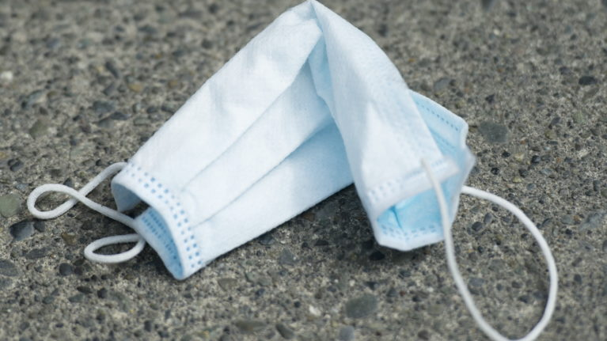
Are you going to take personal responsibility for that choice?

Slide 7
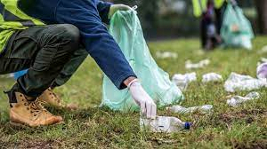
How did you feel as the adults were asked about the masks they had dropped?
Why did they not pick it up and what impact does that have?

Slide 8
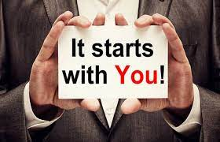
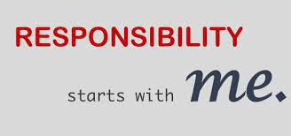
What do you think personal responsibility is?
Do you think they made the right choice?

Slide 9



Why was it shocking that the staff refused to take responsibility? Who could you have spoken to if you saw that?
Do you have somebody in school who you trust to talk to when you see things that aren’t right?

Slide 10



Think:
It is easy to ignore one piece of rubbish. What difference did one face mask make? But the problem multiplies rapidly when people choose to not take responsibility.
And it is a choice.
You can choose to do the right thing, or you can choose not to. But when you make a choice there are consequences.

Slide 11
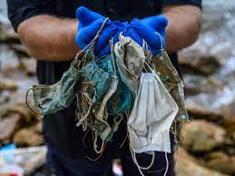
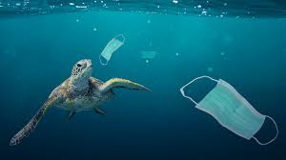
Sadly, one of the unexpected problems with Covid was the dramatic increase in plastics that come from face masks.
That is a consequence.

Slide 12
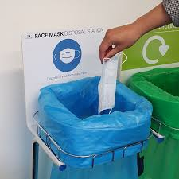
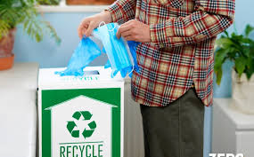
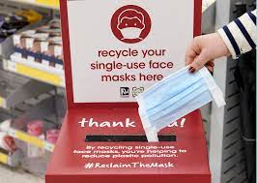
129 billion face masks are currently being worn. In the Collective Worship today, only a few made a big mess!
Can you create a mini-campaign to encourage adults to dispose of face masks safely?

Slide 13
The Bible is full of examples of people who made choices that had consequences.
Our Bible story shows where some people made a poor choice (but one that was convenient for them, like it was convenient to drop a mask) and one person who took responsibility.
There was a cost, but it was easily worth it. He made a good choice.

Slide 14
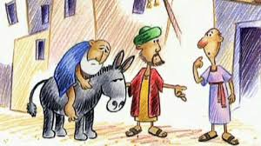
Luke 10:30-37
The Good Samaritan – “Go and do likewise.”
How will you ‘go and do likewise’ today?

Slide 15
I would like to invite you to prayer:
Lord Jesus, we are sorry when we make decisions that, when we think about them, are only made because they are convenient for us. Help us to be wise to make good decisions. We pray, Lord, that we can also have the courage to challenge others when they are making a poor decision and that you can give us wise words to encourage other people to change their habits so that everyone can let their light shine.
Amen

