Slide 1
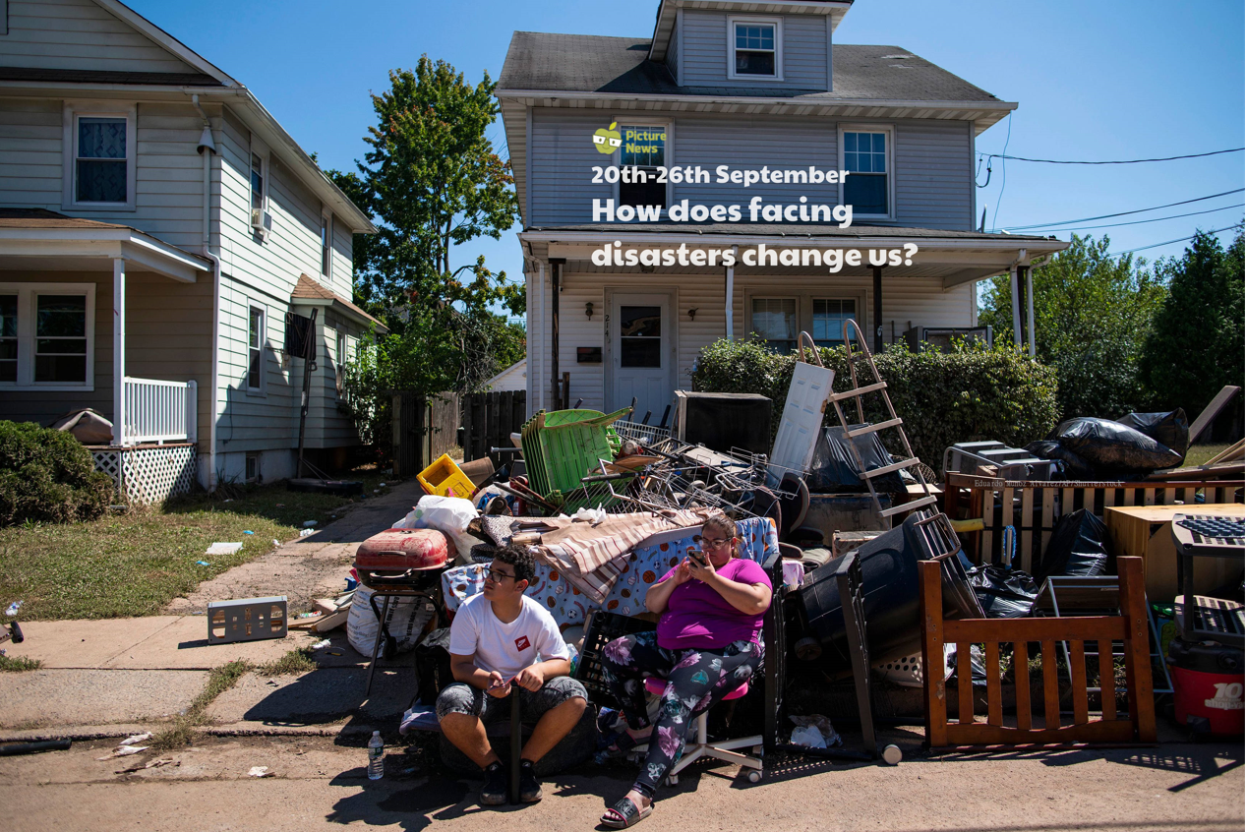

Slide 2
How does facing disasters, change us?
Nahum 1:7
“The LORD is good, a refuge in times of trouble. He cares for those who trust in him.”

Slide 3
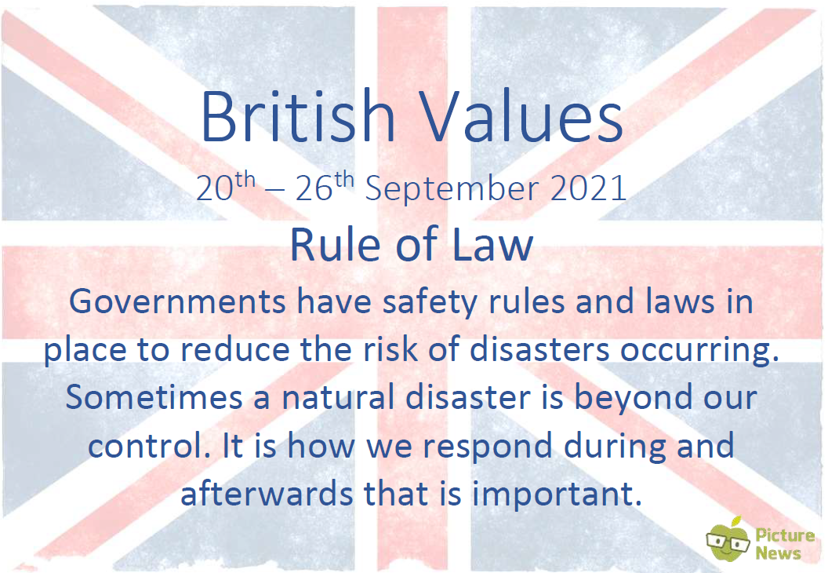

Slide 4
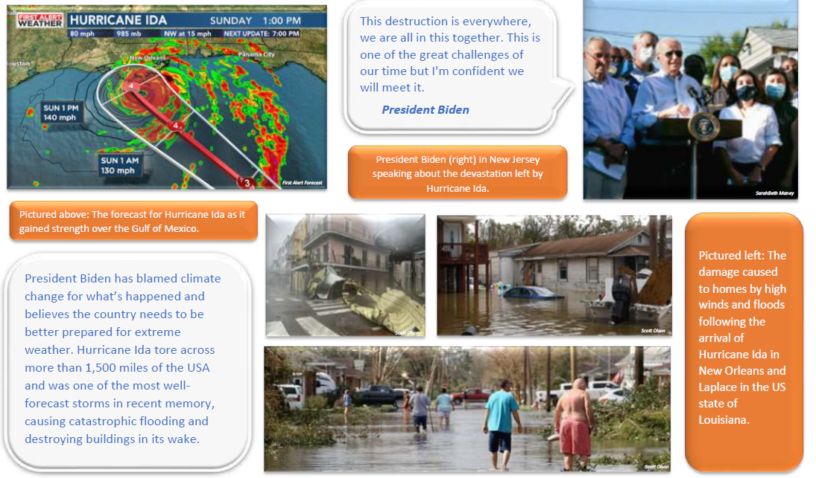

Slide 5
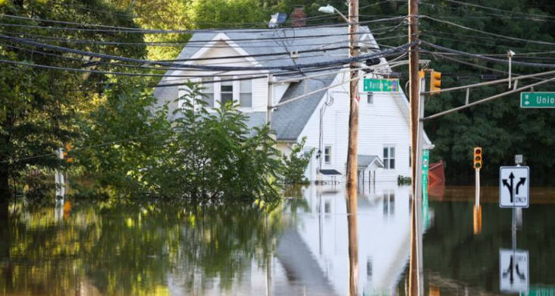
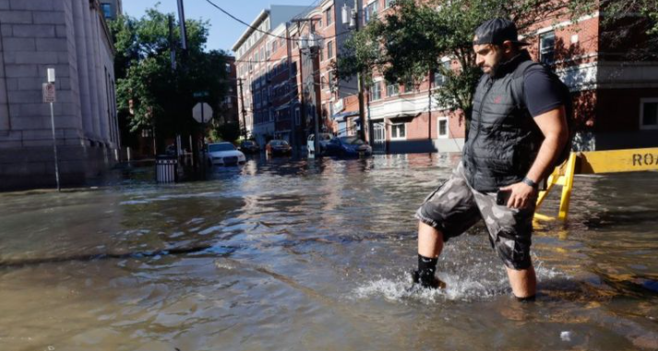
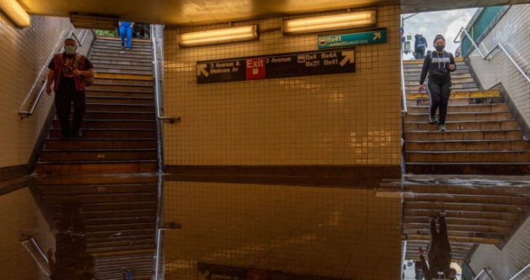
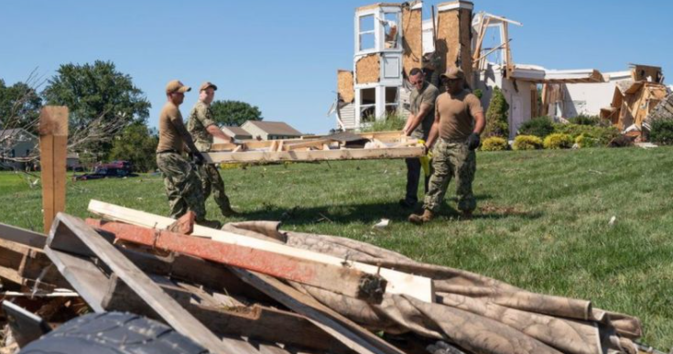
Newsround website - Storm Ida

Slide 6
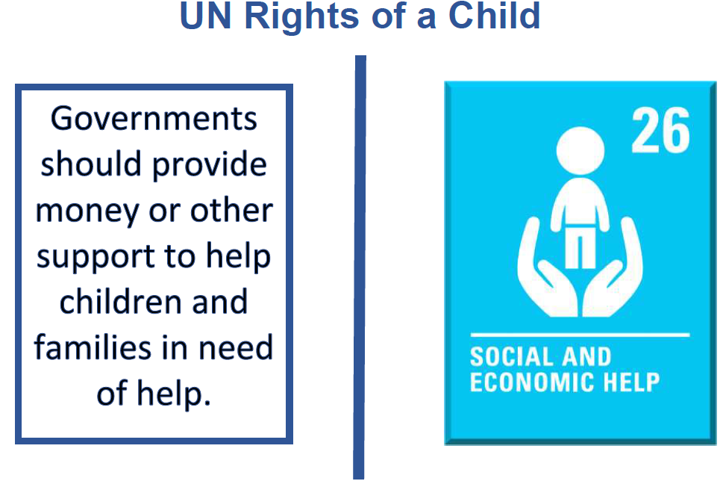

Slide 7
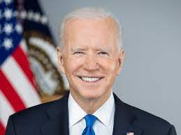
Following the trail of devastation left by Hurricane Ida, President Biden declared that ‘historic investment’ is needed to deal with the impact of the climate crisis.

Slide 8
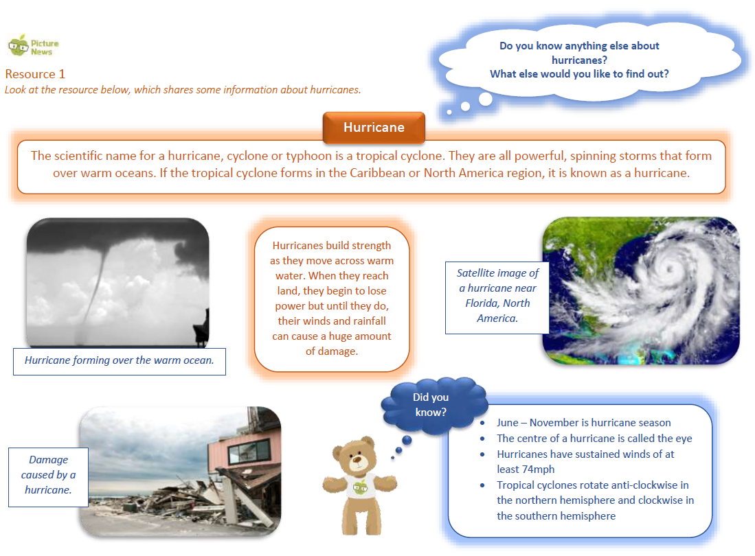

Slide 9
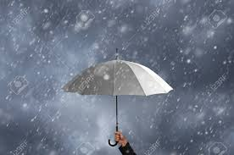
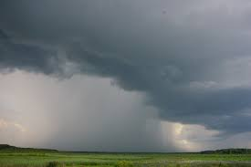
We are going to make our own rainstorm!
We are going to make a human rainstorm and to do that we need to stand up!
Start by rubbing hands together.
Now start to snap fingers.
Clap hands.
Slap thighs (start to speed up the rhythm at this point).
Stamp feet (this will be noisy).
Begin to reverse the actions, slowing down as you go.
Slap thighs, clap hands, snap fingers.
Silence

Slide 10
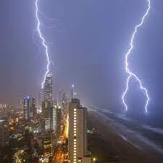
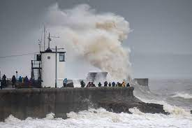
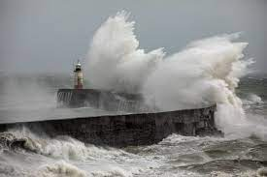
What does it feel like when there is a storm? What could happen when it rains too hard or is too windy?
Storms are incredibly powerful forces of nature. They come in all shapes but, typically, they have strong winds with heavy rain. They are full of energy.
Some people find them exciting whilst others don’t. In only a few minutes, a flash flood can cause incredible damage, which can take a community a long time to recover from.

Slide 11
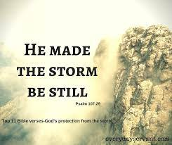
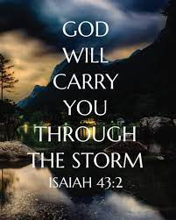
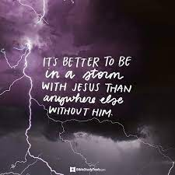
Psalm 89:8-9 Lord God All-Powerful, there is no one like you. You are strong, Lord, and always faithful. You rule the stormy sea. You can calm its angry waves.
Storms are a common feature in the Bible.
It is important to remember that God is NOT a storm, but storms do remind us that there are forces much stronger than us.
A strong storm is a reminder that we need a God, who is stronger than the storm. And because Christians believe in a Lord, who is stronger than any storm, we can have hope that we will recover.

Slide 12
I invite you to pray or reflect on what we have discussed …
Dear Lord,
We pray for the people around the world, who are being affected by natural disasters. We pray for the communities, who are trying to recover from these.
Father, you know that there are real storms that we ask for protection from, but there can also be times in our lives when things are going wrong for us that feel like a storm inside our hearts.
We pray, that in these times of difficulty we can put our hope in you, that you will give us strength to live through these moments until the sunny days of happiness and safety return so that we can let our light shine once again.
Amen

Slide 13
This Week’s Useful Vocabulary
Catastrophic – something causing great damage or suffering.
..causing catastrophic flooding.
Damaged – physically harmed.
The picture is of a house in New Jersey, USA, that has been seriously damaged by floods and high winds.
Devastation – great destruction or damage.
…the trail of devastation left by Hurricane Ida.
Disaster – an event that causes a huge amount of damage and harm.
Discuss the different responses and reactions of the people affected by the disaster.
Extreme – very severe or bad.
The country needs to be better prepared for extreme weather.
Installing – placing something such as machinery or equipment in a position ready to be used.
By doing things such as installing electrical lines underground and creating flood-proof power stations, the affects won’t be as bad

