Slide 1
“We are often capable of much more than we think, and we may find that we surprise ourselves with what we can achieve!”

Slide 2
Does anybody know what happened on Saturday night that might explain what we are going to talk about today?

Slide 3
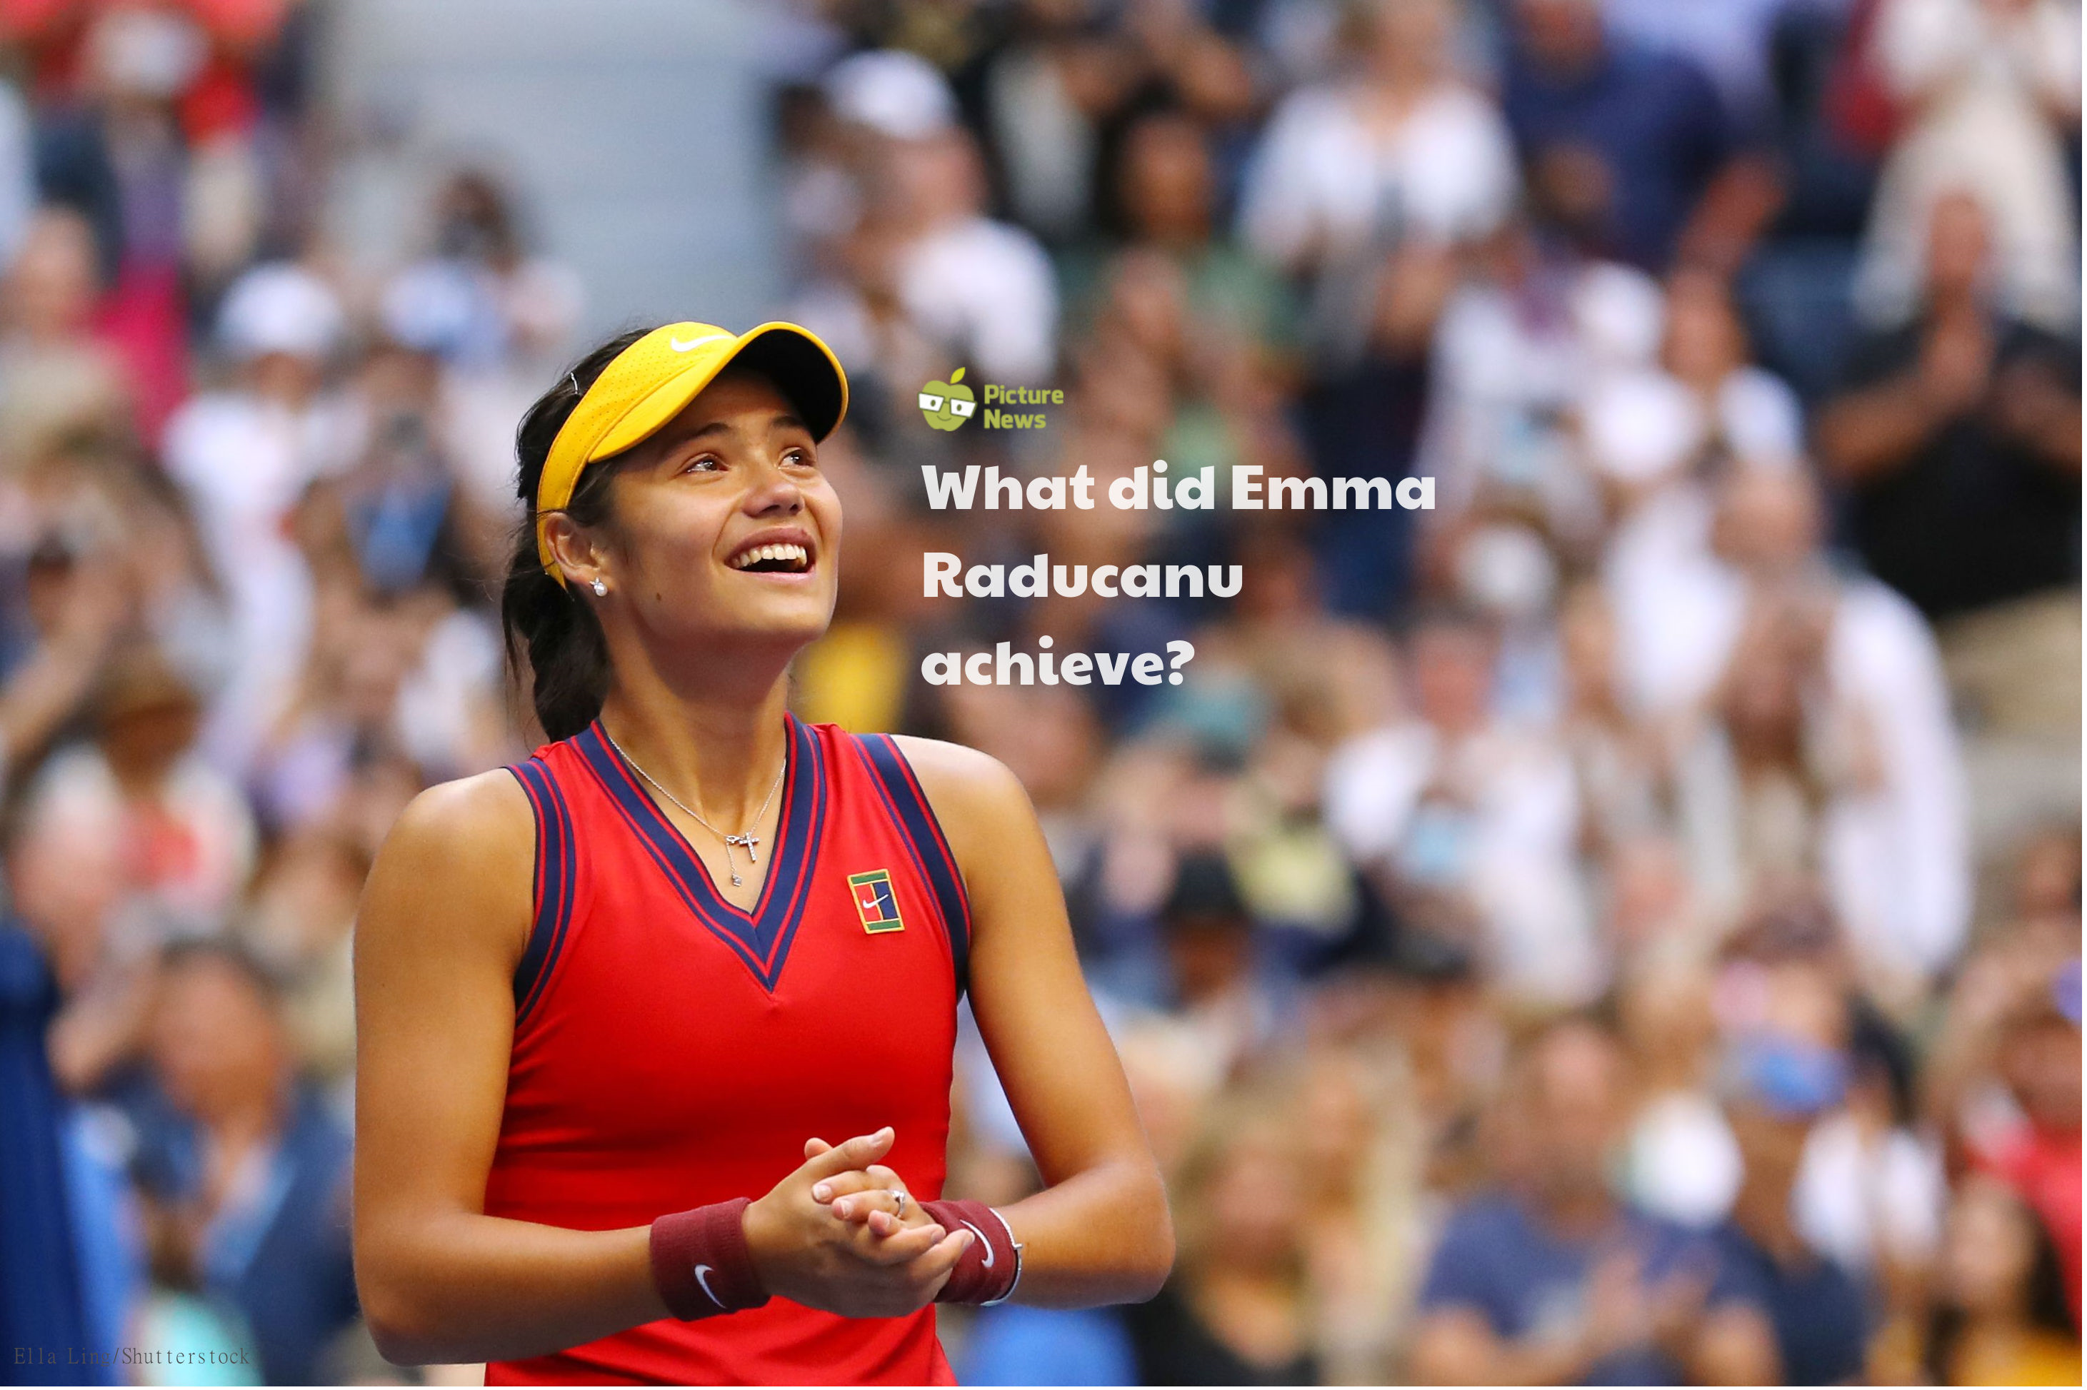

Slide 4
18-year-old British teenager Emma Raducanu has made history by winning the US Open tennis tournament beating fellow teenager Leylah Fernandez in straight sets in an exciting and tense final in New York. Emma is the youngest Britain to ever win a Grand Slam tennis tournament and has also become the first British woman to become a singles champion for 44 years!

Slide 5
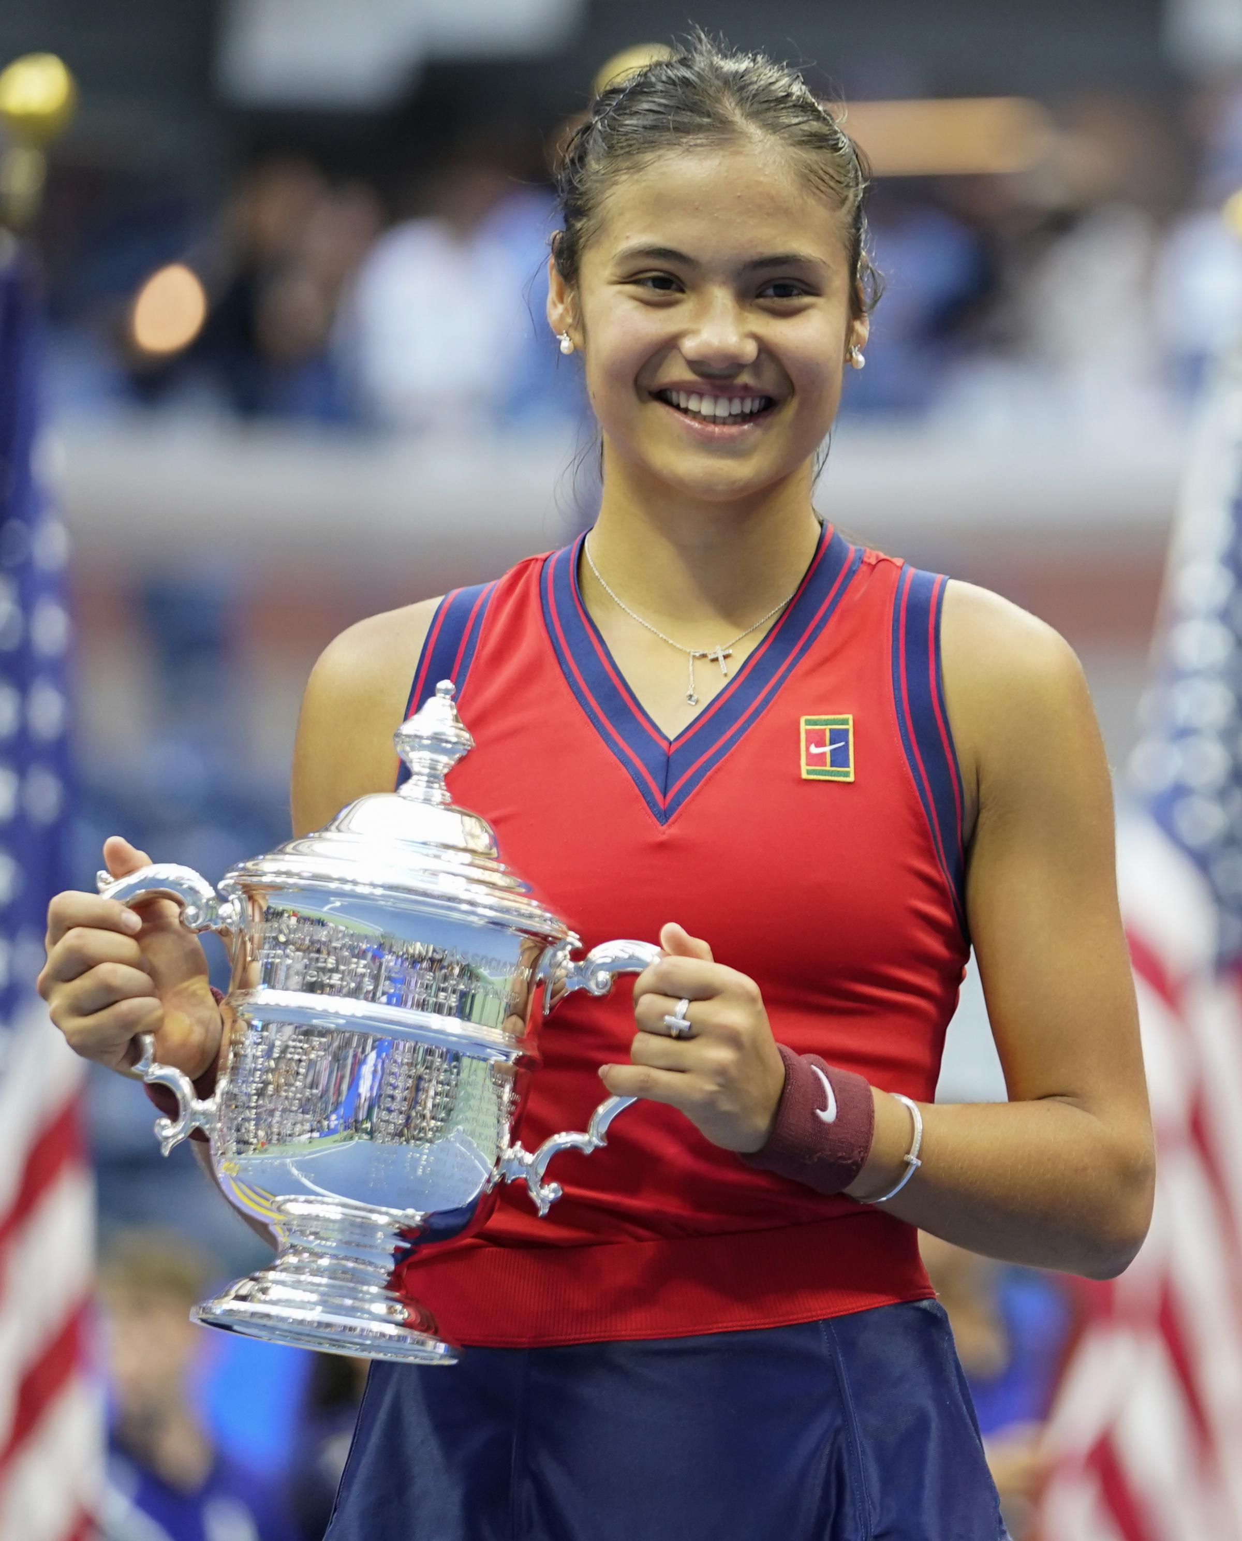
Emma's winning highlights

Slide 6
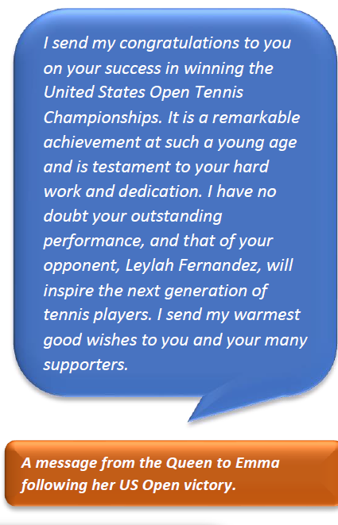
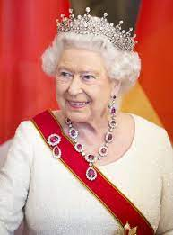

Slide 7
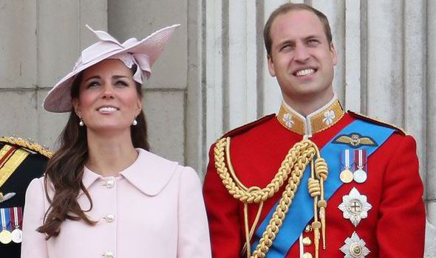
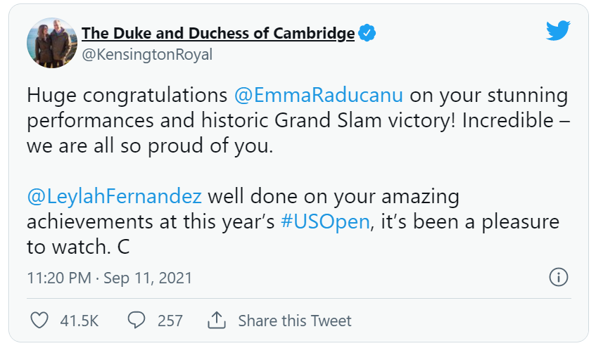

Slide 8
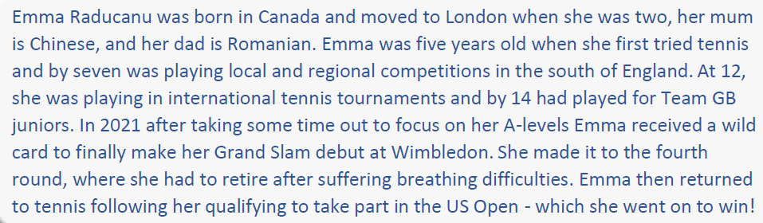
Who is emma raducanu?

Slide 9
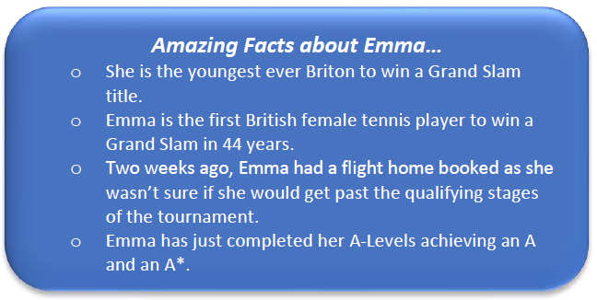

Slide 10
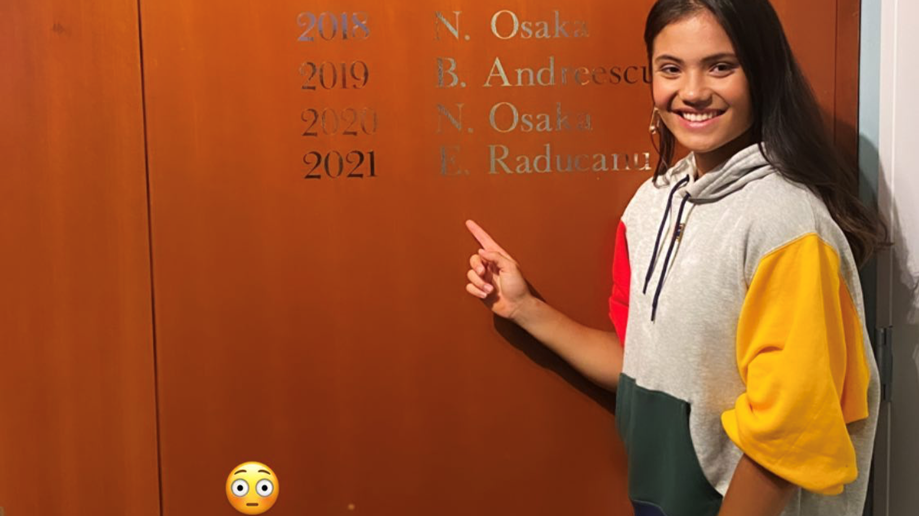
Why do you think Emma’s victory in the tournament has surprised many people?

Slide 11
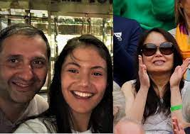
What do you think would have been the hardest part for Emma about not having her parents there?
Would you have found that difficult?
Emma Raducanu talks about her parents ...

Slide 12

How do you think you would have been feeling?

Slide 13

“We are often capable of much more than we think, and we may find that we surprise ourselves with what we can achieve!”
What will YOU achieve today?

Slide 14
Dear Lord,
Let us shine our light for you this day.
We all have special talents that you have given to us.
Guide us as we follow your teachings and use our talents to help others; to overcome challenges and to become the best we can be.
Let us shine our lights for all to see.
Amen.

