Slide 1
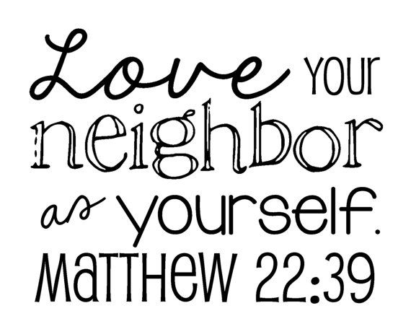
Love
Taking inspiration from The Good Samaritan

Slide 2

Key message …
Christians believe that to Love, is the greatest thing they are called to.
Jesus said: “Love the Lord your God with all your heart and with all your soul and with all your strength and with all your mind, and, Love your neighbour as yourself.”
This means loving those who may be different from us, it also means it might not always be an easy thing to do.

Slide 3
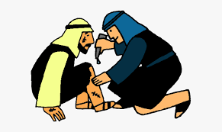
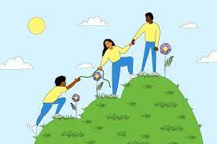

BIBLE STORY OF THE TERM:
The Good Samaritan from Luke 10:25-37

Slide 4
Each Jew knew the command:
“Love your neighbour as yourself.”
When a man asked Jesus whom exactly was meant by “neighbour”, he was trying to get out of his responsibility.

Slide 5
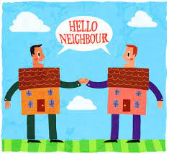
Who do you think of when you hear the words “my neighbour”?

Slide 6
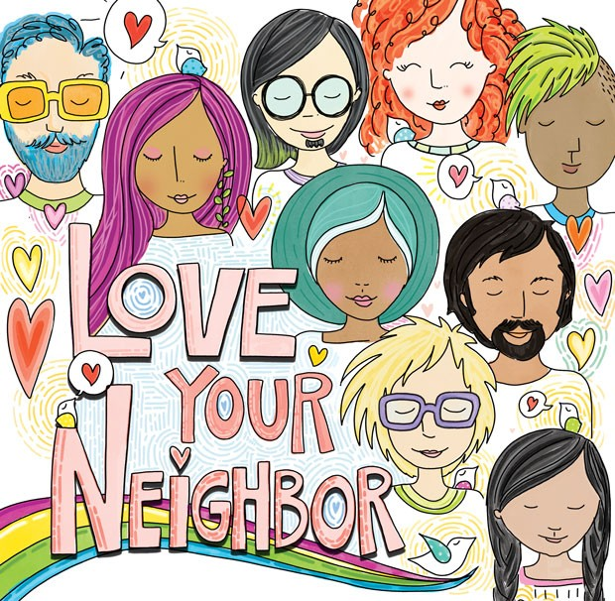
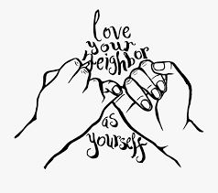
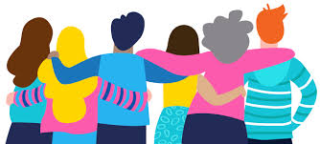
By telling the parable of a Samaritan who helped a complete stranger, Jesus made it plain that
any person who is in need is our neighbour.

Slide 7
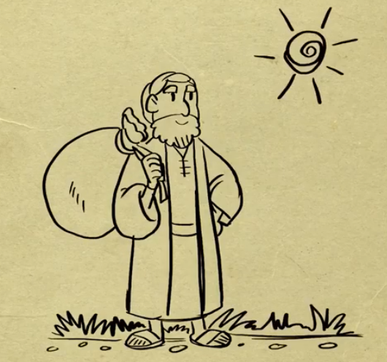
Take a look at the story!

Slide 8

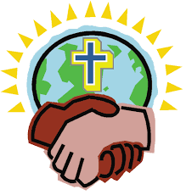
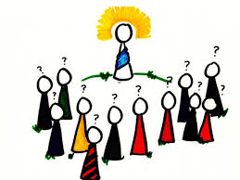
What do you think?
Is it better to look like someone who helps others, or to actually be someone who helps others?

Slide 9
Do real life Good Samaritans exist?

Slide 10
I wonder why the parable of the good Samaritan is important for Christians?

Slide 11
Christians believe that by loving their neighbour they are communicating the love of God to others.

Slide 12
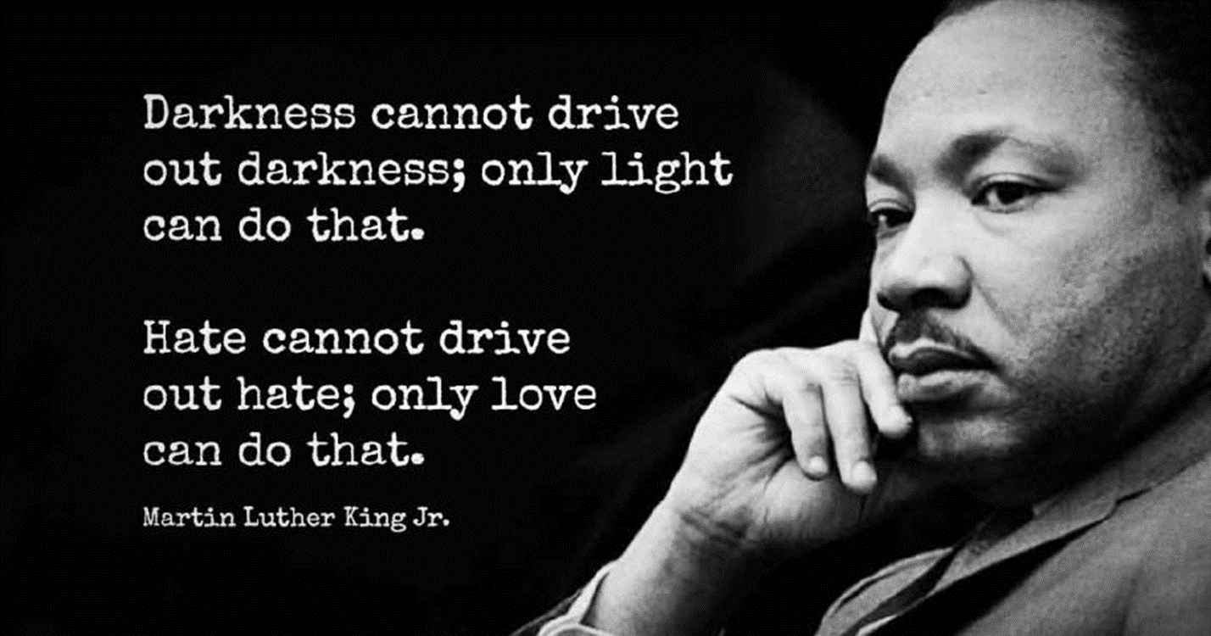
‘Every unselfish act of love whispers God’s name.’
Bob Goff, Restore International

Slide 13

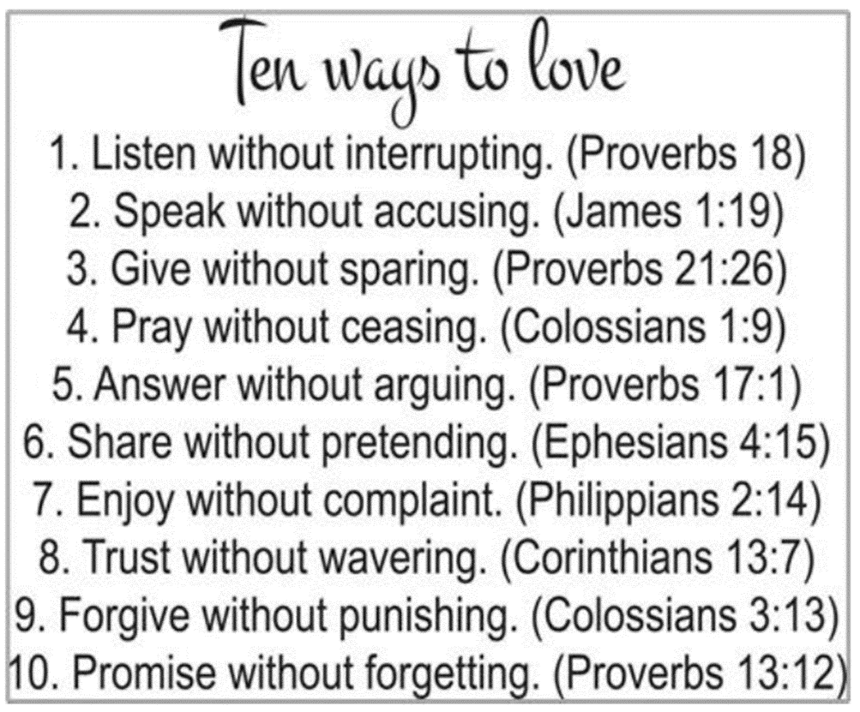
Love is …

Slide 14
Thank you, God, for the times I have been helped and shown love by others.
Help me to spot, and act on, opportunities this week - to love my neighbour as myself.
Amen.

Slide 15

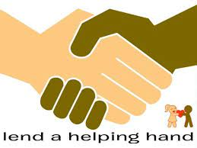
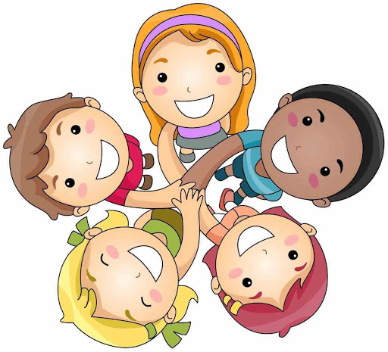
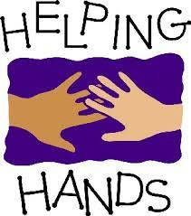


How will you show love to your neighbour this week?

