Slide 1
Collective Worship 8.6.21
Who can draw a picture of the Sun?.

Slide 2















Slide 3
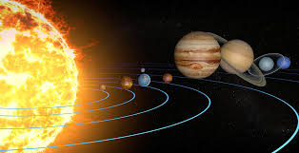
Although we draw the Sun in this way, it actually looks very different ….

Slide 4


Slide 5
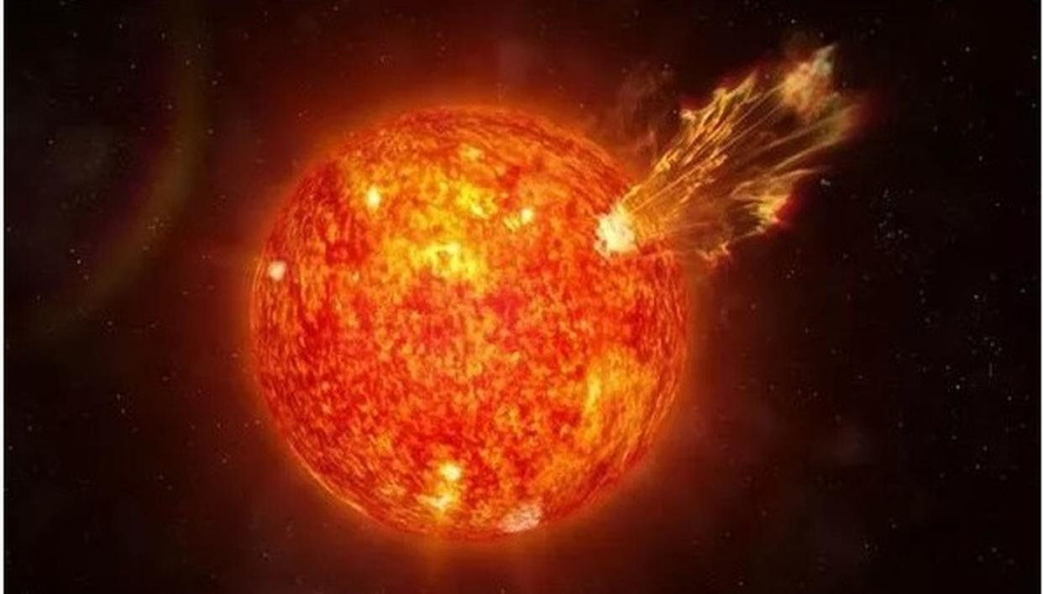
The Sun is actually a star.

Slide 6
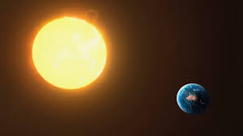
The Sun is the nearest star to the Earth – that is why it looks so big!

Slide 7
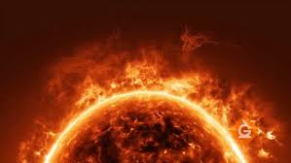
The Sun is a ball of burning gas.

Slide 8
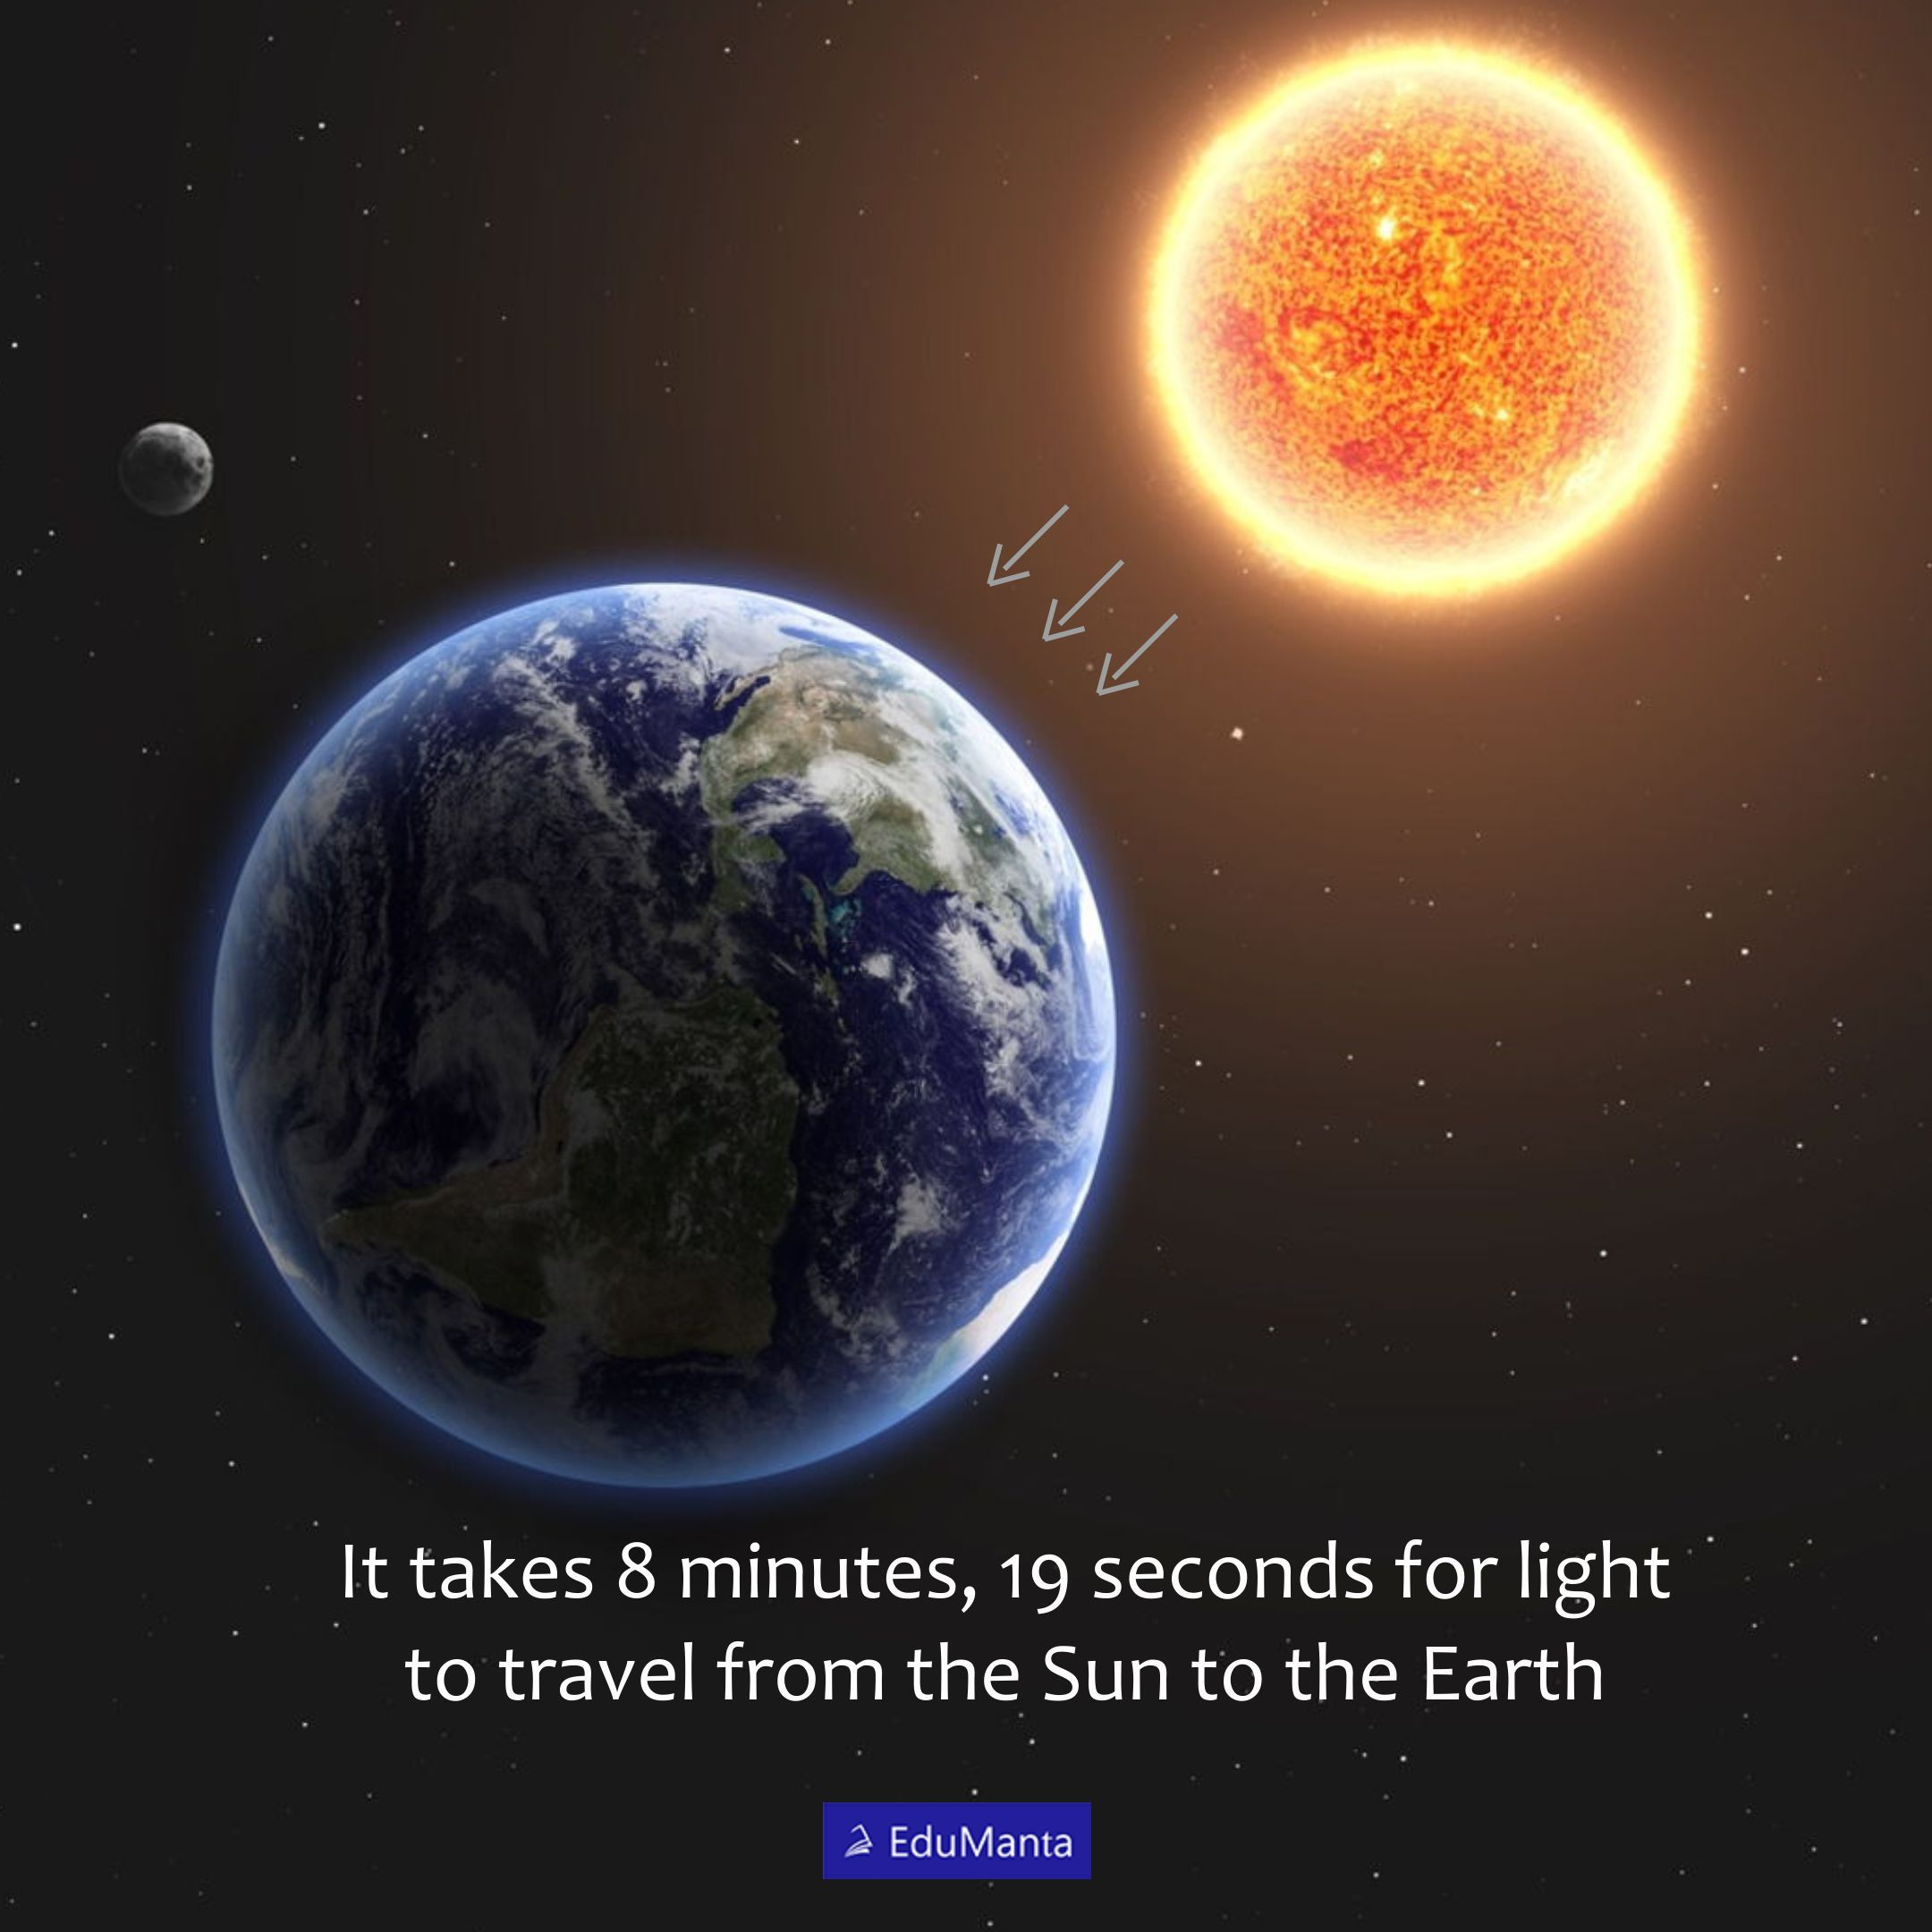
It takes about eight minutes for light to travel from the Sun to the Earth..

Slide 9
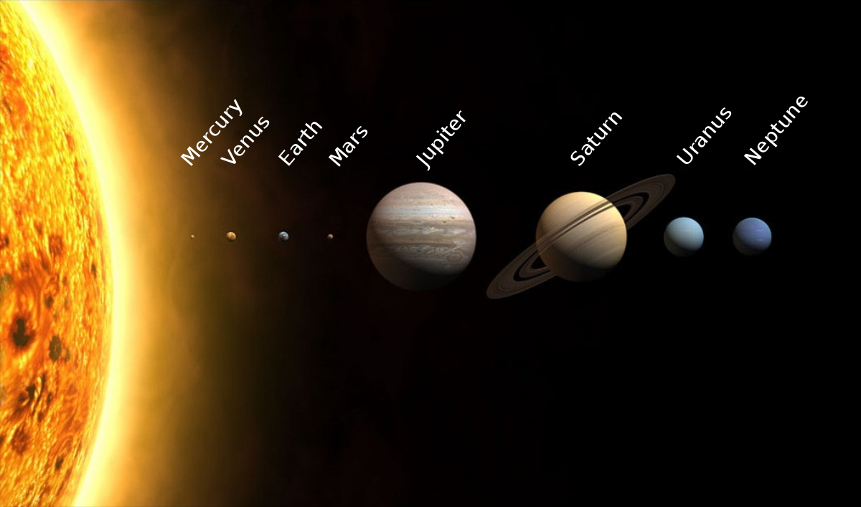
The Sun is the largest object in our solar system.

Slide 10
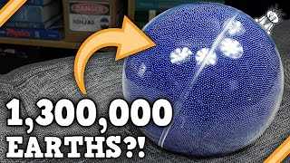
The Sun is so big that the Earth could fit inside it more than a million times!.

Slide 11
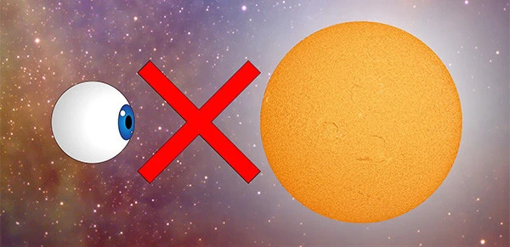
You should never look at the Sun directly.

Slide 12
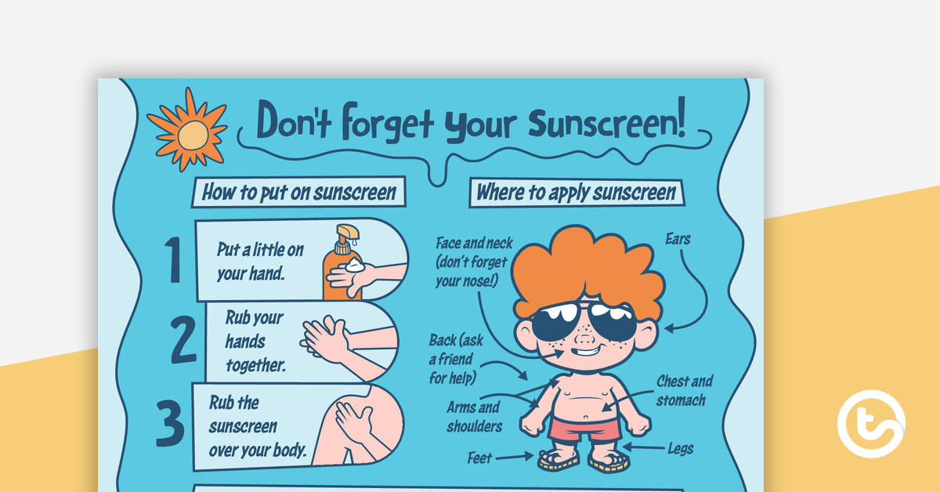
You should wear sunscreen to protect you from the Sun..

Slide 13
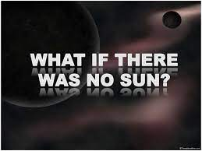
Without the Sun, the Earth would have no heat or light so nothing could live on it.

Slide 14
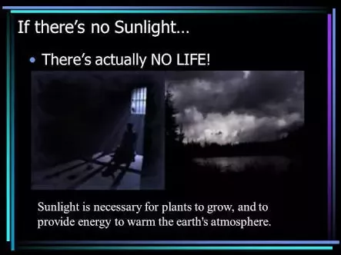
All of us need to be kept warm otherwise we wouldn’t be able to grow. Without the Sun, Earth would be very cold indeed.

Slide 15
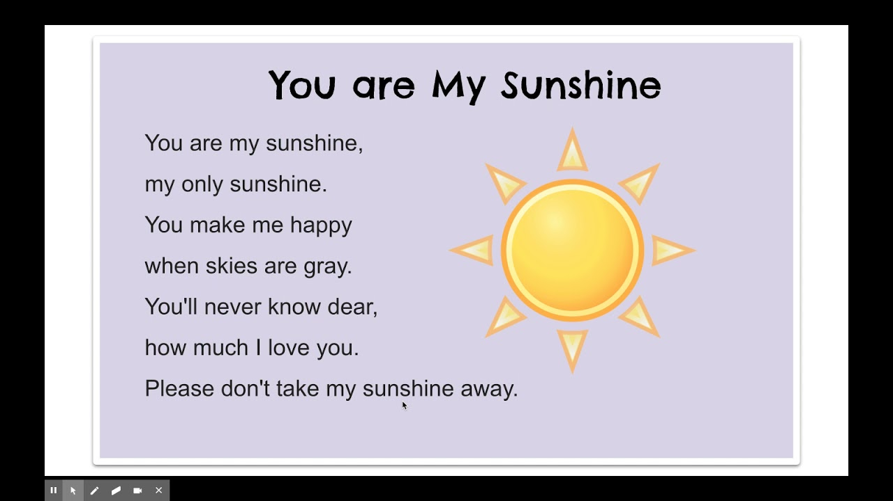

Slide 16
Why might a person be called someone’s ‘sunshine’?

Slide 17

Just like the Sun brings light and warmth to us, we as people can do the same for those around us.

Slide 18

Sometimes, people can feel sad, as if a dark cloud is blocking out the sunshine in their lives.
By our actions, we can help move that cloud and bring light in the form of happiness to them.

Slide 19

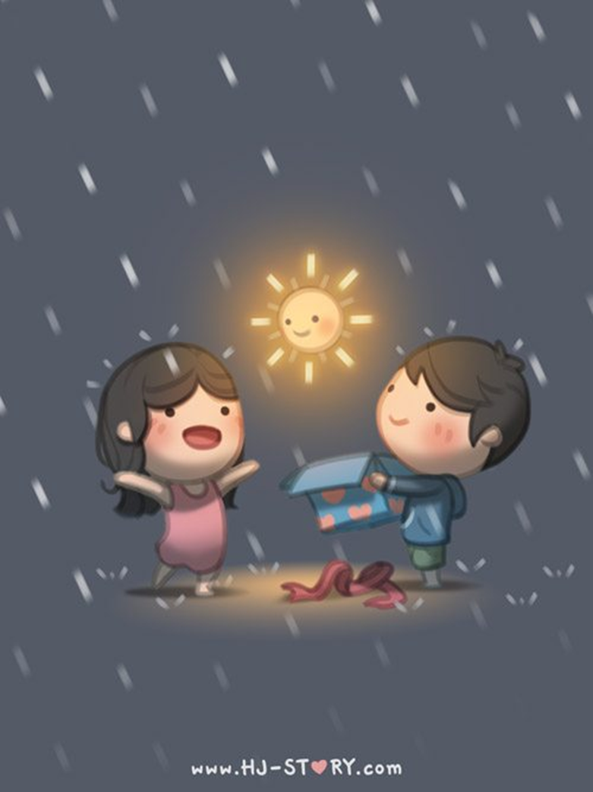



Even a simple smile can bring ‘sunshine’ in the form of happiness to someone else!

Slide 20


Slide 21


Slide 22
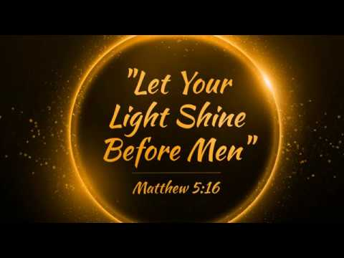

Slide 23

Time for reflection
Think about the people seated around you. How could you make them happy?
Think about the people in your families. How could you be like sunshine to them?
Think about the people in our school. What could you do to bring warmth and light to them today?
Remember that sometimes, we all feel sad. Remember that if you feel that way, there are people around you who are there to listen to you and help in any way they can.

Slide 24

Dear God,
Thank you that we can all make a difference to the people we meet every day.
Thank you that, through our generosity and kindness, we can make a difference to the lives of people who live far away.
Please help us to be people who always think about others and help us to bring light and warmth into people’s lives.
Amen.

