Slide 1


Noah’s Ark Collective Worship
Quiz
St Nicholas CE Primary Academy values……

Slide 2

Question 1
Can you work as a class team to name our school values?
I........ C........ U...
H… L…

Slide 3

Question 2
HOPE
Miss Allen led the Prophets class Collective Worship and discussed diversity. Can you share an idea of how you celebrate diversity in your class?

Slide 4
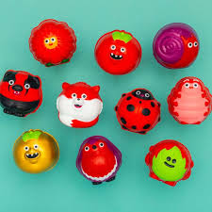
Question 3
LOVE
Mrs Dobbs and Saints Class explained why we take part in Red Nose Day. What did we do at St Nicholas CE Primary Academy to raise money for Red Nose Day causes?

Slide 5


Question 4
What did Mrs Oliver and Pilgrims class use to show Unity at school?
Was it A?
Or B?

Slide 6
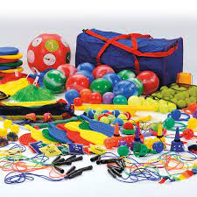

Question 5
CURIOSITY
Mr Lee and Disciples class discussed curiosity and asked for applicants for a new role on the playground. What was this role?

Slide 7
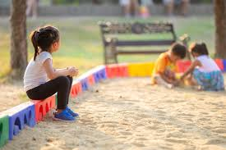
Question 6
Mrs Smith and Gospels class discussed integrity and what that meant. The children modelled some ideas of how to show integrity, can you name some of their ideas?

Slide 8
Answers
How many answers did you get correct?

Slide 9
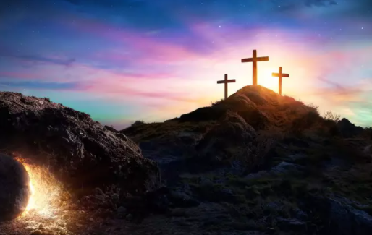
Easter Prayer

Slide 10
Keep shining
We go out shining…

Slide 11
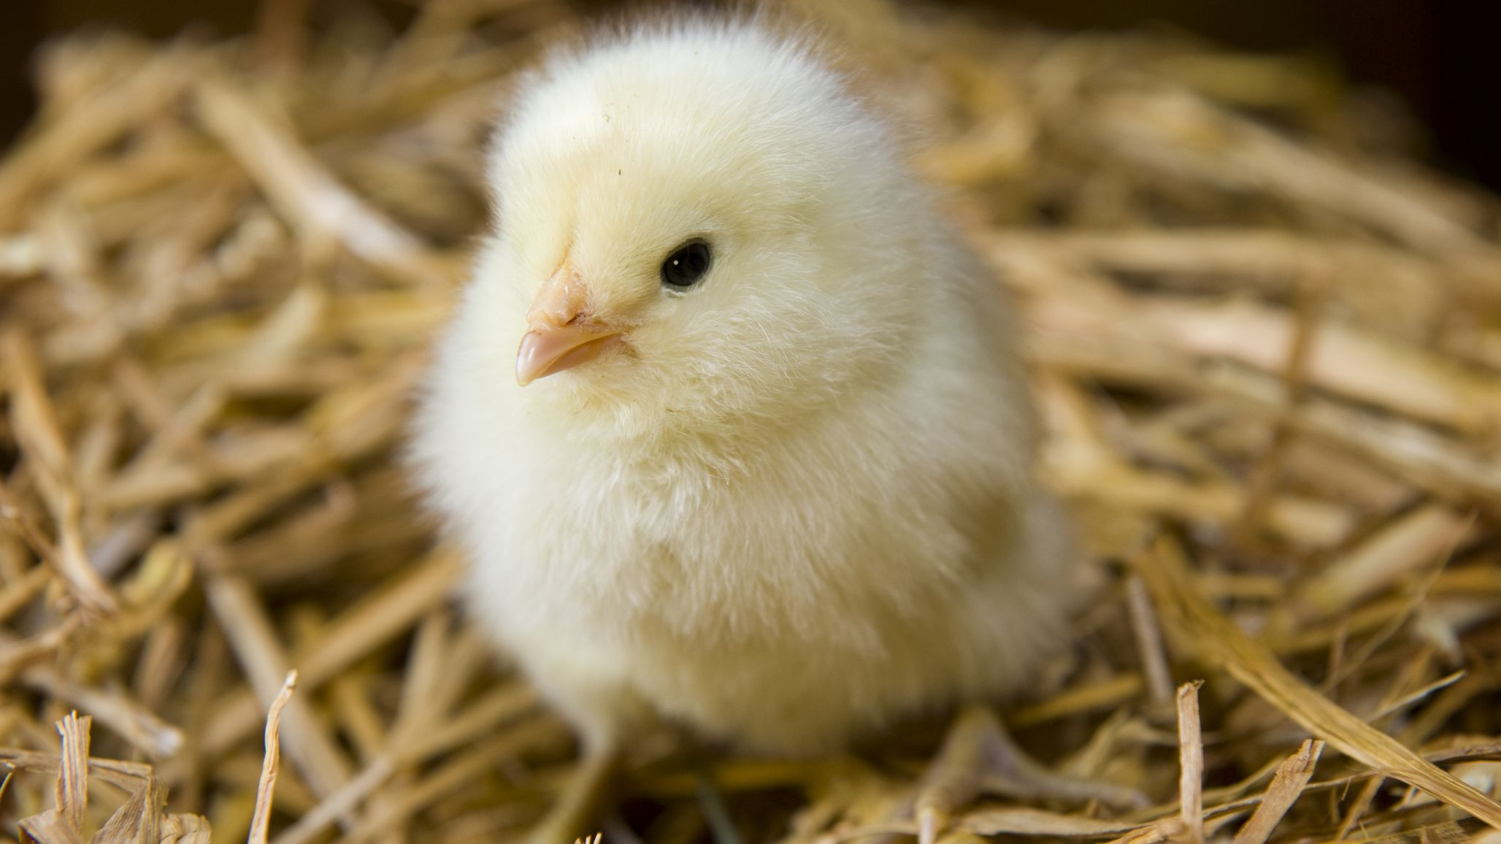
Prize time
Noah’s Ark would like to sing you a song and wish you all a very Happy Easter

