Slide 1
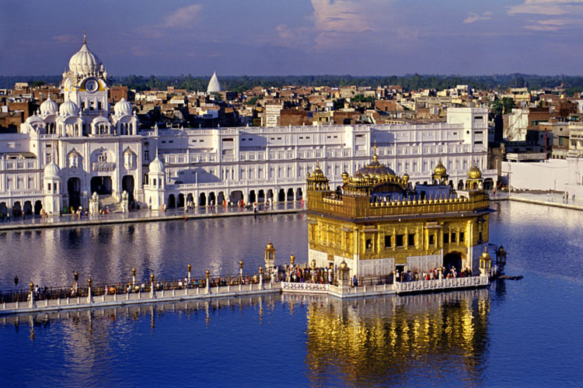
Sikh’s call their pilgrimages to religious places Yatra.

Slide 2
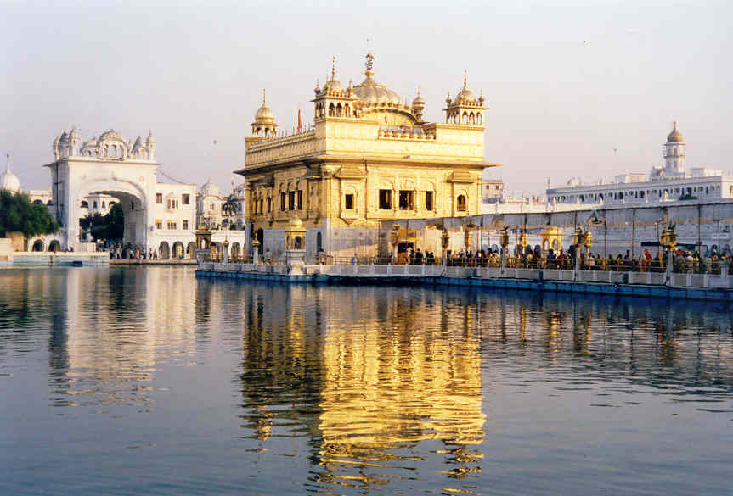
The Golden Temple in Amritsar, India

Slide 3
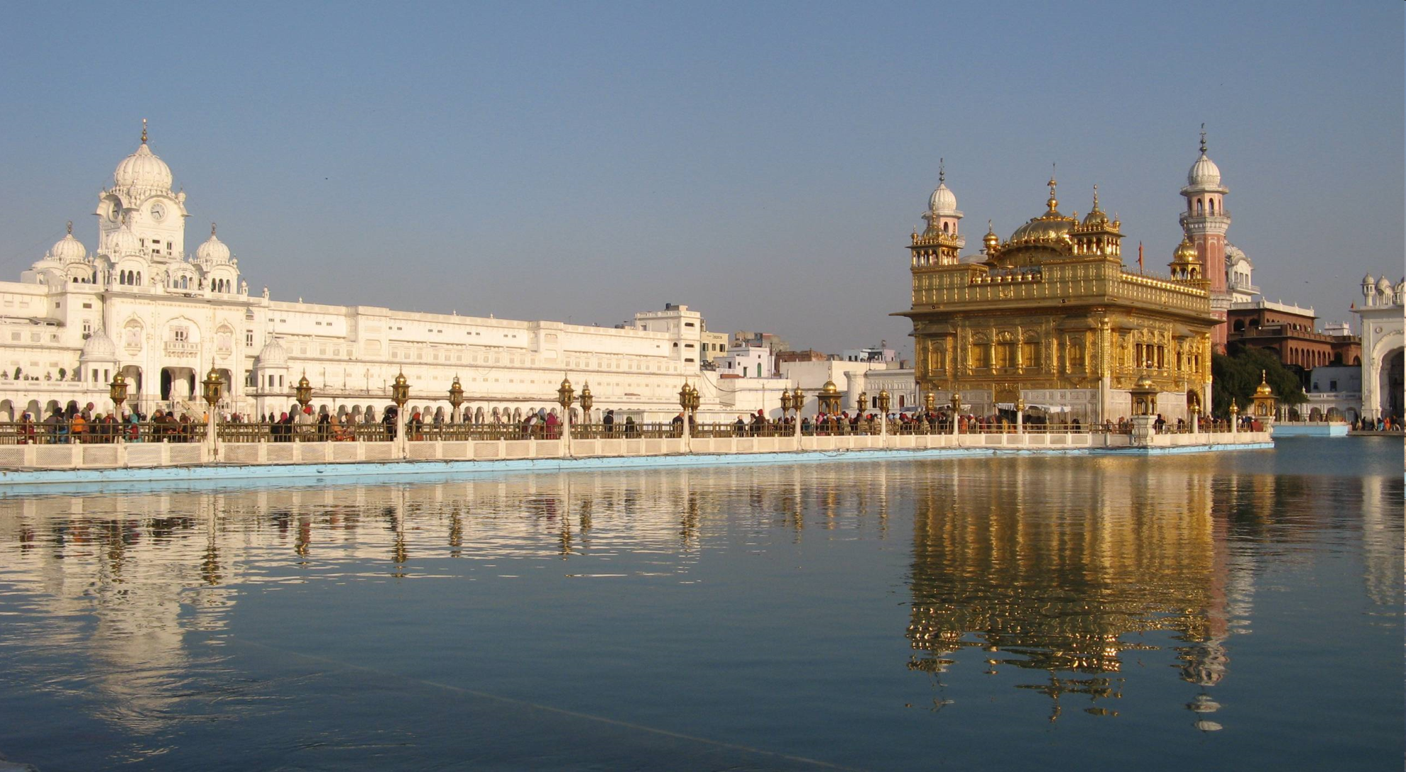

Slide 4
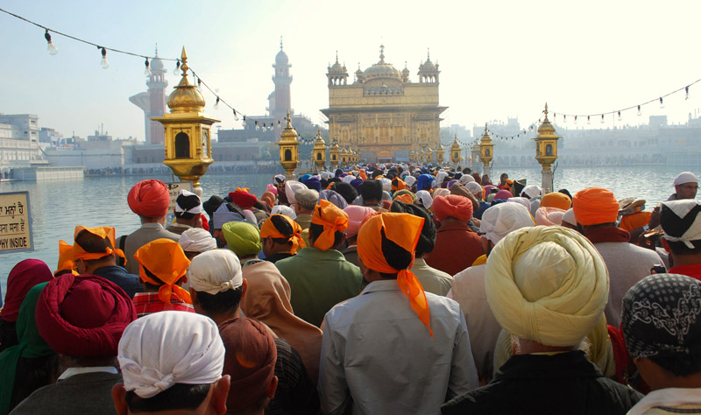

Slide 5
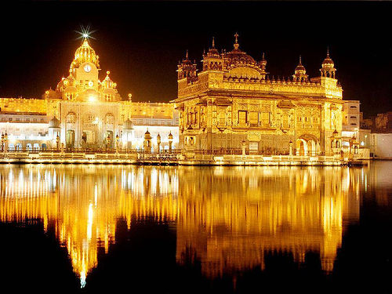
Why do Sikh pilgrimage to the Golden Temple?
The Golden Temple is also known as Harmandir Sahib (God’s Temple) was completed in 1604. It is the most famous Sikh temple in the world. The temple was founded by Guru Ramdas, the fourth Guru of the Sikh faith.

Slide 6
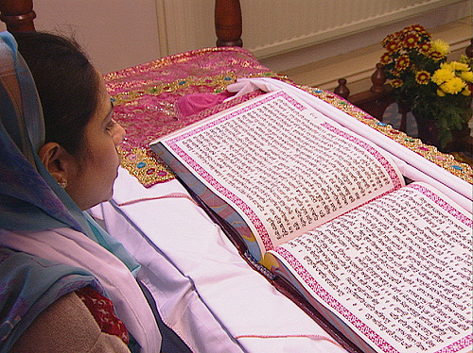
Sikh’s visit the temple to show their respect and worship for the Guru Granth Sahib (Holy Book).

Slide 7
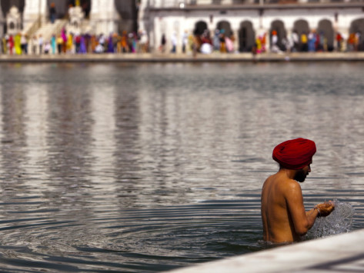
The water surrounding the Golden Temple is called the Amrit Saras Kund (pool of immortality) and is believe to have miraculous healing powers.
On pilgrimage Sikhs bathe in the water as they believe they will be healed.

Slide 8
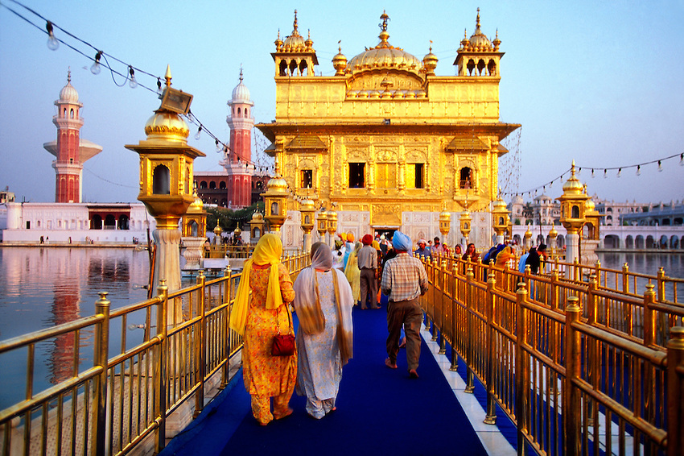
When entering the temple Sikh’s remove their shoes and cover their heads as a mark of respect to God.

Slide 9
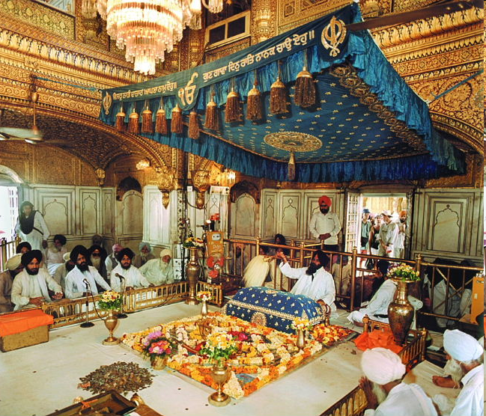
Everyone sits on the floor to show that we are all equal in the eyes of God.

Slide 10
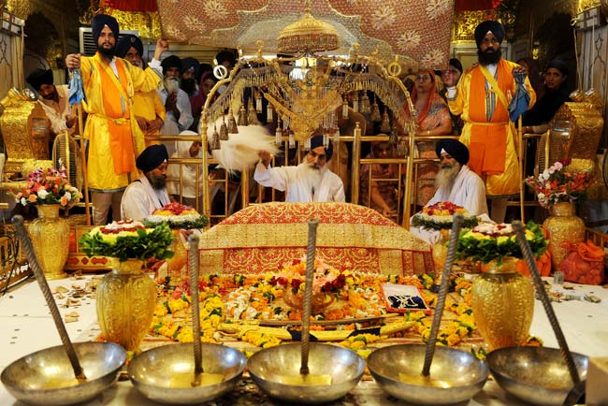
There are no religious pictures, statues or candles. People imagine God. Any Sikh can hold a service. There are no priests.

Slide 11
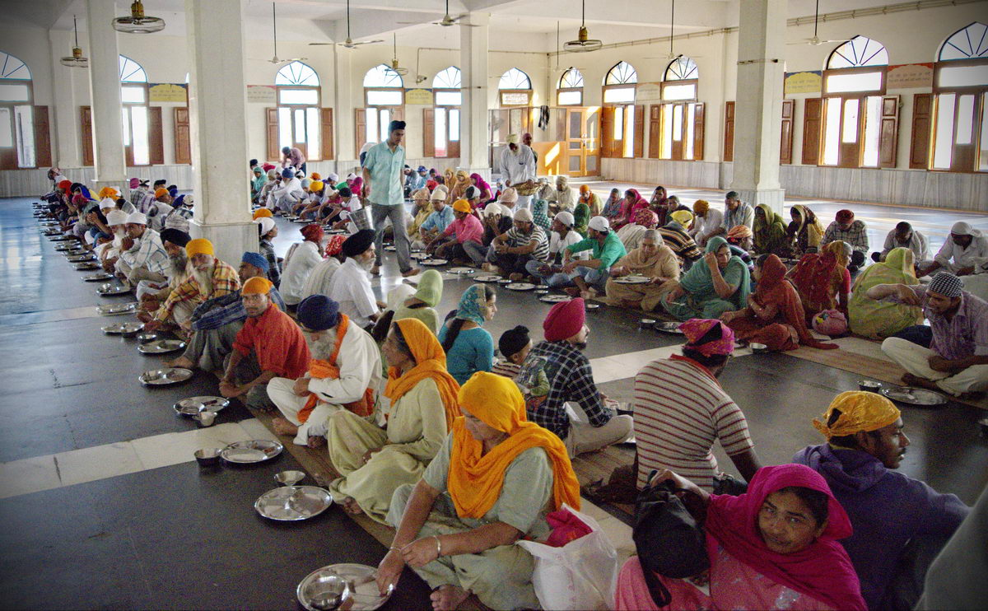
It offers food and shelter. It has a strong community spirit.

Slide 12
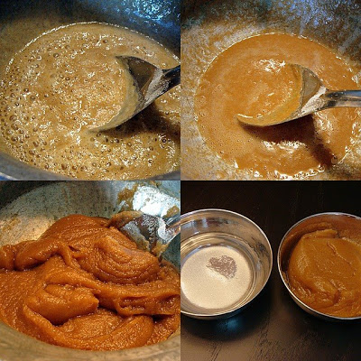
The Langar (a meal) is available inside.
Sweets (Parshad) are offered after prayer.

Slide 13
The canopy is the focus of the temple and the Guru Granth Sahib (holy book) is placed below it.

Slide 14
Glossary
Yatra – This is the name given to Sikh pilgrimage
Sikh – A Sikh is someone who worships the religion Sikhism
Guru Granth Sahib – The holy book
Langar – Meal offered inside the temple
Parshad – Sweets offered after prayer
Harmandir Sahib – Golden Temple
Amrit Saras Kund - Pool of Immortality
Immortality – This means you will never die
Miraculous – This means an event happens that is not supposed to be possible
Guru Ramdas - The fourth Guru of the Sikh faith.

