Slide 1

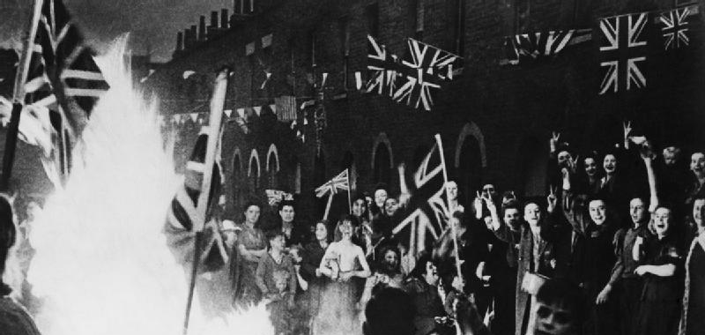
Victory in Europe
Victory in Europe day/VE day took place on the 8th May 1945. It was the day that marked the end of World Word 2, which had lasted for 6 years.
Everyone was given a day’s holiday to celebrate and families and friends joined together to have parties. They decorated with flags and bunting. Can you decorate your own bunting?
Can you see all the flags being waved? They are the Union Jack flag, which is the national flag of the United Kingdom.
Can you make your own flag to wave on the 75th anniversary?
Anniversary is a day when a special event is celebrated, like your birthday every year. This Friday will be 75 years since the official end of World War 2.

Slide 2
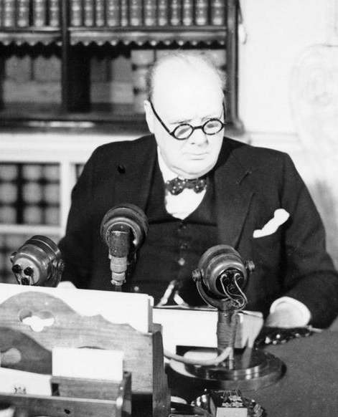
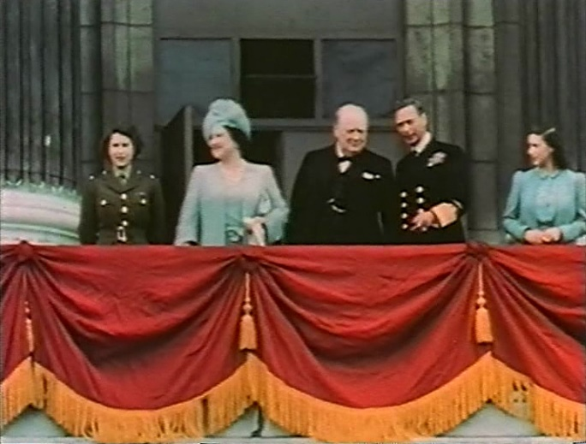
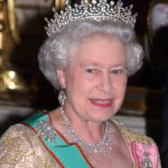
Our Prime Minister in 2020 is Boris Johnson, but 75 years ago in 1945 the Prime Minister was Winston Churchill. At 3pm on VE Day he spoke on the radio to declare that the war was over.
The lady in the uniform is Princess Elizabeth age 19, pictured with her family and Winston Churchill at Buckingham Palace in London, watching the people of London celebrating. She is now our Queen and age 94.

Slide 3
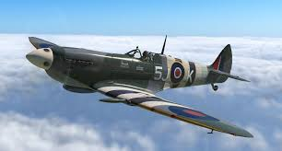
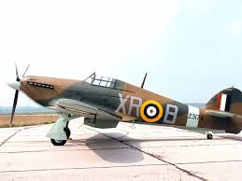
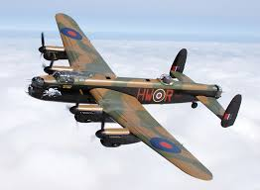
Do you recognise the planes and their names?
That’s right they are the names of our school ‘house teams’ and are aeroplanes that were flown during World War 2. Why not draw your teams plane.
Spitfire
Hurricane
Lancaster

