Slide 1
PSHE and Citizenship
Health and Wellbeing | Safety First
PSHE and Citizenship | KS1 | Health and Wellbeing | Safety First | Staying Safe Outside | Lesson 3

Slide 3
Aim
I know how to stay safe when I am out and about.
Success Criteria
I understand how to stay safe around roads and other busy areas.
I can identify other dangers I might face when I am outside.
I know who can help me if I am in danger.
This resource is fully in line with the Learning Outcomes and Core Themes outlined in the PSHE Association’s Programme of Study.

Slide 4
The Big Questions

Slide 5

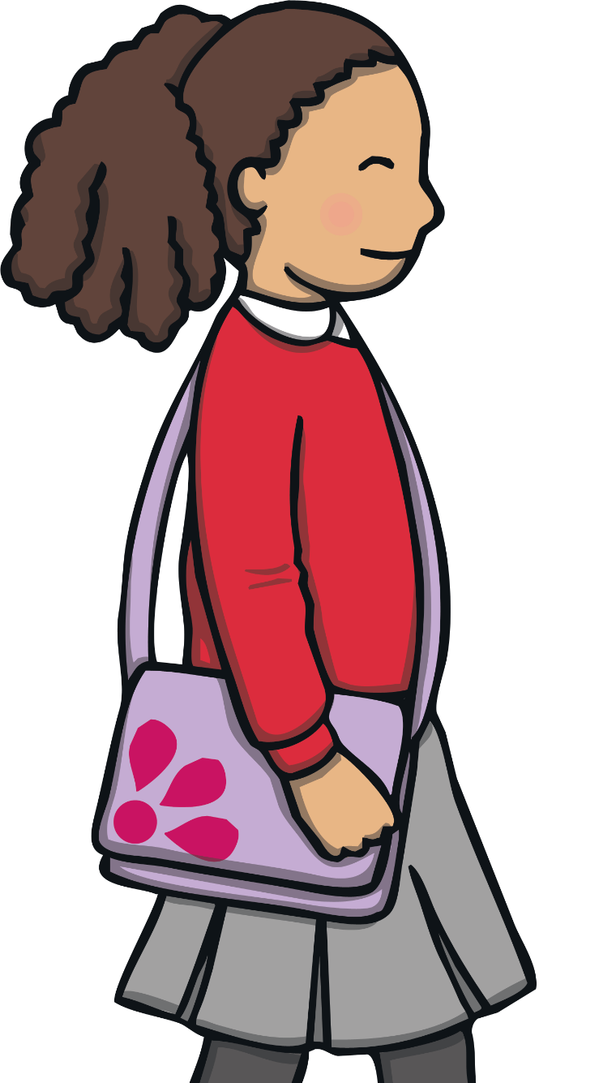
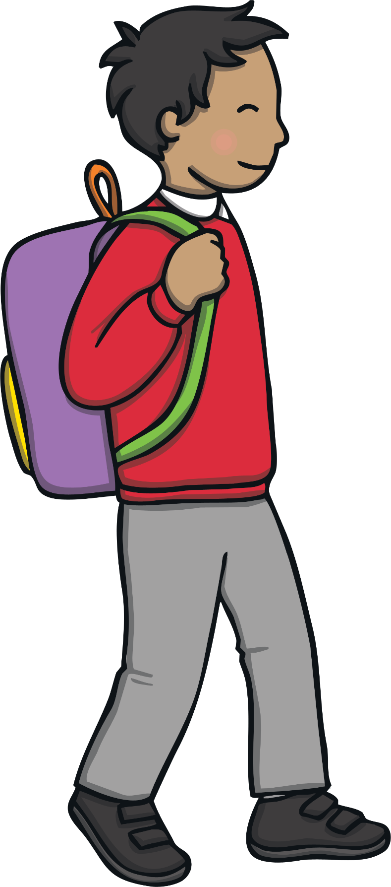
How can we stay safe around roads?
What other dangers do we need to
look out for?

Slide 6
Reconnecting

Slide 7

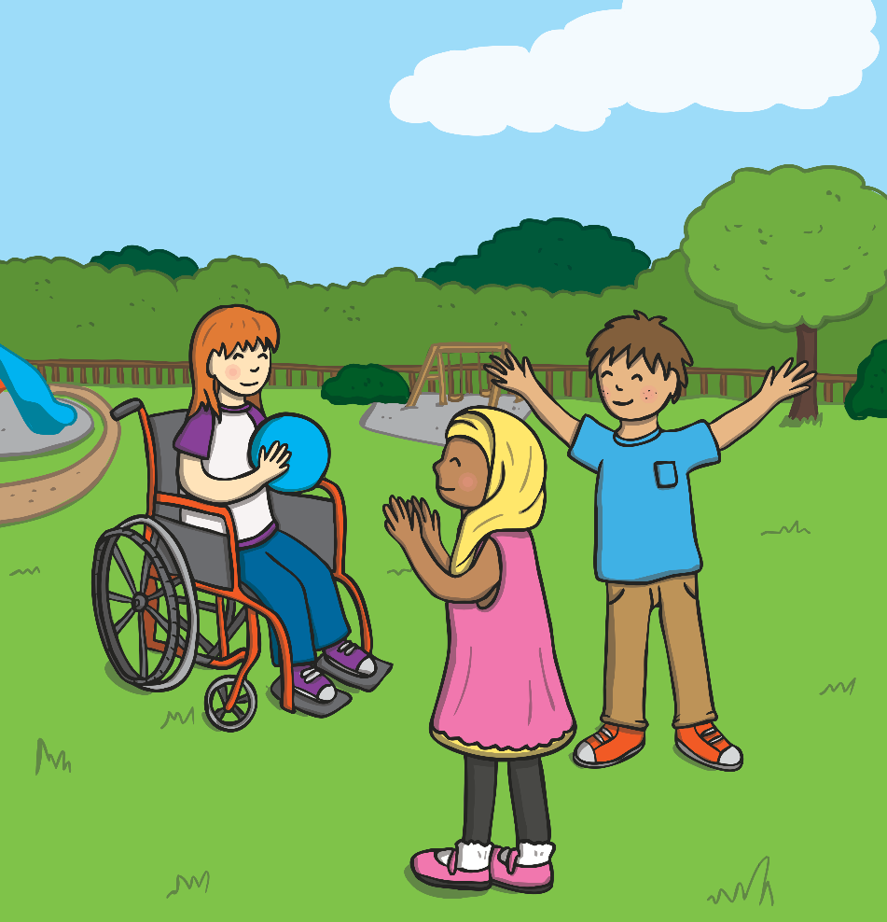
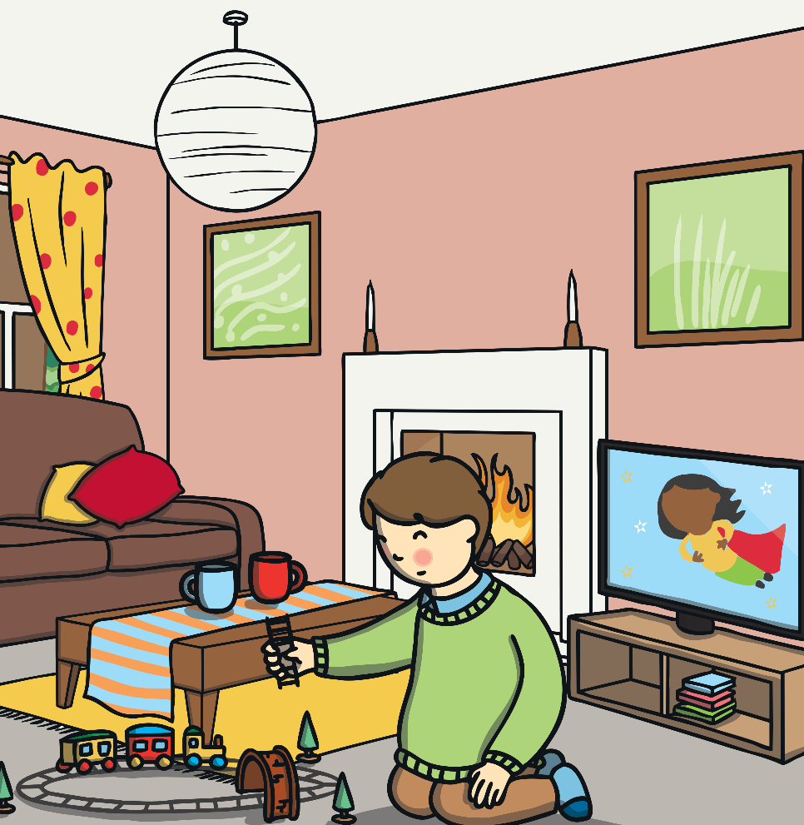
Dangers Outside
When we think about keeping ourselves safe, we might think about staying safe both indoors and outdoors.
The dangers outside are quite different from those inside the home.

Slide 8
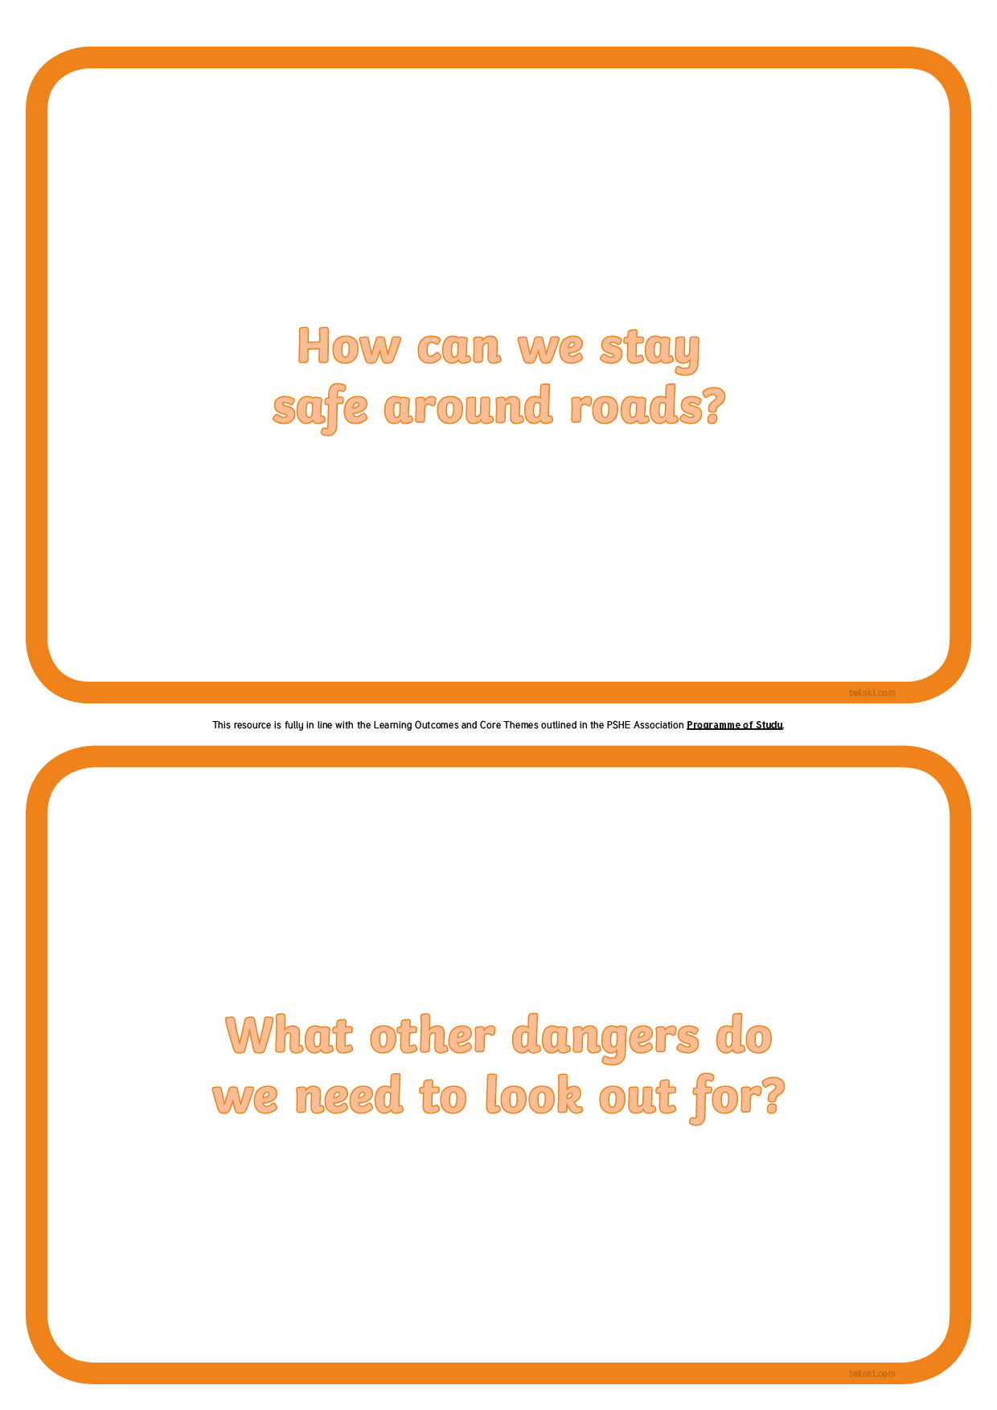
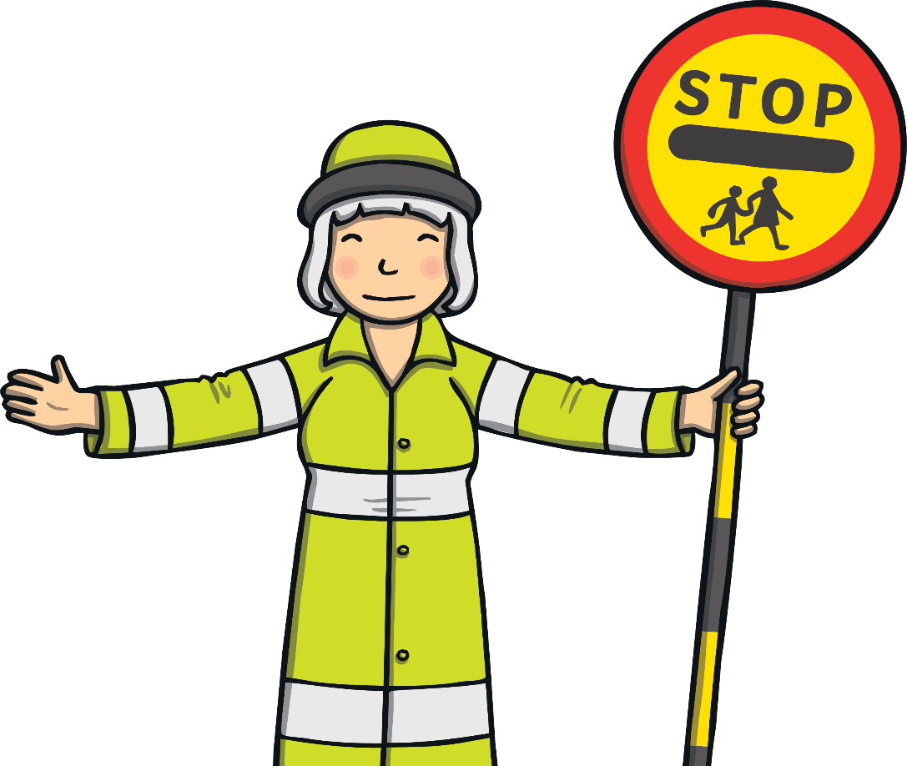
Dangers Outside
On your Big Questions Ideas Sheet, work with your partner to write down ways to stay safe around roads and any other dangers you can think of outside.
Who taught you about these dangers?
How do you know how to stay safe?

Slide 9
Exploring

Slide 10
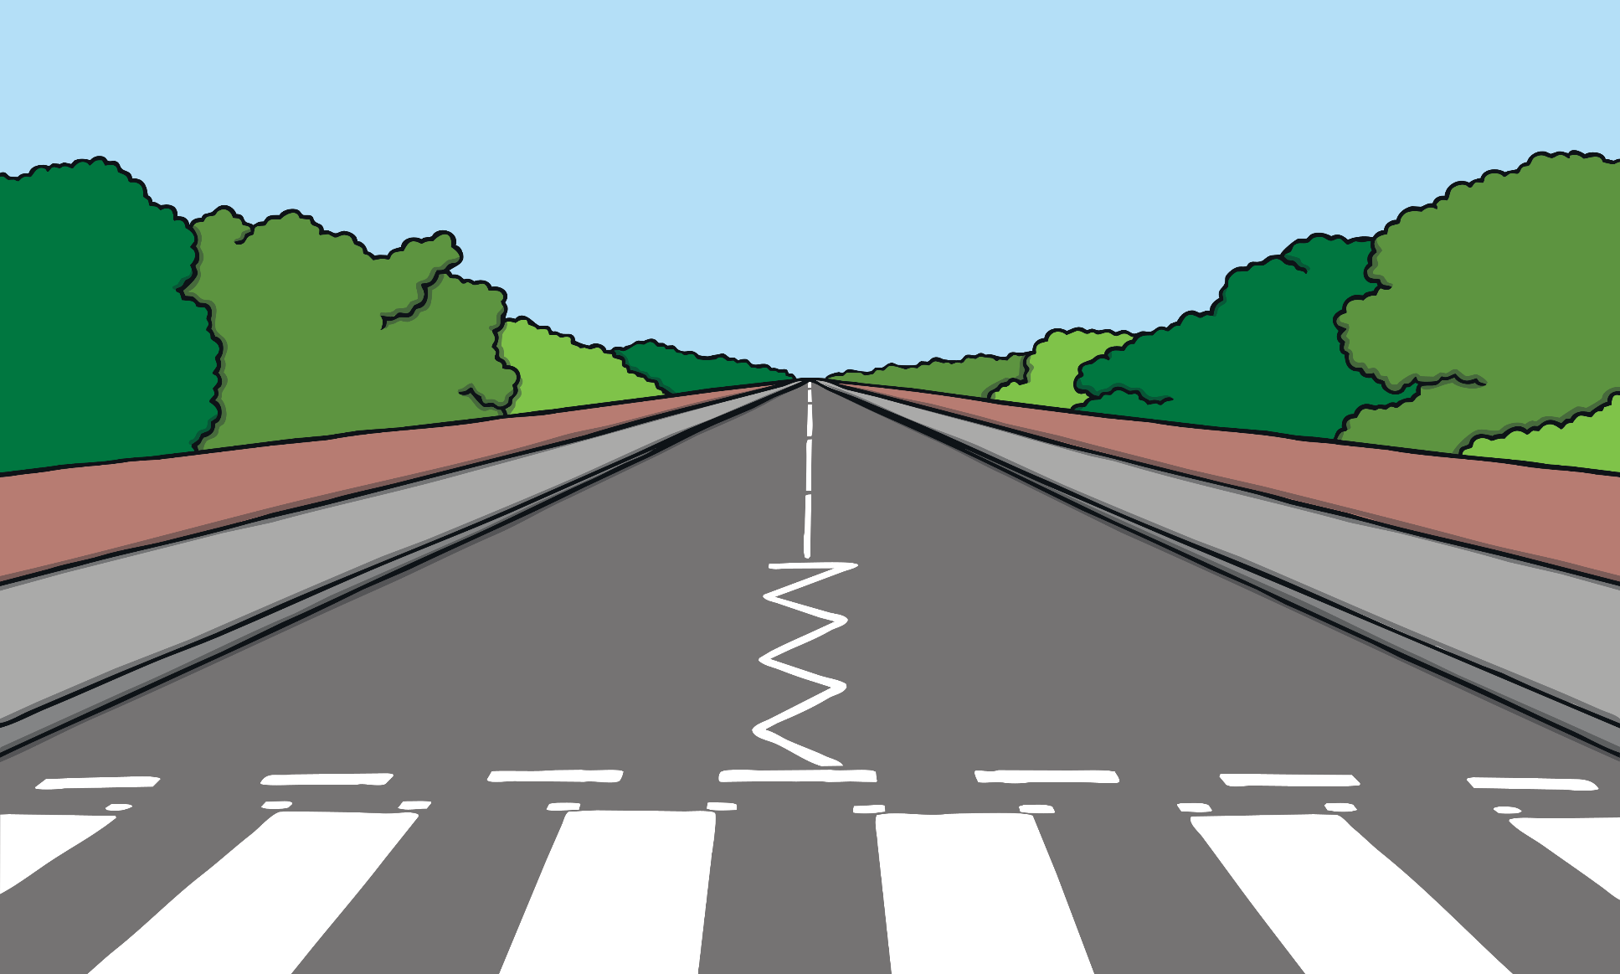
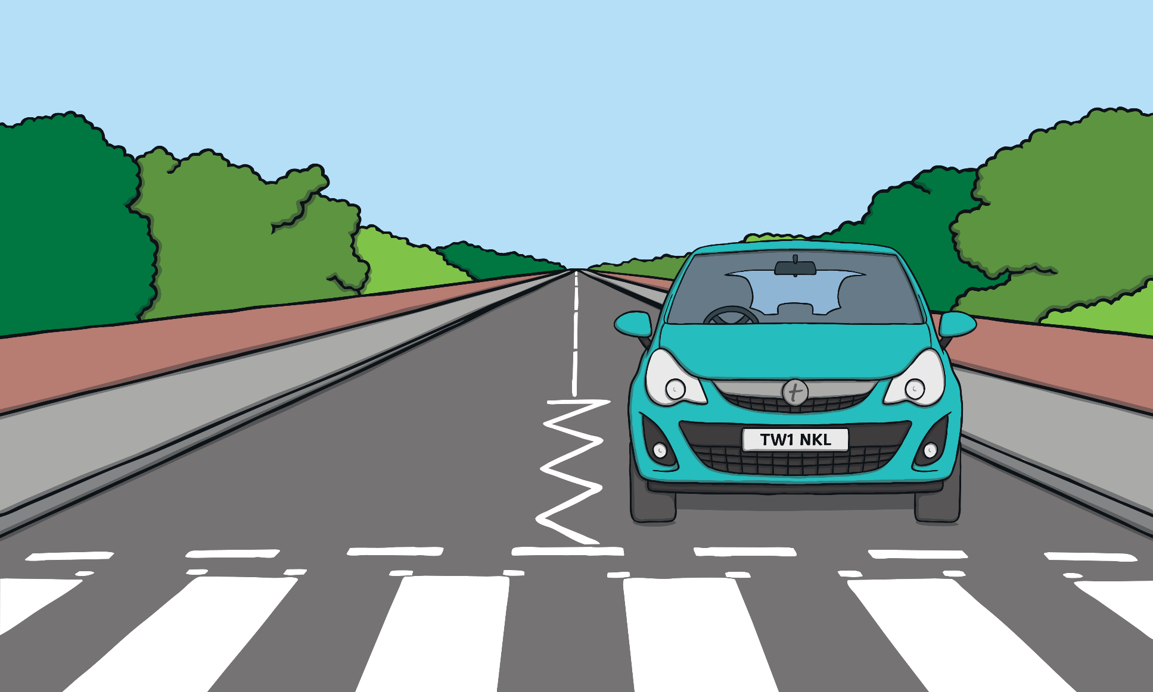
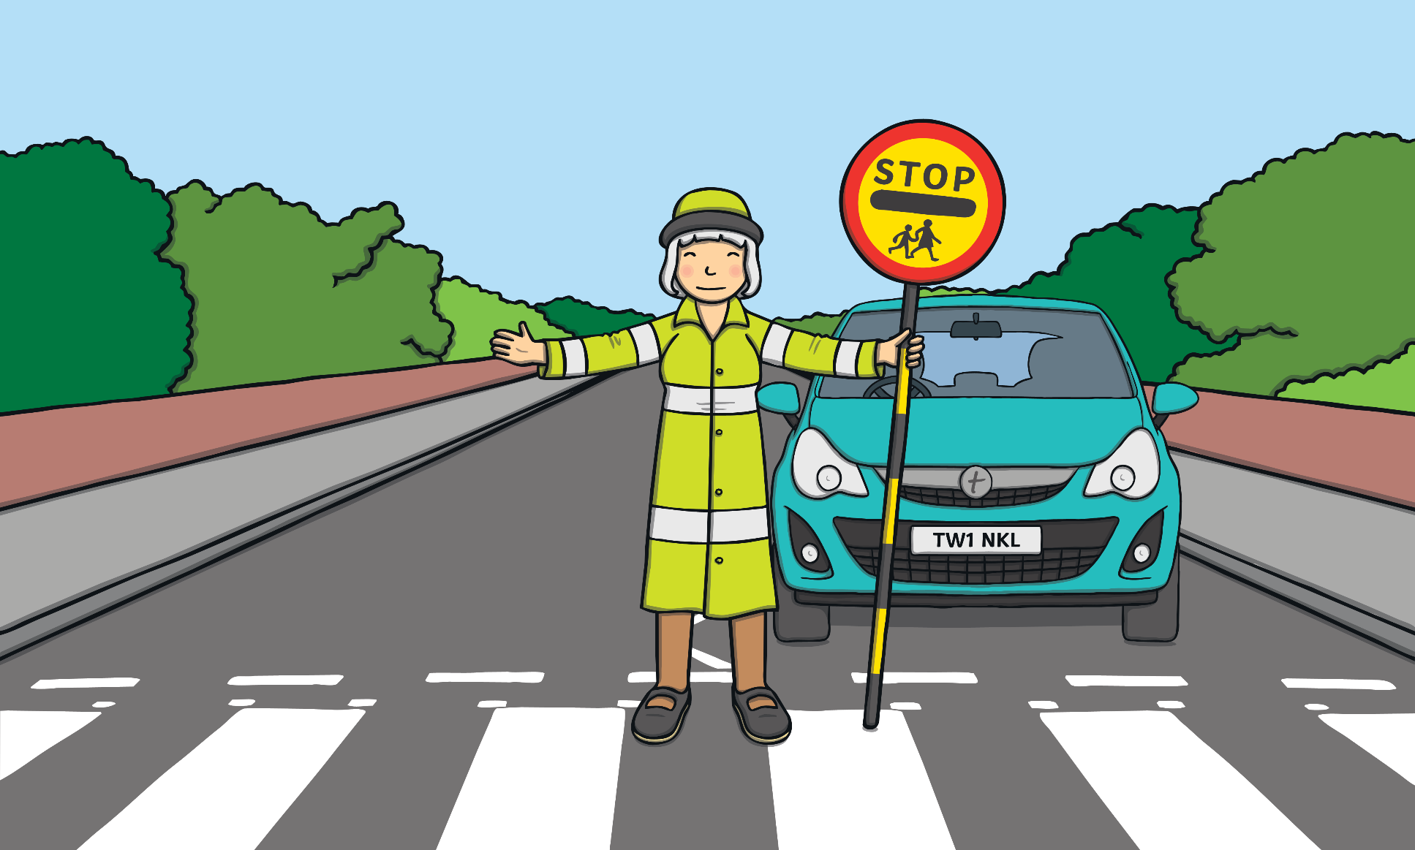

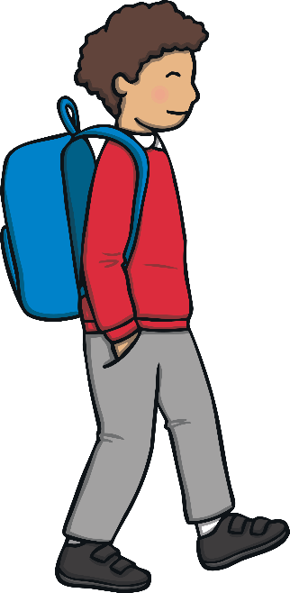

Be Street-Smart
Busy roads, full of different vehicles travelling at high speeds, mean we have to take extra care whenever we are
near roads.
You have already worked in pairs to think about ways to stay safe around roads.
One of the biggest dangers we all face when we are out and about is traffic.
Have you ever heard of the Green Cross Code?
Tell your partner what you think this might be.

Slide 11
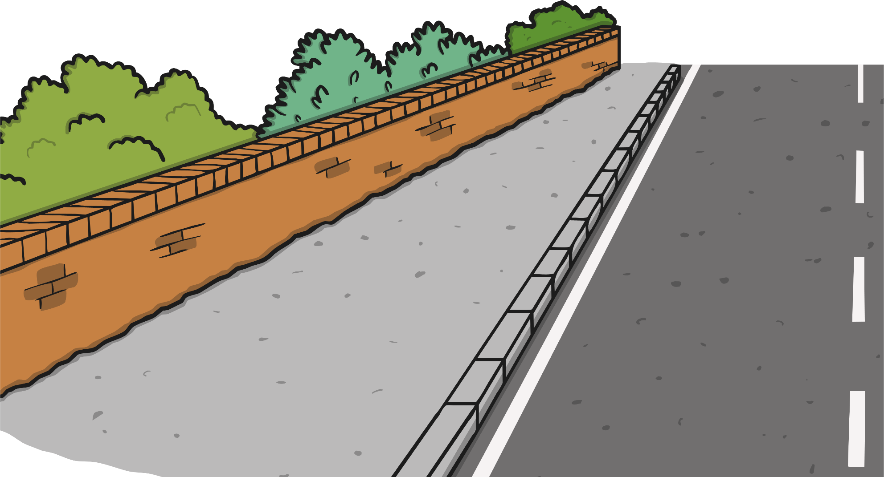
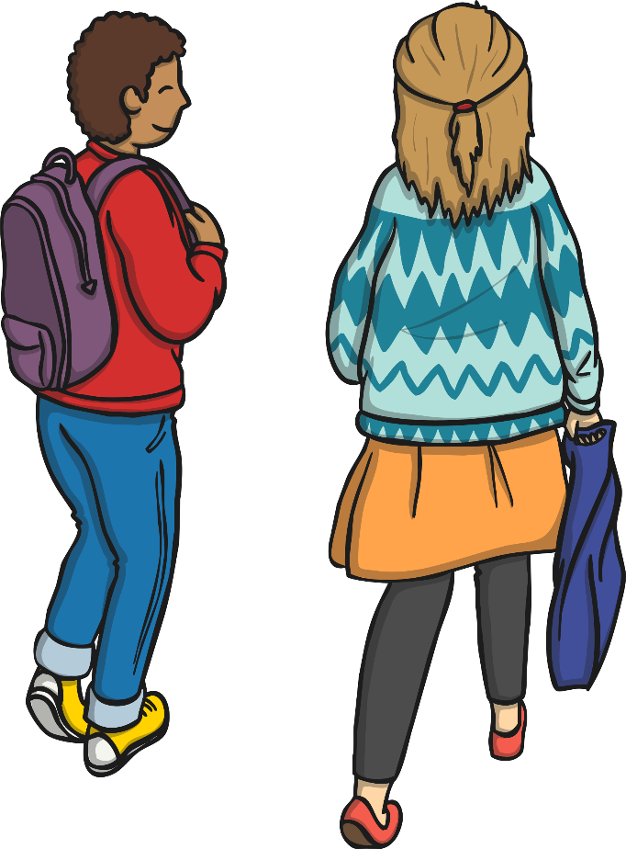
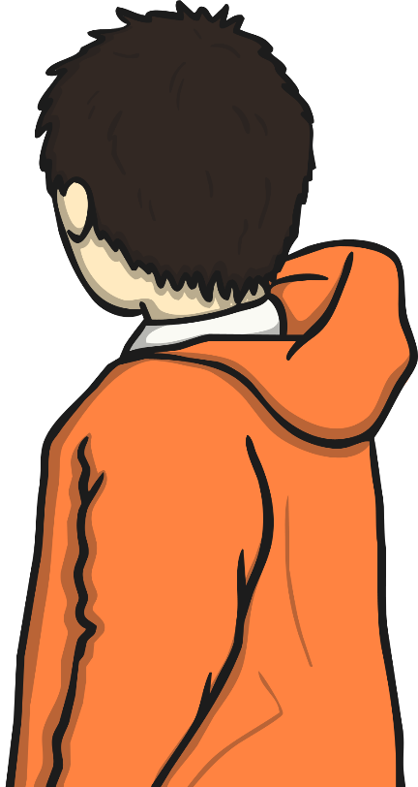
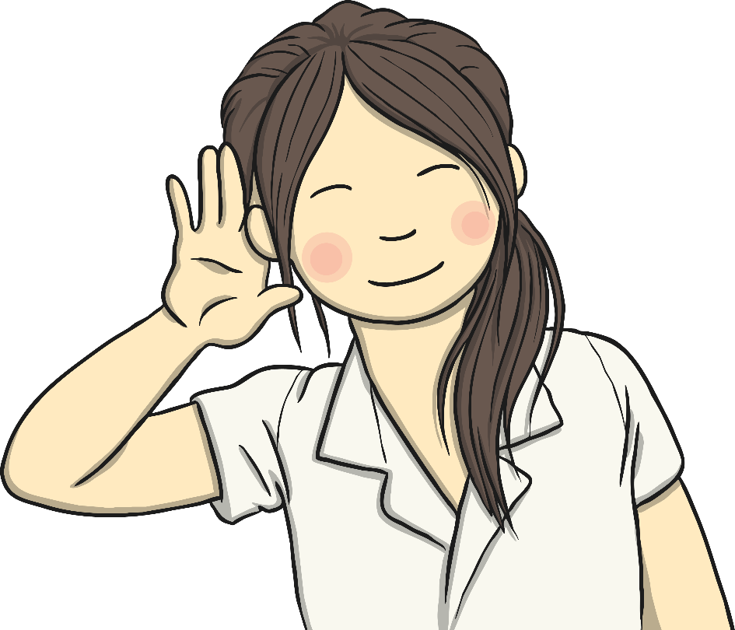

Be Street-Smart
The Green Cross Code is a set of instructions to help keep pedestrians safe when they cross roads.
Tell your partner what you know about crossing roads safely.
The Green Cross Code was introduced in 1971. It reminds us to:
stop;
look and listen;
wait;
look and listen again;
cross carefully.

Slide 12
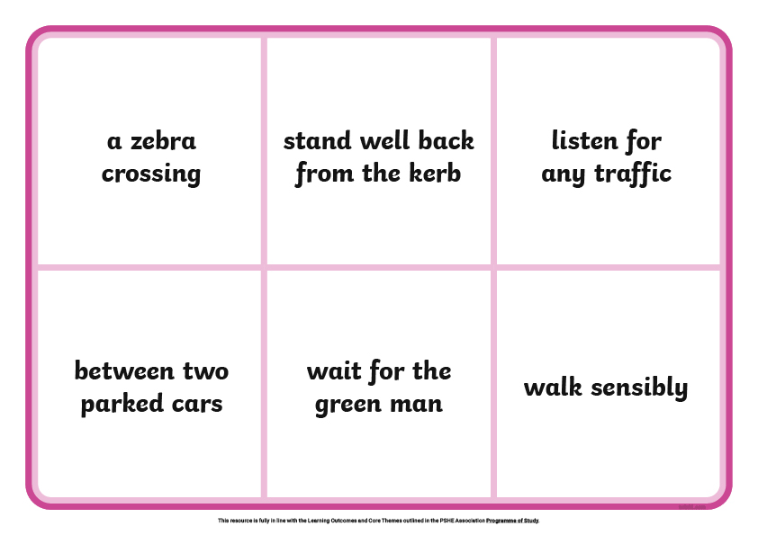
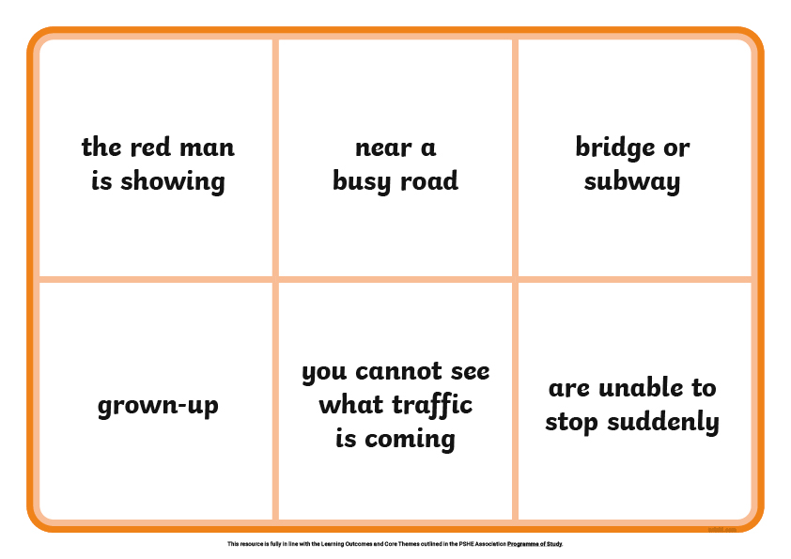
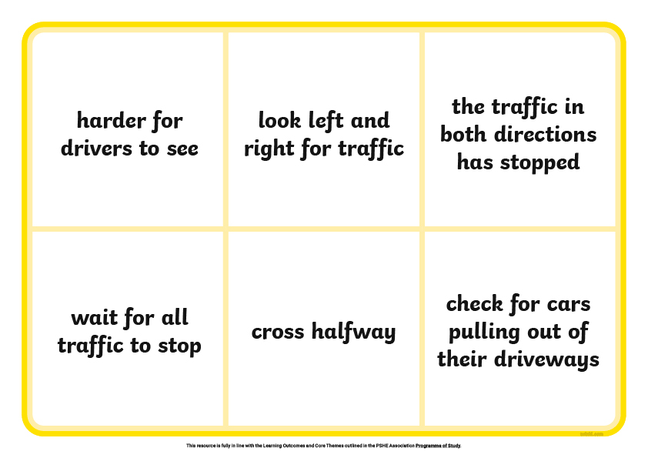
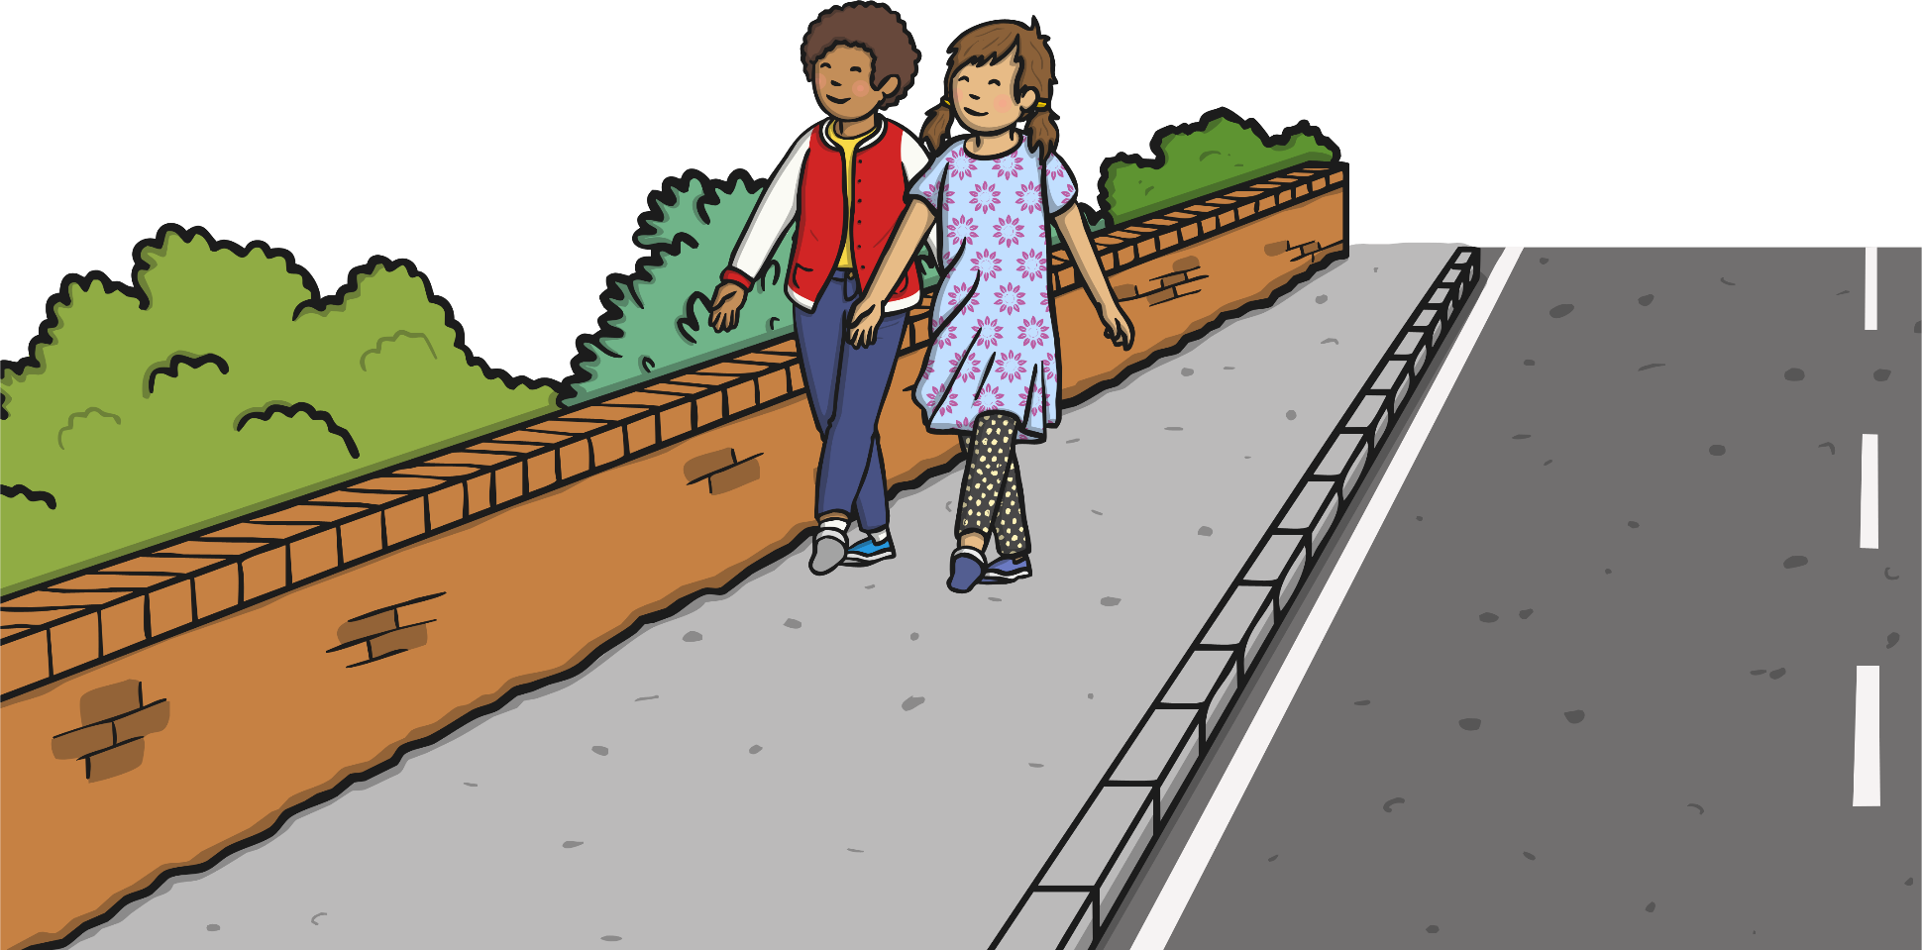
Be Street-Smart
We can be street-smart by knowing all about the Green Cross Code
and following it when we are out and about.
You and your partner will have a grid with six phrases, all linked to dangers on the road or ways to stay safe.
You will hear the start of a sentence and if you have a phrase that finishes that sentence on your grid, cross it out. The aim is to be the first pair to cross out all of your phrases.
It isn’t just when we cross the road that we have to be careful.
We should always take care when we walk next to roads and it is never a good idea to play near roads.
You are going to stay in your pairs for this next game.
We are going to play Street-Smart Bingo.

Slide 13

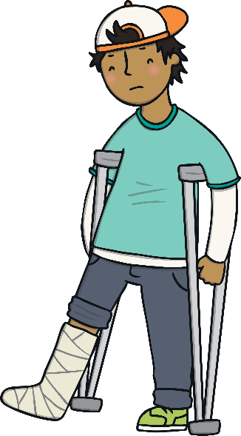
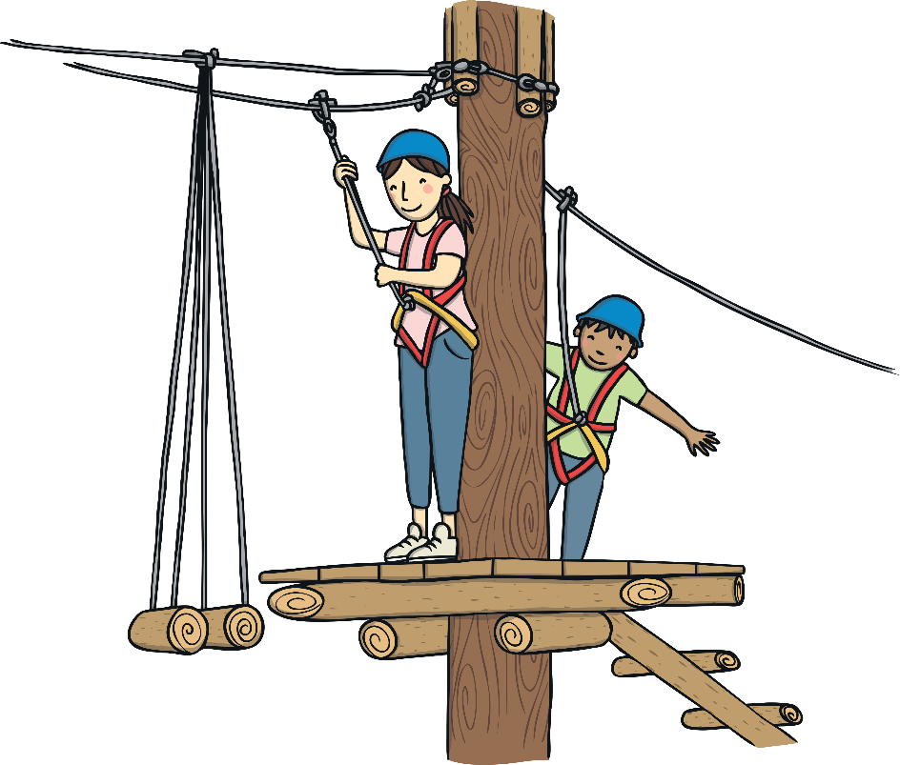
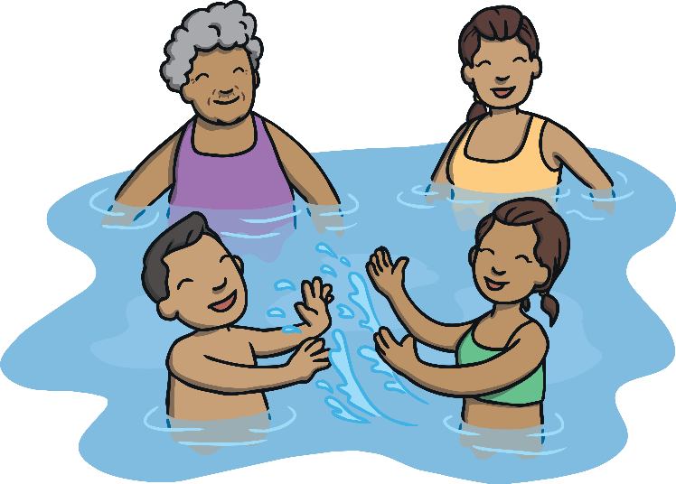
Different Dangers
Of course, road safety is really important but it isn’t the only danger we need to be aware of when we are out and about.
In your groups, can you think of any other dangers we might face outside?

Slide 14
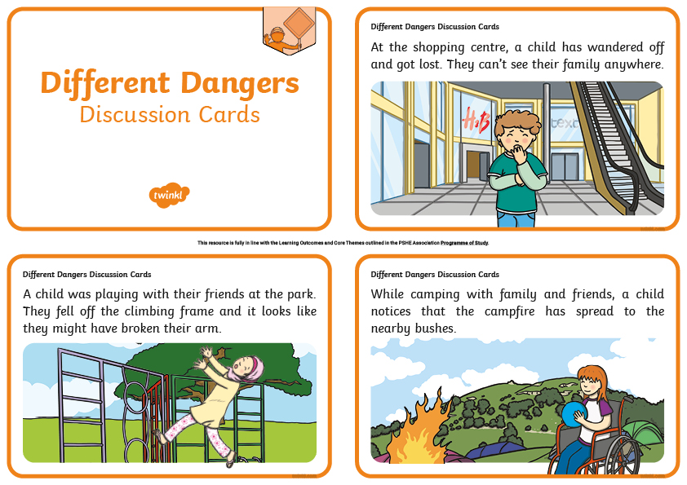
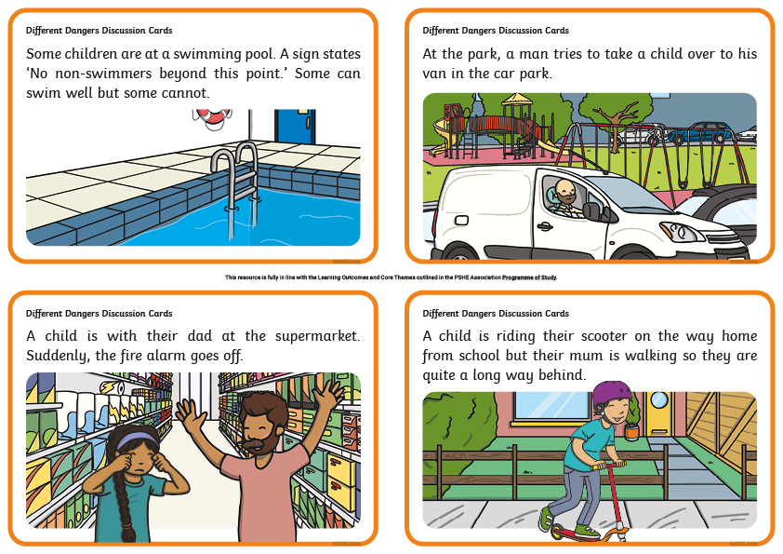
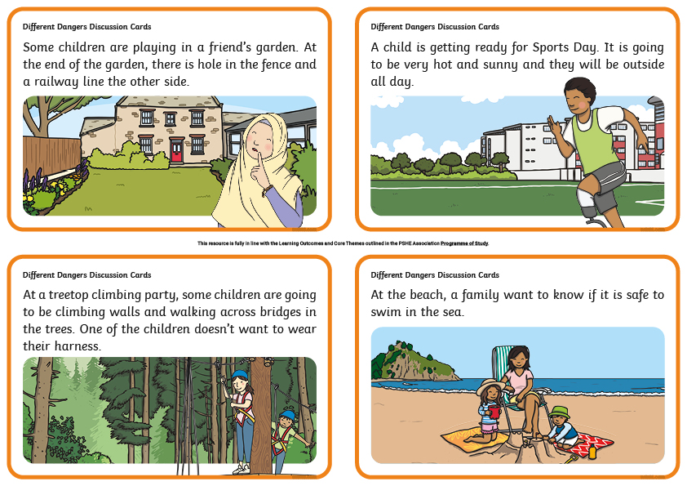
Different Dangers
In your groups, you are going to look at the Different Dangers Discussion Cards and talk together about why the situation is dangerous and what the child should do.
On the next slide, you will see a list of possible actions that could help keep the
child safe.
Choose one that you think would help in each situation or think of your own ideas.

Slide 15
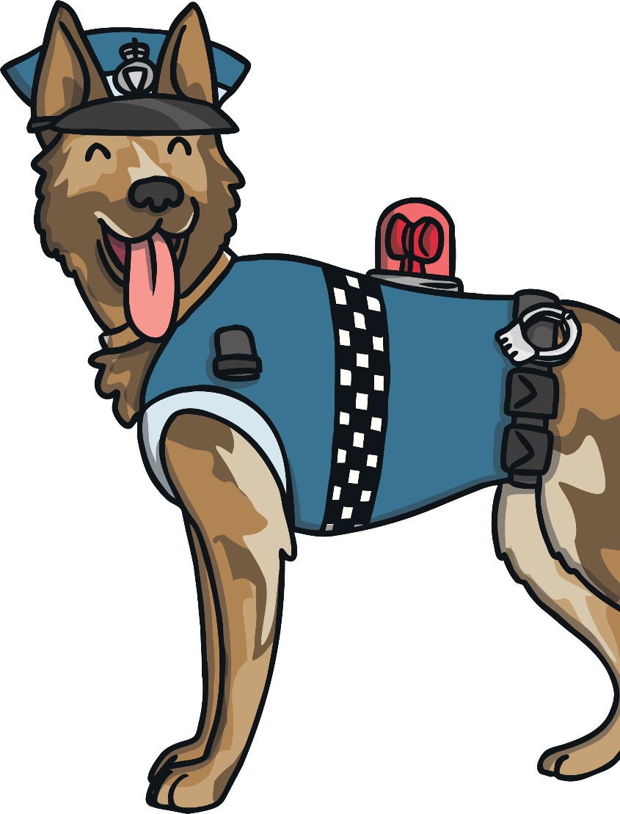
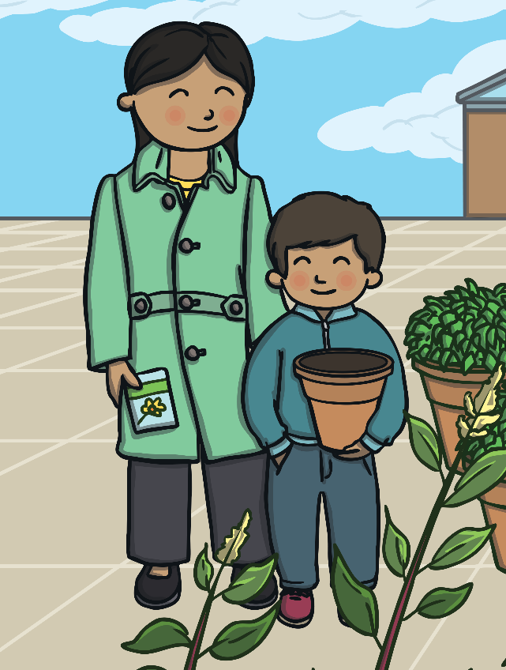
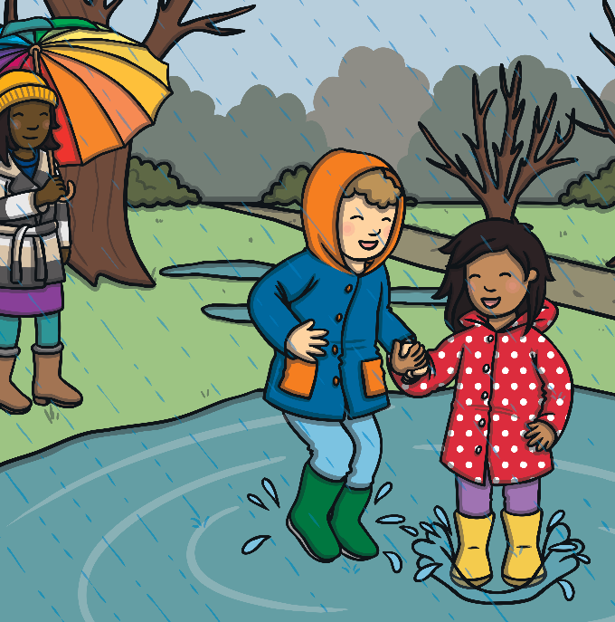
Different Dangers
Things we can do to stay safe outside:
Say, ‘No!’ and run away.
Tell a trusted grown-up what has happened.
Call 999 to get the emergency services.
Stay with your grown-up.
Find a trusted adult, such as a police officer.
Make sure you can see your grown-up and they can see you.
Look carefully at the signs, read what they say and do what they say.
Choose somewhere safer to play.
Look, listen and concentrate.
Remember to follow instructions.
Follow sun-safety rules.

Slide 16
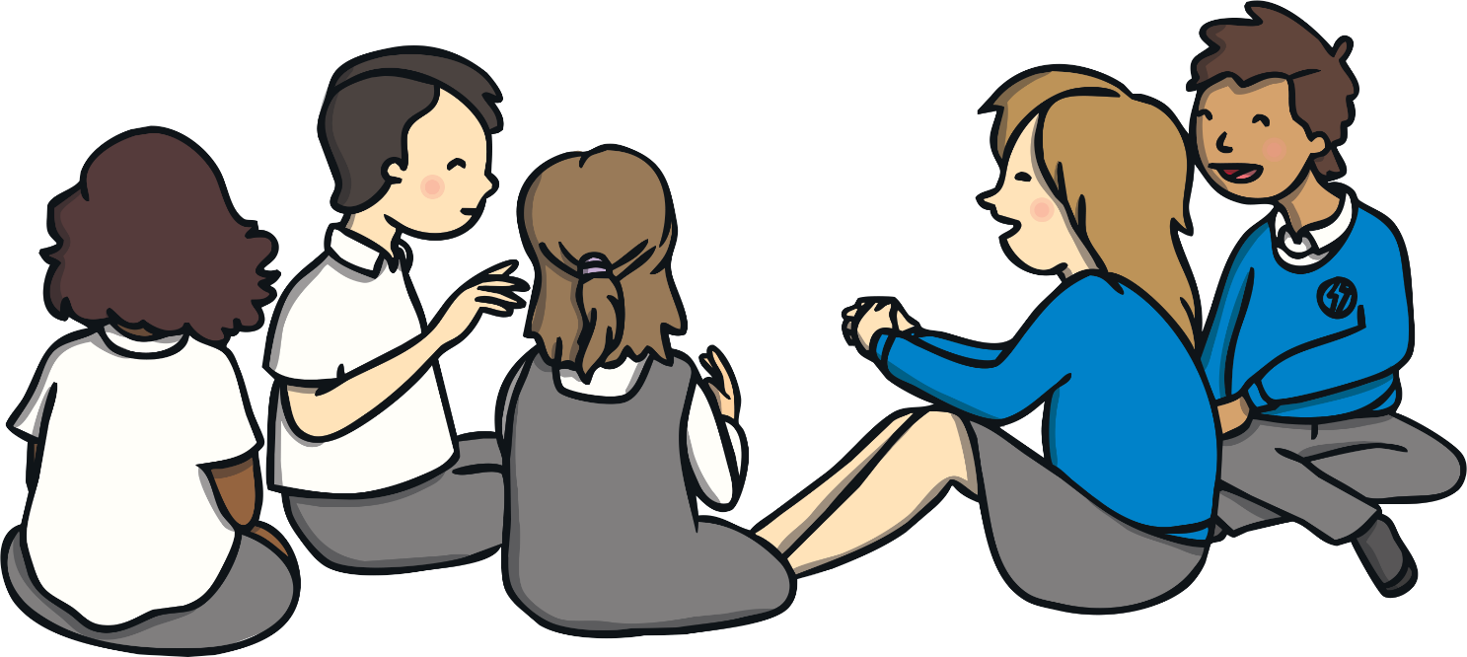
Different Dangers
How did your group get on?
Were you able to agree on some actions to stay safe for each situation?
Did you think of any ways to stay safe that weren’t on the list?
Does anyone have any other scenarios they want us to discuss?
Consolidating
Reflecting

Slide 17
Consolidating

Slide 18
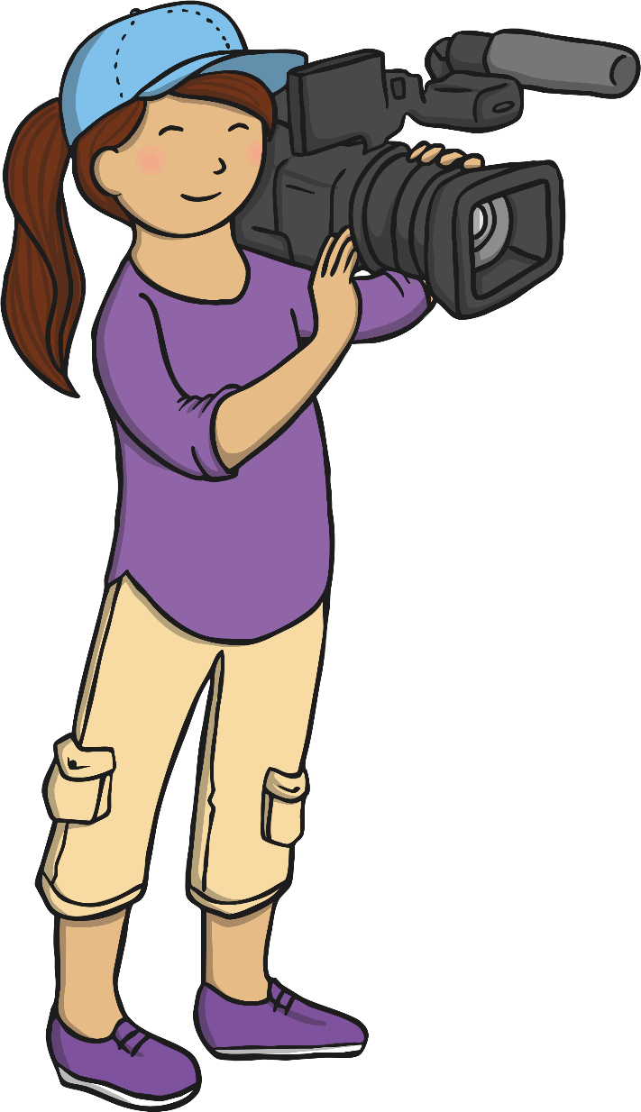
Safety Video
Videos are a great way of sharing information.
Today, in your groups, you are going to create a short safety video about staying safe outside.
In your video, you can choose which danger to focus on. It could be road safety, safety around water, staying safe at the park, sun safety, stranger danger or something else.
Talk about what you would like to do in your groups, have a few practices, then we can record your safety video.

Slide 19
Reflecting

Slide 20
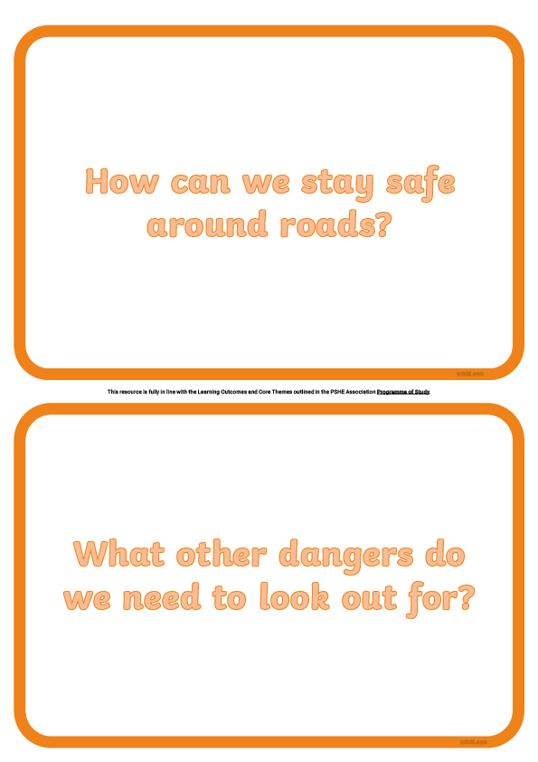

What Have We Learnt?
At the start of the lesson, we wrote down our answers to the Big Questions.
Take another look at your
Big Questions Ideas Sheet.
Write down anything you have learnt today about road safety or any other dangers that we need to be aware of outside.
Can you and your partner think of anything else to add that you hadn’t thought
of before?

Slide 21
The Big Questions

Slide 22
How can we stay safe around roads?
What other dangers do we need to look out for?
Do you feel more confident now about knowing what the dangers are and how to stay safe when you are out and about?

Slide 23
Aim
I know how to stay safe when I am out and about.
Success Criteria
I understand how to stay safe around roads and other busy areas.
I can identify other dangers I might face when I am outside.
I know who can help me if I am in danger.

