Slide 1

PSHE and Citizenship
Living in the Wider World | One World
PSHE and Citizenship | Year 2 | Living in the Wider World | One World | Planet Protectors | Lesson 6

Slide 3
Aim
I can say why it is important to care for the earth and identify how I can help protect it.
Success Criteria
I can think about what I love about the earth.
I can design a poster to tell others why it is important to care for the earth and how to do this.
I can make a pledge to be a planet protector.
This resource is fully in line with the Learning Outcomes and Core Themes outlined in the PSHE Association.

Slide 4
The Big Questions

Slide 5

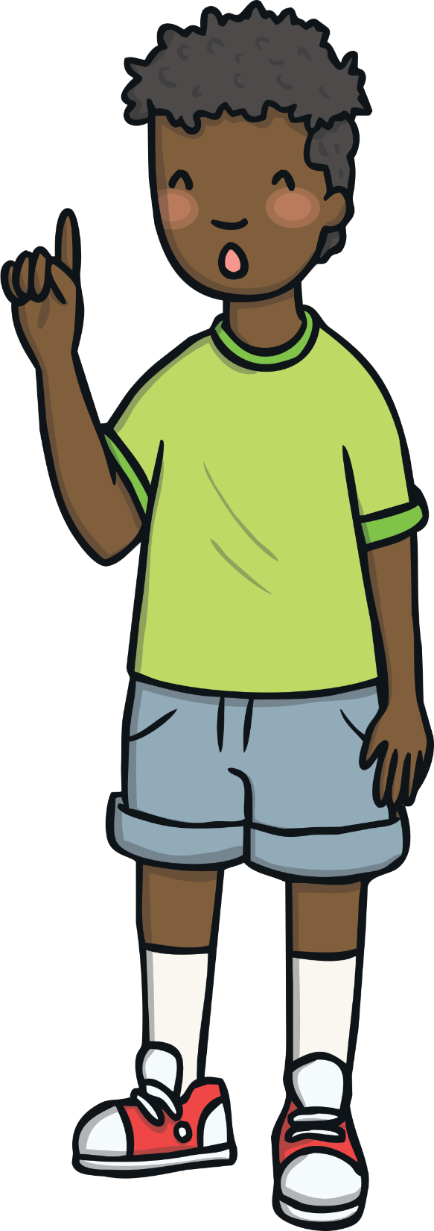
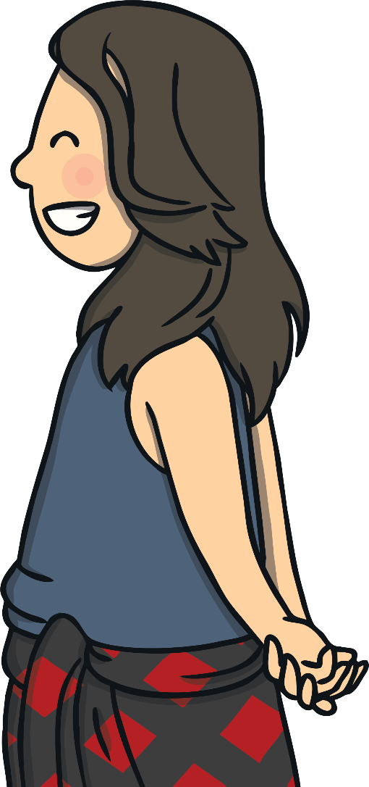
The Big Questions
Why is it important to care for
the earth?
What can we do
to help?

Slide 6
Reconnecting

Slide 7

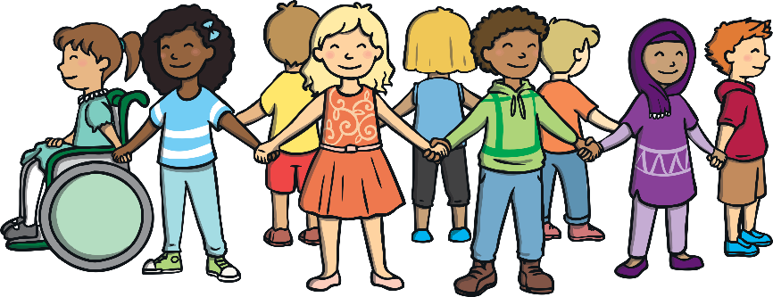
Our Beautiful World
Planet Earth is an amazing place. What do you love about our
beautiful world?
On your Our Beautiful World Activity Sheet draw the natural things you love about Planet Earth.
If you feel happy to, share your drawings with the class.

Slide 8
Exploring

Slide 9

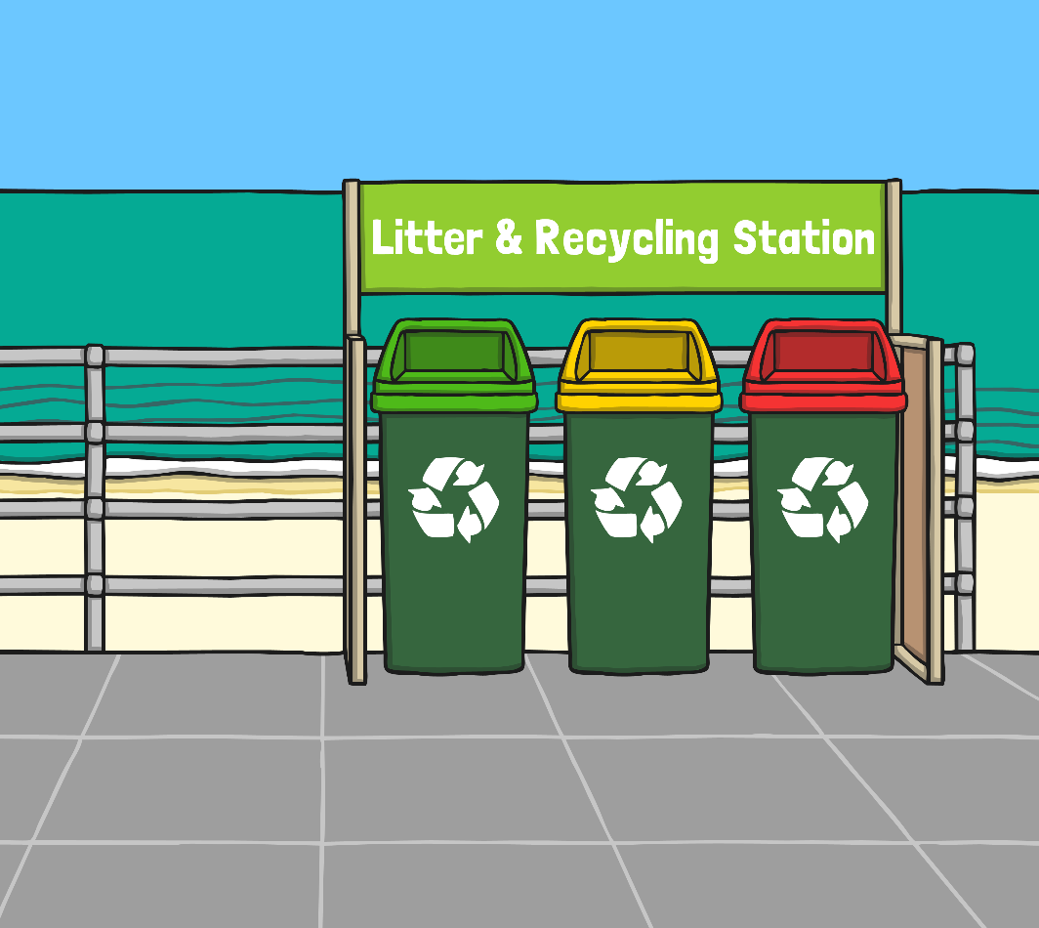
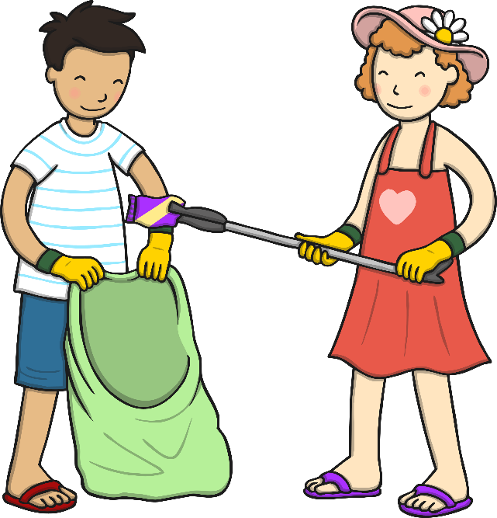
Environmental Effects
Planet Earth is an amazing place. We can help and protect our world by the choices we make. Or we can harm our world by the choices we make.
We can choose to recycle our waste, put litter in the bin and save natural resources. Or, we can choose to drop litter on the ground and harm plants, animals and other people.

Slide 10
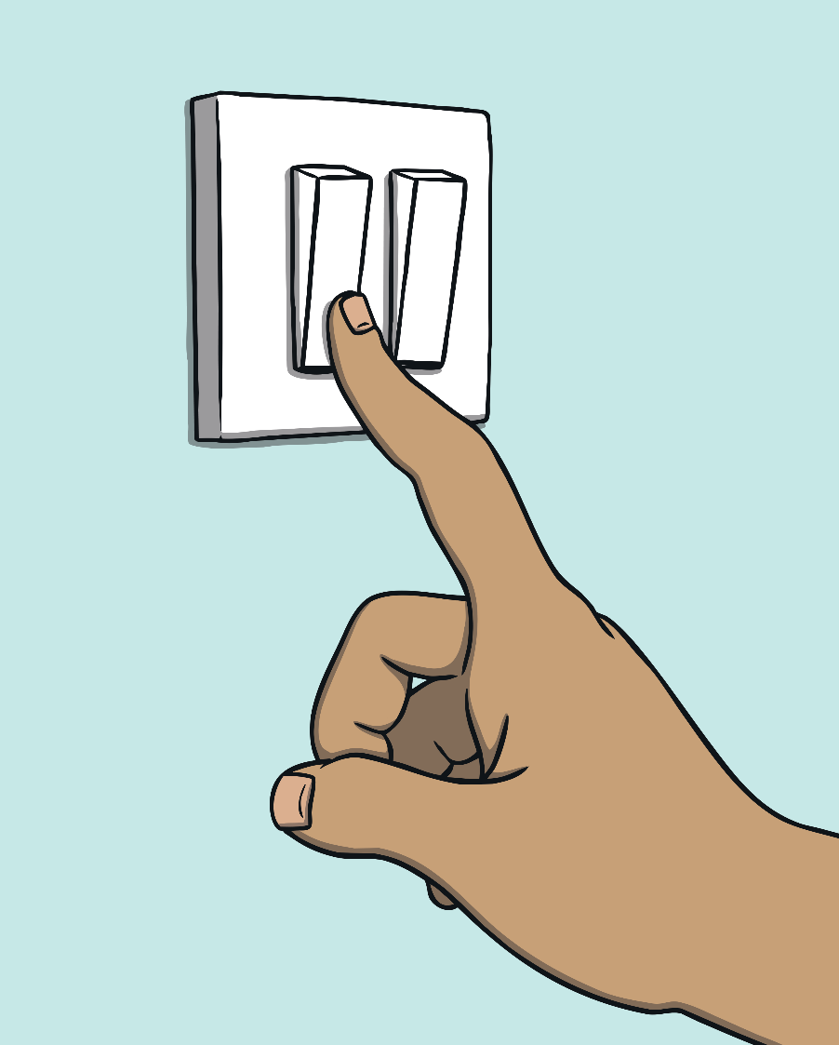
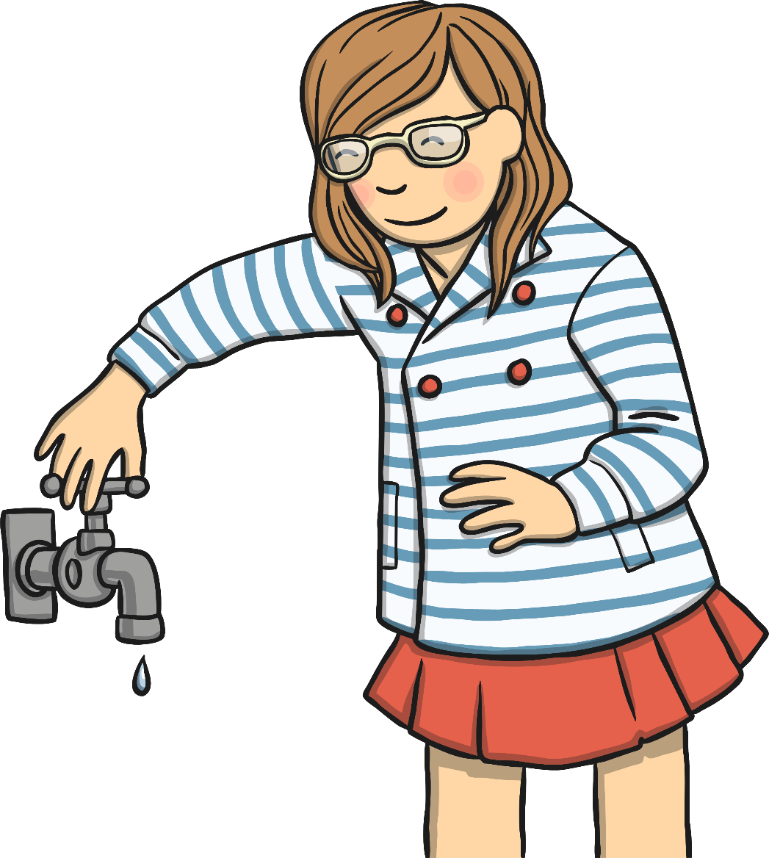
Environmental Effects
We can choose to switch off lights and electrical items when we leave a room to save energy. Or, we can leave them all on and waste energy.
We can turn off the tap while we are brushing our teeth to save water. Or, we can leave the tap running and waste water.

Slide 11
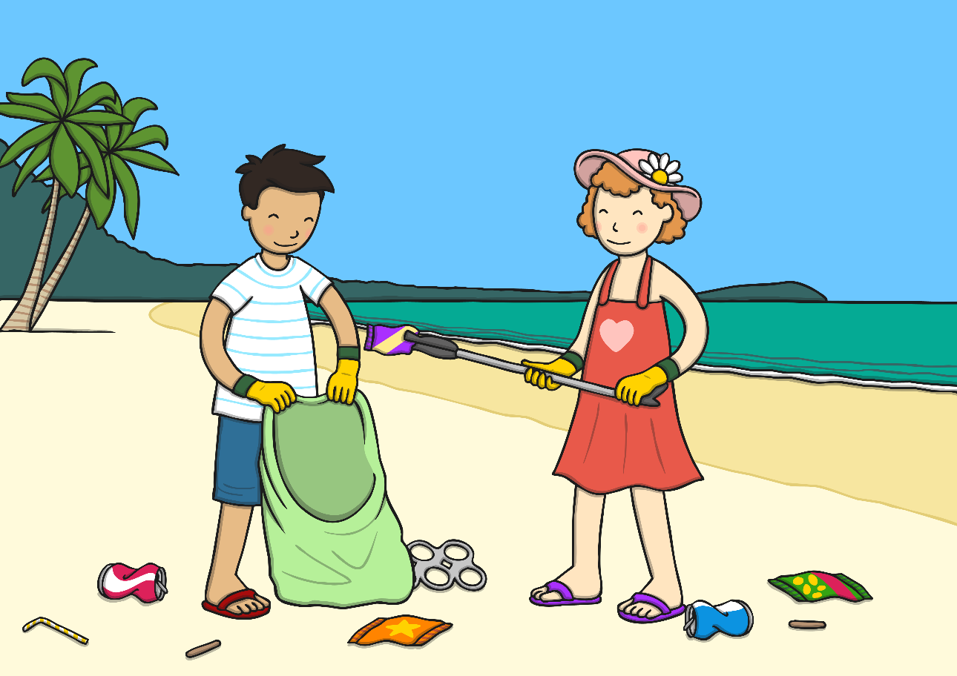
Environmental Effects
We can ignore what's happening in other countries. Or, we can choose to support charities that are working to protect the environment throughout the world.

Slide 12

Taking Care of Planet Earth
What could we do to help make the problems in the images better?
How would this help Planet Earth?
Talk to a partner about your ideas, then share your thoughts with
the class.
Let’s all be planet protectors and make choices which will help look after our beautiful world.

Slide 13

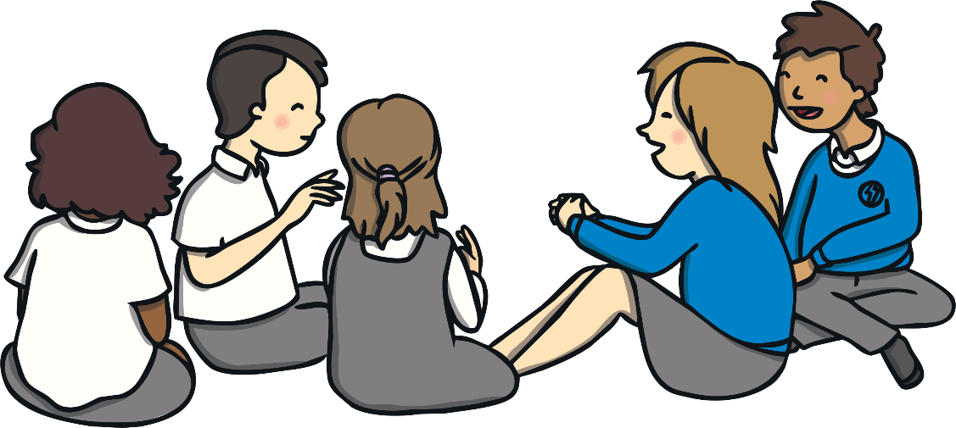
Consolidating
Reflecting

Slide 14
Consolidating

Slide 15
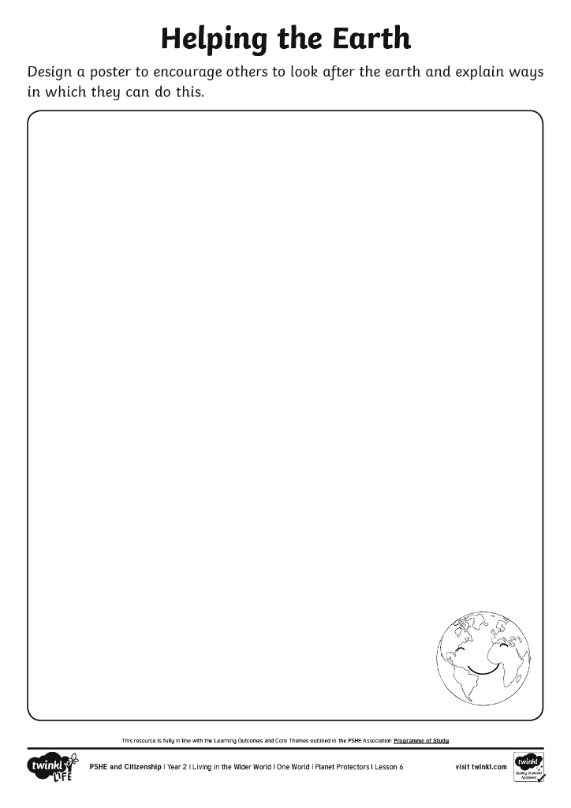
Helping the Earth
Let’s encourage others to be planet protectors too!
Design a poster to explain to others why it is important to care for Planet Earth and tell them about ways in which they can do this.
You can use the words below to
help you.
Word Bank
Planet
earth
world
protect
help
harm
choose

Slide 16
Reflecting

Slide 17

My Pledge to the World
We have the power to protect the earth by the choices we make.
What will you do to help care for the earth?
Draw around your hand and write or draw what you pledge to do to help our world.
After you have finished, decorate and cut out your hand print. If you feel happy to do so, share your pledges with the class.
Let’s do our bit to help our beautiful world
stay beautiful!

Slide 18
The Big Questions

Slide 19
The Big Questions
Why is it important to care for
the earth?
What can we do
to help?
Take a moment to think about all you have learnt throughout this unit about the people and places of our amazing world.
How will it help you live in a way which looks
after others and the earth?

Slide 20
Aim
I can say why it is important to care for the earth and identify how I can help protect it.
Success Criteria
I can think about what I love about the earth.
I can design a poster to tell others why it is important to care for the earth and how to do this.
I can make a pledge to be a planet protector.

