Slide 1
RE
What is the importance of light in religion?
To understand why light is used as a symbol at Christmas
To know how Christians might interpret the symbolism of a Christingle
Jesus’ as ‘Light of the World’ belongs to the first years of Christianity. John’s Gospel (Chapter 8 verse 12), Jesus himself declares: ‘I am the light of the world. No follower of mine shall wander in the dark; he shall have the light of life’.

Slide 2
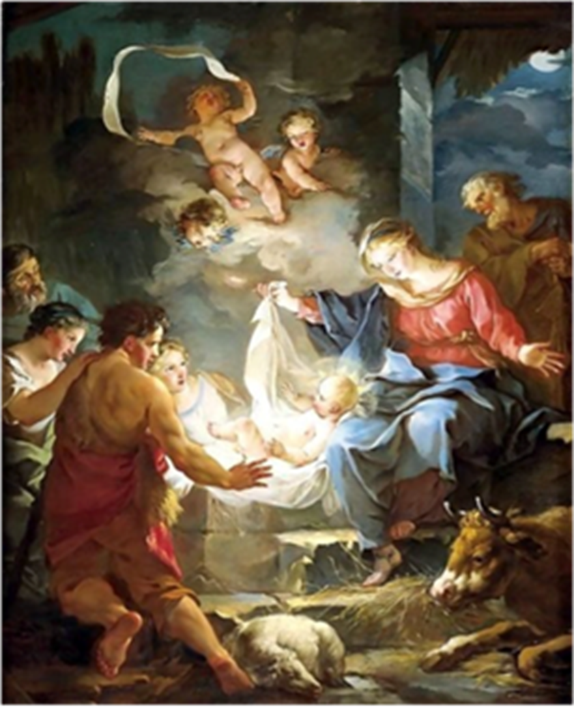
What do they notice first in the picture? For me it was the light shining from within it ..

Slide 3
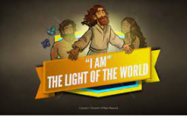
https://www.youtube.com/watch?v=BsaDKAtoGFA

Slide 4
Today we will be thinking of ways in which light is used at Christmas
Write ‘Light at Christmas’ in the middle of your piece of paper
Then, around outside, write the different ways light is used at Christmas with possible reasons for their use

Slide 5
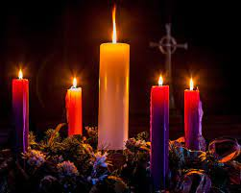
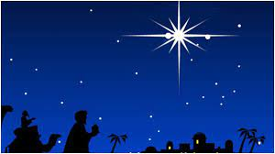
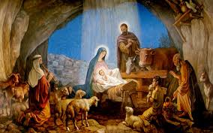
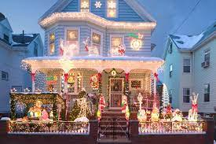


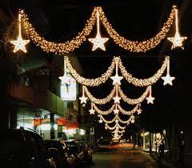
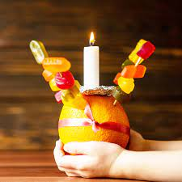
Light at Christmas examples

Slide 6

Light is used all over the world to express feelings and beliefs, when something is used like this it is known as a symbol.
Do you have or use any symbols?

Slide 7
Reflection:
How do you feel in the darkness?
When light is added-how do you feel?

