Slide 1
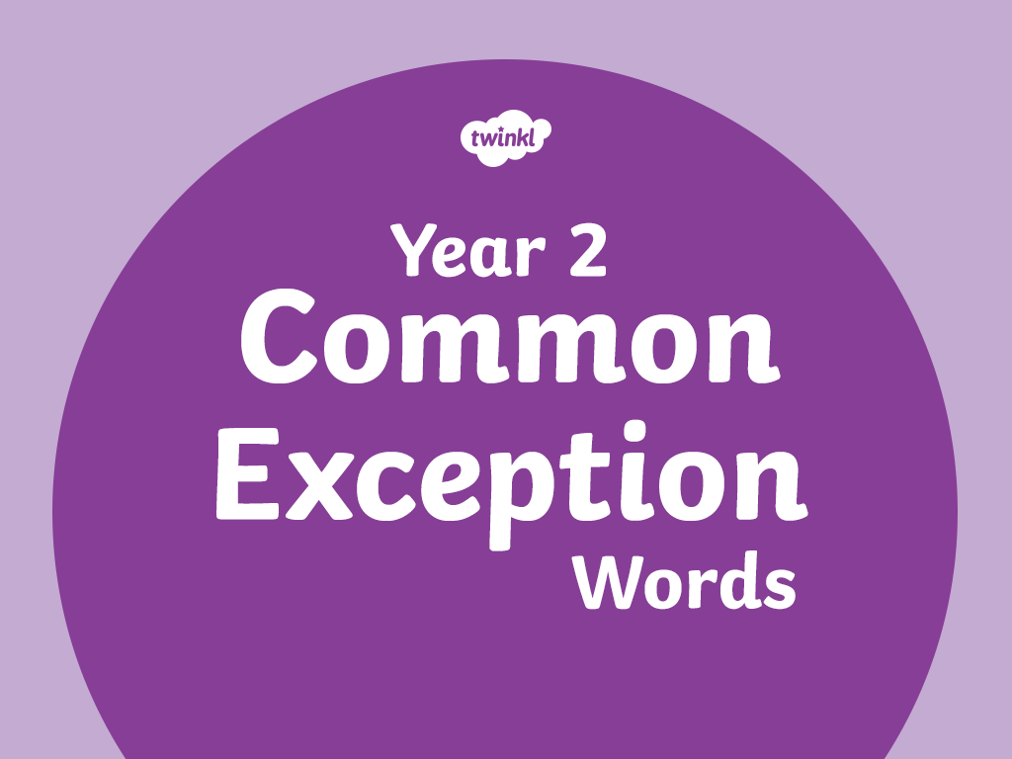

Slide 2
door

Slide 3
floor

Slide 4
poor

Slide 5
because

Slide 6
find

Slide 7
kind

Slide 8
mind

Slide 9
behind

Slide 10
gold

Slide 11
hold

Slide 12
told

Slide 13
every

Slide 14
great

Slide 15
break

Slide 16
steak

Slide 17
pretty

Slide 18
beautiful

Slide 19
after

Slide 20
fast

Slide 21
last

Slide 22
past

Slide 23
father

Slide 24
class

Slide 25
grass

Slide 26
pass

Slide 27
child

Slide 28
children

Slide 29
wild

Slide 30
climb

Slide 31
most

Slide 32
only

Slide 33
both

Slide 34
old

Slide 35
some

Slide 36
cold

Slide 37
plant

Slide 38
path

Slide 39
bath

Slide 40
hour

Slide 41
move

Slide 42
prove

Slide 43
improve

Slide 44
sure

Slide 45
sugar

Slide 46
eye

Slide 47
could

Slide 48
should

Slide 49
would

Slide 50
who

Slide 51
whole

Slide 52
any

Slide 53
many

Slide 54
clothes

Slide 55
busy

Slide 56
people

Slide 57
water

Slide 58
again

Slide 59
half

Slide 60
money

Slide 61
Mr

Slide 62
Mrs

Slide 63
parents

Slide 64
Christmas

Slide 65
everybody

Slide 66
even

Slide 67


