Slide 1


Slide 3
1) Count in 2s until you get to 20
2) Count in 5s until you get to 20
3) Can you count in 3s and get to 20?

Slide 4



1) Count in 2s until you get to 20
2) Count in 5s until you get to 20
3) Can you count in 3s and get to 20?

Slide 6

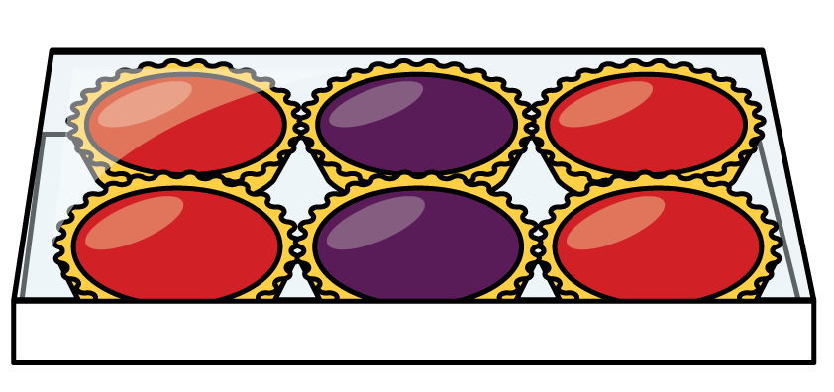

Arrays have rows and columns
Columns
Rows

Slide 7

How many columns are in these arrays?
There are columns.
4
There are columns.
2

Slide 8
How many rows are in these arrays?
2
There are rows.
4
There are rows.

Slide 9
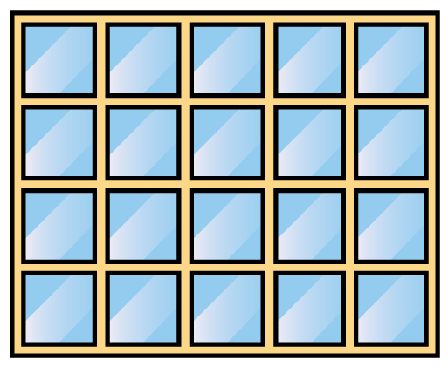
How many windows?
There are rows.
4
5
There are windows in each row.
There are windows altogether.
20

Slide 10

How many shells?
3
There are rows.
3
There are shells in each row.
There are shells altogether.
9

Slide 11
Have a go at the questions on the worksheet

