Slide 1


Slide 3
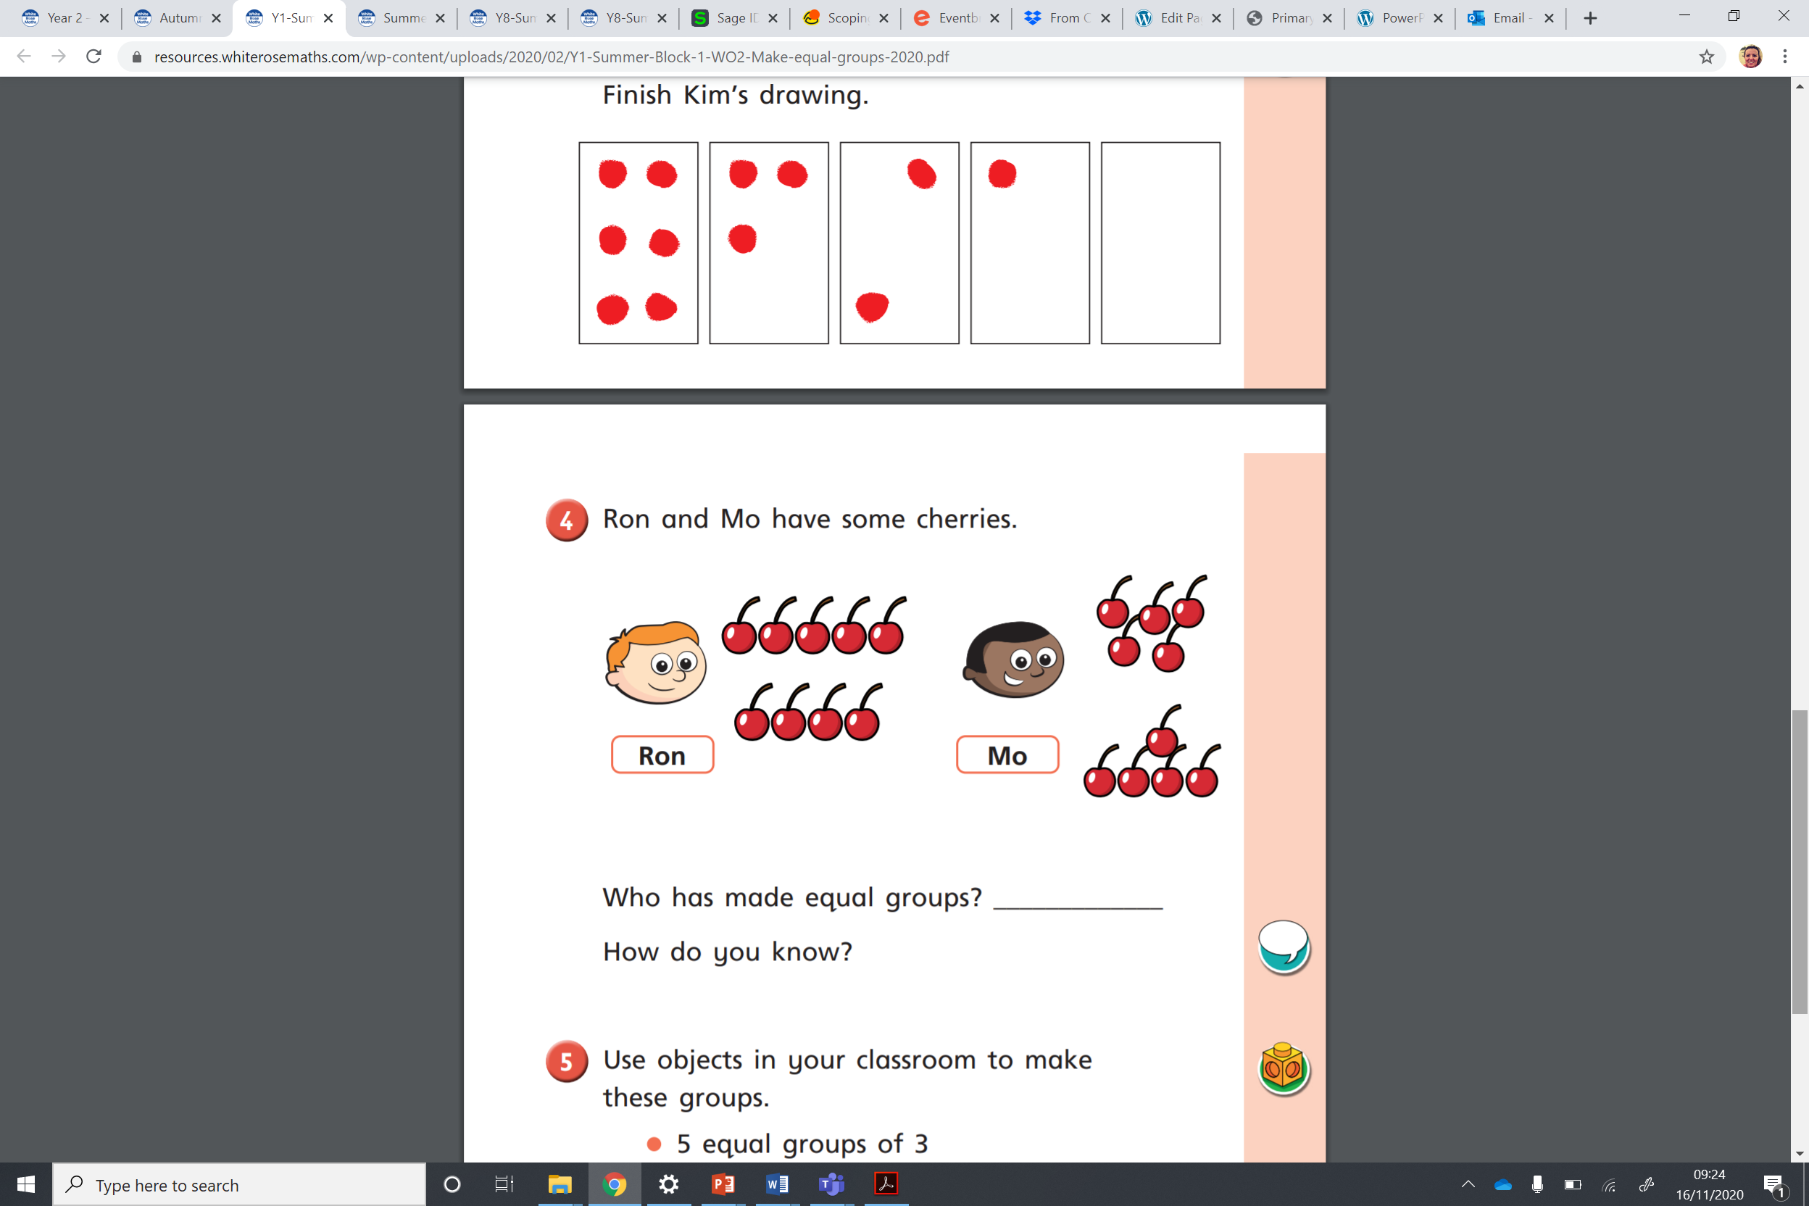
1) Are the groups equal?
2) Draw 3 equal groups with 2 circles in each group.
3) How many circles have you drawn altogether?

Slide 4
1) Are the groups equal?
2) Draw 3 equal groups with 2 circles in each group.
3) How many circles have you drawn altogether?
6

Slide 6
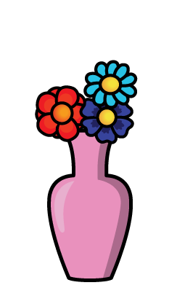




There are flowers in each vase.
3
There are vases.
4
3
There are equal groups of
4
$$+$$
3
$$+$$
$$+$$
12
3
3
3
$$=$$

Slide 7










There are equal groups of
6
2
2
$$+$$
2
$$+$$
2
$$+$$
2
$$+$$
2
$$+$$
2
$$=$$
12

Slide 8

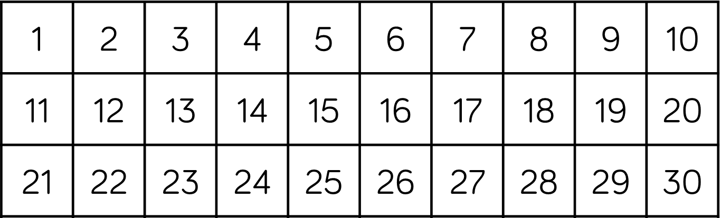




There are equal groups of
4
5
5
$$+$$
5
$$+$$
5
$$+$$
5
$$=$$
20

Slide 9
Have a go at the questions on the worksheet

