Slide 1


Slide 3



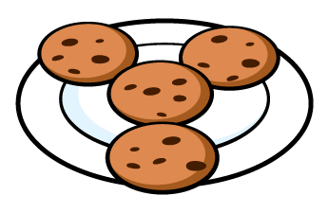
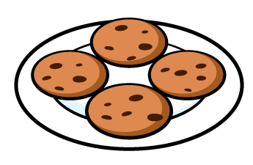
Are these equal groups?

Slide 4
Are these equal groups?

Slide 6
Equal
Unequal

Slide 7








?
?
4
4
I have 2 unequal groups.
I have 2 equal groups.

Slide 8
Can you make two equal groups?

Slide 9
Can you move one item?

Slide 10







Unequal
Equal

Slide 11
Make three equal groups and then make them unequal.

Slide 12
Unequal
Equal

Slide 13
3 unequal groups
3 equal groups of 4
6 unequal groups
6 equal groups of 2

Slide 14
12 counters
6 equal groups of 2
4 equal groups of 3
3 equal groups of ?
Are there any other amounts which can start as unequal groups but make equal groups?

