Slide 1


Slide 3
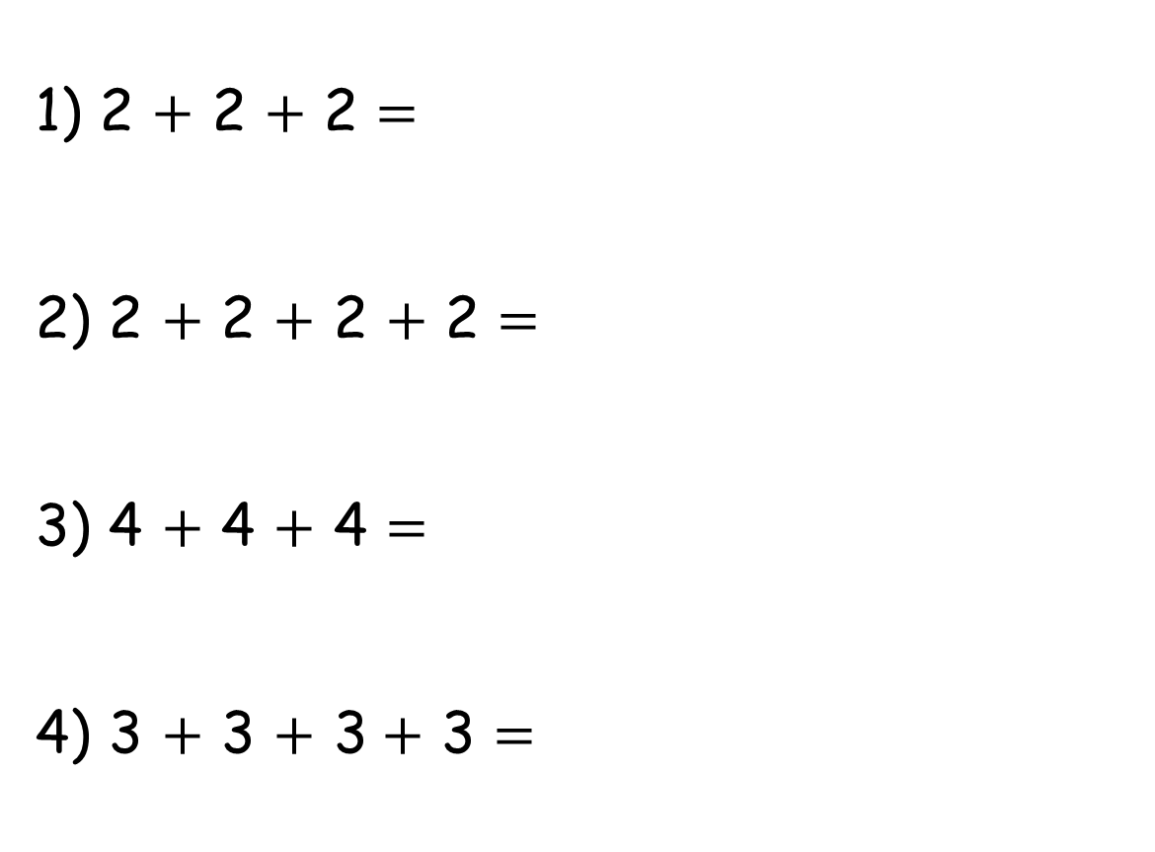
1) 2 $+$ 2 $+$ 2 $=$
2) 2 $+$ 2 $+$ 2 $+$ 2 $=$
3) 4 $+$ 4 $+$ 4 $=$
4) 3 $+$ 3 $+$ 3 $+$ 3 $=$

Slide 4
4
1) 2 $+$ 2 $+$ 2 $=$
2) 2 $+$ 2 $+$ 2 $+$ 2 $=$
3) 4 $+$ 4 $+$ 4 $=$
4) 3 $+$ 3 $+$ 3 $+$ 3 $=$
6
4
4
8
8
12
6
6
12

Slide 6




Ron and Whitney are playing spot the difference.
Have a
think

Slide 7


equal groups
3
3
3
3
unequal groups
Have a
think
4
4
5

Slide 8
Have a go at question
1 on the worksheet

Slide 9


These apples are in equal groups.
There are equal groups of
5
3
Have a
think
There are equal groups of
3
5

Slide 10

Have a think
There are equal groups of
2
4

Slide 11
Have a go at questions 2, 3 and 4 on the worksheet

Slide 12


Can you describe how these carrots are grouped?
There are equal groups of
4
3
There are equal groups of
3
4
Have a think

Slide 13
Have a go at question
5 on the worksheet

