Slide 1
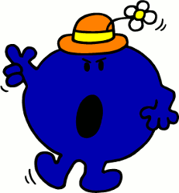
Imperative (Bossy) Verbs

Slide 2

What is a verb?
A doing word.
It describes an action.
E.g. I baked a cake.

Slide 3

What is an imperative verb?
It is a bossy verb! It makes a sentence bossy! Use Miss Bossy to help you remember!
It gives you an order or command.
They are direct and sharp.
E.g. Line up for assembly.
Turn left at the traffic lights.
Mix the flour and eggs together.

Slide 4
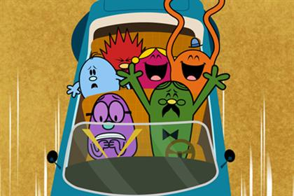
When do we use them?
We often use them in instructional writing.
What types instruction can you think of?
Recipes.
DIY manuals.
Game instructions.
Car directions.

Slide 5

For example!
Hammer the nail into the wood.
Turn right at the zebra crossing.
First, pour the milk into the bowl.
Bounce across the yard.

Slide 6

Can you find the bossy verb?
First, list the ingredients for the recipe.
Jump on the spot.
Next, cut along the dotted line.
Stick the picture in the middle of the card.
What do you notice?
Where do bossy verbs go in the sentence?

Slide 7

Which sentences are bossy?
Please very carefully lift the lid of the box.
Lift the lid of the box.
Gently remove the pie from the oven.
Remove the pie from the oven
When you have time, check to see if the paint is dry.
Check to see if the paint is dry.

Slide 8

How can we change these sentences to make them bossy?
In your own time add two drops of food colouring.
Carefully clap your hands together.
Please can you fold your paper in half.

Slide 9
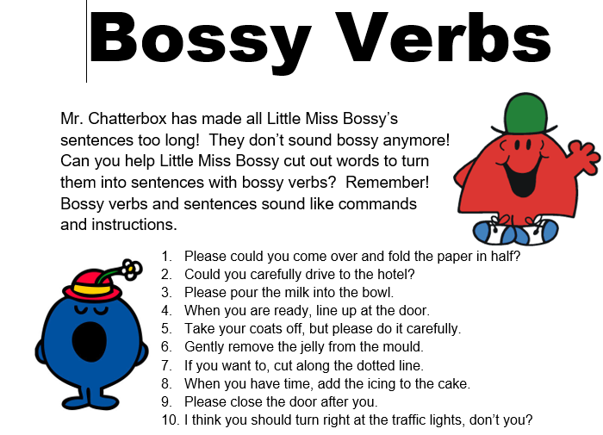
Write some of your own BOSSY instructions!

