Slide 1
Friday 9th July

Slide 2




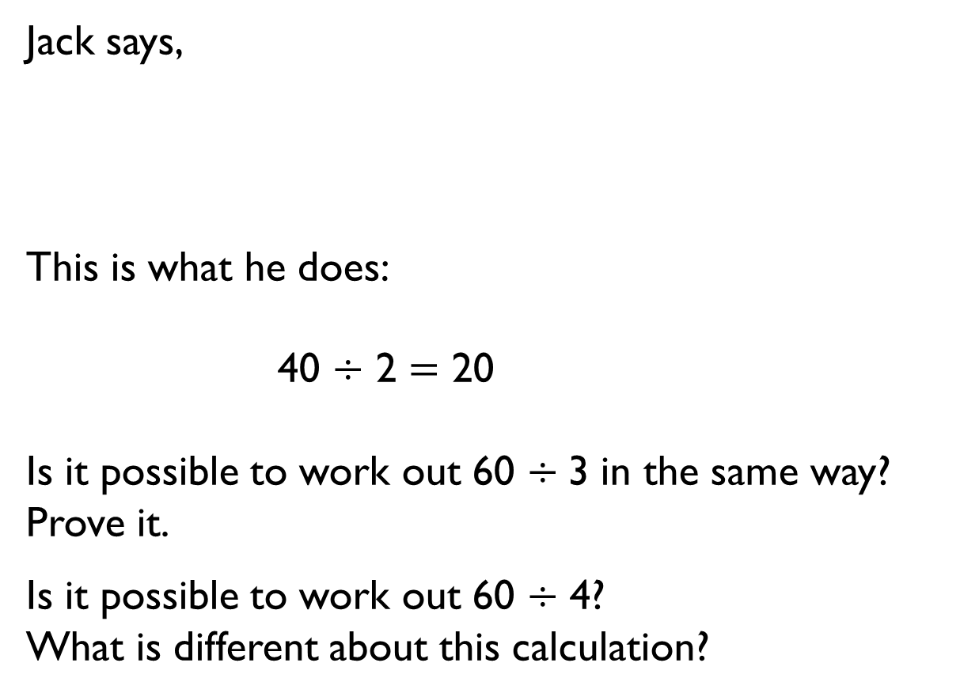
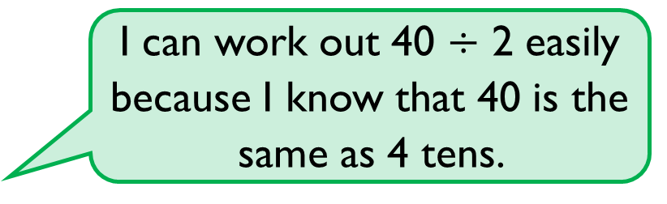
Jack says,
This is what he does:
40 $÷$ 2 $=$ 20
Is it possible to work out 60 $÷$3 in the same way?
Prove it.
Is it possible to work out 60 $÷$ 4?
What is different about this calculation?
I can work out 40 $÷$ 2 easily because I know that 40 is the same as 4 tens.

Slide 3

Alex has 20 sweets and shares them between 5 friends.
Tommy has 20 sweets and shares them between 10 friends.
Whose friends will receive the most sweets?
How do you know?

Slide 4





I have 24 p.
I divide it equally between 2 friends.
How much will they get each?
I have 24 p in 2 p coins.
How many 2 p coins do I have?
Consider the two questions above.
What is the same and what is different?

Slide 5
Tommy and Annie have some counters.
Tommy shares his counters into 2 equal groups.
He has 15 in each group.
Annie groups her counters in twos.
She has 19 groups.
Who has more counters and by how many?
How did you work it out?

Slide 6










True or false?
12 is an odd number.
Prove your answer using concrete, pictorial and abstract representations.
Explain each approach.

Slide 7
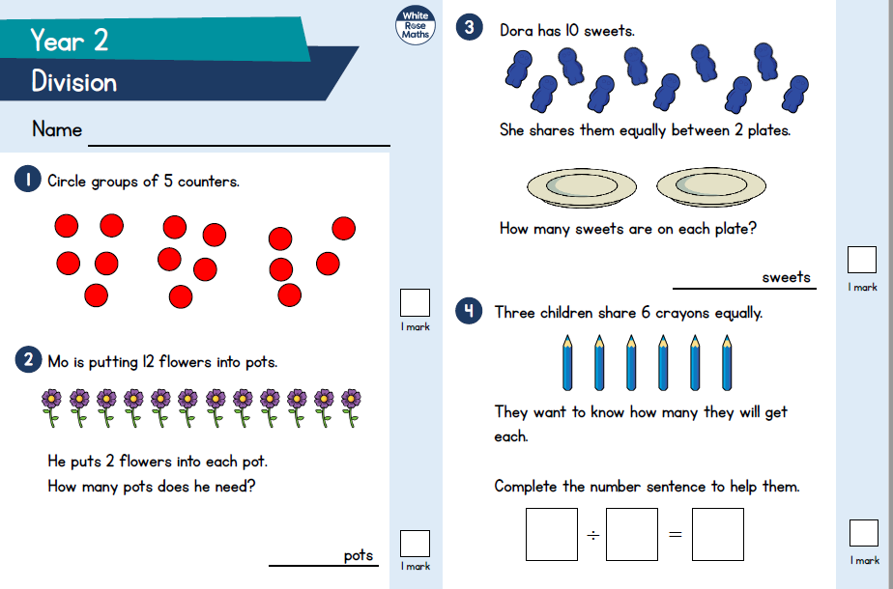

Slide 8


