Slide 2


Slide 4





Complete the sentences below.
1) There are ____ groups of ____ apples.
2) There are ____ groups of ____ flowers.
3) There are ____ groups of ____ sweets.

Slide 5
Complete the sentences below.
1) There are ____ groups of ____ apples.
2) There are ____ groups of ____ flowers.
3) There are ____ groups of ____ sweets.
3
3
4
2
3
5

Slide 7

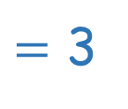
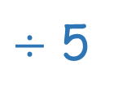
15
5
15 pears are divided into groups of 5
There are 3 groups.
3
tells us how many in total
tells us how many in each group
tells us how many groups
15
$÷$ 5
$=$ 3

Slide 8











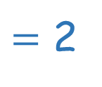
10
10
5
2
$÷$ 5
$=$ 2
tells us how many in total
tells us how many in each group
tells us how many groups
10 _____ are divided into groups of 5
There are 2 groups.

Slide 9





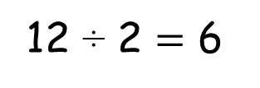
12 oranges, 2 in each basket.
Have a think
12 divided into groups of 2
12 ÷ 2 $=$ 6

Slide 10






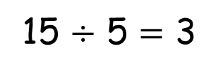
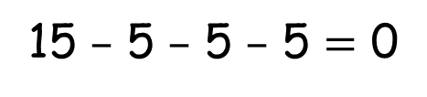
– 5
– 5
– 5
0
5
10
15
15 $–$ 5 $–$ 5 $–$ 5 $=$ 0
15 $÷$ 5 $=$ 3
15 divided into groups of 5 is equal to 3.

Slide 11


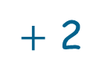


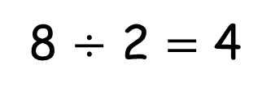
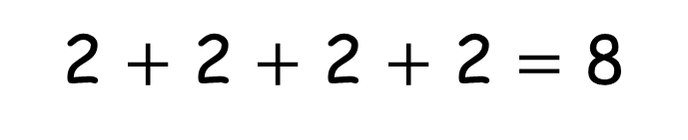

2 $+$ 2 $+$ 2 $+$ 2 $=$ 8
$+$ 2
$+$ 2
$+$ 2
$+$ 2
0
2
4
6
8
8 is made of 4 equal groups of 2
8 $÷$ 2 $=$ 4

Slide 13

3
9 ÷ 3 =

Slide 14

5
10 ÷ 2 =

Slide 15

2
8 ÷ 4 =

Slide 16

2
6 ÷ 3 =

Slide 17

4
12 ÷ 3 =

Slide 18
5
20 ÷ 4 =

Slide 19

3
30 ÷ 10 =

