Slide 2
Multiplication Calculations

Slide 4


Continue the sequence
2, 4, 6, 8, ____, ____, ____, ____
Continue the sequence
5, 10, 15, 20, ____, ____, ____, ____
What is the total score in each row?
a)
b)

Slide 5
Continue the sequence
2, 4, 6, 8, ____, ____, ____, ____
Continue the sequence
5, 10, 15, 20, ____, ____, ____, ____
What is the total score in each row?
a)
b)
10 12 14 16
25 30 35 40
15
12

Slide 7





What do you see?
Have a think
3
4
There are ____ equal groups of ____
$+ + =$
12
4
4
4
$× =$
3
4
12

Slide 8

What do you see?
Have a think
2
6
There are ____ equal groups of ____
$+ =$
12
6
6
$× =$
2
6
12

Slide 9


Have a think
2
2
2
2
8
$+ + + =$
$× =$
4
2
8

Slide 10



2
2
2
2
8
$+ + + =$
$× =$
4
2
8
$× =$
2
4
8

Slide 11
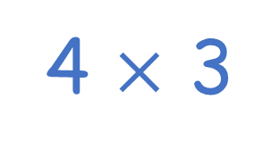
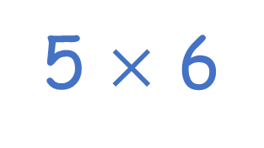
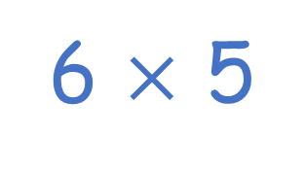
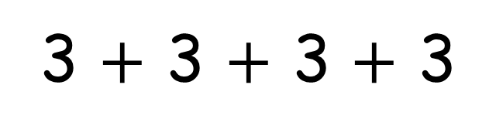
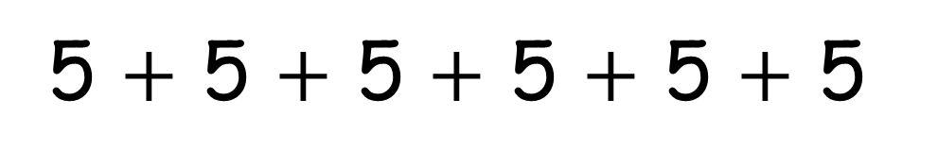
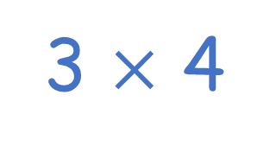
Have a think
5 $+$ 5 $+$ 5 $+$ 5 $+$ 5 $+$ 5
6 $×$ 5
5 $×$ 6
3 $+$ 3 $+$ 3 $+$ 3
4 $×$ 3
3 $×$ 4

Slide 12


Have a think
I can write 4 different multiplications
I think there are 8

Slide 13
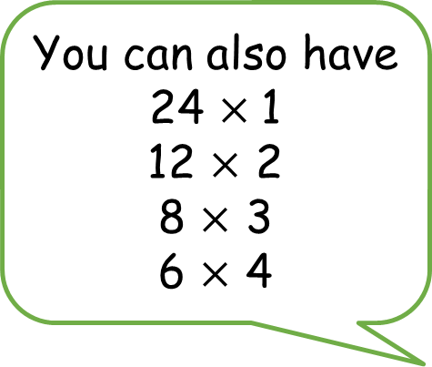
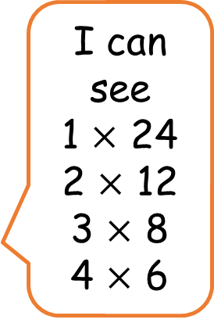
You can also have
24 $×$1
12 $×$ 2
8 $×$ 3
6 $×$ 4
I can see
1 $×$ 24
2 $×$ 12
3 $×$ 8
4 $×$ 6

Slide 14


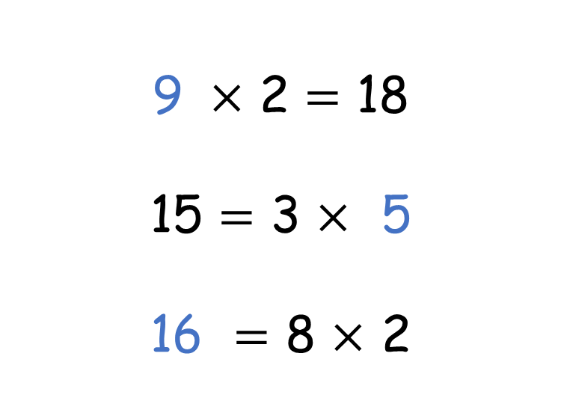

Have a think
4 $×$ 3 $=$ 12
9 $×$ 2 $=$ 18
15 $=$ 3 $×$ 5
16 $=$ 8 $×$ 2

Slide 15
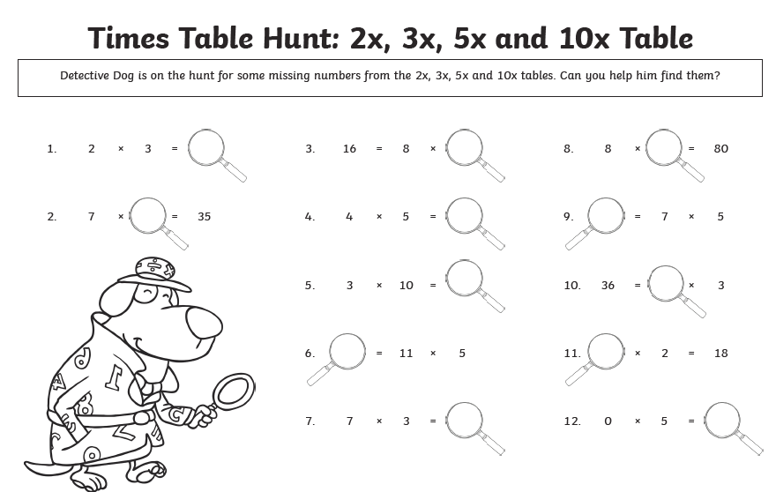

Slide 16
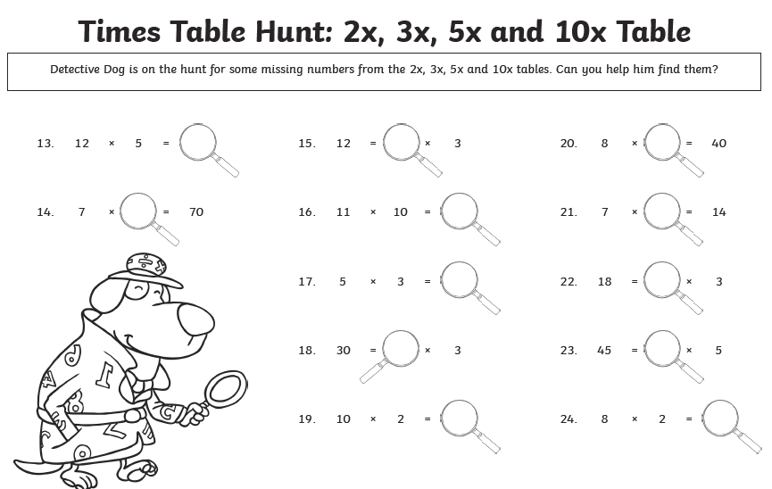

Slide 17


