Slide 1
RE
To understand that Jesus is God incarnated.
Can you remember the nativity story last week ?
Which parts of the story or which people in the story show Jesus as human, and which might suggest he is more like ‘God’?

Slide 2
We are going to use a painting of the nativity to help understand what the story means for Christians.

Slide 3
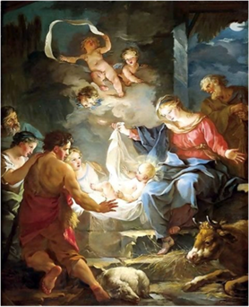
How does this painting show Jesus as a human being?
How does it show him as God?

Slide 4
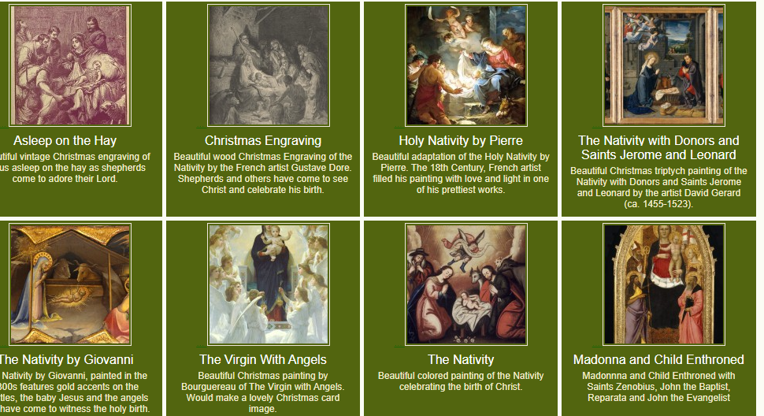
Look for other photos on the internet and explore the same questions

