Slide 1
PSHE and Citizenship
Health and Wellbeing | Safety First
PSHE and Citizenship | KS1 | Health and Wellbeing | Safety First | Staying Safe at Home | Lesson 2

Slide 3
Aim
I know how to stay safe at home.
Success Criteria
I can identify dangers in the home.
I understand that household products, including medicines, can
be harmful.
I can identify ways to stay safe at home.
This resource is fully in line with the Learning Outcomes and Core Themes outlined in the PSHE Association’s Programme of Study.

Slide 4
The Big Questions

Slide 5

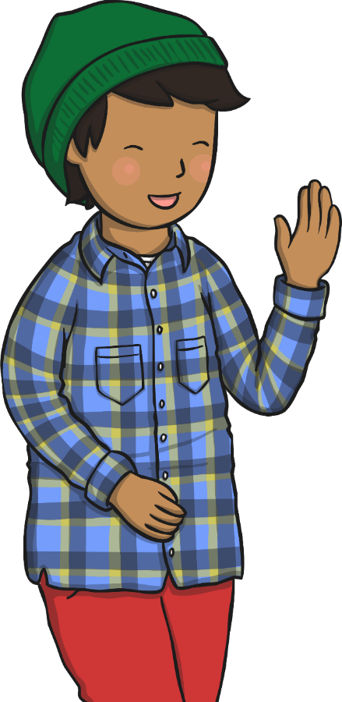
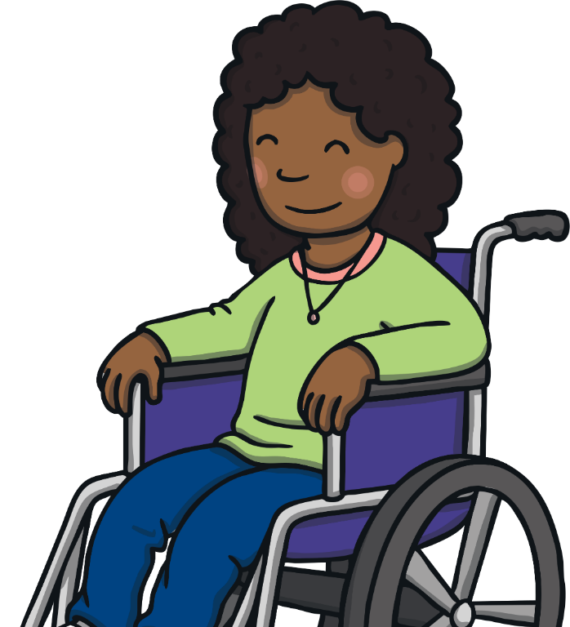
Which objects in our home can
be dangerous?
What can we do to keep ourselves safe at home?

Slide 6
Reconnecting

Slide 7

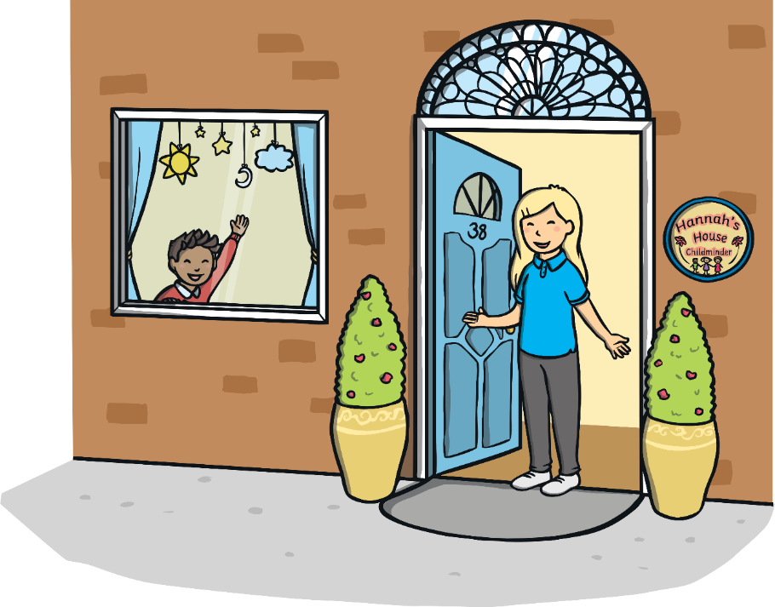
What’s the Danger?
Mostly, our homes are safe places. However, there are some objects that can be dangerous and can cause injuries around the home. We need to be aware of the dangers and how to keep ourselves safe.

Slide 8

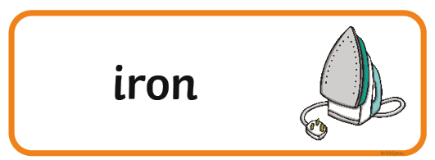
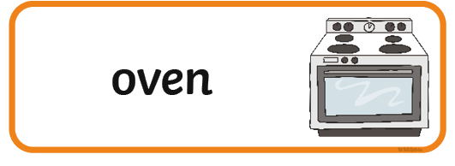

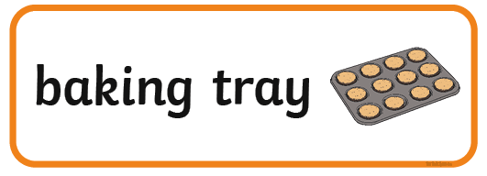

What’s the Danger?
In your groups, you are going to look at some pictures of household objects. Discuss why these objects might be dangerous and see if you can sort them into three sets.
Make sure everyone in the group gets to speak and share their ideas.

Slide 9
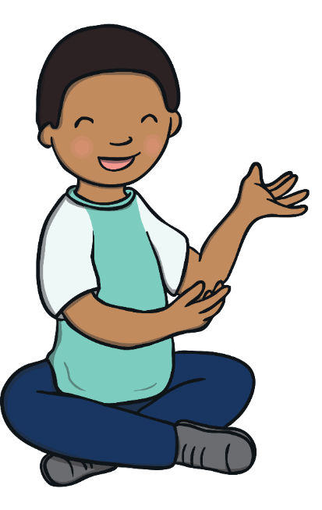
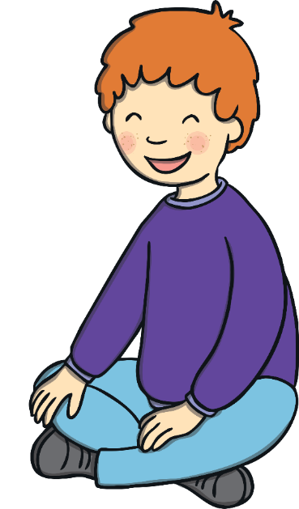
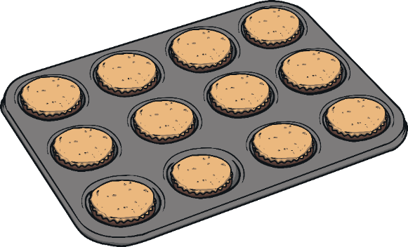
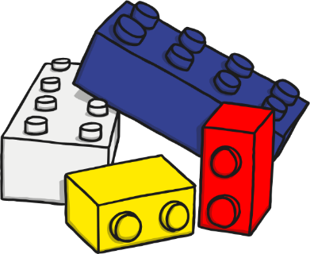
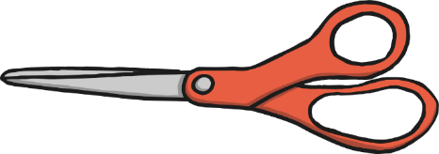
What’s the Danger?
How did you find that challenge?
You might have grouped the objects into:
things that are sharp;
things that are hot;
things that you can trip over or slip on.
Was it tricky?
How did you sort the cards out?
Did your group members all agree?
Were you surprised that all of these objects could
be considered dangerous?

Slide 10
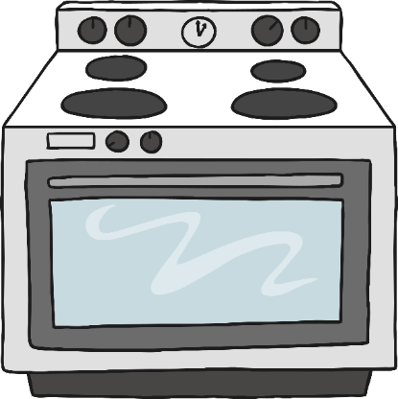
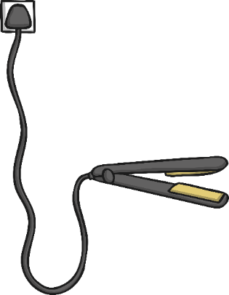
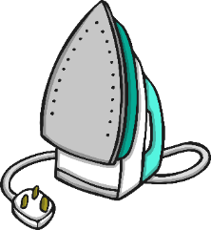
What’s the Danger?
The Danger of Electrical Appliances
All of these objects are electrical appliances, which means they are powered with electricity (through a wire and a plug).
Electricity is very powerful and it can be dangerous. Not being careful around electricity could cause an electric shock – this is when electricity enters the body and makes a person very ill.

Slide 11
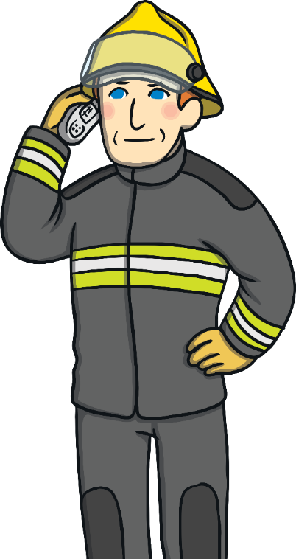
What’s the Danger?
Fire Safety
If electrical items are damaged, fires can start. If you find a fire, there are some things you can do to stay safe.
If your clothing catches fire – stop, drop and roll.
Stay low to the floor – get down on all fours and crawl to the nearest exit.
Move away from the fire – get out of a room or building where there is a fire and stay out.
Call 999 and ask for the fire service.

Slide 12
Exploring

Slide 13

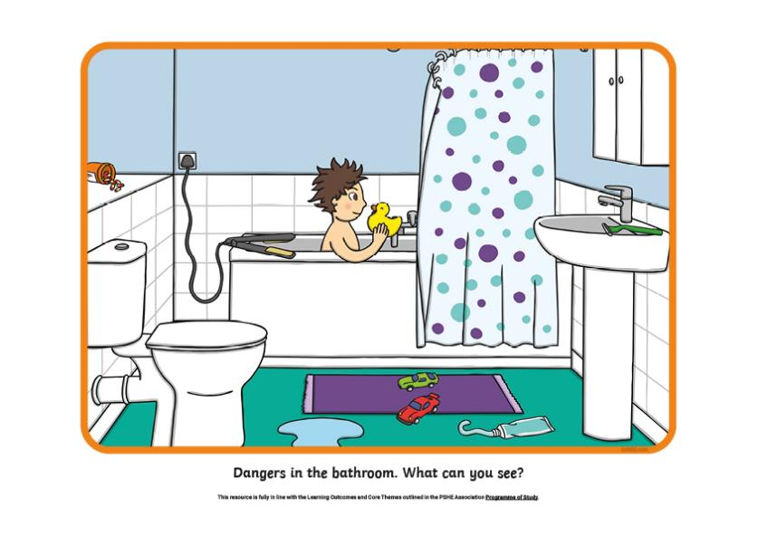
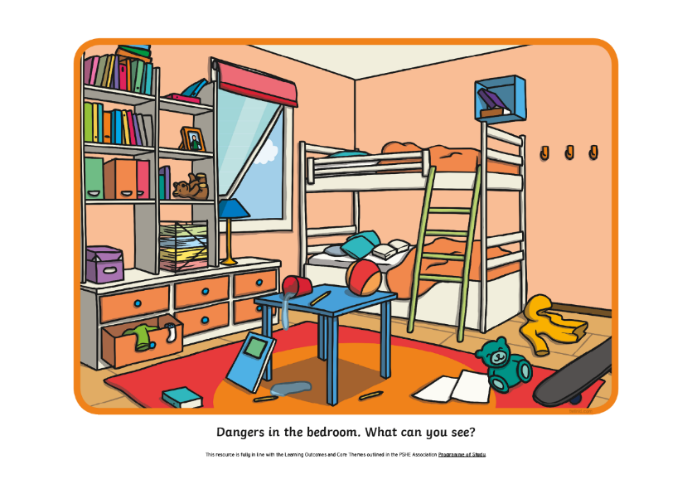
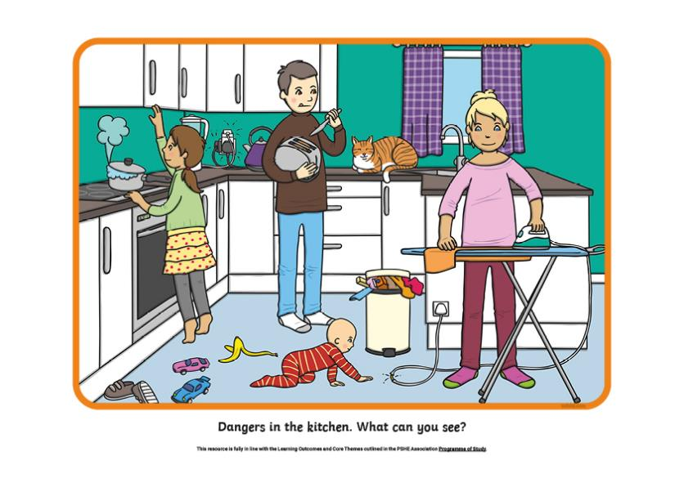
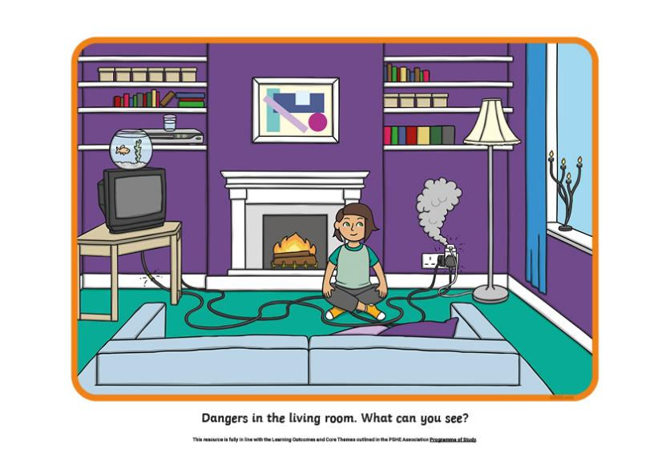
Spot the Hazards
There are different hazards or dangers in different rooms in our homes. With your partner, look carefully at the pictures in your pack and see if you can spot all of the hazards.

Slide 14
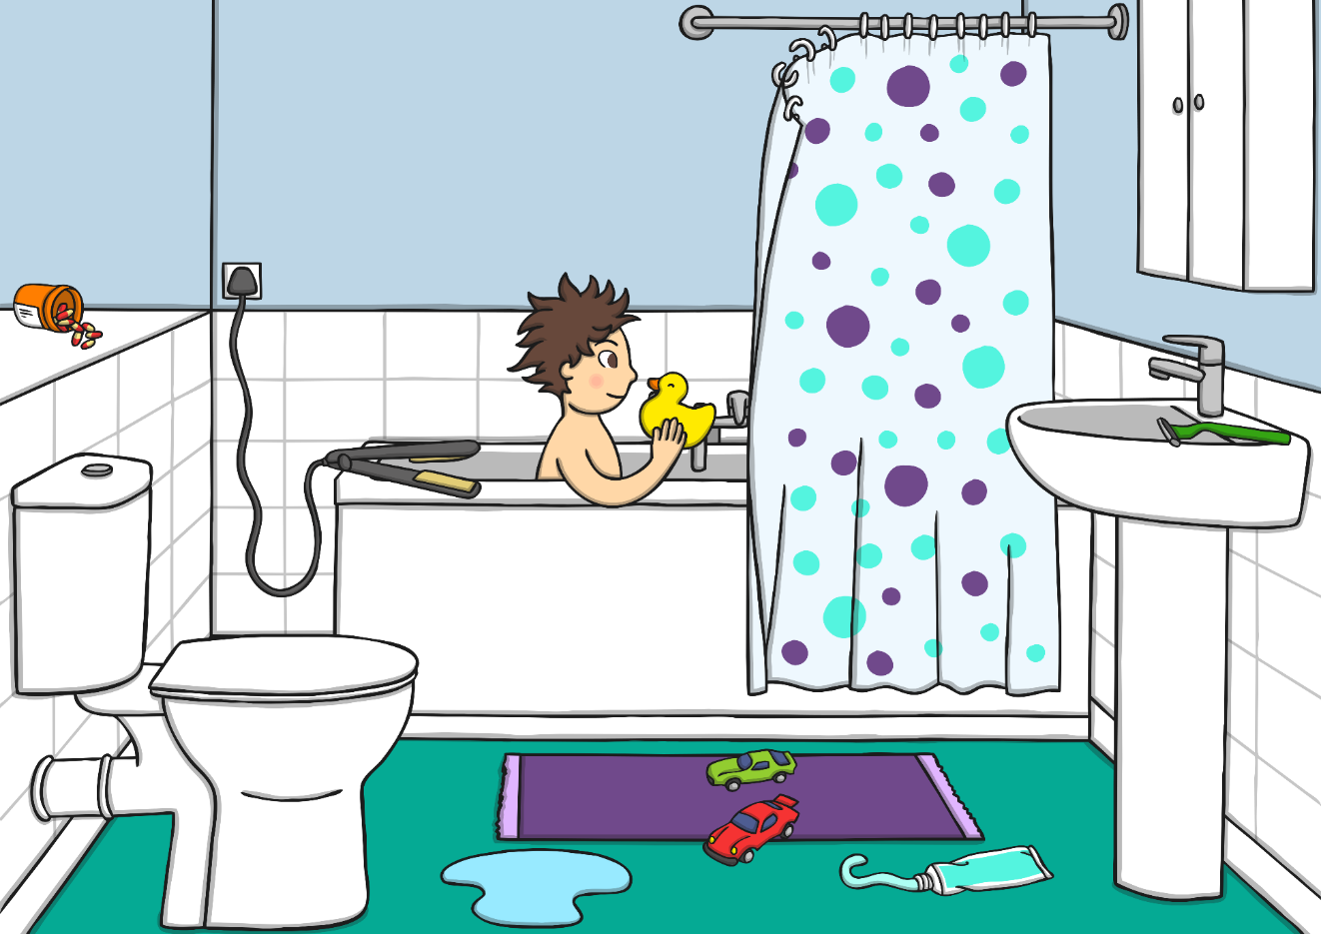
Spot the Hazards
What hazards did you spot in the bathroom?
What could the child in the picture, or another member of their family, do to make this room safer?

Slide 15
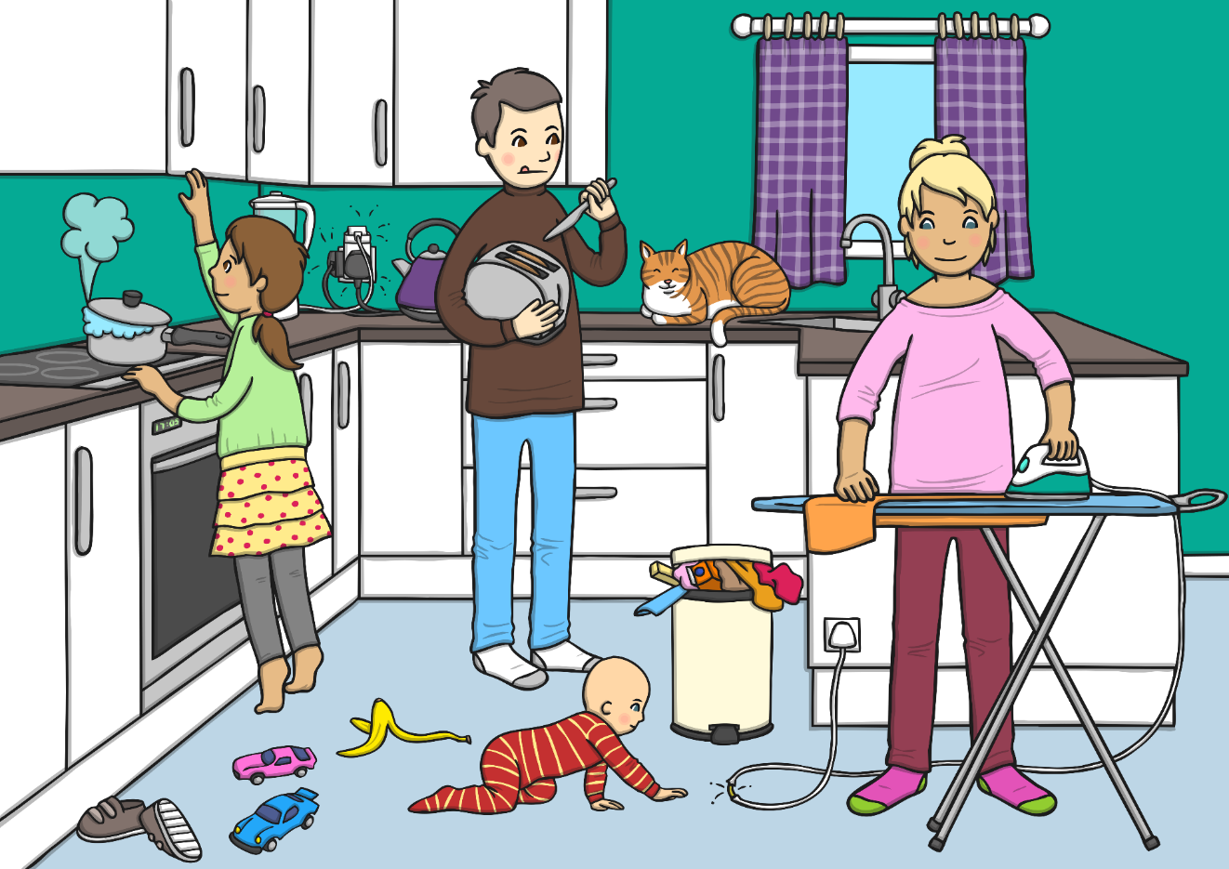
Spot the Hazards
What hazards did you spot in the kitchen?
What could the child in the picture, or another member of their family, do to make this room safer?

Slide 16
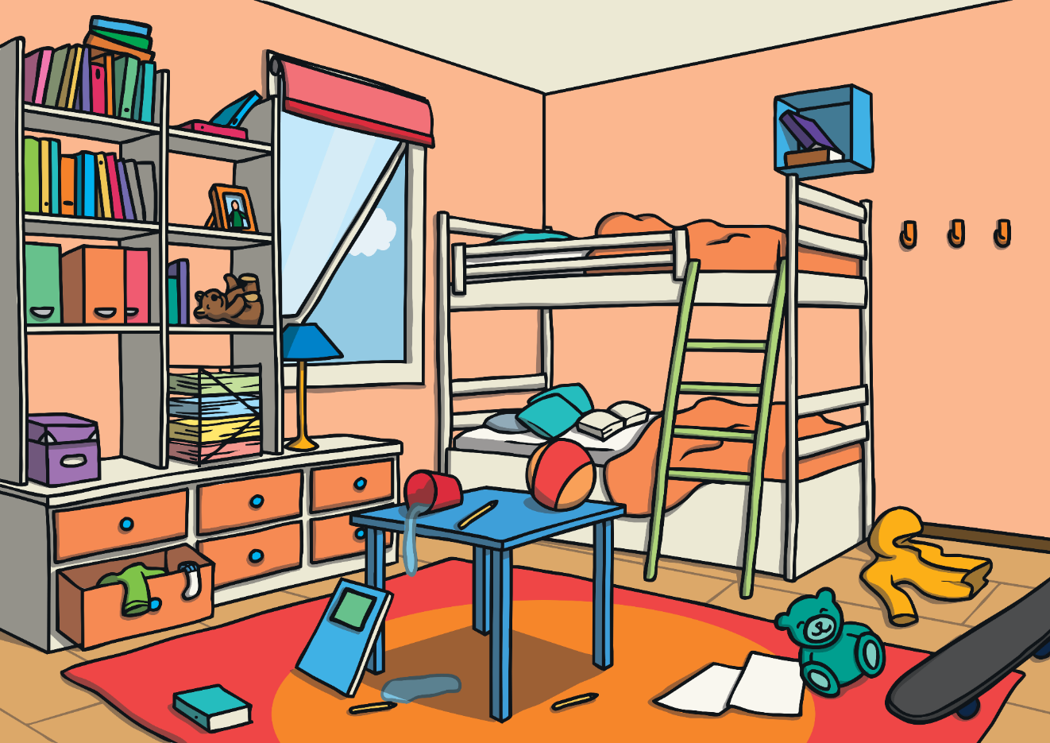
Spot the Hazards
What hazards did you spot in the bedroom?
What could the child who owns this bedroom, or another member of their family, do to make this room safer?

Slide 17
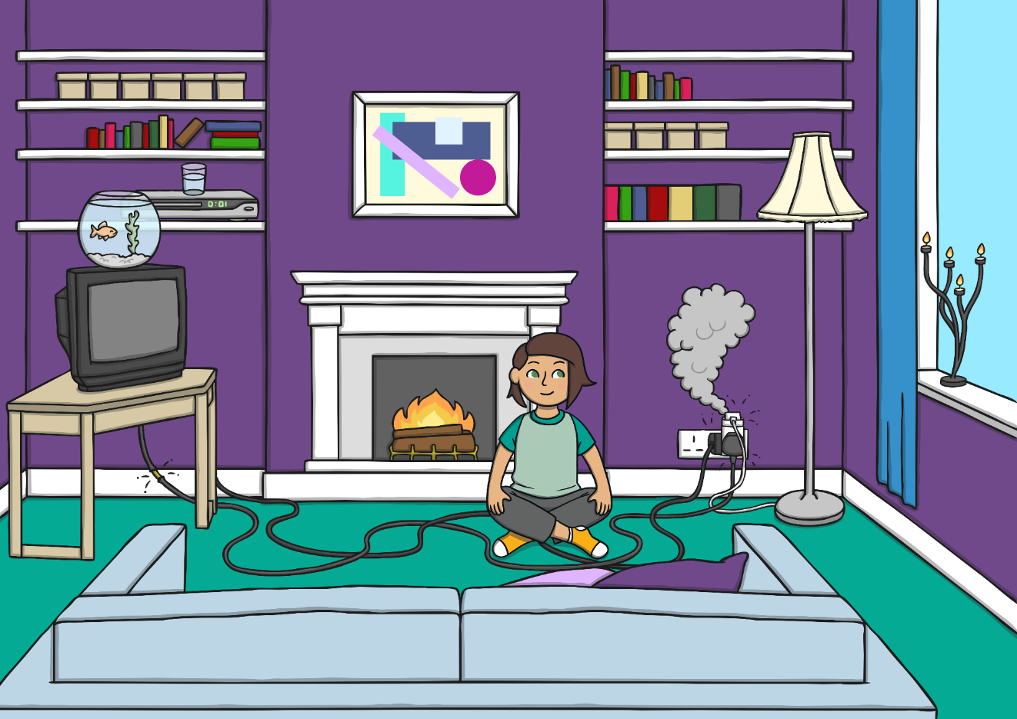
Spot the Hazards
What hazards did you spot in the
living room?
What could the child in the picture, or another member of their family, do to make this room safer?

Slide 18

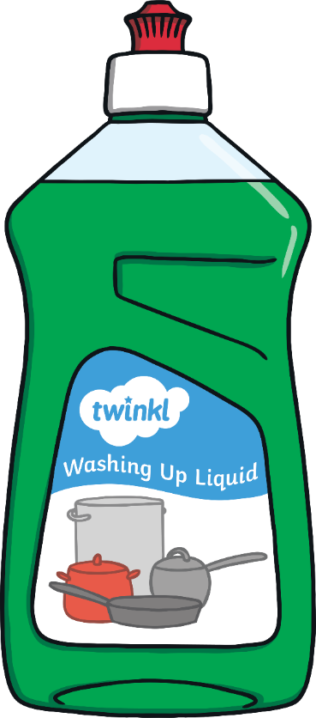
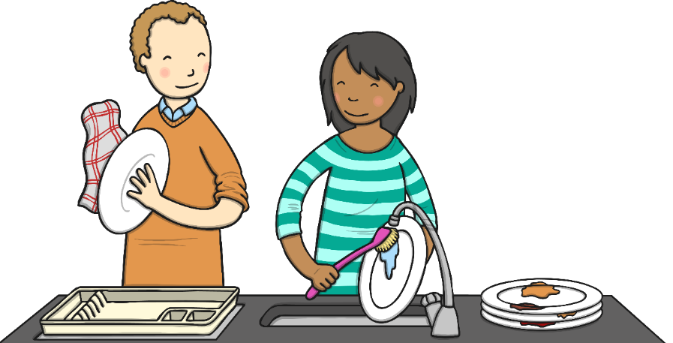
Can I Drink It?
In the bathroom and the kitchen there are
household products that can be dangerous.
Many liquids are poisonous and must never
be drunk.
We need to remember that these are for adults to use.

Slide 19
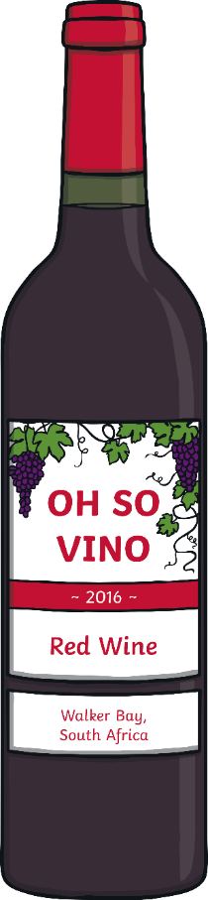
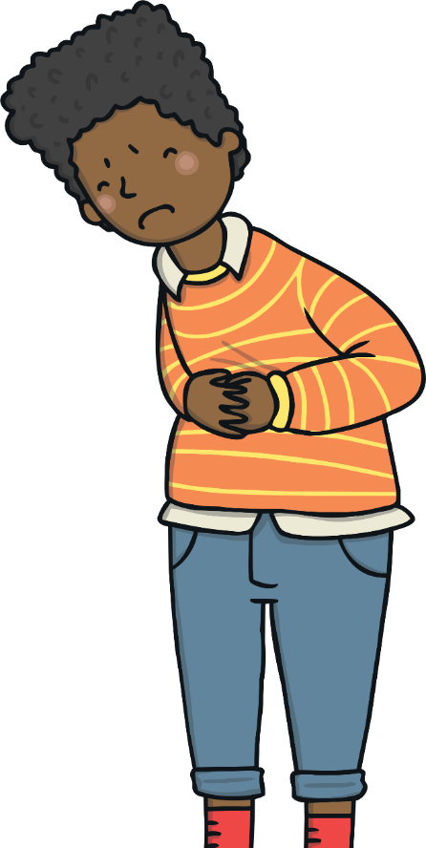
Can I Drink It?
In the kitchen, there might be drinks that are not suitable for children.
Alcohol is only for grown-ups to drink.
It would make a child ill if they drank it.

Slide 20
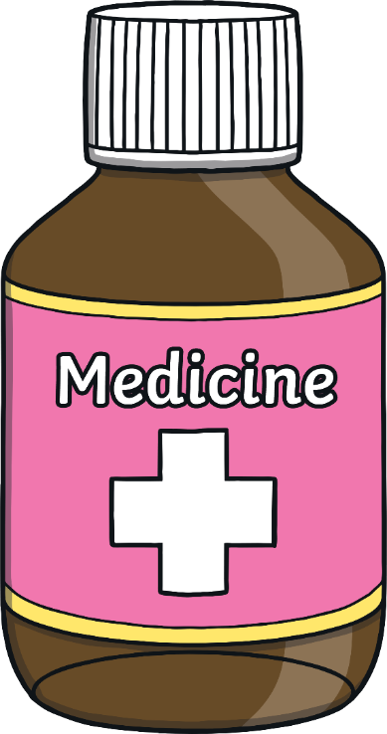
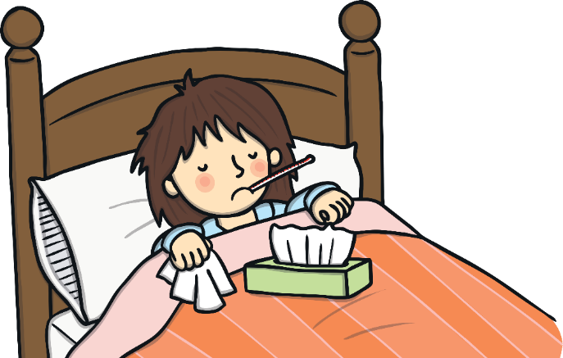
Can I Drink It?
Medicines are for drinking but only when a grown-up can help and can make sure we are having the right medicine and the right amount.
Taking the wrong medicine or having too much can make us very ill.
Many medicines should not be given at all to children under 16 and lots of medicines have different doses for different ages. This is why it is important that grown-ups give medicine to children.

Slide 21





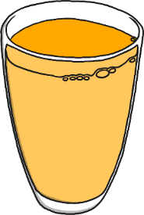
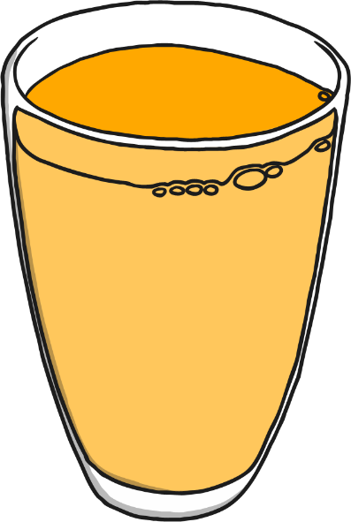


Can I Drink It?
Let’s vote on whether or not it is safe to drink these liquids.
Thumbs up for ‘yes’, thumbs down for ‘no’ and thumbs sideways for ‘sometimes’ or ‘not sure’.
Yes. Fruit juice is fine for children to drink but remember, too much is bad for your teeth.
Sometimes. Medicine is fine to drink but only if you are poorly and a trusted adult has said that you can drink it.
No. Household cleaning liquids are poisonous.
No. Beer is alcohol and alcoholic drinks are only for adults to drink.
Consolidating
Reflecting

Slide 22
Consolidating

Slide 23

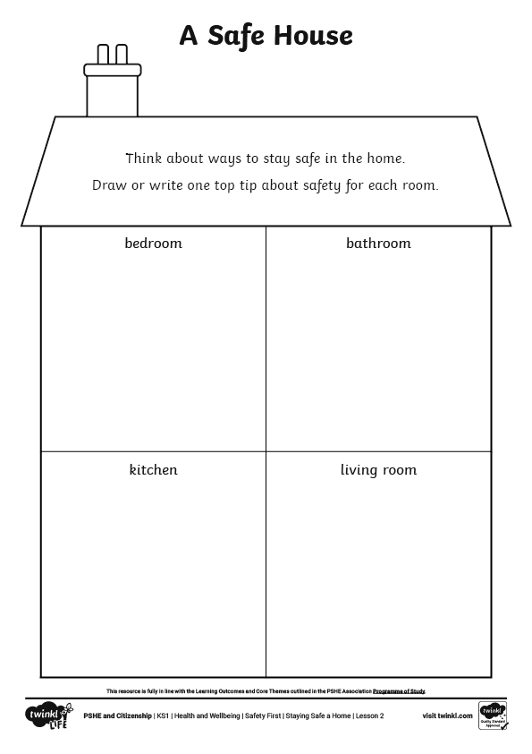

A Safe House
We have learnt a lot about dangers in the home. Now, let’s think positively about how we can stay safe in our homes.
On your A Safe House Activity Sheet, you are going to write or draw one tip for staying safe in each room of the house.

Slide 24
Reflecting

Slide 25
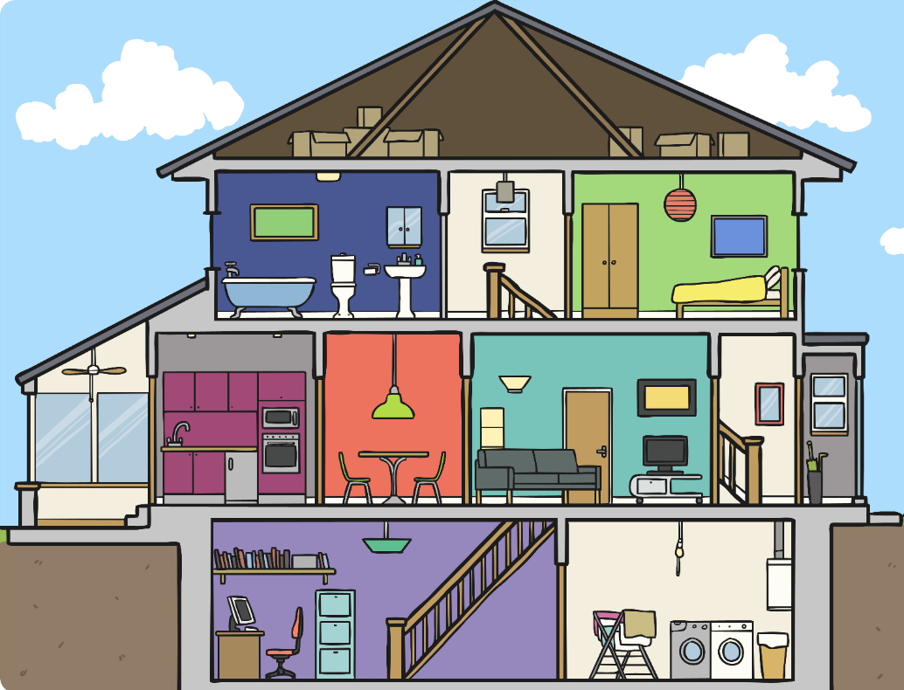
In My Home
Let’s go around the class and hear everyone’s contribution.
It’s time to think about how we can use what we have learnt today in our own homes.
There will be lots of ways that you and your families stay safe in your home already.
Think about one thing you do in your home that keeps you and your family safe.

Slide 26
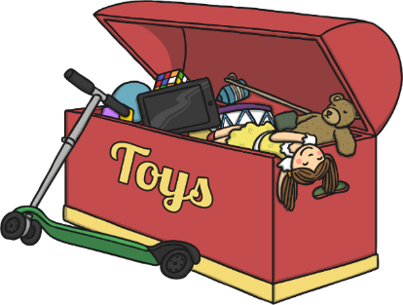
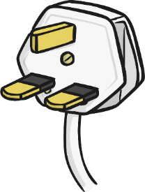

In My Home
There are many ways to stay safe at home. Did anyone say any of these?
Put toys away so no one trips over them.
Keep medicines and pills out of reach of children.
Check that the batteries in the smoke alarms
are working.
Keep sharp tools locked away.
Stay out of the kitchen when someone is
cooking hot things.
Never touch household cleaning products,
like bleach.
Wipe up spills so no one slips.
Unplug electrical devices when they are not in use.

Slide 27
The Big Questions

Slide 28
Which objects in our home can be dangerous?
What can we do to keep ourselves safe at home?
What have you learnt today that you can share with your parent
or carer when you go home?

Slide 29
Aim
I know how to stay safe at home.
Success Criteria
I can identify dangers in the home.
I understand that household products, including medicines, can
be harmful.
I can identify ways to stay safe at home.

