Slide 1
PSHE and Citizenship
Health and Wellbeing | Safety First
PSHE and Citizenship | KS1 | Health and Wellbeing | Safety First | Staying Safe around Strangers | Lesson 4

Slide 3
Aim
I can keep myself safe in different situations with people I
don’t know.
Success Criteria
I can identify risks in different situations.
I know what to do if I feel uncomfortable in a situation.
I understand ways that I can stay safe from strangers online.
This resource is fully in line with the Learning Outcomes and Core Themes outlined in the PSHE Association’s Programme of Study.

Slide 4
The Big Questions

Slide 5

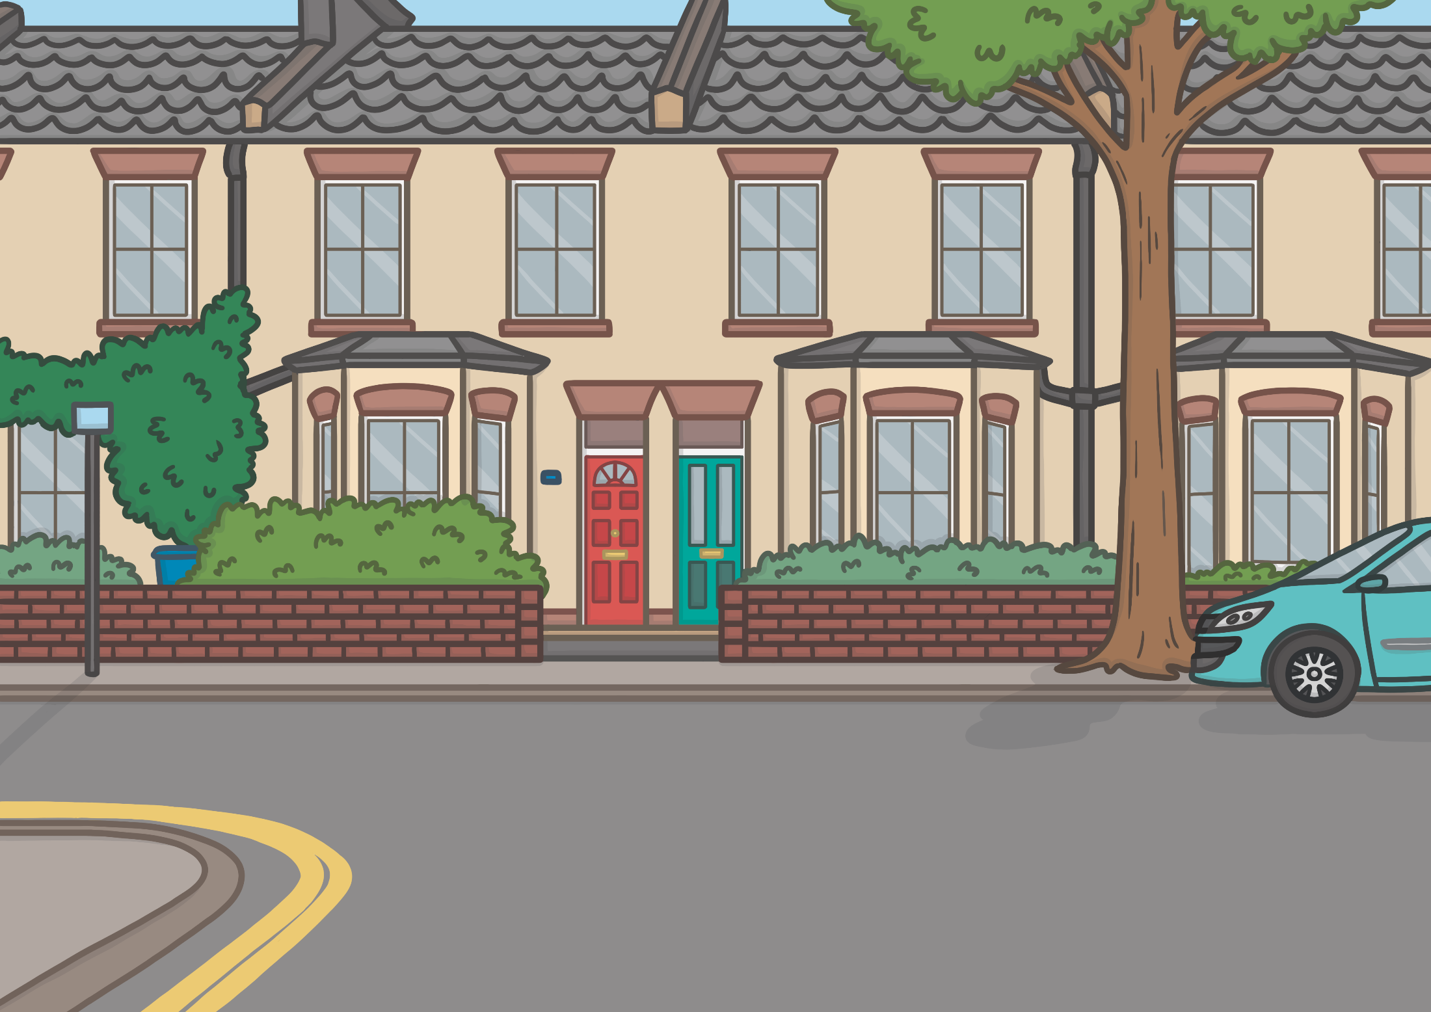

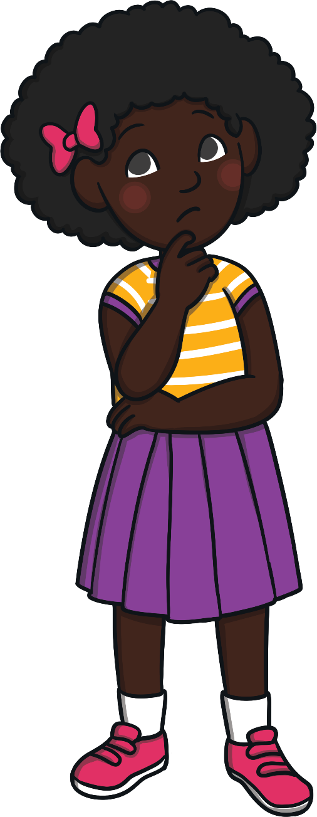
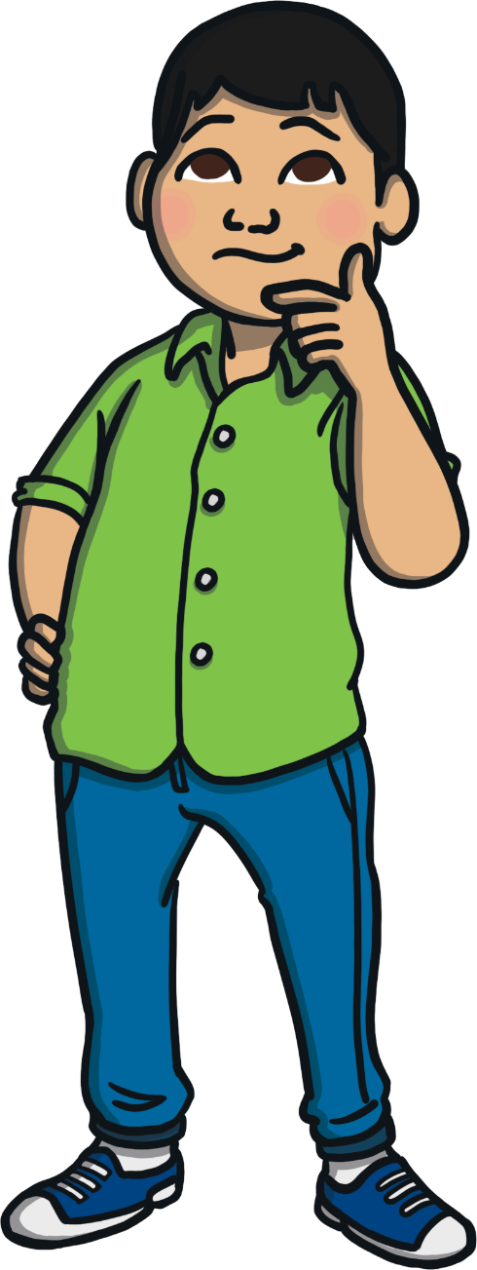
What can I do when I feel unsafe around people I don’t know?
How can I stay safe from strangers when I’m using the Internet?

Slide 6
Reconnecting

Slide 7

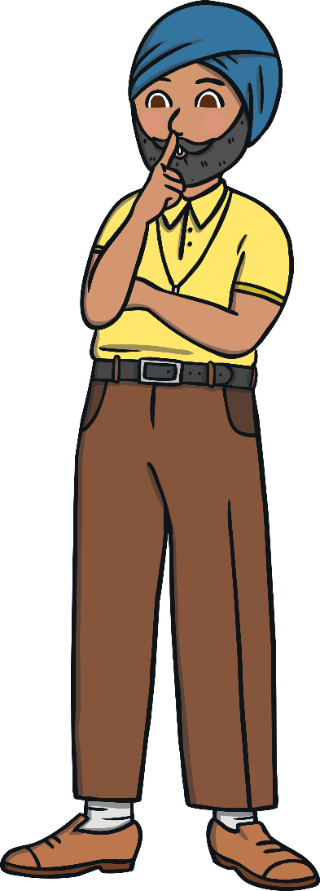
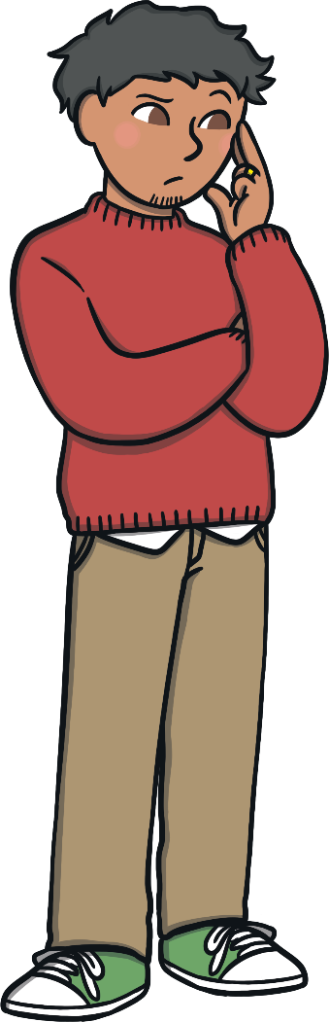
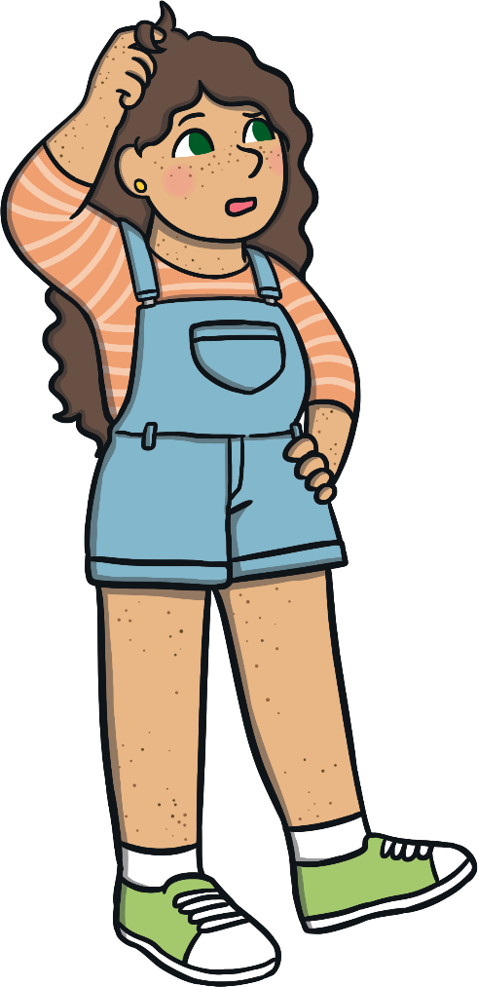
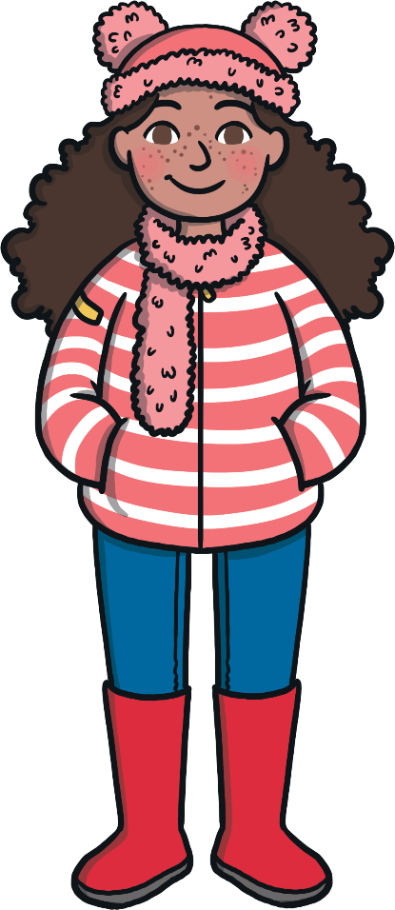
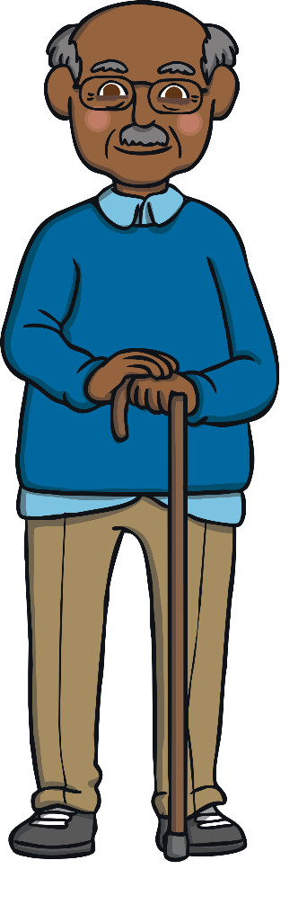
What Is a Stranger?
How would you describe a stranger?
Anybody that we don’t know well, or at all, is a stranger.

Slide 8

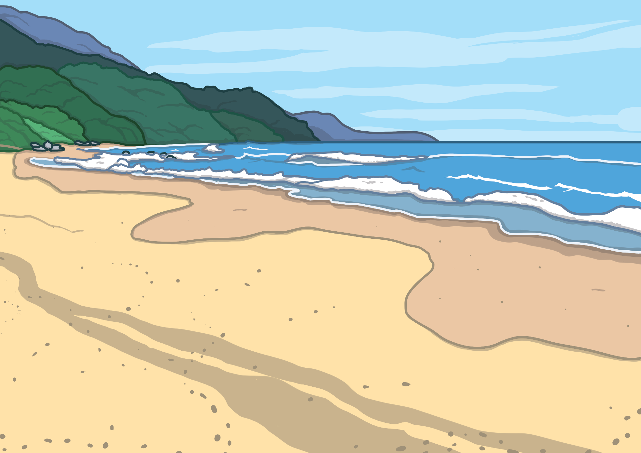
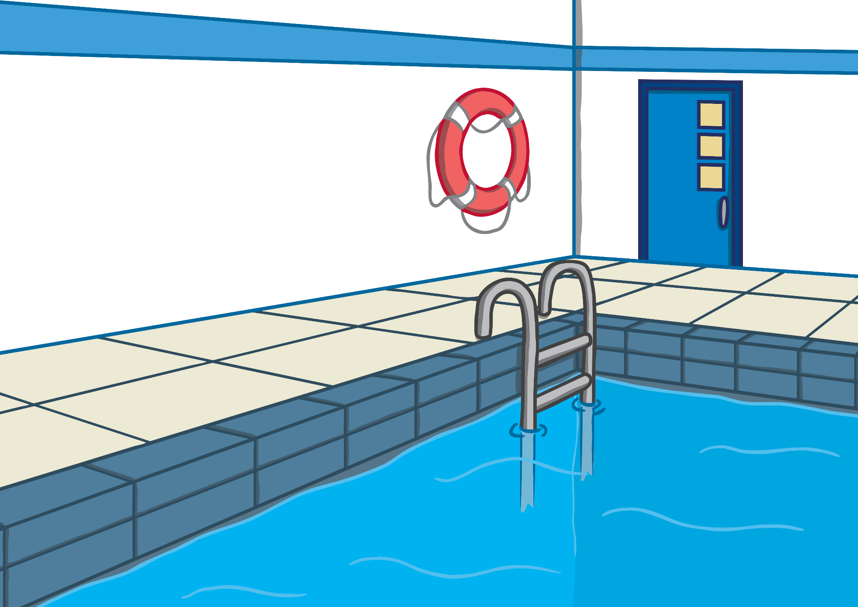
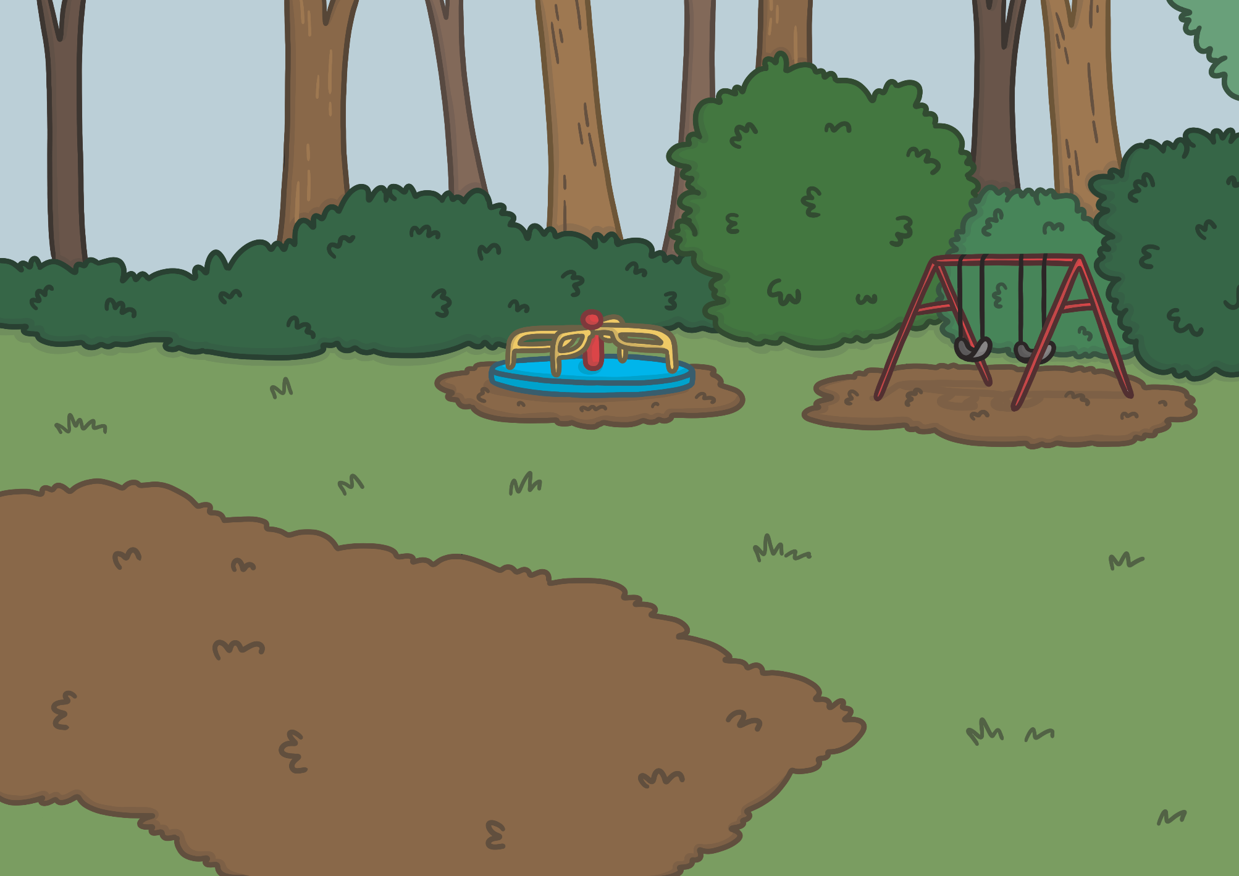
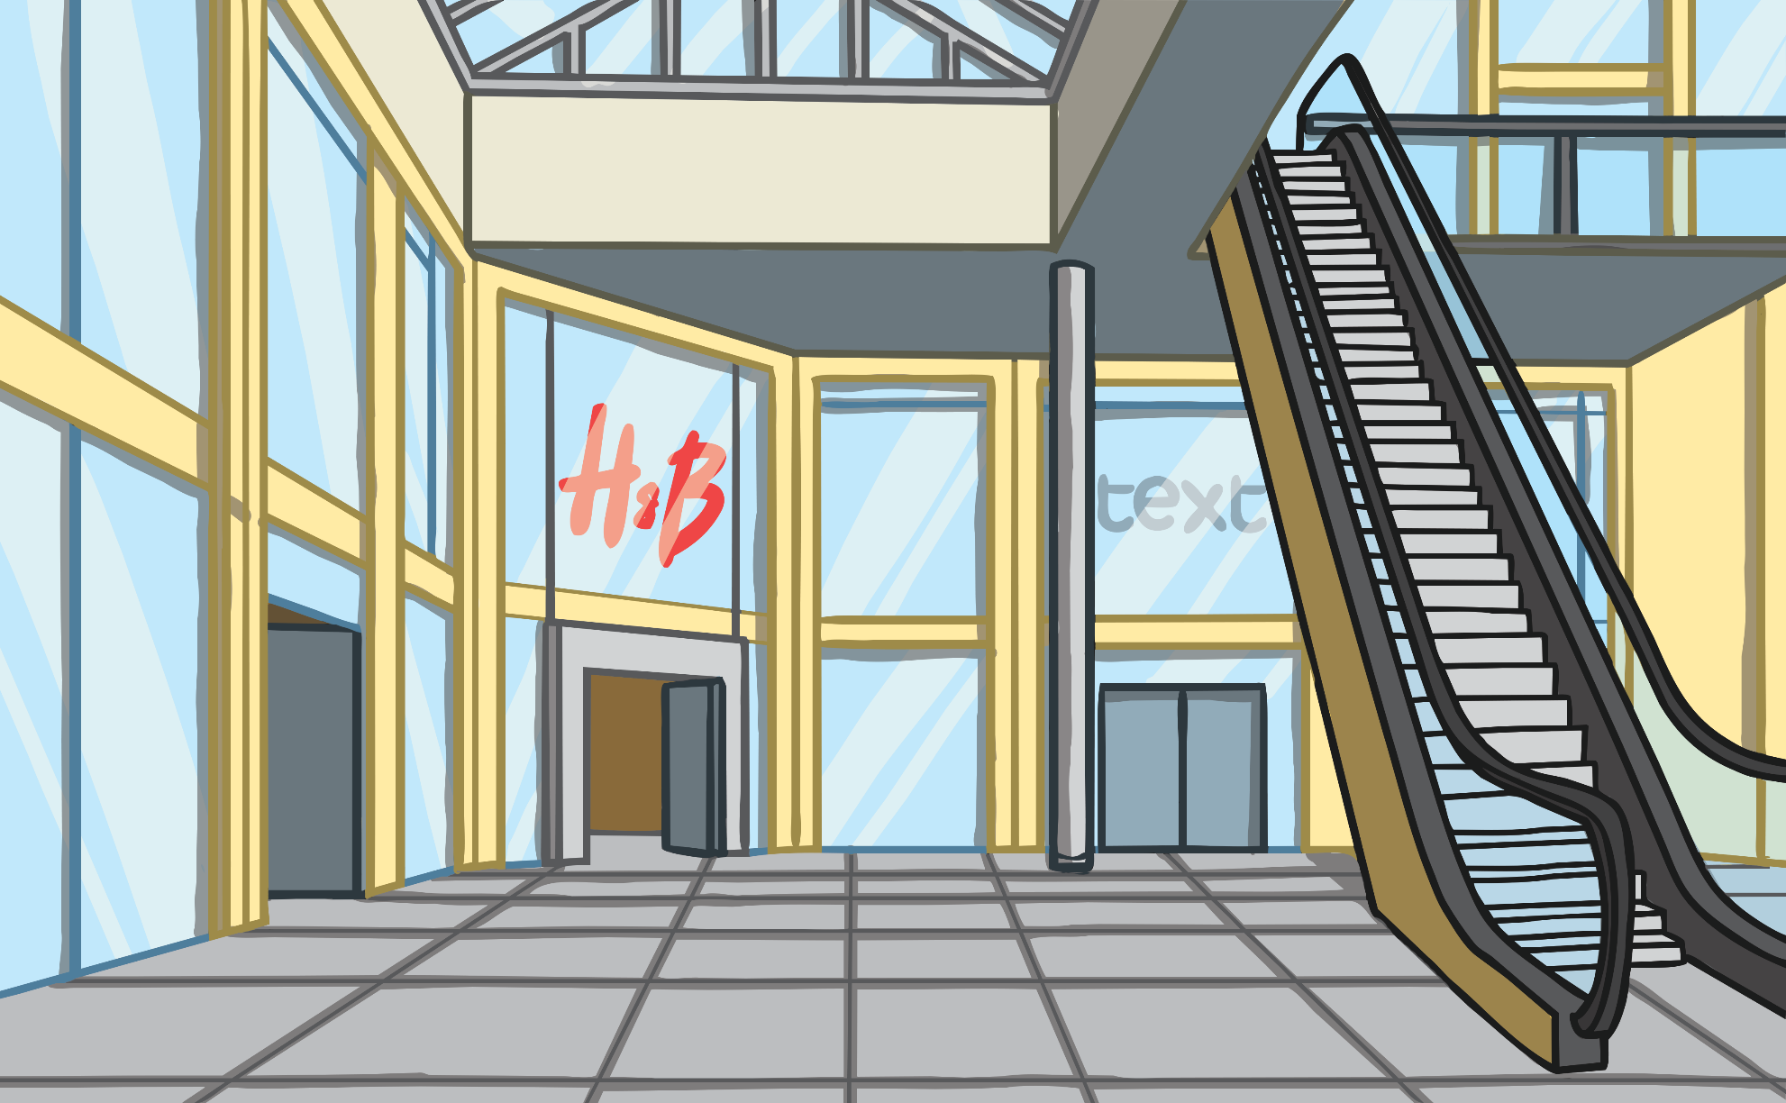
What Is a Stranger?
We come across strangers in lots of different places. For example:
Many strangers are kind people but some strangers can be unkind and there is no way of knowing when we first meet someone. Being around strangers can pose different risks.
shopping centres
parks
swimming pools
on the street
at the beach
Or anywhere else we might go, including the place where we live.

Slide 9

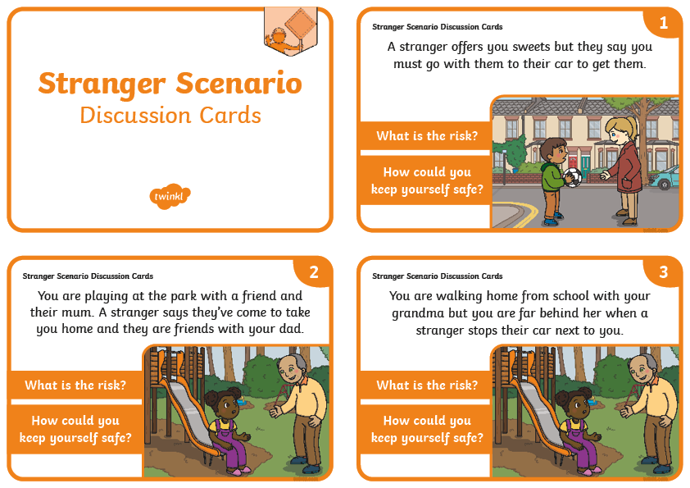
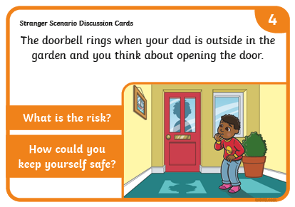
What Is a Stranger?
In your pairs, read the Stranger Scenario Discussion Cards. Discuss the risk in each scenario and the ways the child could keep themselves safe in each situation.

Slide 10
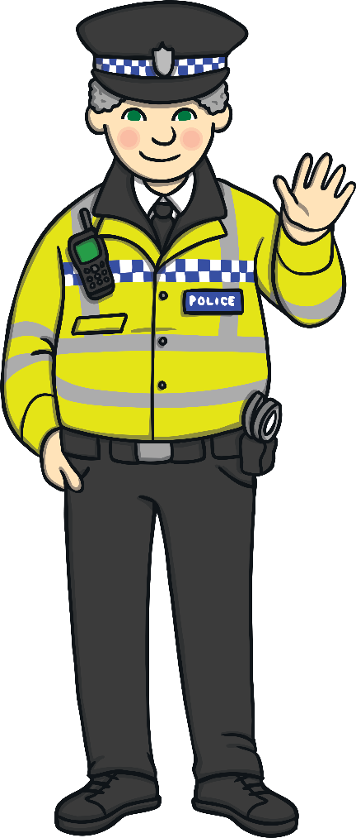
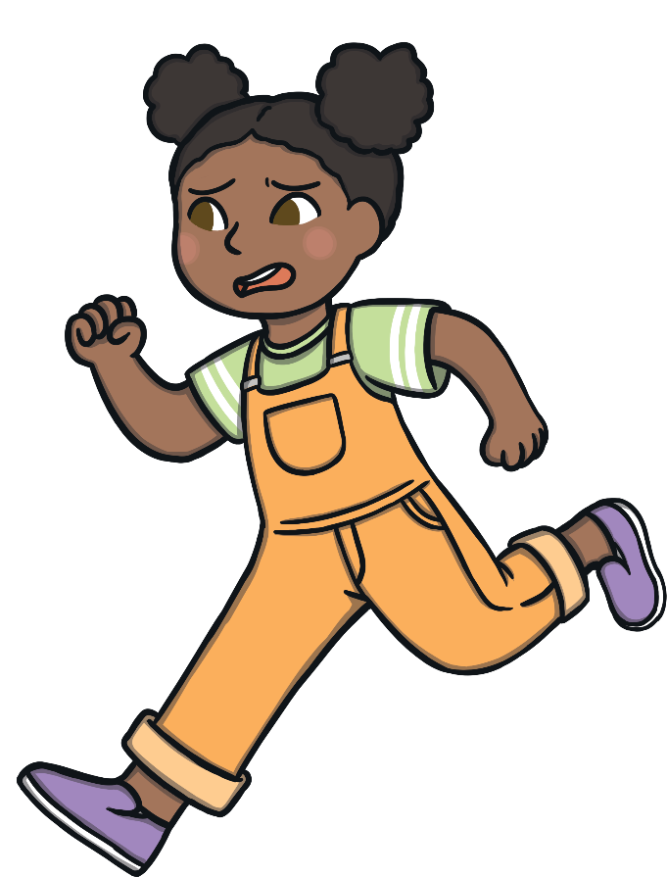
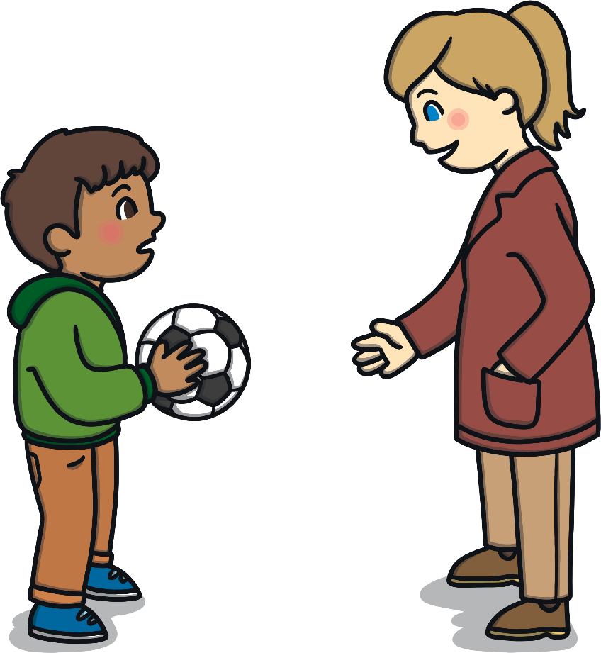
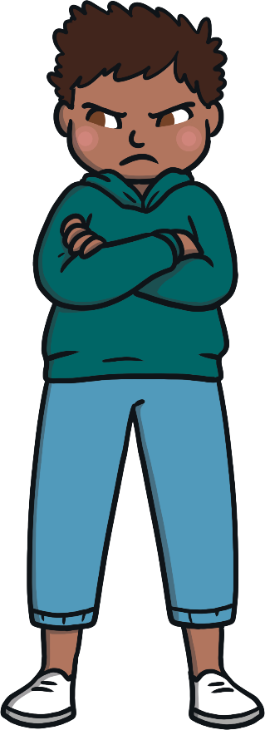
What Is a Stranger?
If you feel uncomfortable when a stranger is near, there are some rules to remember to stay safe.
Never go anywhere on your own with
a stranger.
YELL! It is OK to shout loudly if you feel unsafe around a stranger.
RUN! It is OK to run to find a safe grown-up.
Never go to or get into a car with
a stranger.
TELL! Always tell a safe grown-up if you have felt unsafe.
Always say ‘NO!’ very loudly to anything a stranger asks you to do or if a stranger offers you a gift.
Find a safer stranger. What could a safer stranger look like?

Slide 11
Exploring

Slide 12

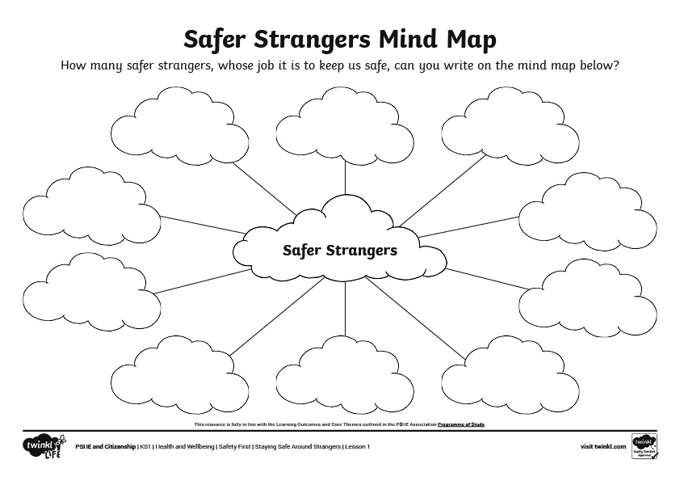
Safer Strangers
There are some people whose job it is to keep us safe and they are called ‘safer strangers’.
In your group, discuss which people might be ‘safer’ strangers and create a mind map of these people on your Safer Strangers Mind Map Activity Sheet.
Safer strangers are usually people who do jobs that require them to help people and they often wear a uniform or a badge with their name on.
Top Tip!

Slide 13
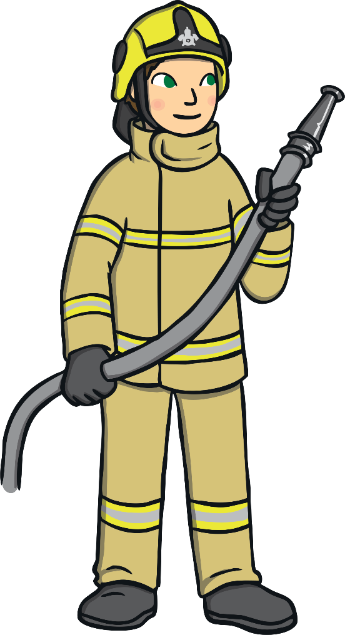
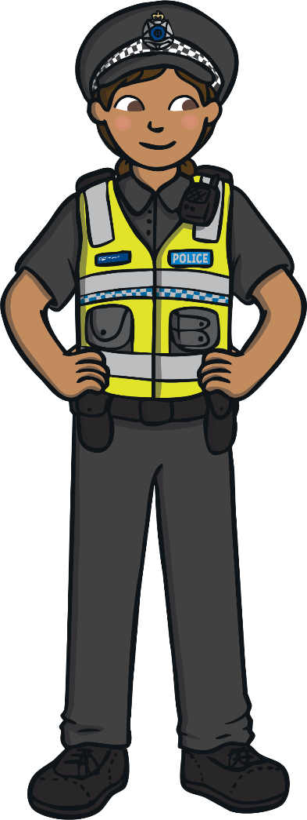
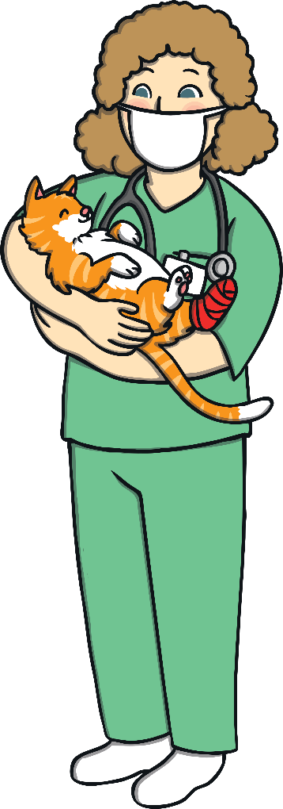

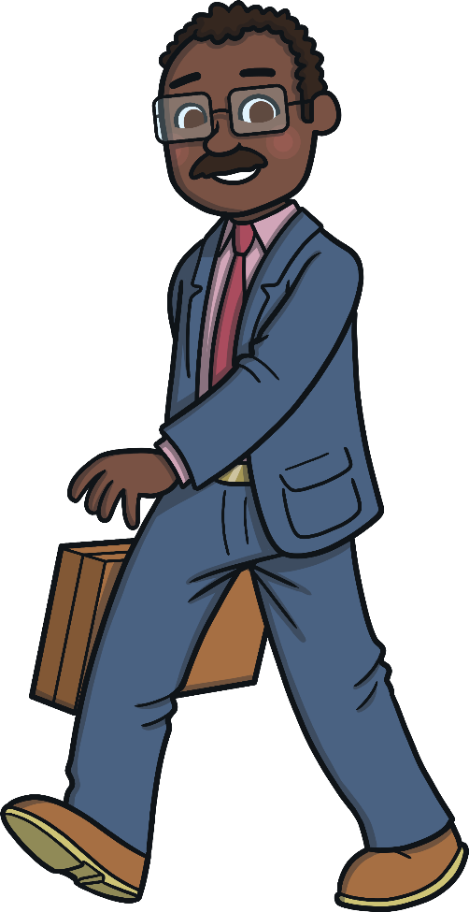

Safer Strangers
Safer strangers are people whose job it is to keep people safe. They are strangers who you can talk to and they will help you if you feel unsafe.
You can ask these people for help if you ever find yourself in an
unsafe situation.

Slide 14
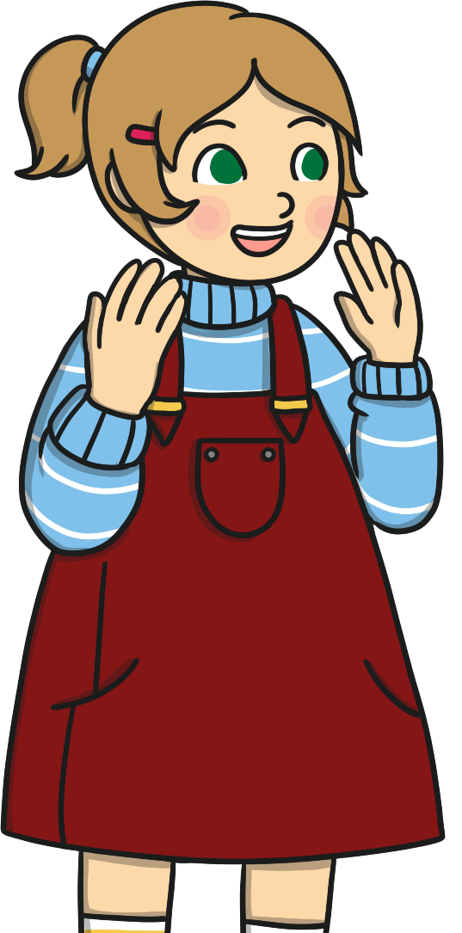

Hidden Strangers
Earlier, we talked about places where we might meet strangers, such as a shopping centre, the park, a swimming pool, on the street or at the beach.
The Internet is a different place where we might meet strangers, especially as you get older and use more online games and social media.
How might it be different meeting strangers online rather than in person?
Can you suggest anywhere else that we might meet strangers?
When we meet people online, these people are still strangers and the true identity of these strangers is hidden because we can’t actually see them.

Slide 15
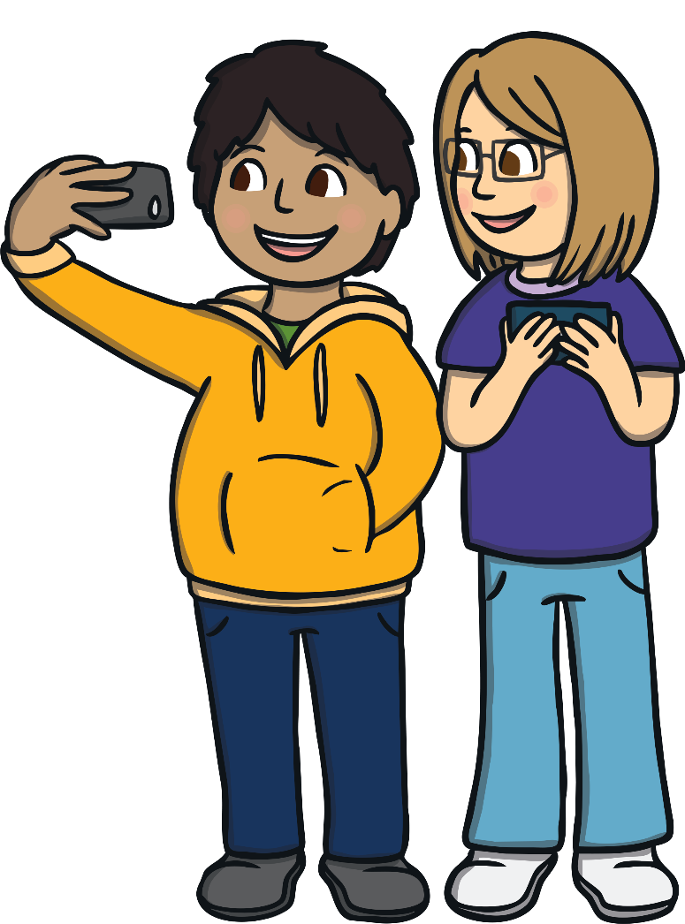
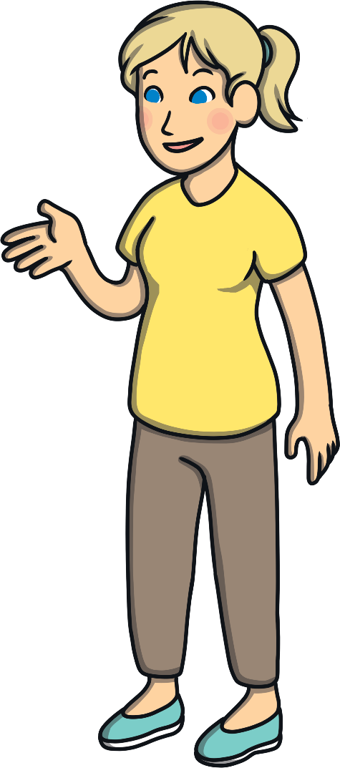
Hidden Strangers
There are some rules we must follow in order to keep ourselves safe online.
Always ask a trusted grown-up, like a parent, carer or teacher, for permission to go online and make sure they are near in case you need them.
Never share pictures of yourself with a person that you don’t know or you
haven’t met.
Keep personal information (name, address, school, username, password) private.
Always tell a trusted grown-up if anybody asks you to say or do something that makes you feel uncomfortable.
Never arrange to meet someone that you have met on the Internet, even if you think you know them really well or if they seem nice.

Slide 16
Consolidating
Reflecting

Slide 17
Consolidating

Slide 18

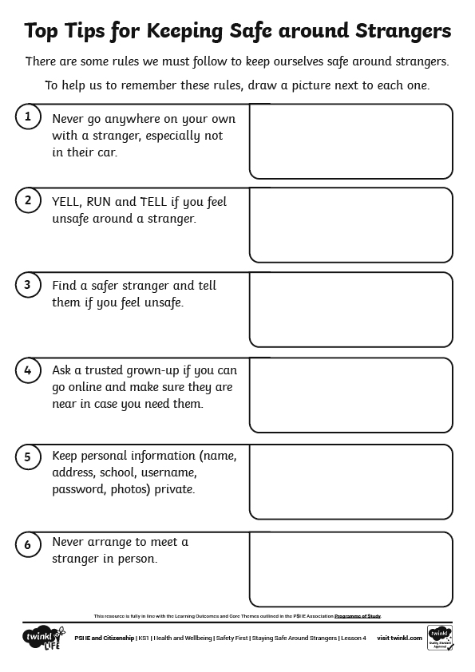
Top Tips
The rules for keeping safe online might be easier to remember if there was a picture to go with each rule.
On the Top Tips Activity Sheet, draw a picture for each rule to help us to remember them.

Slide 19
Reflecting

Slide 20

Staying Safe Around Strangers
In today’s lesson, we have learnt a lot about staying safe.
We know that there are risks when we’re out and about around strangers and that there are rules we must follow to keep us safe.
We also know that we might meet strangers online and that there are rules we must follow to keep us safe.
If you were asked to choose just one rule about staying safe around strangers, to share with someone else, which would you choose?

Slide 21
The Big Questions

Slide 22
What can I do when I feel unsafe around people I don’t know?
How can I stay safe from strangers when I’m using the Internet?

Slide 23
Aim
I can keep myself safe in different situations with people I
don’t know.
Success Criteria
I can identify risks in different situations.
I know what to do if I feel uncomfortable in a situation.
I understand ways that I can stay safe from strangers online.

