Slide 2
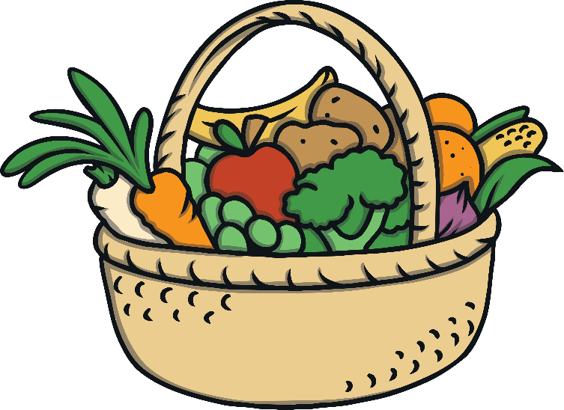
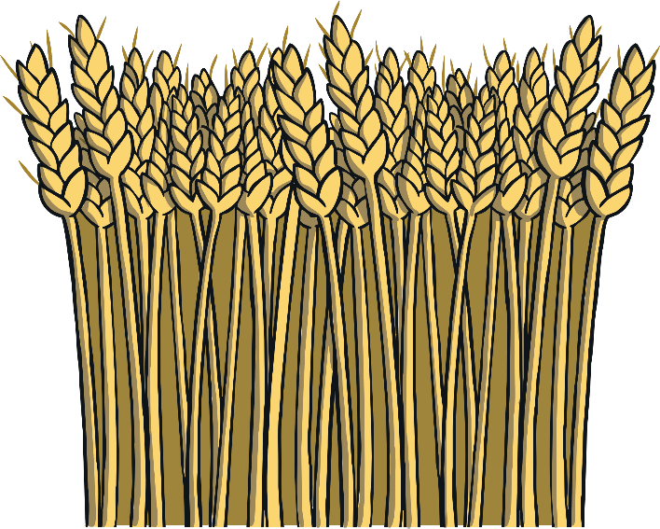
Harvest Festivals
Harvest festivals are celebrations of the food that grows on the land.
They happen at different times of the year around the world and are held when crops are harvested.
Read on to learn how harvests are celebrated around the world.

Slide 3
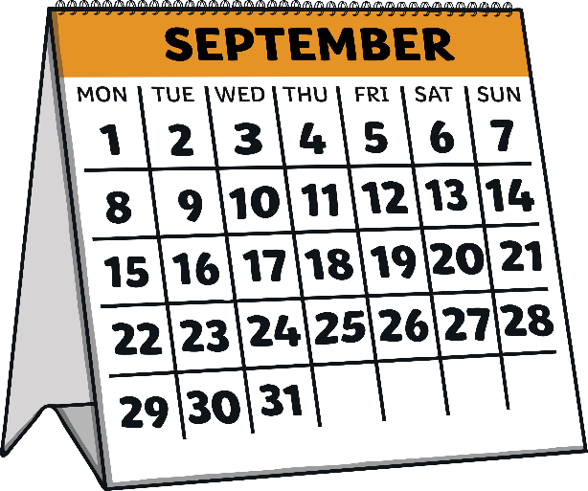
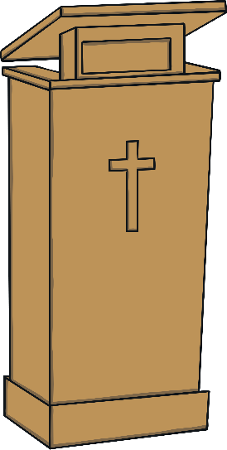

Britain
In Britain, harvest festival is usually celebrated near the end of September.
People sing songs, pray and sometimes
go to church.
Food is often collected in baskets to give to people in need.

Slide 4
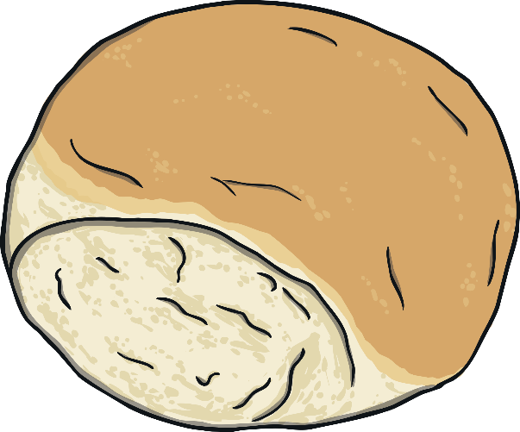
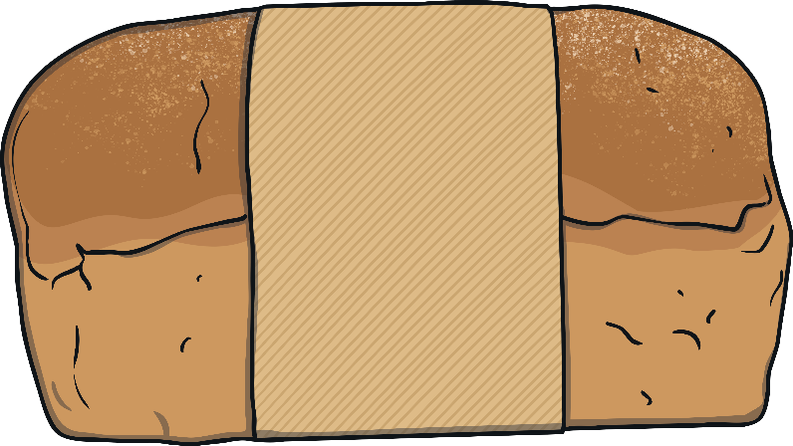
Britain (Scotland)
In Scotland, some people celebrate a wheat harvest called Lammas.
People make bread from the first wheat harvest and take it to church to eat.

Slide 5
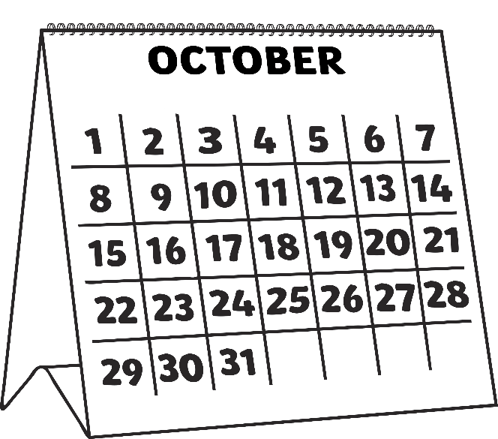
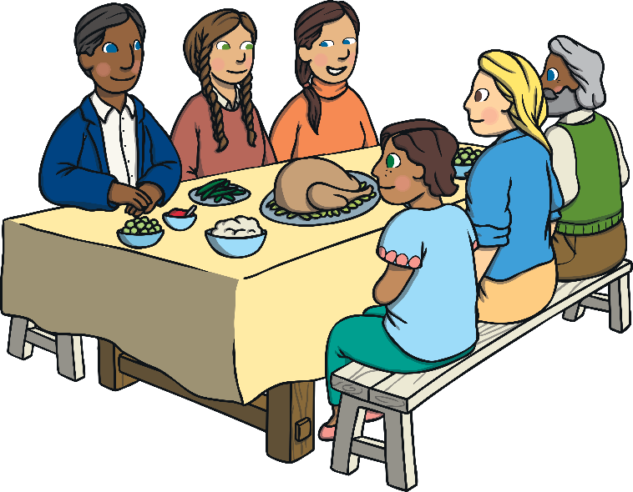
America and Canada
In America and Canada, harvest celebrations are called Thanksgiving.
Thanksgiving is in October or November.
People celebrate by having a family dinner with lots of different foods, like roast turkey with lots of vegetables.

Slide 6
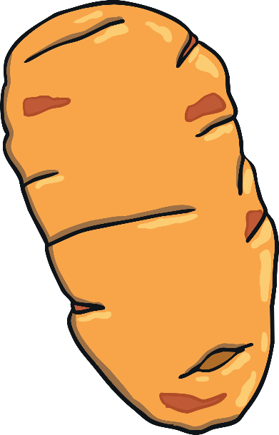
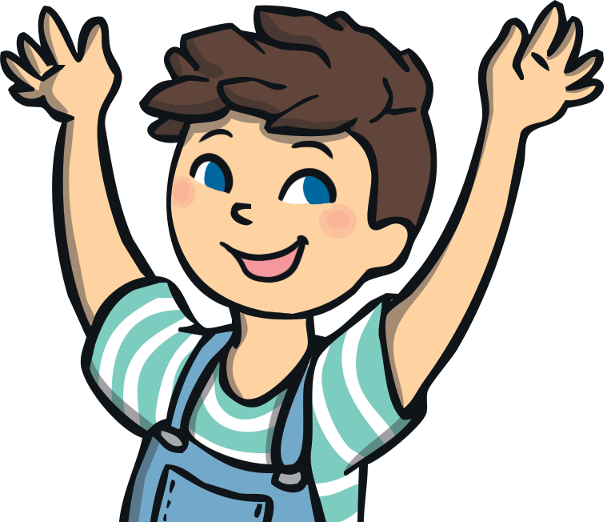
Africa
In West Africa, there is a celebration called The Festival of Yams, which celebrates the yam harvest. The festival usually takes place in August.
Yams are a vegetable, similar to a sweet potato.
People celebrate by dancing and sharing the yams with
the village.

Slide 7
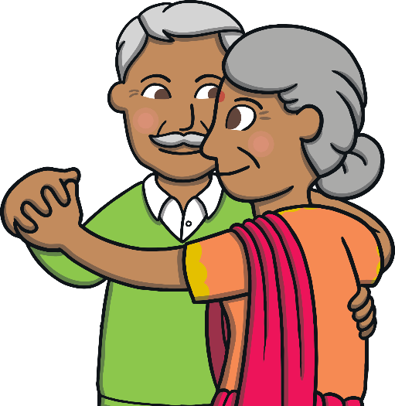
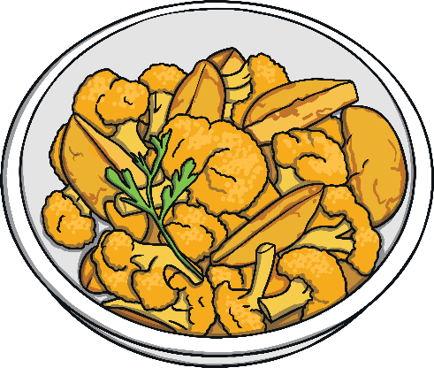
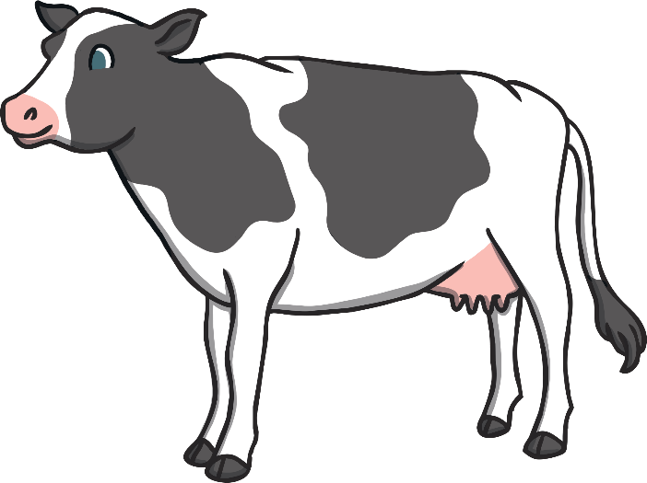
India
In India, there are many different harvest festivals because lots of different foods grow there.
The different crops are celebrated and shared, and sometimes cattle is worshipped too.
Many of the festivals are celebrated with family and friends. Food and drink are shared, new clothes worn and sometimes gifts are given.

